Slide 1

Product presentation
MFT-R
Deburring tool

Slide 2
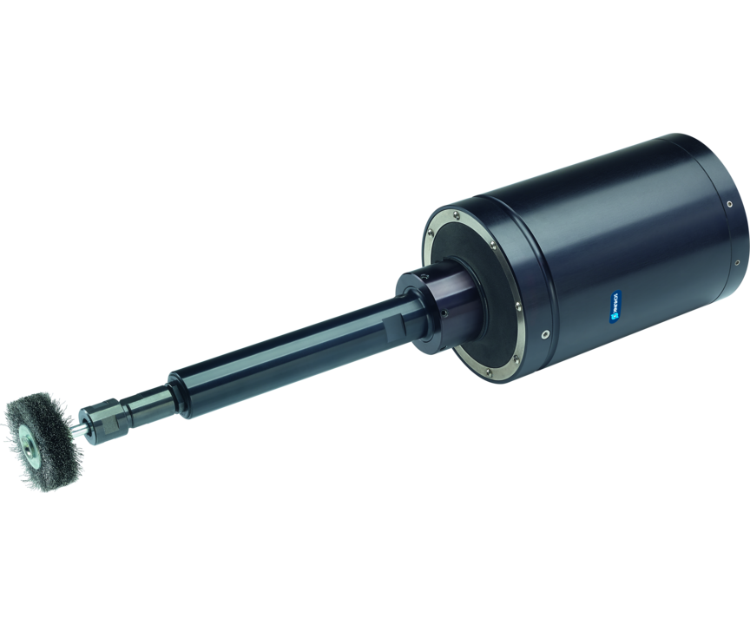
Deburring tool
Radially compliant pneumatic polishing spindle, perfect for polishing and brushing workpieces
The most robust polishing spindle with radial compensation on the market
Up to 5,600 RPM

Slide 3

Compliant. Flexible. Robust.

Slide 4
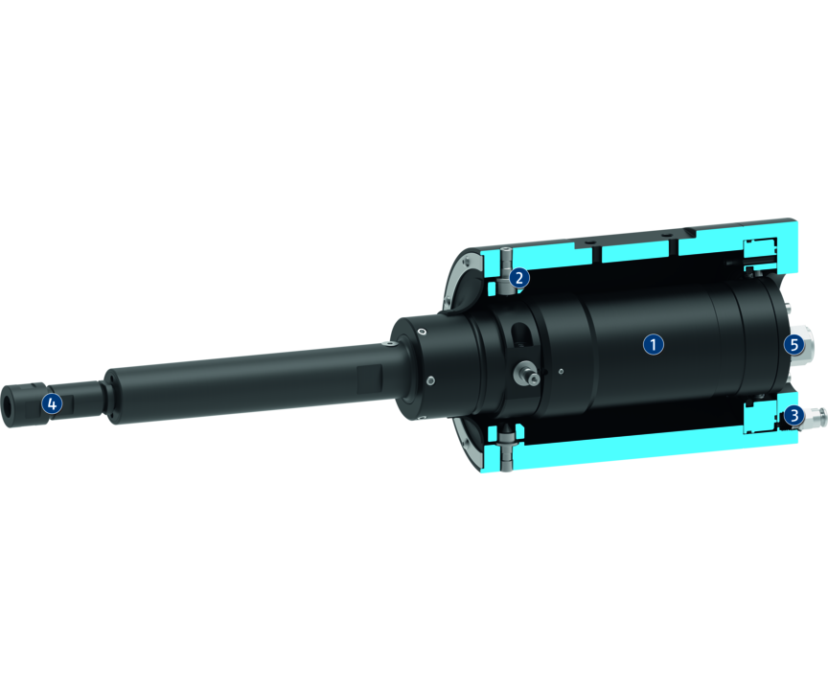
Principle of function
Functional description
The unit is driven by a vane-type air motor. The motor is driven by filtered and oiled air. The spindle is gimbal-mounted to compensate for tolerances on the workpiece contour. The Y-axis can be optionally fixed by axis fixation set screws. This means that pendulum compensation is only possible in the X axis. The compliance force is controlled via a second air connection. Depending on the pressure setting, a variable pressure force acts on the tool.
1
Rotating piston air engine
2
Gimballed system
3
Air connection
4
Tool holder
5
Air connection

Slide 5
Advantages – Your benefits
Adjustable stiffness of the spindle via air pressure for high-quality deburring results in any installation position
Flexible use on the robot arm or as a stationary unit
Rotating piston air engine with high torque for short stopping times and reduced processing times
Radial compliance for machining processes with radial compensation
Gimballed system for a robust set-up with compensation function and reduced programming effort of the robot
Lock function for the Y axis for an oscillating compensation only in the X-axis

Slide 6
Technical data
Technical data overview
Size | Power | Idle speed | Max. compensation X | Max. compensation Y | Min. radial compensation force | Max. radial compensation force | Tool holder | Weight
 | [W] | [1/min] | [mm] | [mm] | [N] | [N] |  | [kg]
490 | 390 | 5600 | 7.1 | 7.1 | 9.4 | 70 | Collet chuck DA 6 mm and 8 mm | 4.42

