Slide 1

Product presentation
RCV
Deburring tool

Slide 2
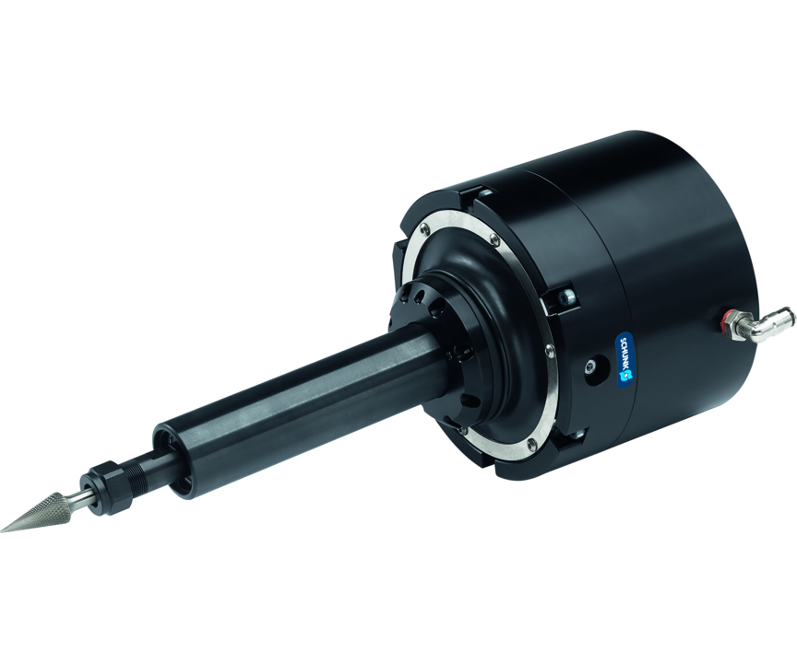
Deburring tool
Pneumatic deburring spindle with radial compensation for deburring workpieces
The deburring spindle that is the most robust and quickest to maintain on the market.
Up to 40,000 RPM

Slide 3

Compliant. Flexible. Robust.

Slide 4
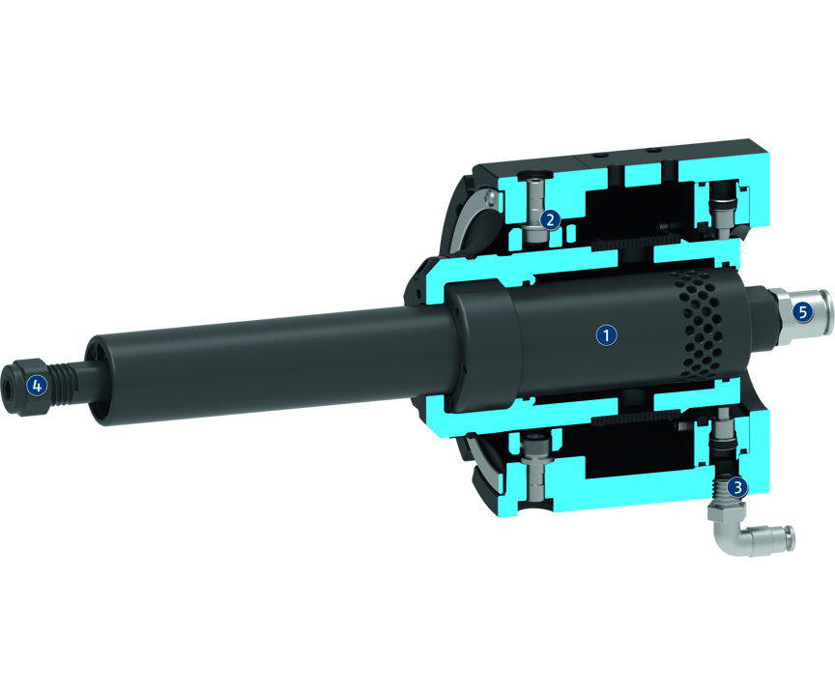
Principle of function
Functional description
The unit is driven by a pneumatic rotating piston air engine. Its speed of rotation depends on the unit size. The motor is driven by filtered and oiled air. The spindle is gimbal-mounted to compensate for tolerances on the workpiece contour. The Y-axis can optionally be fixed by a set screw. This means that pendulum compensation is only possible in the X axis. The compliance force is controlled via a second air connection. Depending on the pressure setting, a variable pressure force acts on the tool.
1
Rotating piston air engine
2
Gimballed system
3
Air connection
4
Tool holder
5
Air connection

Slide 5
Advantages – Your benefits
The compensation force can be adjusted means of compressed air. for high-quality deburring results in any installation position
Flexible use on the robot arm or as a stationary unit
Rotating piston air engine with high torque for high feed rates and a reduced machining time
Flexibility in radial direction for a simplified robot programming
Lock function for the Y axis for an oscillating compensation only in the X-axis
Simple exchange of wear parts for maximum system availability and minimum spare parts requirements
Robust bearing for an optimized service life

Slide 6
Technical data
Technical data overview
Size | Power | Idle speed | Max. compensation X | Max. compensation Y | Min. radial compensation force | Max. radial compensation force | Tool holder | Weight
 | [W] | [1/min] | [mm] | [mm] | [N] | [N] |  | [kg]
250 | 250 | 40000 | 7.1 | 7.1 | 9 | 54 | Collet chuck ER-11 6 mm and 8 mm | 1.71
490 | 490 | 30000 | 8.3 | 8.3 | 7 | 53 | Collet chuck ER-11 6 mm and 8 mm | 3.36

