Slide 1


ROTA THW plus
Power Lathe Chucks with Jaw Quick-change System

Slide 2














Productoverview
SCHUNK
Synergy machine
Gripping Systems
Clamping Technology
Chuck Jaws
Stationary Workholding
Lathe Chucks
Toolholders
Hydraulic Expansion Technology
Manual Lathe Chucks
Power Lathe Chucks with Jaw Quick-change System
Power Lathe Chucks with Through-hole
Power Lathe Chucks without Through-hole
Pneumatic Power Chucks
Steady Rests
Quick-change Systems
Customized Solutions

Slide 3
Challenges
Variants
Global
competition
Time
Time
Demand
Time
Flexibility and und set-up time optimization
heute
zukünftig

Slide 4


Reduction of set-up costs due to
Jaw Quick-change
 | Case 1 | Case 2
Number of Jaw Changes per day | 2 | 5
Time per jaw change without SCHUNK Jaw Quick-change system [min] | 20 | 5
Time per jaw change with SCHUNK Jaw Quick-change system [min] | 5 | 2
Machine costs per hour [€] | 80
Number of workshifts per day | 2
Working days per year | 260
Reduction of set-up costs
Time saving per jaw change [min] | 15 | 3
Annual saving potential [€] | 10.400 | 5.187
ROI
Rechner

Slide 5


ROTA Overview
Power Lathe Chucks with Jaw Quick-change System
ROTA THW plus
ROTA THW vario
ROTA NCX

Slide 6
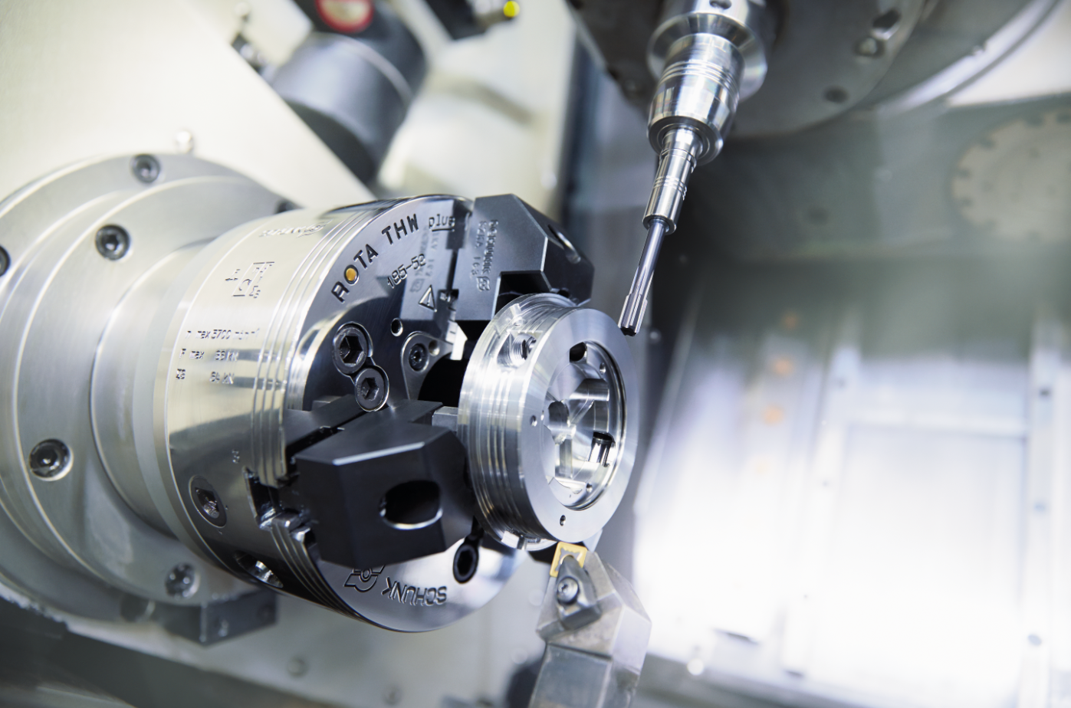
ROTA THW plus
Example of application
Clamping device:
ROTA THW plus 185 with claw jaws.
Features/Application:
Raw part clamping of base body of VERO-S mini in a lathe and milling machine.
Quick conversion for changing diameters.

Slide 7
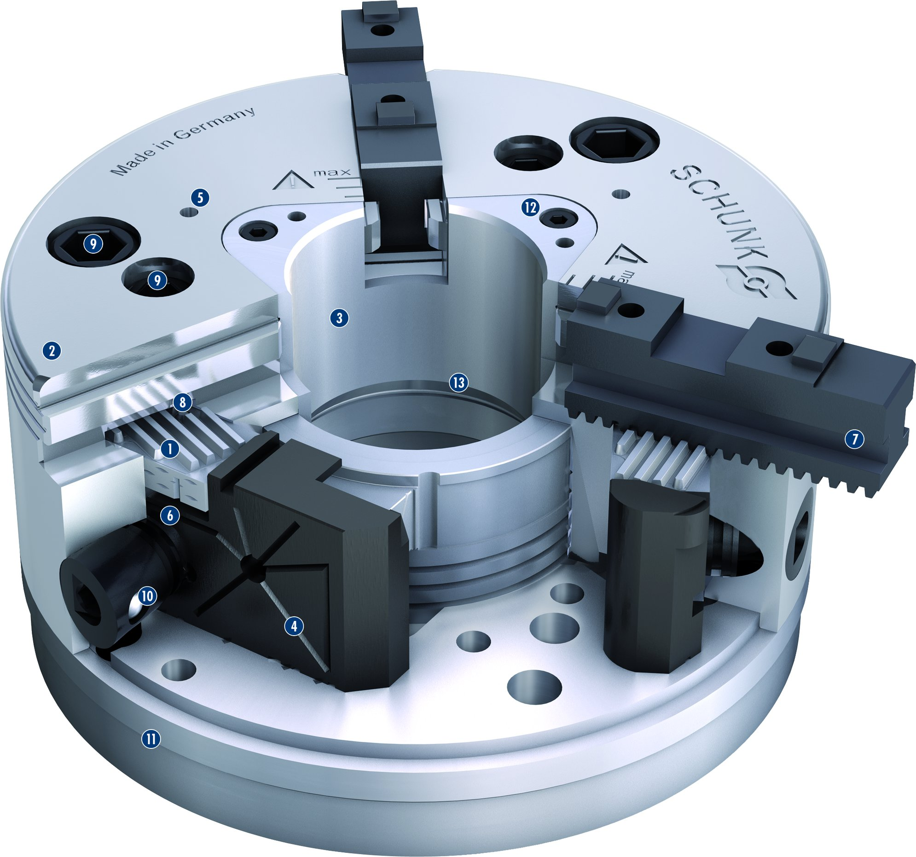
ROTA THW plus
1
Wedge bar actuation system
Hardened and extremely rigid base body
Large through-hole
Optimized lubrication system
Mounting threads
Jaw quick-change system
Base jaws with straight serration (GBK)
Locking mechanism
Two mounting bolt circles
Reliable jaw lock
Various direct mountings
Modular center sleeve system
Additional seals
2
5
12
9
3
9
4
3
5
2
13
6
8
7
1
7
6
8
9
10
10
4
11
11
12
13

Slide 8
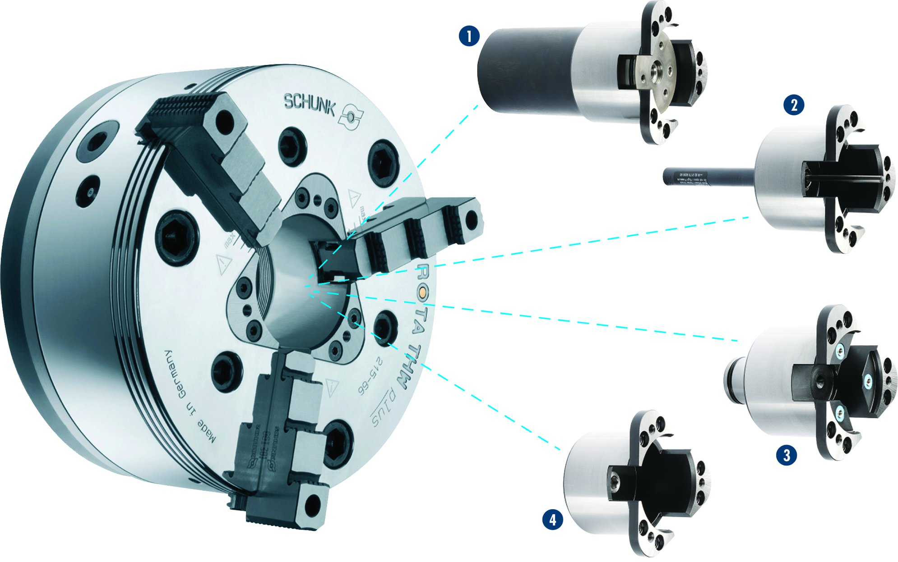
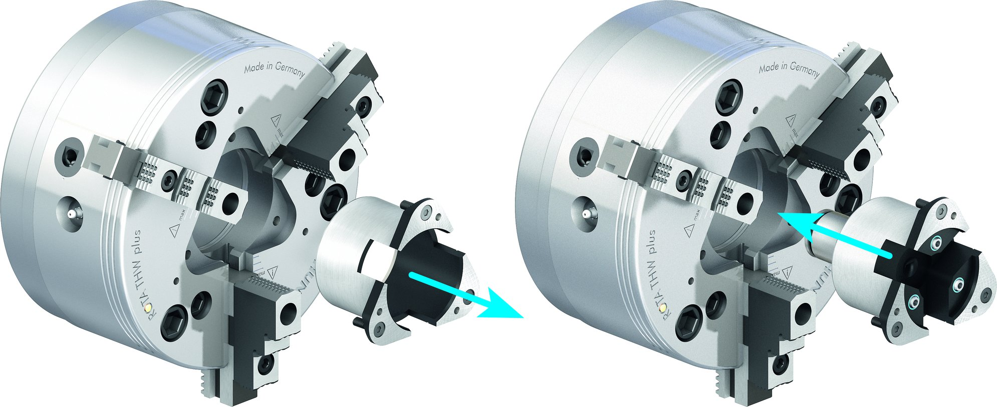

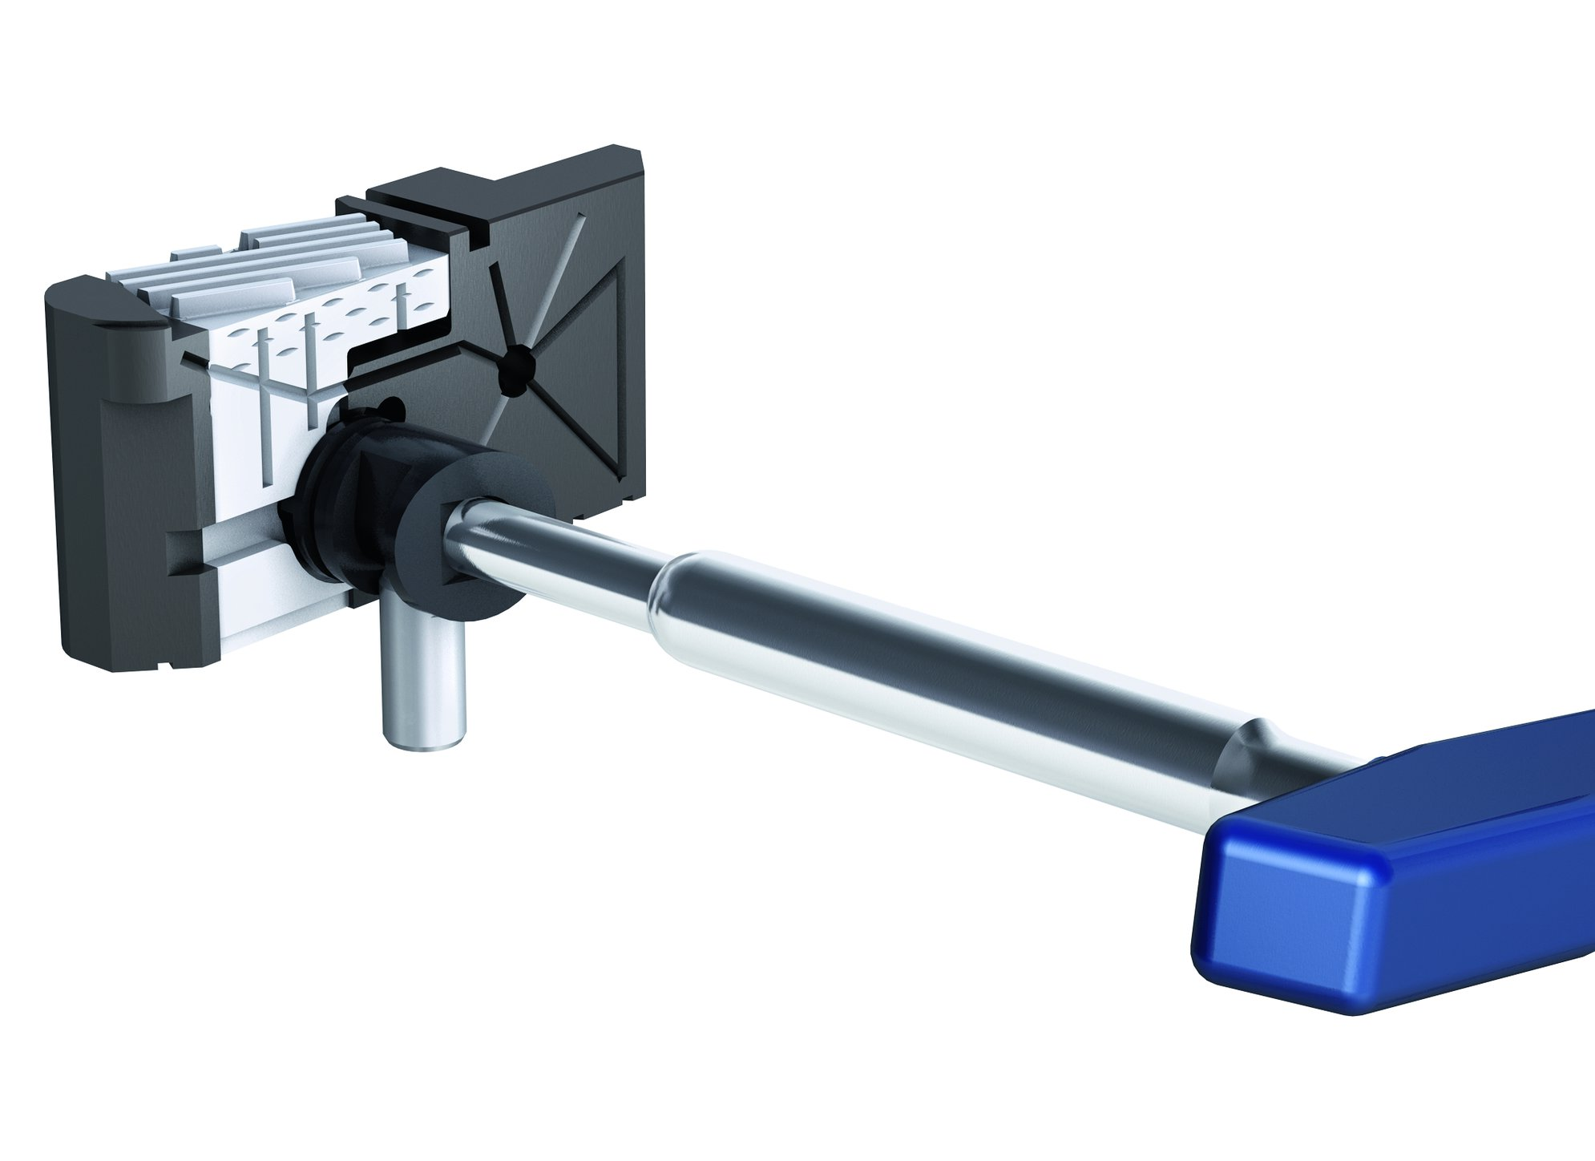
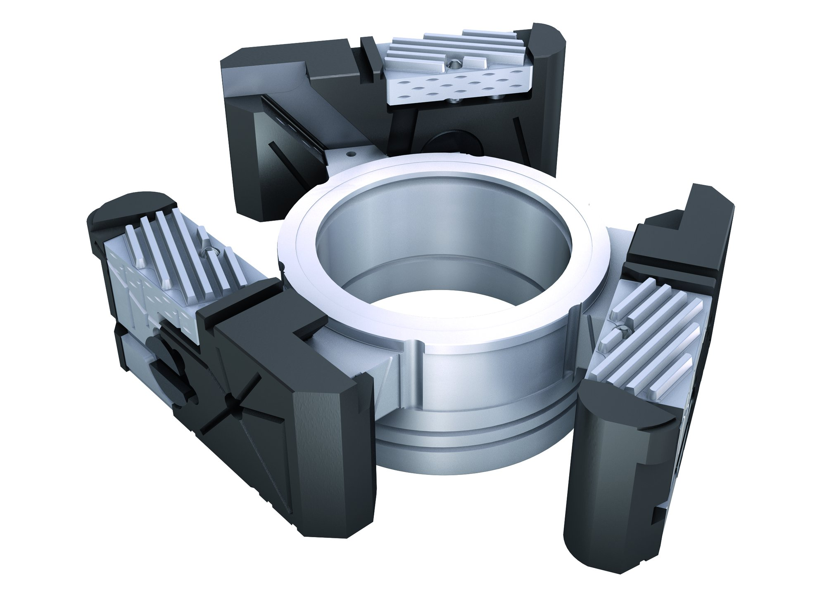
ROTA THW plus
Modular Center Sleeve System
Changing the center sleeve
1
1
Adjustable stop in
the center sleeve
Part ejector in the center sleeve
Coolant nozzles in
the center sleeve
Closed center sleeve
2
2
3
3
4
Quick jaw change
High changing repeatability

Slide 9
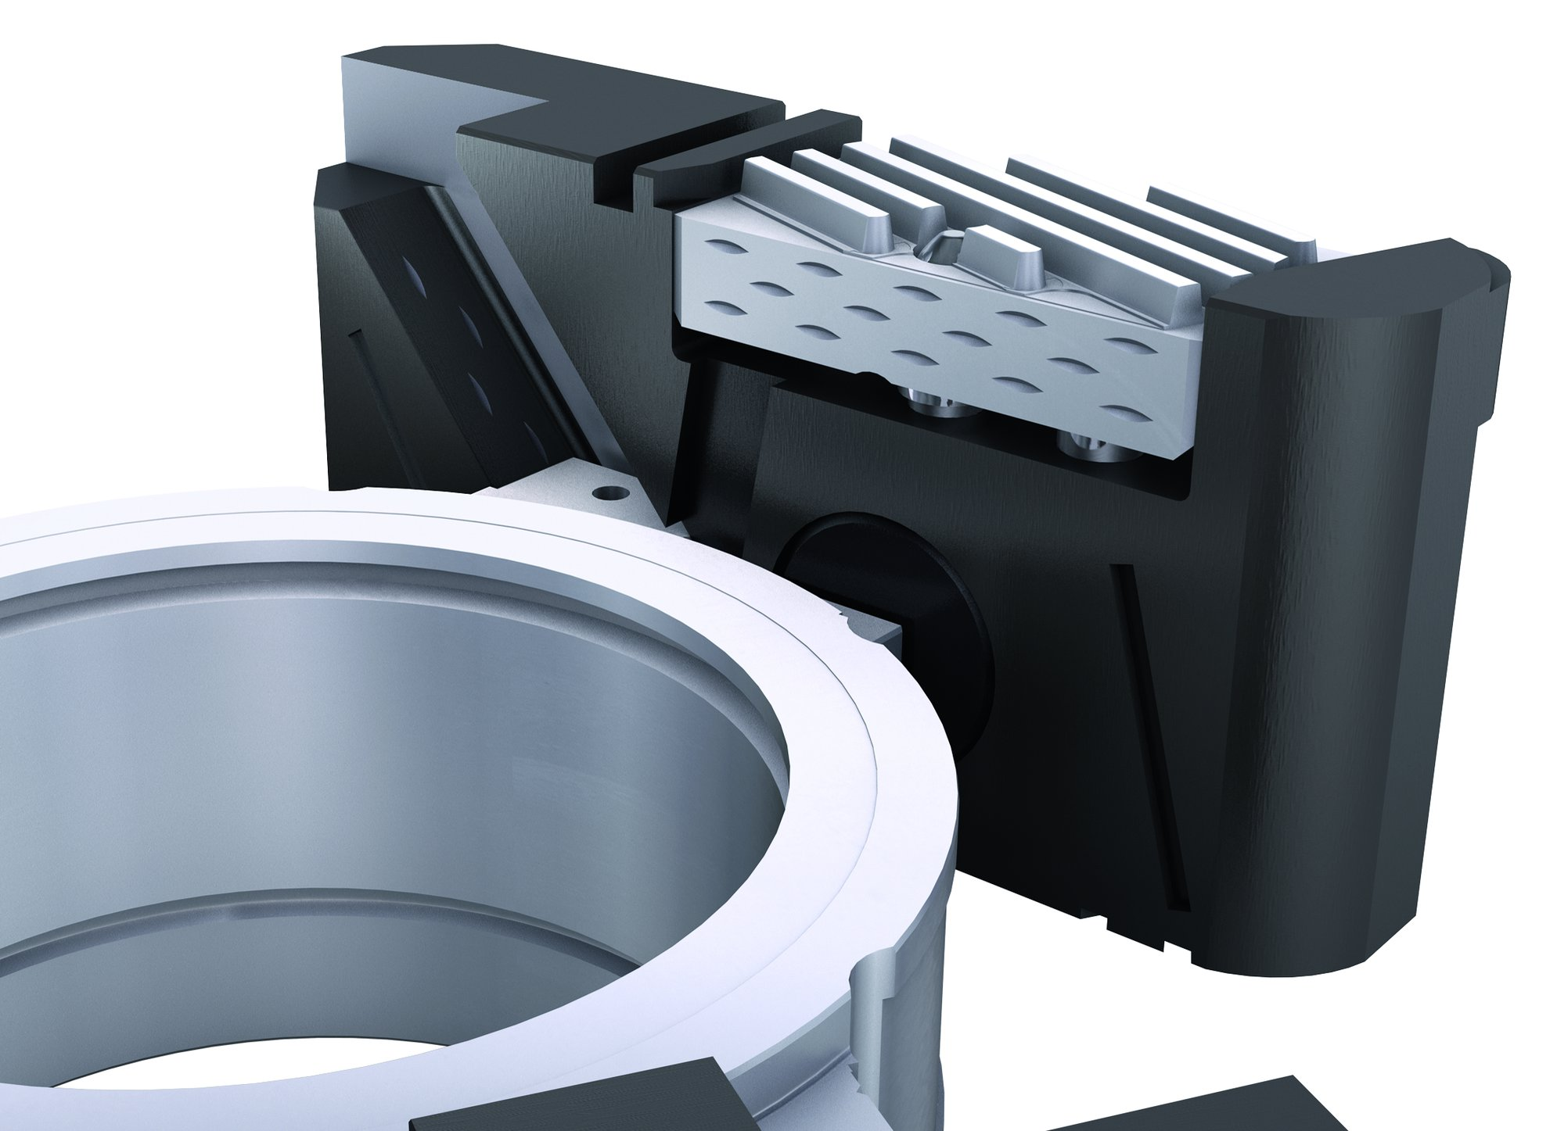
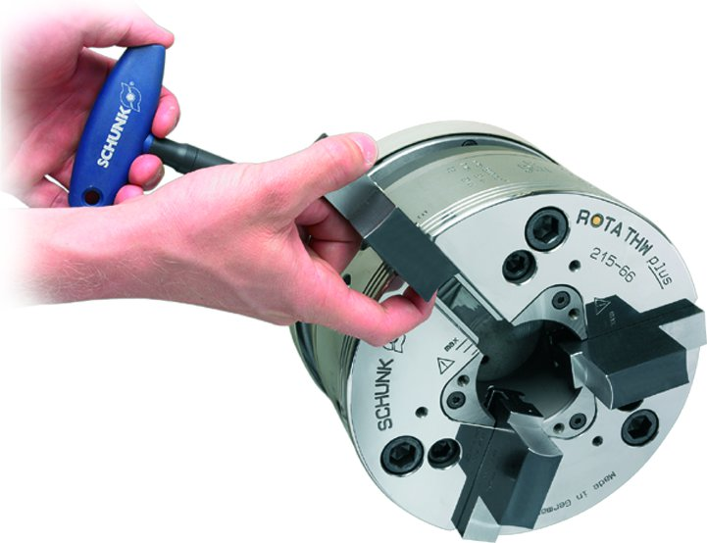
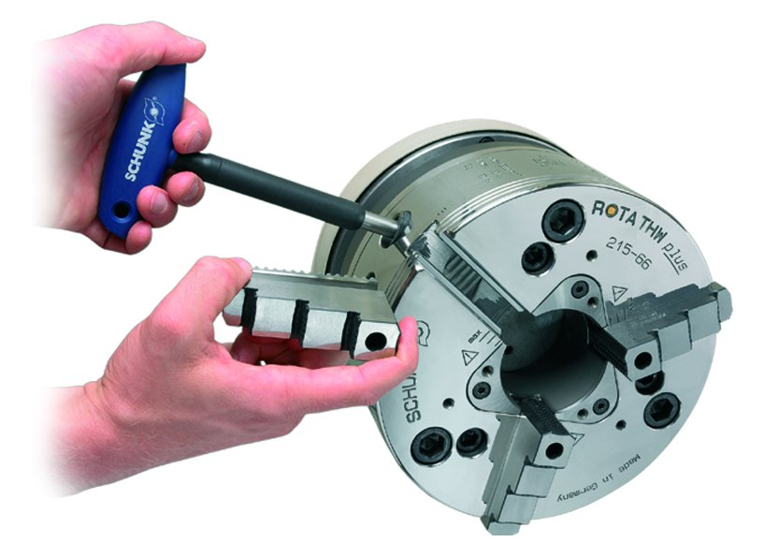
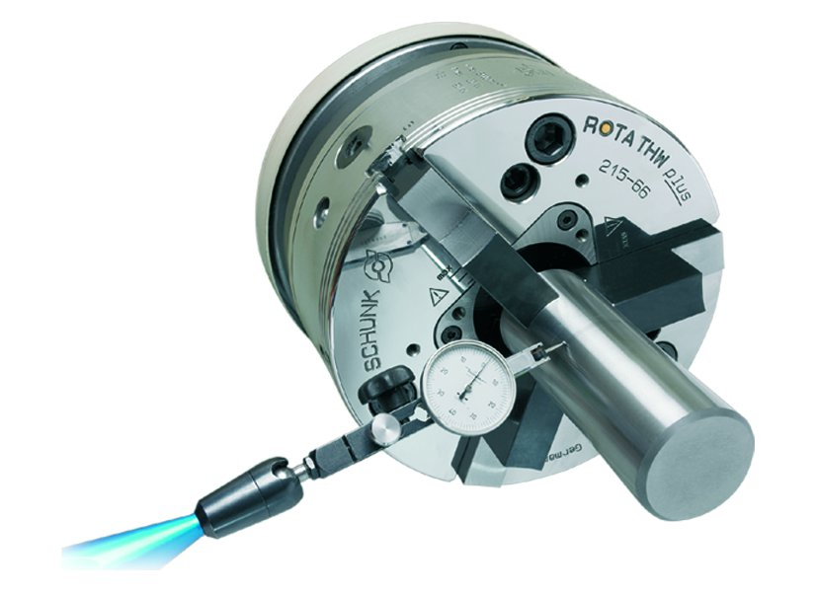
ROTA THW plus
Innovative greasing system
Insertion of the chuck jaws
Removal of the chuck jaws
High repeat accuracy after a jaw change

Slide 10
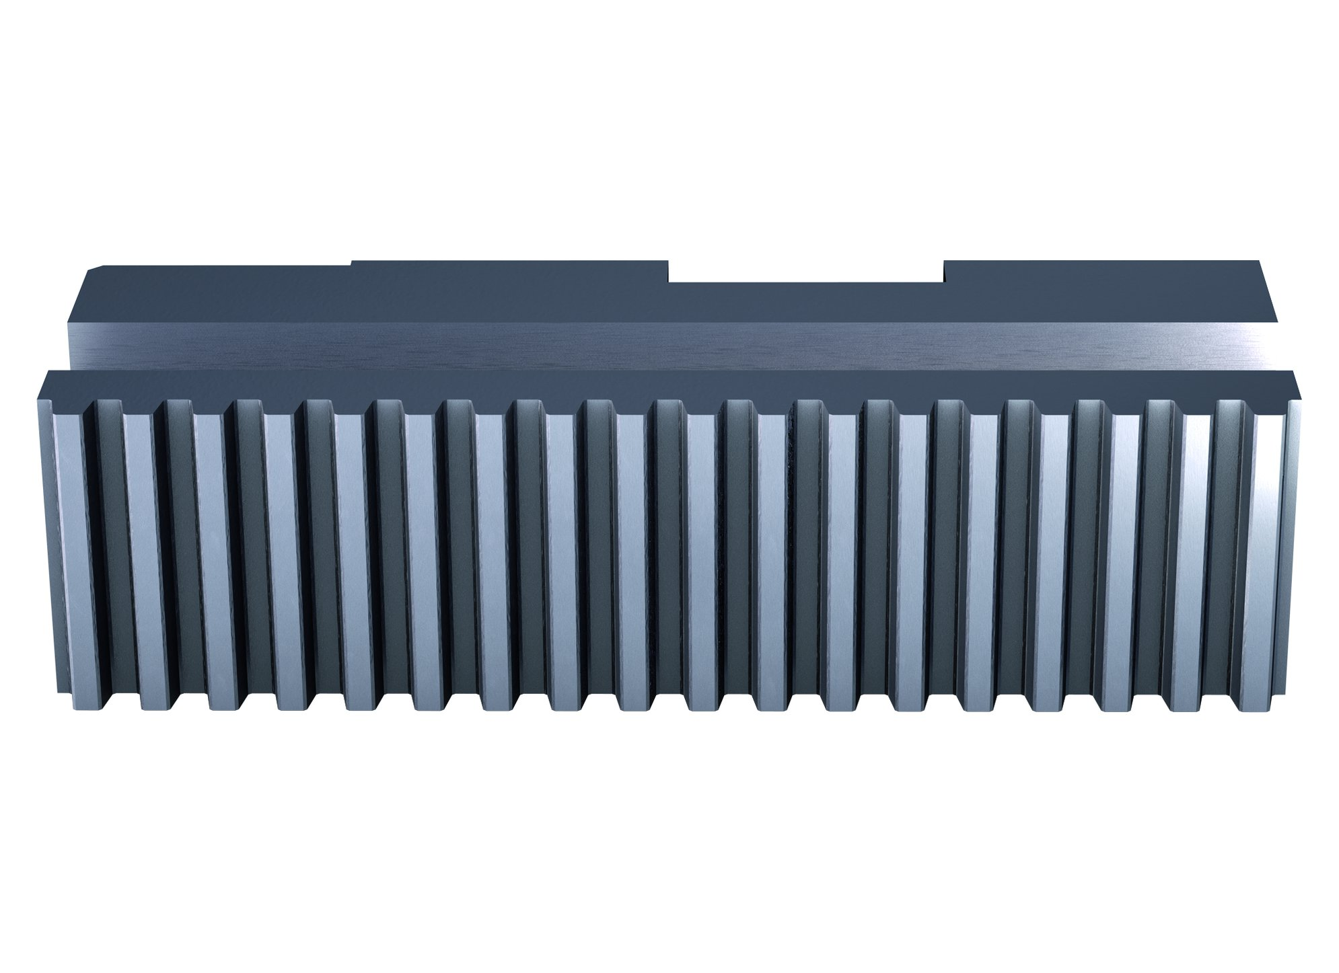
ROTA THW plus
The jaws are interchangeable

Slide 11
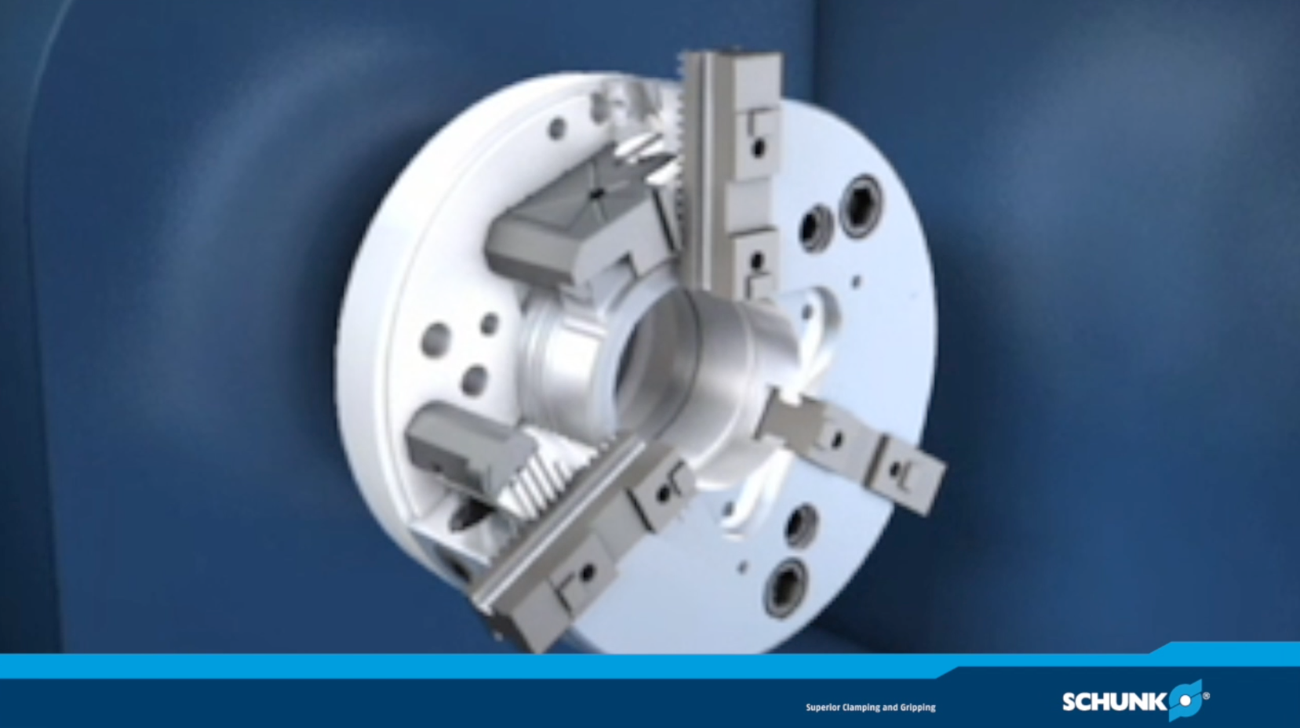
ROTA THW plus

Slide 12
Variants ROTA THW plus
Technical Data | Max. RPM [min⁻¹] | Max. clamping force [kN] | Max. actuating force [Nm] | Stroke/jaw [mm] | Through-hole [mm] | Piston stroke [mm]
ROTA THW plus 165-43 | 6000 | 45 | 30 | 5.9 | 43 | 20
ROTA THW plus 185-52 | 5700 | 64 | 36 | 6.7 | 52 | 23
ROTA THW plus 215-66 | 5400 | 82 | 46 | 7.4 | 66 | 25
ROTA THW plus 260-81 | 4000 | 115 | 65 | 8.2 | 81 | 28
ROTA THW plus 315-104 | 3600 | 160 | 90 | 8.6 | 104 | 28
ROTA THW 400-120 | 3500 | 240 | 133 | 6.5 | 120 | 23
ROTA THW 500-128 | 2200 | 240 | 133 | 9 | 128 | 30
ROTA THW 630-160 | 1700 | 240 | 133 | 9.8 | 160 | 34
ROTA THW 800 | 1200 | 240 | 133 | 10 | 160 | 34

Slide 13




SCHUNK Services
Back to overview
Engineering
Dimensioning of special plates designed to the manufacturing specifications
Development of special solutions together with the customer
FEM analysis for critical components
Testing
Endurance tests with all new developments
Abrasion checking
Measurement of accuracy
Service
Initial operation of customer´s solution
Inspection and maintenance
Repairs

