Slide 1

Product presentation
PCFC
Deburring tool

Slide 2
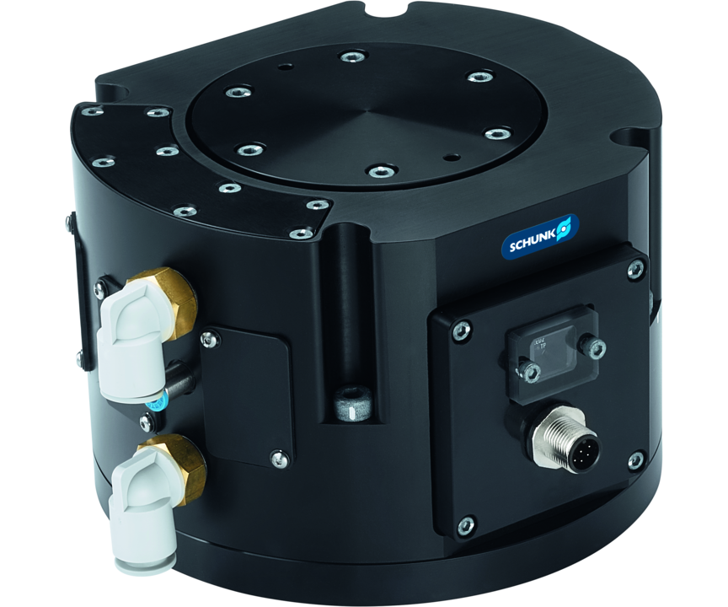
Deburring tool
Pneumatic, axial compensation unit for flexible adjustment of compensation or contact forces
Universally applicable compensation unit with integrated path measuring system for a constant compensation force in any position.
Up to 12 mm compensation path in z-direction

Slide 3

Compliant. Flexible. Compact.

Slide 4
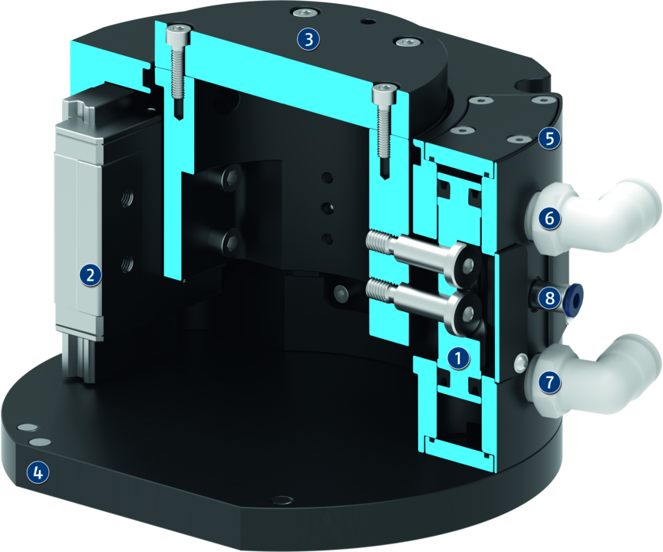
Principle of function
Functional description
The compensation unit is operated by a double-acting pneumatic cylinder. The unit has a compensation stroke and is axially flexible. The compensation pressure is adjusted with dry and filtered air to ensure a constant compensation contact force. The contact force can be controlled separately in two directions (retracting and extending) via two air connections. Depending on the piston configuration, a variable pressure force can be achieved. Due to the integrated path measuring system, the position of the compensation unit is confirmed via an analog signal and can be used for further process control.
1
Piston
2
Linear guide
3
Mounting
4
Robot-side connection
5
Integrated path-measuring system
6
Retract air connection compensation
7
Extend air connection compensation

Slide 5
Advantages – Your benefits
Compensation can be adjusted by means of a double-action pneumatic cylinder for a constant contact force
Integrated path-measuring system for monitoring and control of the process
Integrated weight force compensation for constant pressure forces independent of the orientation of the tool, especially in robot-guided applications
Flexibility in axial direction for a simplified robot programming
Simple extension of the force range by adjusting the piston configuration
Versatile in use due to the option of screwing customer tools onto the adapter plate or into a through-bore
Compact design for minimum installation height

Slide 6
Technical data
Technical data overview
Size | Compensation Z | Min. compensation force | Max. compensation force | Weight
 | [mm] | [N] | [N] | [kg]
12 | 12 | 18 .. 49 | 85 .. 240 | 3.54 .. 3.63

