Slide 1

Product presentation
CRT
Deburring tool

Slide 2
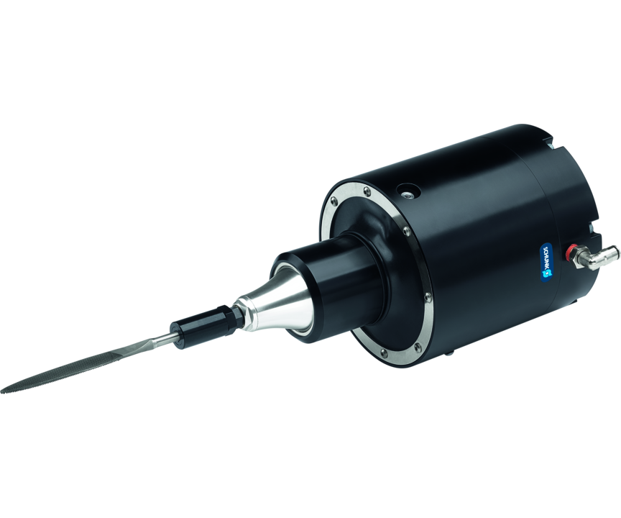
Deburring tool
Pneumatically driven file with radial compensation for machining workpieces
Flexible, pneumatic deburring tool for narrow and tight workpiece geometries.
Up to 12,000 strokes per minute

Slide 3

Compliant. Flexible. Robust.

Slide 4
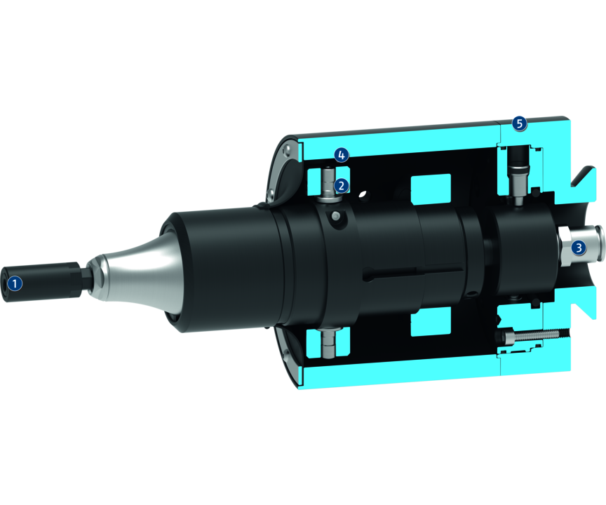
Principle of function
Functional description
The unit is driven by a pneumatic motor. The motor is driven by filtered and oiled air. The motor is gimbal-mounted to compensate for tolerances on the workpiece contour. The toolholder mounting is held by a file holder as standard for files with a 5 mm shank. The Y-axis can optionally be fixed by a set screw. This means that pendulum compensation is only possible in the X axis. The compliance force is controlled via a second air connection. Depending on the pressure setting, a variable contact force acts on the file tool.
1
Tool holder
2
Gimballed system
3
Air connection
4
Locking function for Y axis
5
Air connection

Slide 5
Advantages – Your benefits
The compensation force can be adjusted means of compressed air. for high-quality deburring results in any installation position
Flexible use on the robot arm or as a stationary unit
Use of proven files for simple automation of manual deburring processes
Flexibility in radial direction for a simplified robot programming
Simple exchange of wear parts for maximum system availability and minimum spare parts requirements
Robust bearing for an optimized service life
Lock function for the Y axis for an oscillating compensation only in the X-axis

Slide 6
Technical data
Technical data overview
Size | Max. compensation X | Max. compensation Y | Min. radial compensation force | Max. radial compensation force | File stroke | Number of idle running strokes | Weight
 | [mm] | [mm] | [N] | [N] | [mm] | [1/min] | [kg]
12 | 8 | 8 | 18 | 62 | 5 | 12000 | 3.08

