Slide 1

Product presentation
CDB
Deburring tool

Slide 2
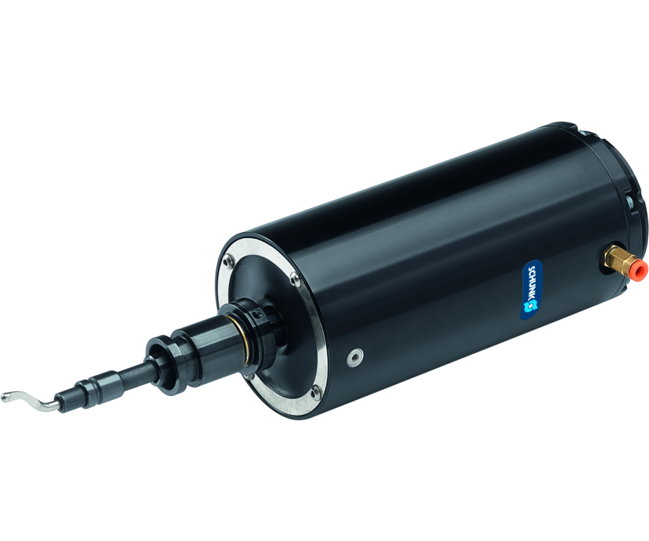
Deburring tool
Compliant tool for deburring with the robot and proven deburring tools
The world's only compliant tool for robot-guided deburring with conventional deburring tools!
Up to 76 N of adjustable radial compensation force

Slide 3

Compliant. Flexible. Economical.
Flexibility in axial and radial direction
Commercially available deburring cutting tools can be used
Uniform toolholder mounting
Cost reduction by autmating manual deburring processes
Lower operating costs

Slide 4
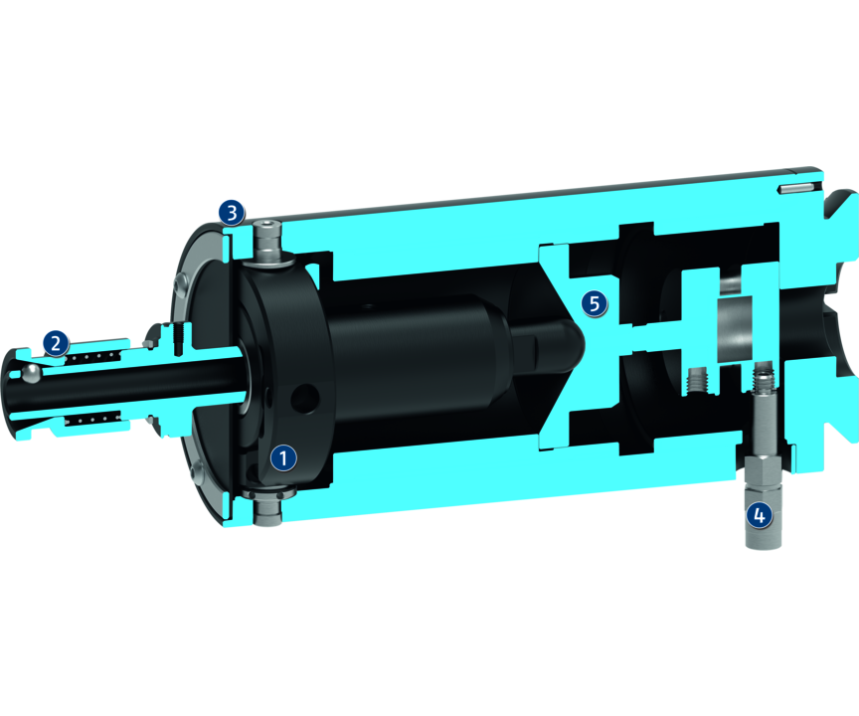
Principle of function
Functional description
The deburring tool has a radial compensation in direction of the X,Y-axis, as well as an axial compensation along the Z axis. Optionally, the compensation of the Y-axis can be fixed with a set screw, so that an oscillating compensation in the X-axis is possible. The compensation force can be flexibly adjusted by means of compressed air. The quick-release fastener can be used for easily exchanging standard blade holders together with the deburring tools. When using the automatic tool change with a storage module, this can be done quickly and automatically.
1
Gimballed system
2
Tool mounting with quick-release fastener
3
Locking function for Y axis
4
Air connection
5
Reset mechanism

Slide 5
Advantages – Your benefits
Adjustable rigidity of the tool via compressed air for flexible use and ideal results with different materials
Optional tool change system for the automatic exchange of different deburring tools
Use of proven deburring tools for simple automation of manual deburring processes
Flexibility in axial and radial direction for a simplified robot programming
Lock function for the Y axis for an oscillating compensation only in the X-axis
Versatile use by using different deburring tools such as knives, scrapers and countersinks

Slide 6
Technical data
Technical data overview
Size | Max. compensation angle X/Y | Compensation Z | Weight | Max. radial compensation force | Max. axial compensation force
 | [°] | [mm] | [kg] | [N] | [N]
8 | 5.5 | 8 | 1.04 .. 1.09 | 76 | 67

