Slide 1

Product presentation
AOV
Deburring tool

Slide 2
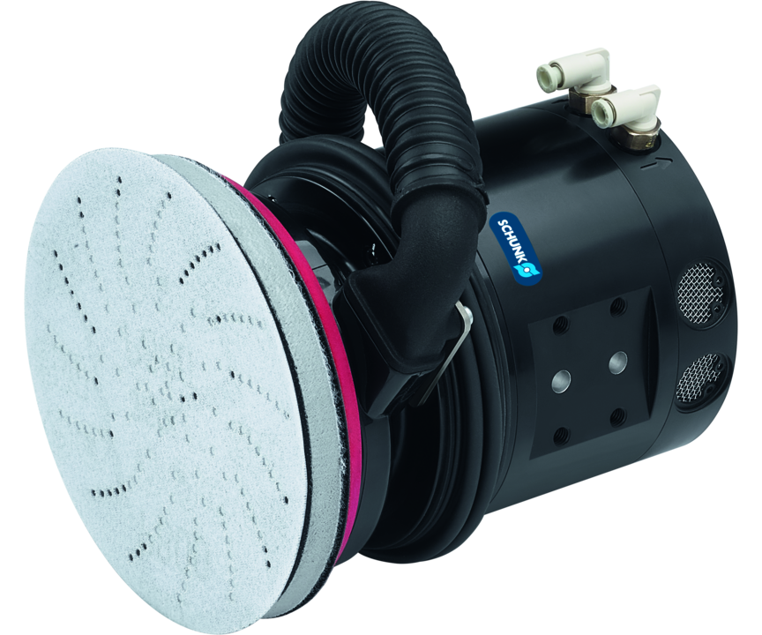
Deburring tool
Pneumatic random orbit sander with axial compensation for grinding and polishing of workpiece surfaces
The easiest to use orbital sander tool for robotic use on the market.
Up to 12.7 mm compensation path in axial direction

Slide 3

Compliant. Compact. Flexible.

Slide 4
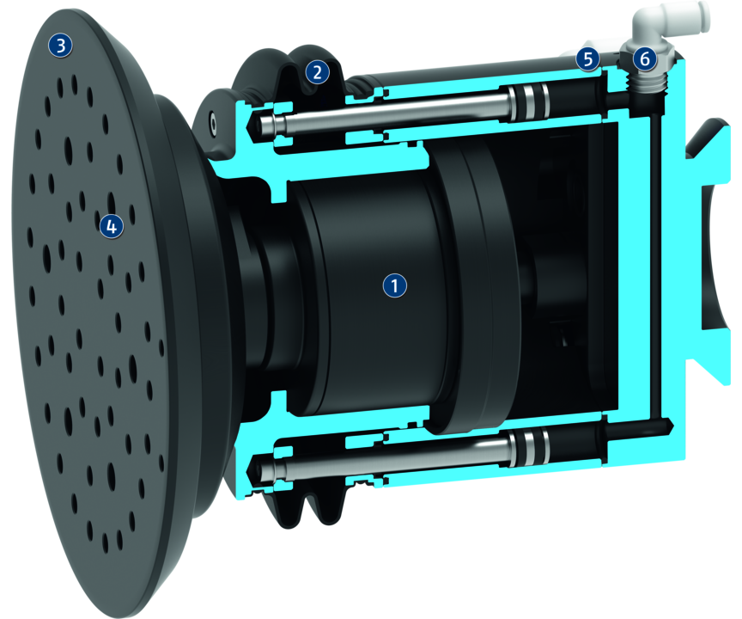
Principle of function
Functional description
The random orbit sander is driven by a vane-type air motor. The motor is driven by filtered and oiled air. The motor is axially and flexibly mounted to compensate for tolerances on the workpiece surface and to ensure a constant contact force during the grinding or polishing process. The contact force can be controlled separately in two directions (retracting and extending) via two air connections, so that a variable contact pressure can be achieved. The random orbit sander can be used with two different sanding pad diameters and can be optionally equipped with a connection for an extraction system.
1
Rotating piston air engine
2
Dust cover
3
Grinding pad
4
Bore holes
5
Air connection
6
Air connection

Slide 5
Advantages – Your benefits
Compensation can be adjusted by means of a double-action pneumatic cylinder for a constant contact pressure independent of the orientation of the tool
Optional media change system for automated exchange of grinding or polishing wheels
Optional connection for suction for reduced contamination and susceptibility to faults
Flexibility in axial direction for a simplified robot programming
Use of proven, adhesive grinding and polishing wheels for simplified automation of manual grinding and polishing tasks
Simple exchange of wear parts for maximum system availability and minimum spare parts requirements

Slide 6
Technical data
Technical data overview
Size | Grinding disk size | Compensation Z | Min. extension compensation force | Max. extension compensation force | Idle speed | Weight
 |  | [mm] | [N] | [N] | [1/min] | [kg]
10 | 125 mm (5'') .. 150 mm (6'') | 12.7 | 13.3 | 66.7 | 10000 | 2.68

