Slide 1

SRH-plus-D
Product information

Slide 2
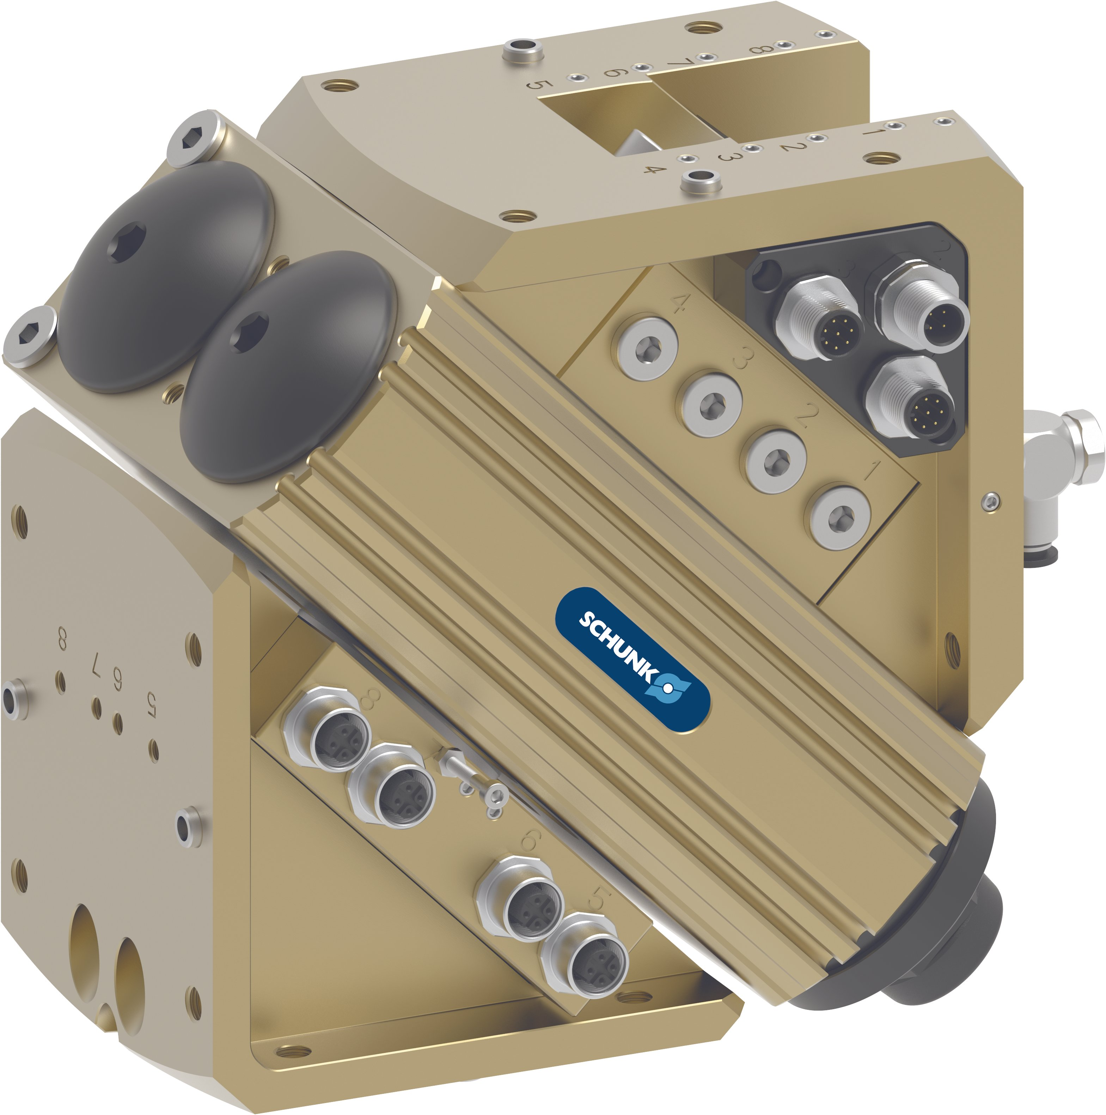
SRH-plus-D
Product information
Universal swivel head optimized for the requirements of the automotive industry.
The basis is the proven SCHUNK universal swivel head SRH-plus.
In addition to the available standard version, various modifications and adjustments according to customer requirements are possible, please contact us.

Slide 3
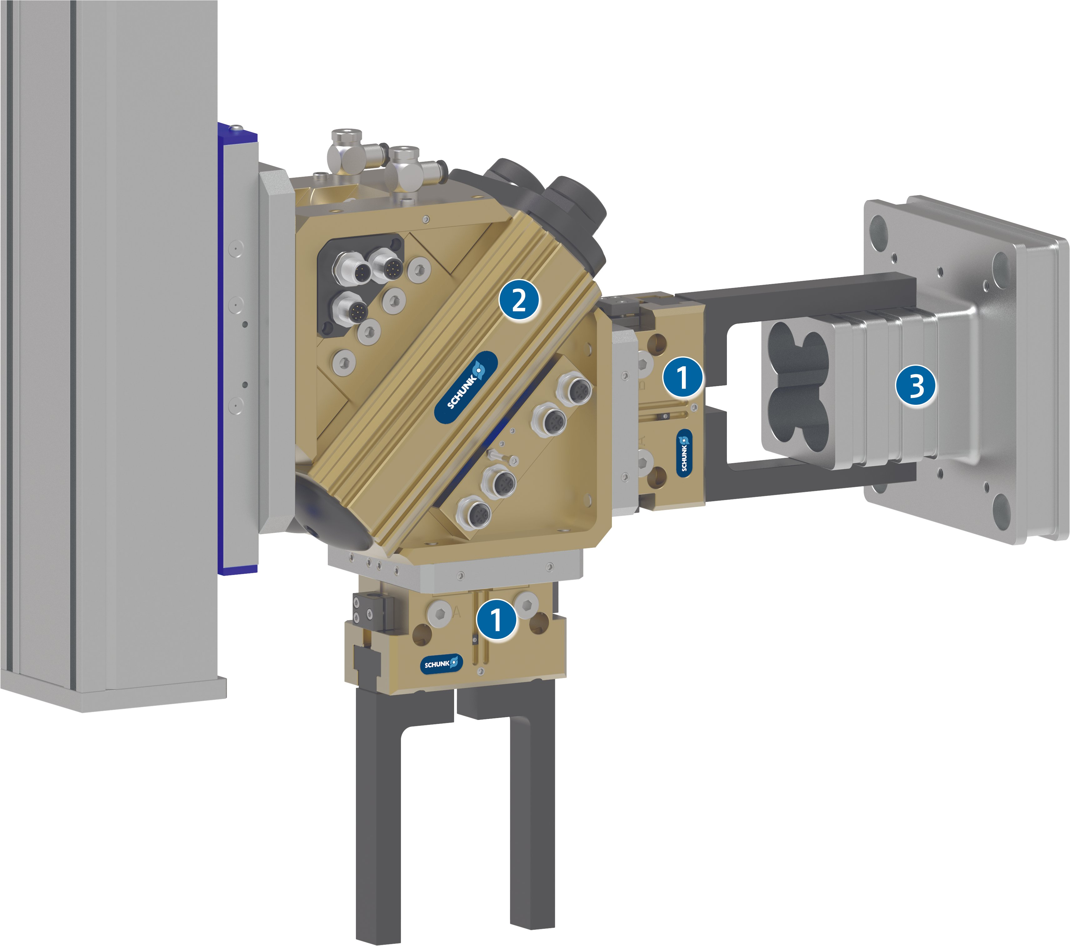
SRH-plus-D
Example application
Swivel head with double parallel gripper for simultaneous loading and unloading of workpieces in a machine.
1
2 finger parallel gripper JGP
Swivel head SRH-plus-D
workpiece
2
3

Slide 4
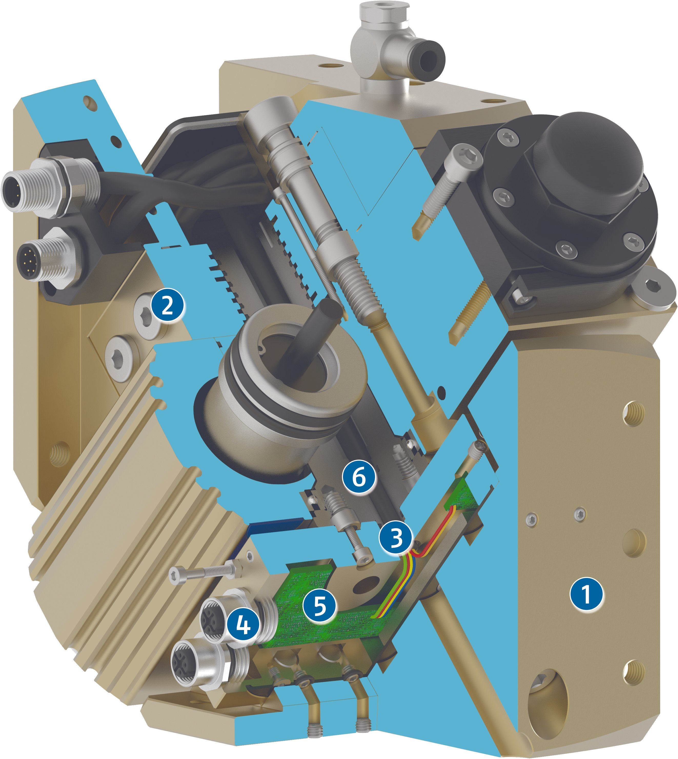
SRH-plus-D
Function
1
Output side
for fastening end actuators such as grippers
2
Media feed-through MDF
guided up to the screw-on surfaces of the swivel head
3
Electrical feed-through EDF
completely integrated, for sensor, acuator signal, and energy transmission
4
Connectors
for the use of the integrated electric feed-through
Distributor board
for bundling the input lines
5
6
Drive principle of pinions and racks
for powerful swiveling and a robust and reliable module

Slide 5
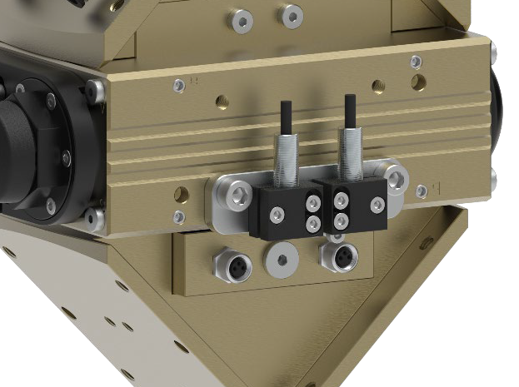
SRH-plus-D
Main differences to SRH-plus series
Prepared for inductive position sensing
The mounting kit is already assembled
Other plugs/sockets for electrical feed-through EDF
M12 connector on drive side instead of M16:
2xM12 instead of 1xM16 for SRH-plus-D 20, 25, 30, 35
3xM12 instead of 1xM16 for SRH-plus-D 40, 50, 60

Slide 6
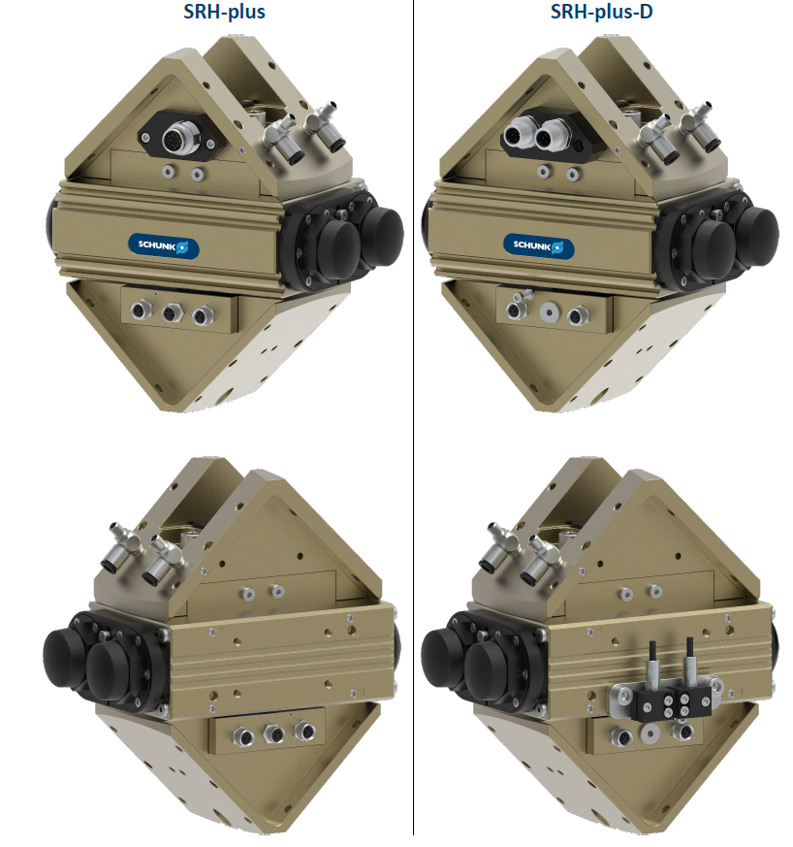
SRH-plus-D
1. Prepared for inductive position sensing
In contrast to SRH-plus, the mounting kit for the inductive sensing is included in the SRH-plus-D delivery and is already pre-assembled.
The sensors are not part of the scope of delivery and must still be ordered separately.

Slide 7
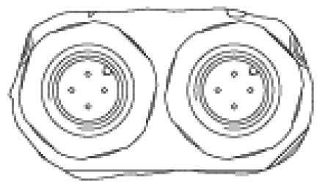
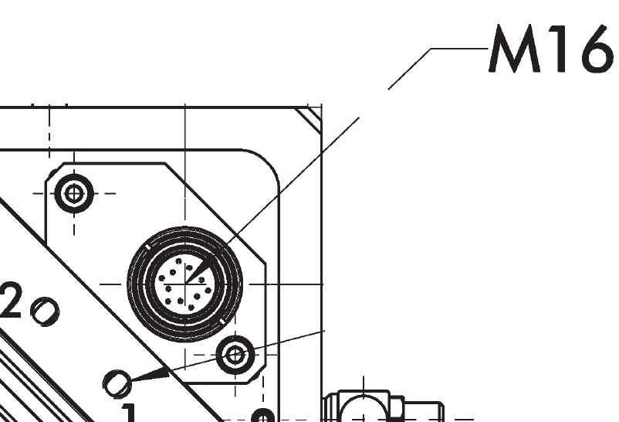
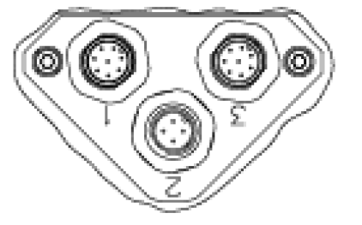
SRH-plus-D
2. Other plugs/sockets for electrical feed-through EDF
 |  | SRH-plus |  | SRH-plus-D
Size |  | Drive side | Output side | Drive side | Output side
20, 25, 30, 35 |  | Plug: 1xM16 – 12 pole | Socket: 4xM8 – 3 pole 2x M8 – 4 pole | Plug: 2xM12 – 4 pole | Socket: 4xM8 – 3 pole
40, 50, 60 |  |  | Socket: 8xM8 – 3 pole 1xM8 – 4 pole | Plug: 2xM12 – 8 pole 1xM12 – 4 pole | Socket: 8xM12 – 4 pole 1xM8 – 4 pole
Notes:
Anmerkung:
Bei SRH-plus-D gibt es keine gesonderte „-D1“ Version wie bei SRU-plus-D.
Die Baugrößen SRH-plus-D 40, 50, 60 entsprechend von der Verdrahtung her bereits der „richtigen Version –D1“ werden aber trotzdem „-D“ benannt da sie unter dieser MatNr und Bezeichnung bei Daimler bereits in MDM gelistet sind.

