Slide 1

Product presentation
Plug & Work Portfolio Techman Robot
Modular System

Slide 2
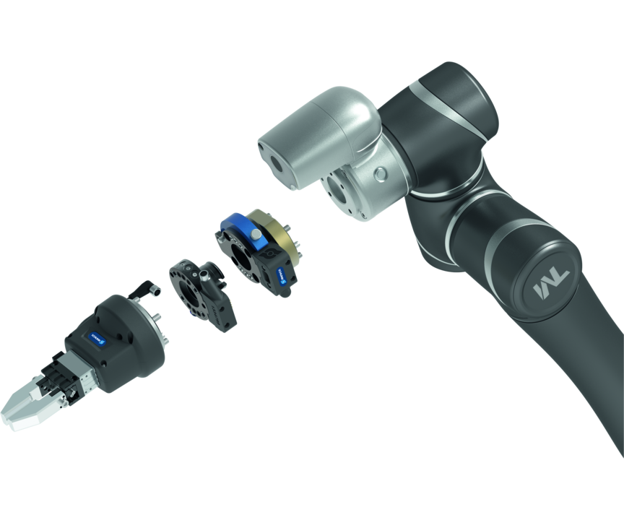
Modular System
The Plug & Work portfolio consists of electrically and pneumatically actuated grippers, as well as quick-change modules that are specifically adapted to robot arms from Techman Robot.
The portfolio with the fastest integration into any Cobot application
Ready for operation in 10 minutes

Slide 3

Modular. Flexible. Easy.
Adapted interface for cobots from Techman Robot
For collaborative operation or conventional automation
Change system for applications with high requirements as to flexibility
Different SCHUNK grippers for a variety of applications
Different components can be combined with each another

Slide 4
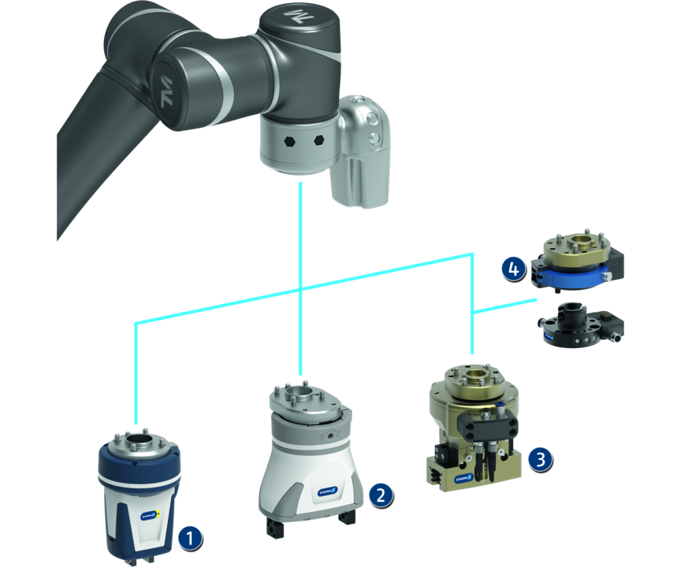
Principle of function
Functional description
All the Plug & Work components are ready for use for mechanical and electrical direct connection to the TM robot sizes 5, 12, and 14. Depending on the requirements, various grippers and end-of-arm components can be selected. The pneumatic gripping units are additionally equipped with micro valves, meaning no external valves are required.
1
Co-act Gripper
2
Electric gripper
3
Pneumatic grippers
4
Change systems

Slide 5
Advantages – Your benefits
Comprehensive portfolio consisting of various components and grippers for different applications for fast and easy entry into automation
Pre-assembled gripping unit with robot interface therefore no mounting kits or external valves required
Plug & Work with the interfaces suitable for all robots of Techman Robot
Software modules for robot control are included in the scope of delivery for fast and easy commissioning
Certified SCHUNK Co-act grippers For quick and easy entry into th world of collaborative applications
Electric grippers with a long adjustable stroke and force range for flexible workpiece handling
Pneumatic grippers For a high power density and simple integration

Slide 6
Technical data
Technical data overview
Description | Stroke per jaw | Max. gripping force | Weight | Recommended workpiece weight
 | [mm] | [N] | [kg] | [kg]
- Collaborative Gripping | 6 .. 10 | 140 .. 230 | 0.6 .. 1.38 | 0.7 .. 1.15
- Electric Gripping | 6 .. 40 | 100 .. 140 | 0.8 .. 1.06 | 0.5 .. 0.7
- Pneumatic Gripping | 6 .. 40 | 175 .. 870 | 1.37 .. 2 | 0.9 .. 4.35
- Changing |  |  | 0.14 .. 0.5 | 11

