Slide 1

Product presentation
LDK

Slide 2
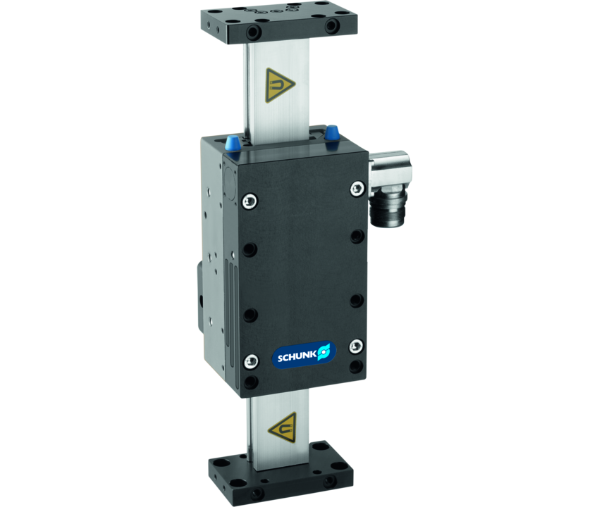
Compact short stroke axis with linear motor and roller guidance

Slide 3

Flexible. Reliable. Fast.

Slide 4
Principle of function
Functional description
The electric drive consists of a primary part (motor coil) and a secondary part (permanent magnets). Inside the controller the phase and amplitude of the applied electric current are controlled. This sets the profile, which is fitted with magnets, in motion.
1
Pneumatic holding brake
2
High precision, hardened and ground steel guide rails
3
Integrated secondary parts
4
Compact primary part slide
5
End plates
6
Motor plug

Slide 5
Advantages – Your benefits
Almost no wear parts For long service life and reliability of the system
No mechanical play between the drive components for flexible response behavior and high positioning accuracy
Low oscillations and high holding force for the shortest positioning times and process stability
Integrated motor and measuring system in the axis minimizes interfering contours and space requirements
Can be fitted with absolute stroke measuring system Less programming effort and time saving when commissioning and in operation
High dynamics for shorter cycle times therefore a high productivity is achieved
Many different variants possible e.g. long slides for special optimization on exactly your application
Optional pneumatic holding brake as rod lock for process reliability during system downtime
Optionally certified safety devices according to SIL2/PLd with the HIPERFACE® and DRIVE-CliQ interfaces for applications with high standards in the area of machine safety

Slide 6
Technical data
Technical data overview
Max. stroke H | Max. driving force | Nominal force | Max. useful load (vertical) | Max. acceleration
[mm] | [N] | [N] | [kg] | [m/s²]
200 | 250 .. 500 | 115 .. 185 | 3 .. 6 | 40

