Slide 1

Detailed presentation
Rotary drive ERT
Julian Kümmerling | Produktmanagement | January 2021

Slide 2
Agenda
Product presentation
Classification of the product in the SCHUNK portfolio
Target applications / industries / applications
Structure of the ERT
Option IP54
Differences to the ERS
Scope of delivery and accessories
Prices
Maintenance / service and commissioning
Accompanying documents
Project plan of the options

Slide 3
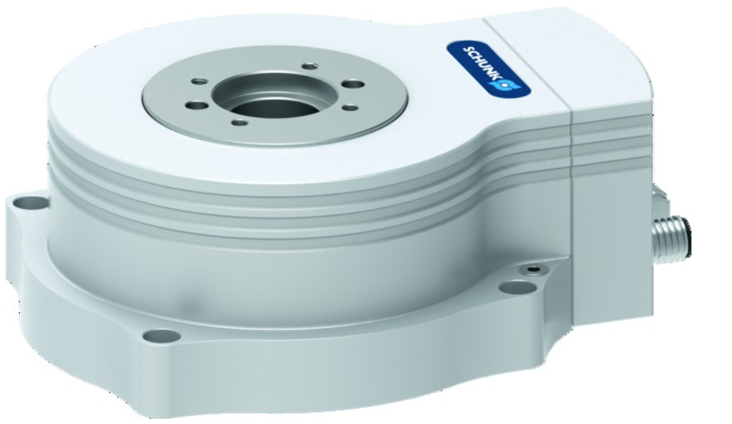
1. Product presentation
Electric rotary unit with torque motor
Compact and flat
3 sizes (ERT 12, 50 und 300)
Nominal torque from 1,5 to 32 Nm
Absolute measuring system
New Optiona: IP54 und DRIVE-CLiQ
Application:
Universally applicable as handling or positioning
Component in clean and light to medium polluted environments

Slide 4
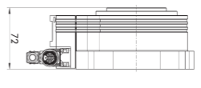
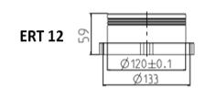
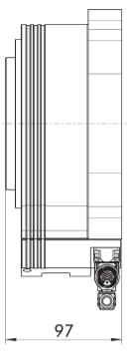
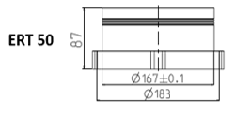
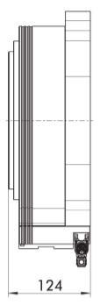
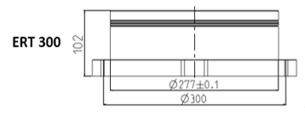
Sizes
Basic version and brake
Option IP 54
ERT 12
64
ERT 50
85
ERT 300
110

Slide 5
Options
ERT with electric holding brake
With electric holding brake for defined stopping of the drive
ERT with rotary feed-through
For carrying electrical signals (also Ethernet-based fieldbuses), a power supply (up to max. 15 A (ERT 300)) and pneumatics
ERT with different measurement system interfaces (Hiperface, Hiperface DSL (Q2 2021) and DRIVE-CLiQ
for easy integration into existing control concepts
Absolute encoder with SIL certification
For the use of safety functions in combination with suitable drive controllers, to increase plant safety
IP-54 Protection class
For use in polluted environments

Slide 6
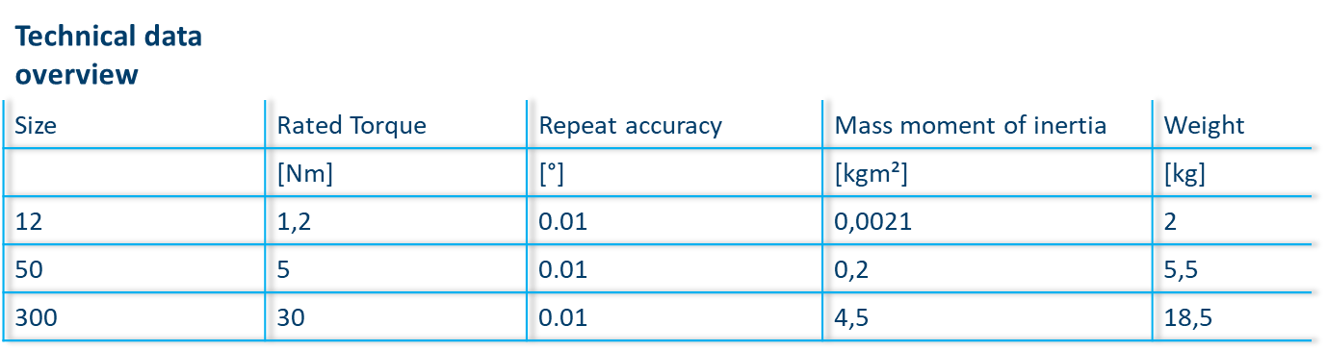
Technical data

Slide 7
2. Classification of the product in the SCHUNK portfolio
Mechatronic-Turning-Rotary drives-Direct drives
Low middle high
ERT
PRICE LEVEL
ERD
ERP
ERS
PERFORMANCE
ERT is intended to replace the ERS in the long term (approx. 5 years). For new projects only the ERT should be used!

Slide 8
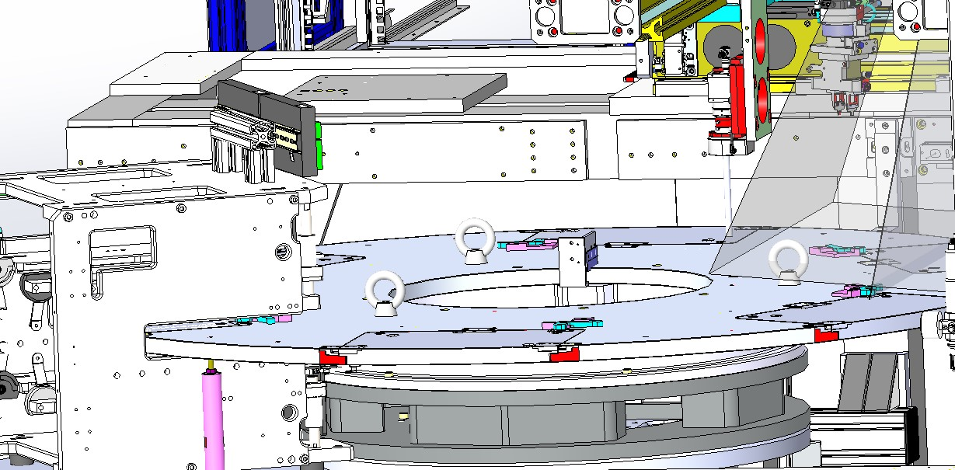
3. Target applications / industries / applications
Depaneling machines (St. Georgen)

Slide 9
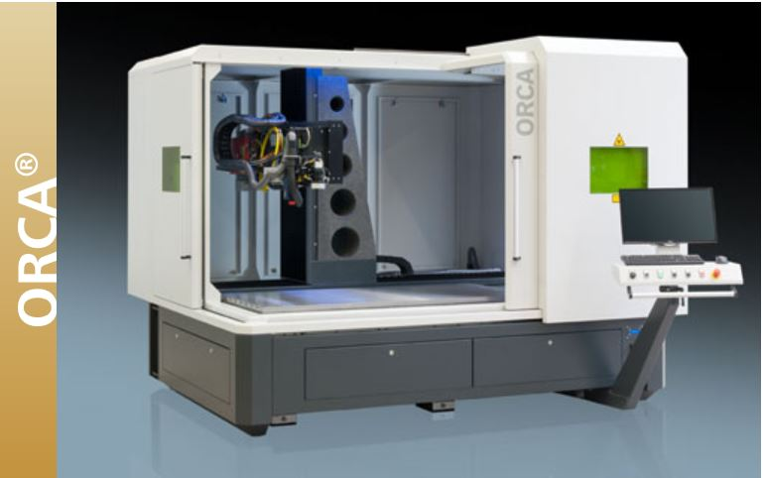
Laser processing
(Swiveling of the laser head)

Slide 10
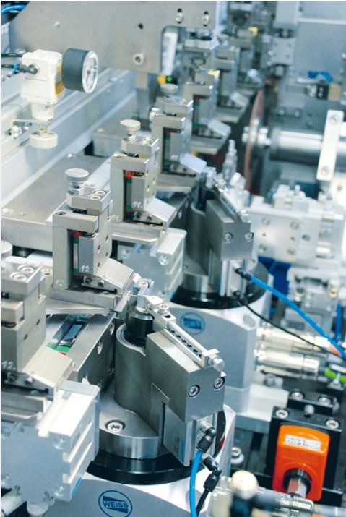
Medical Technology
(bending of medical needles)

Slide 11
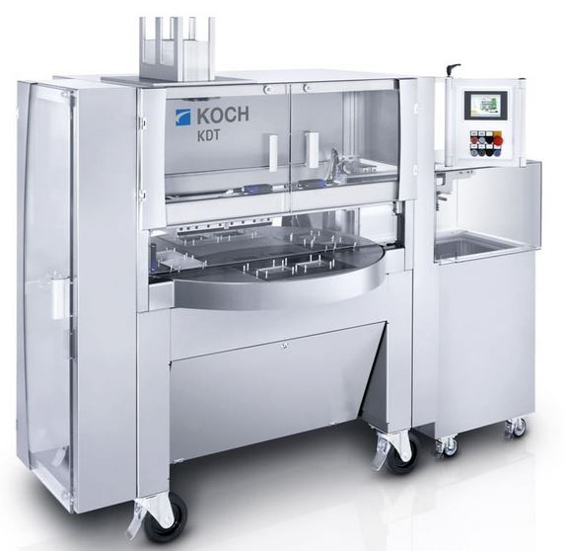
Packaging industry
(Rotary table machine)

Slide 12
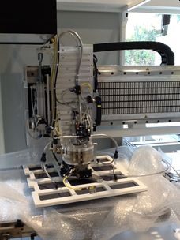
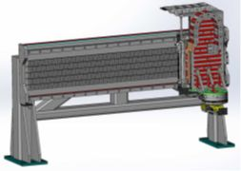
E- Mobility
(Handling/swiveling of battery cells)

Slide 13
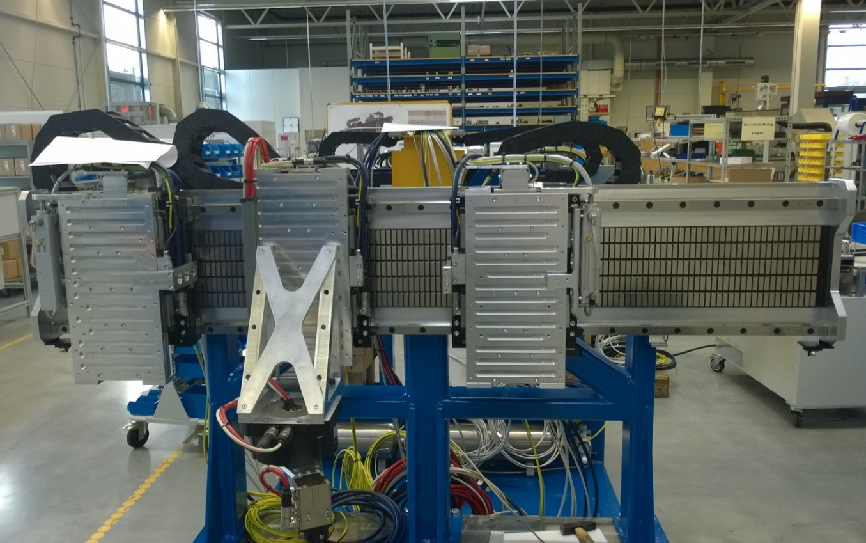
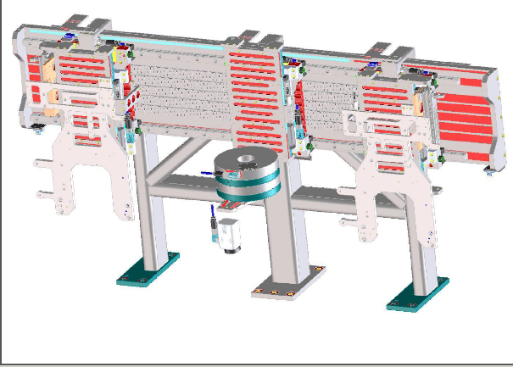
Solarzellenhandling
(Handling/swiveling of solar cells)

Slide 14
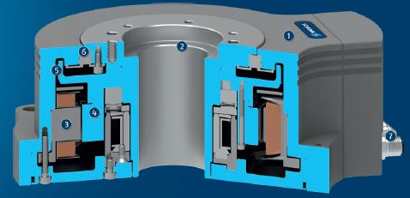
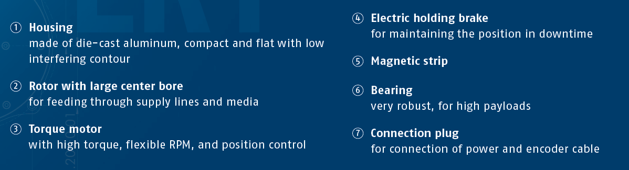
4. Structure of the ERT

Slide 15
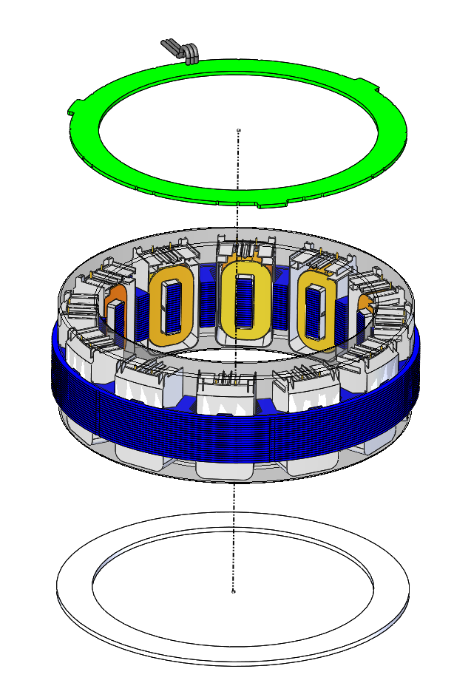
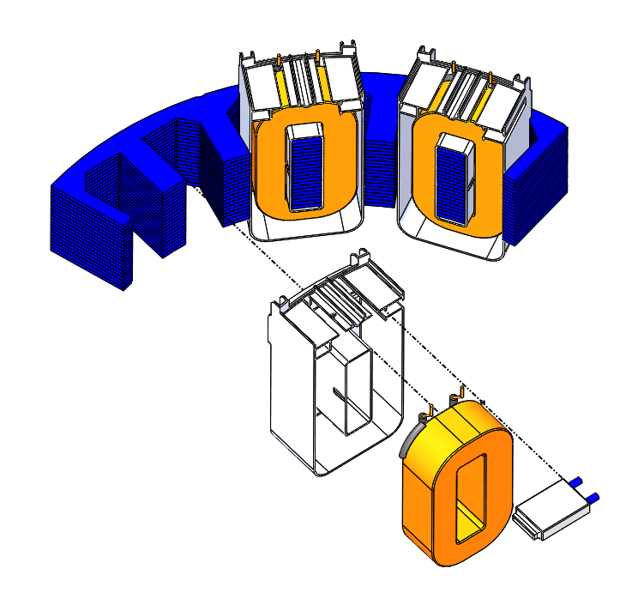
UL certified Motor
Stator
Circuit board wiring
Sealing compound
Sheet metal package
Insulating body
Coil
Temperature switch
Shielding plate

Slide 16
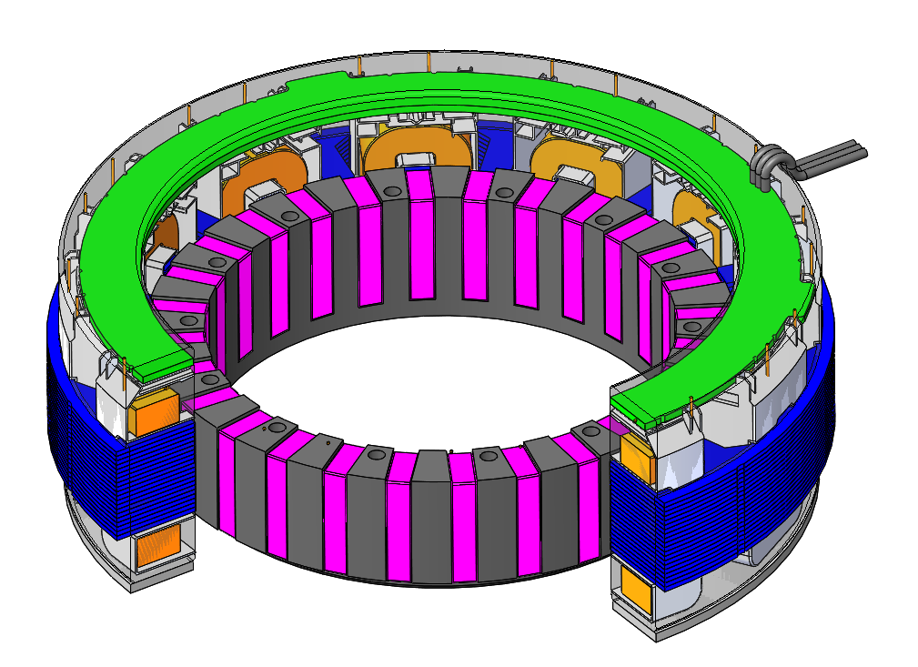
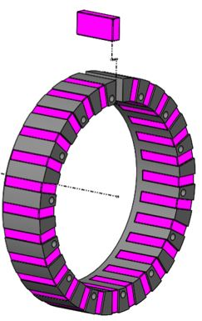
UL certified Motor
Rotor

Slide 17
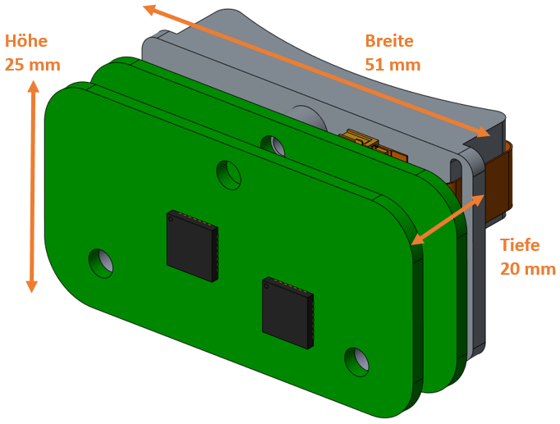
Modular measuring system (Hiperface, Hiperface DSL and DRIVECLiQ)
Height
Wide
Deep

Slide 18
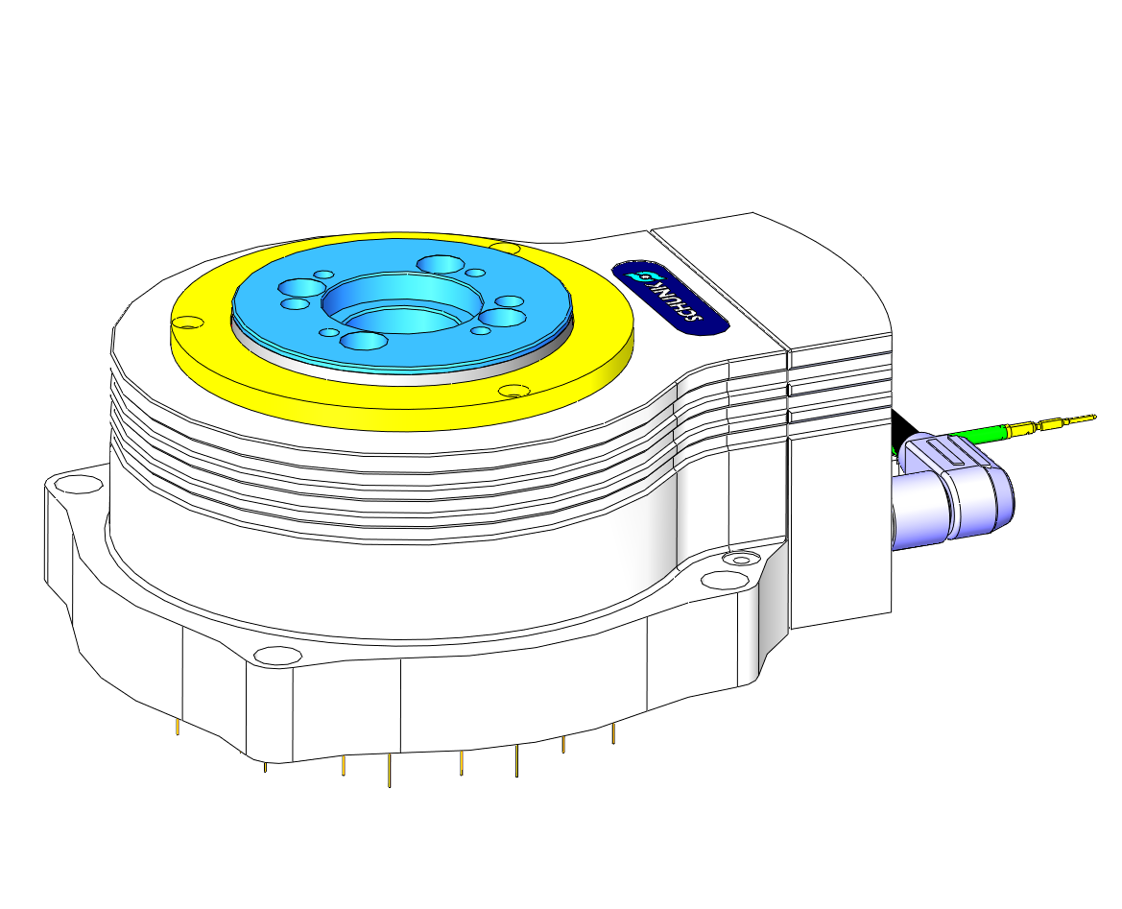
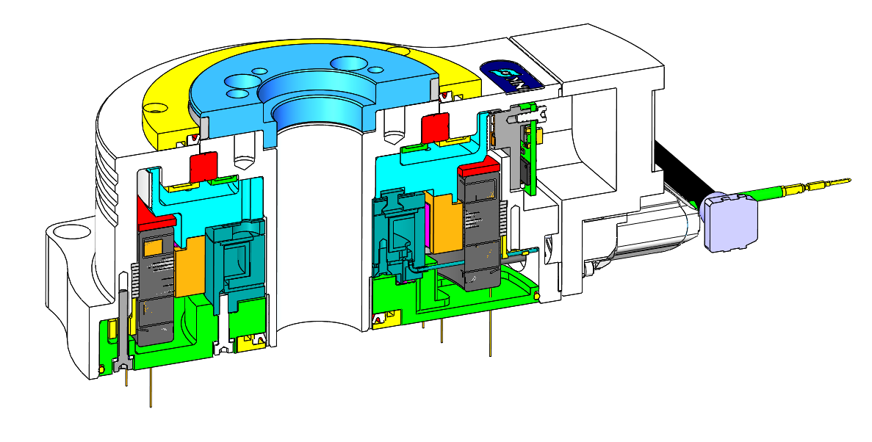
5. Option IP54
With the IP 54 option, the ERT achieves protection class IP54 with the aid of seals.
This requires an additional structure on the ERT housing and the turntable.
This results in a minimal change in height for the IP54 option compared to the basic version.
Construction housing
Construction housing

Slide 19
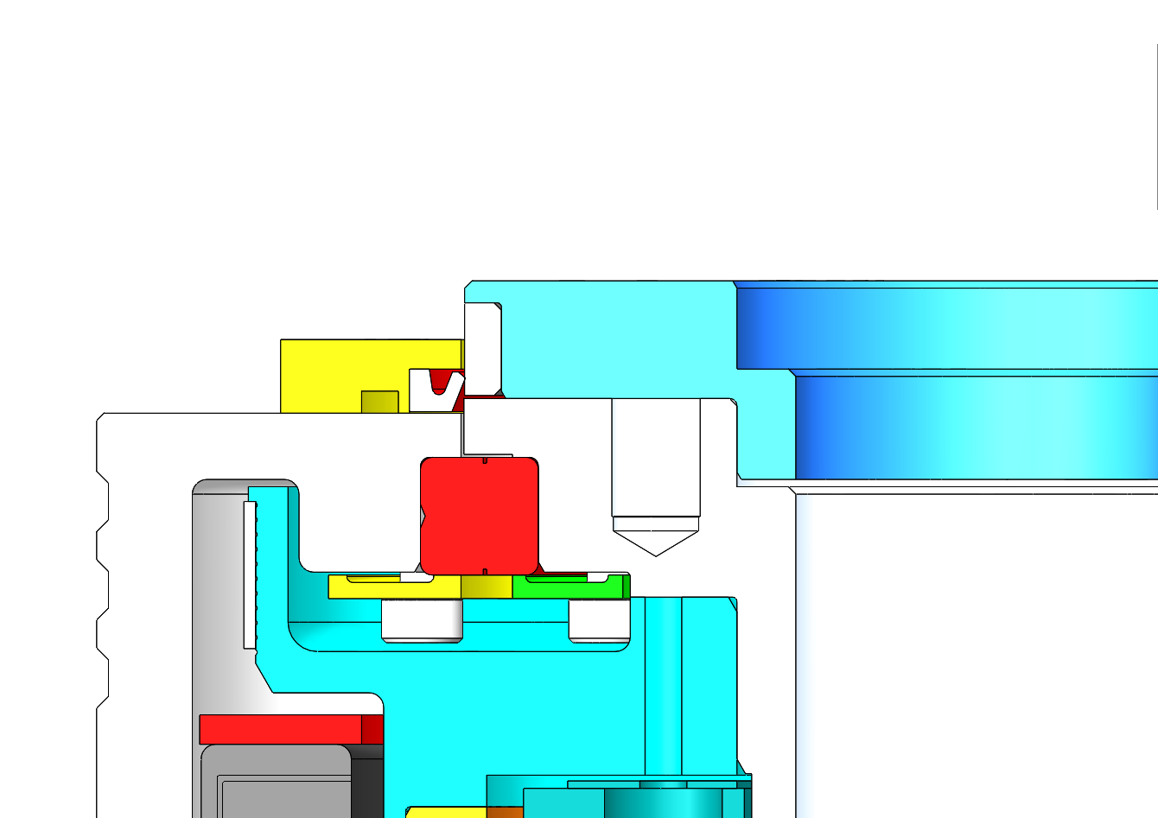
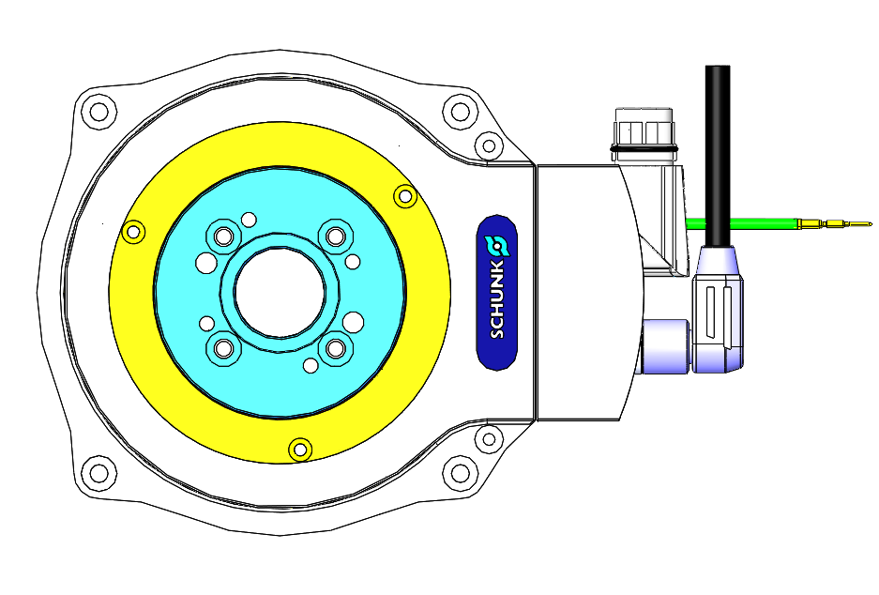
Top view
O-ring
Sealing ring
Tread steel

Slide 20
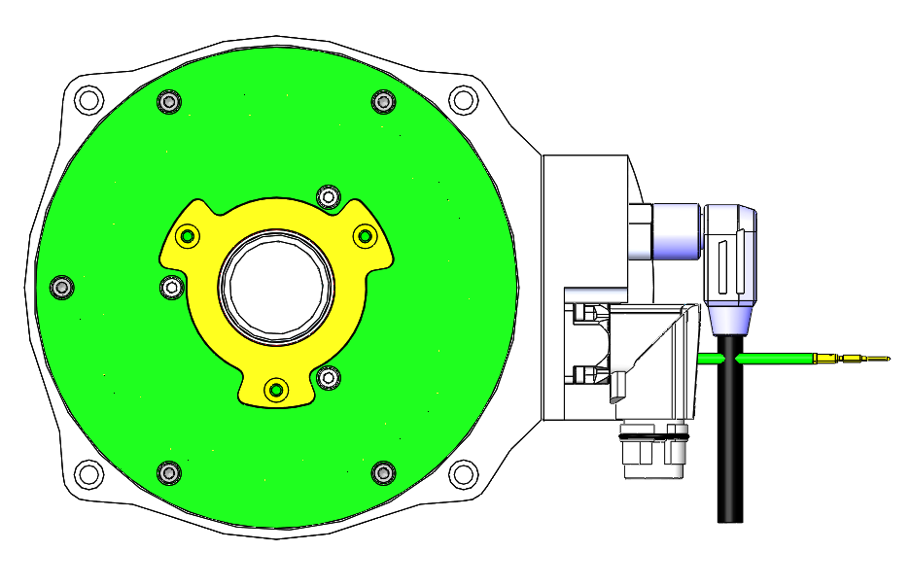
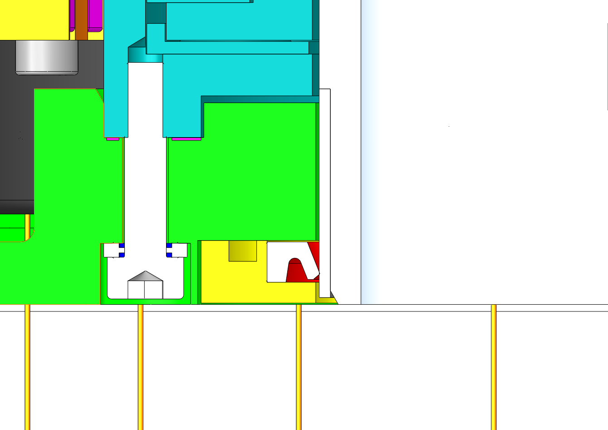
Bottom view
O-ring
Tread steel
Sealing ring

Slide 21
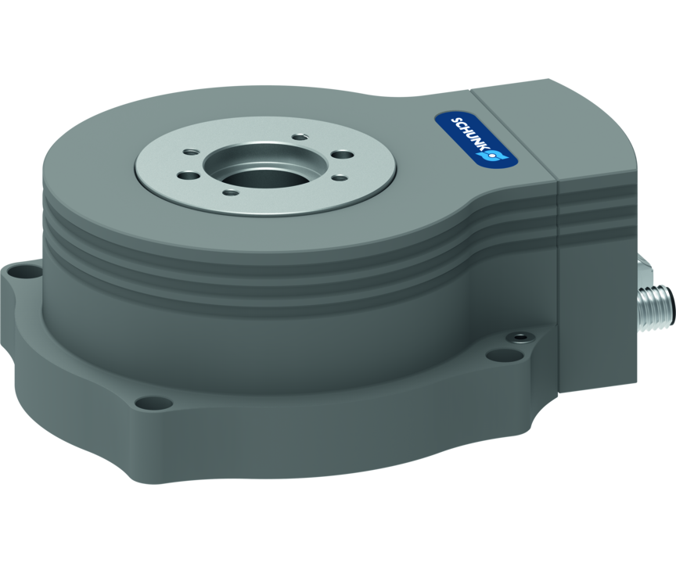
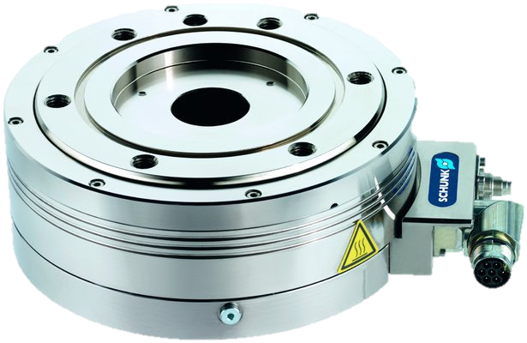
6. Differences to the ERS
Size differences
ERS
ERT
Size | Rated torque | Max. mass moment of inertia
ERS 135 | 2,5 Nm | 0,07 kgm²
ERS 170 | 5,0 Nm | 0,2 kgm²
ERS 210 | 10,0 Nm | 0,6 kgm²
Size | Rated torque | Max. mass moment of inertia
ERT 12 | 1,5 Nm | 0,07 kgm²
ERT 50 | 7,8 Nm | 0,39 kgm²
ERT 300 | 32,0 Nm | 5,53 kgm²
Note: Example pictures with different sizes - not to scale.

Slide 22
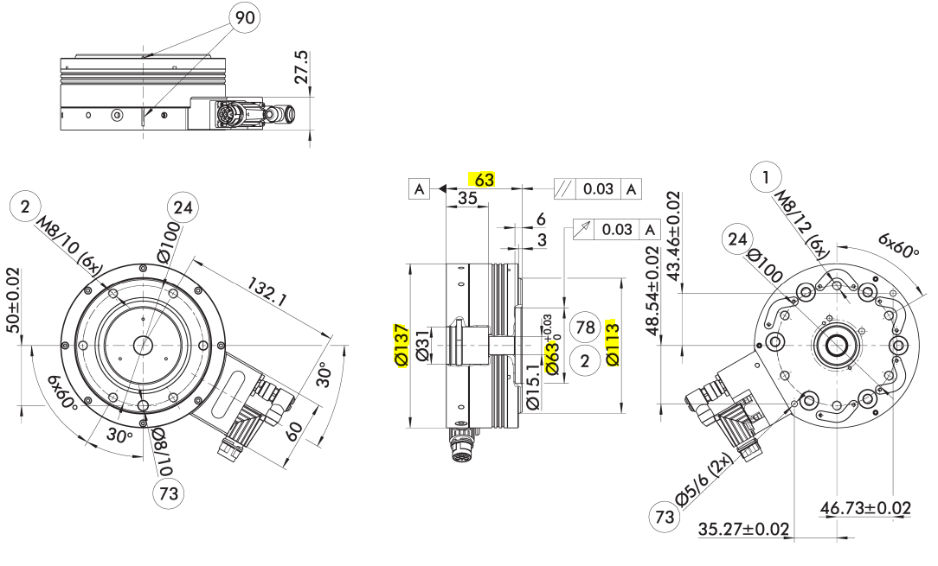
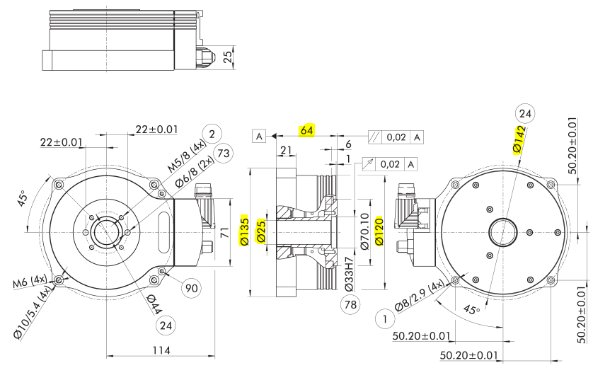
ERS 135
ERT 12

Slide 23
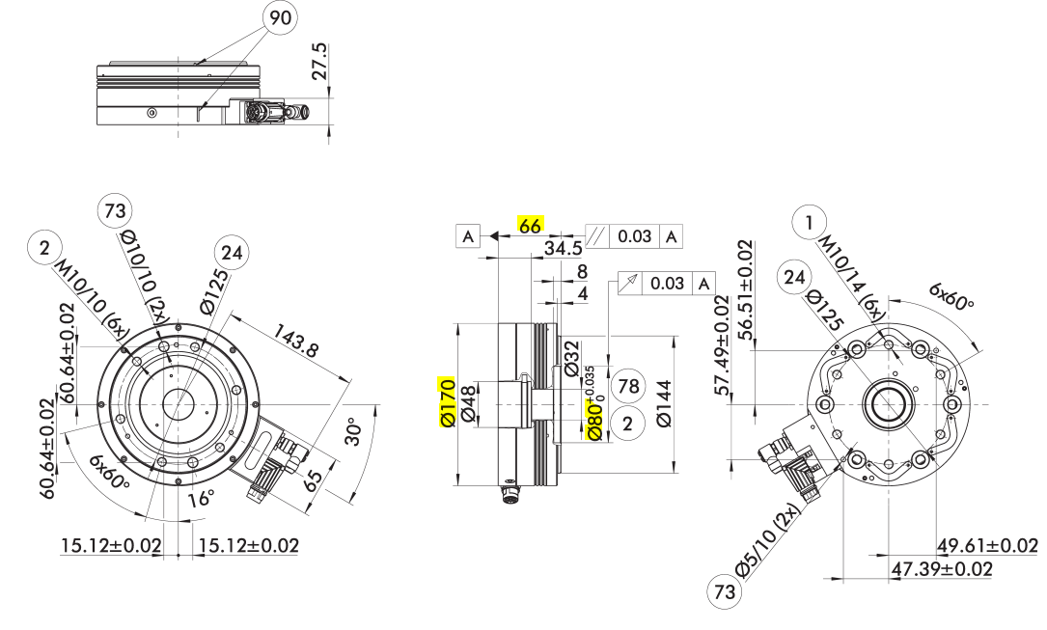
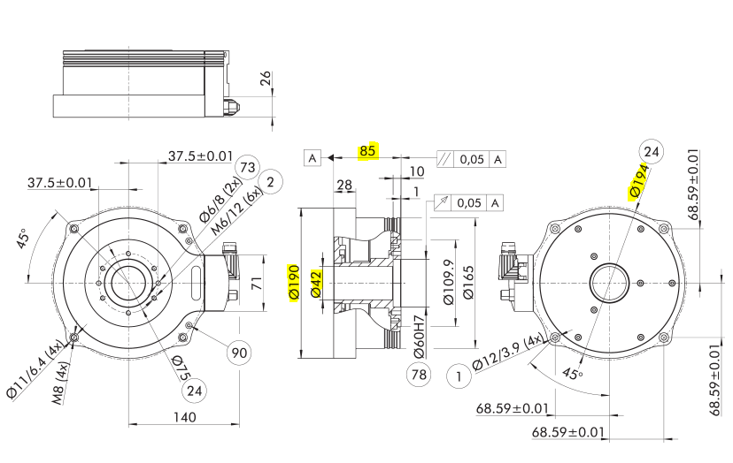
ERS 170
ERT 50

Slide 24
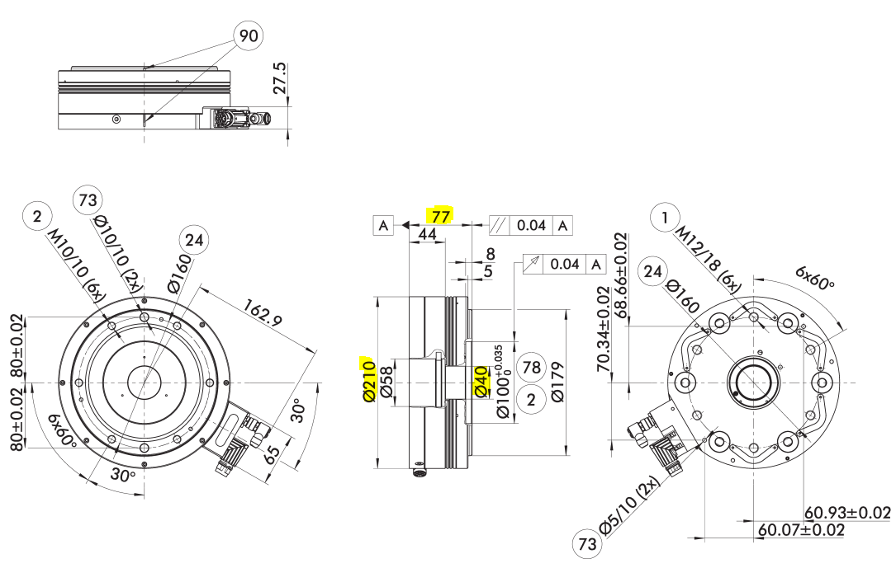
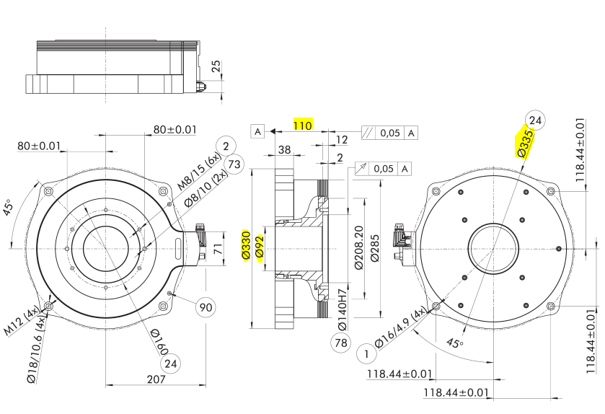
ERS 210
ERT 300

Slide 25
Technical differences
ERS | ERT
Body | Aluminium alloy (milled part) | Aluminium alloy (die-casting)
Coating | Chemical nickel plating | Powder coating
Advantage | High quality design | Very good heat dissipation
Disadvantage | Poor heat dissipation | No shiny surface
Note: Example pictures with different sizes - not to scale.

Slide 26
ERS | ERT
Encoder system | inkrementell | absolut
Output signal | Sin/Cos 1Vss | Hiperface, Hiperface DSL, DriveCliq
Holding brake | pneumatisch | elektrisch
Radial/axial runout | 0,03 – 0,04 mm | 0,02 mm

Slide 27
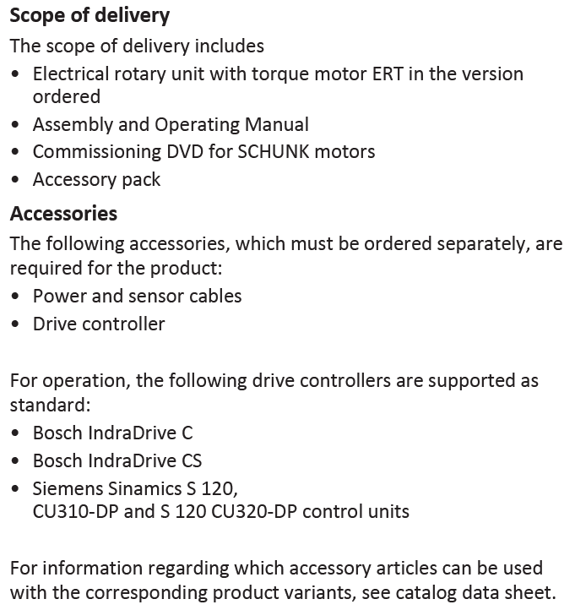
7. Scope of delivery and accessories

Slide 28
8. Prices
ERT 12
ERT 50
Designation | extra charge | List price
Basic module (with Hiperface) |  | 2.890 €
Basic module (with DRIVE-CLiQ) | 337 € | 3.227 €
Electrical brake | 817 € | 3.707 €
IP 54 | 318 € | 3.208 €
Designation | extra charge | List price
Basic module (with Hiperface) |  | 3.290 €
Basic module (with DRIVE-CLiQ) | 337 € | 3.627 €
Electrical brake | 980 € | 4.270 €
IP 54 | 362 € | 3.652 €

Slide 29
ERT 300
Designation | extra charge | List price
Basic module (with Hiperface) |  | 5.190 €
Basic module (with DRIVE-CLiQ) | 337 € | 5.527 €
Electrical brake | 1.176 € | 6.366 €
IP 54 | 648 € | 5.838 €

Slide 30
List price/(€)
Torque/(Nm)

Slide 31
9. Maintenance / service and commissioning
The ERT does not require any current maintenance or service. The ERT is lubricated for life and therefore requires no subsequent lubrication.For the IP54 option, the seals must be replaced after an interval of 5 million revolutions or cycles to maintain the IP54 rating.million revolutions or cycles to maintain the IP54 protection class. The customer can carry out this maintenance independently.For this purpose, we offer a maintenance set for each size.Translated with www.DeepL.com/Translator (free version)
Commissioning is carried out by means of the IBN-DVD supplied.
There are standard parameter sets for our supported controller from Bosch.
A motor data sheet for third-party controllers is stored on the IBN-DVD.
With this the customer can parameterize the ERT for all third-party controllers.
The contact persons for questions regarding the commissioning of the ERT are
Stefan Weiner
+49-7725-9166-5014
stefan.weiner@de.schunk.com

Slide 32
10. Accompanying documents
Catalogue chapters
Instruction manual
Commissioning instructions ERT on Indradrive Cs and Sinamics
Competition comparison
ERT and ERS differences
ERT with DRIVE-CLiQ
Commissioning Instructions / DVD
Checklist rotary modules
Motors and controllers overview
INFO: All documents listed here will be available at the STB

Slide 33

11. Project plan of the options
✓
Absolute encoder
Modular encoder system Hiperface DRIVE-CLiQ Hiperface DSL )
UL suitable: ERT12 ERT50 ERT300
Electrical brake
IP54
Pneumatic rotary feed-through
Electric rotary feed-through (Bus suitable)
✓
✓
✗
Q2 / 2021
Entscheidung steht aus
✓
Entscheidung steht aus
✓
✓
✗
Q3 / 2021
✗
Q4 / 2021

