Slide 1

Product presentation
ERT
Universal rotary unit

Slide 2
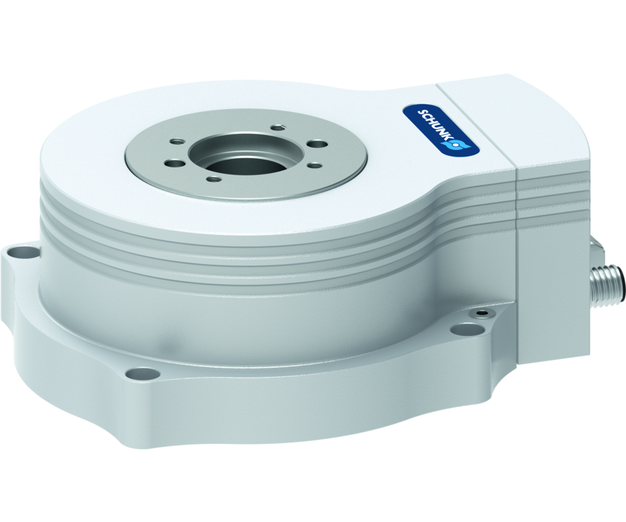
Universal rotary unit
Universal flat rotary unit with absolute encoder and electric brake as well as optional increased protection class (IP54)
The flattest rotary unit with absolute-value transducer and electric brake on the market

Slide 3

Flat. Dynamic. Precise.
Absolute measuring system
Extremely flat design
Integrated torque drive
Electrical brake
Modular transducer system

Slide 4
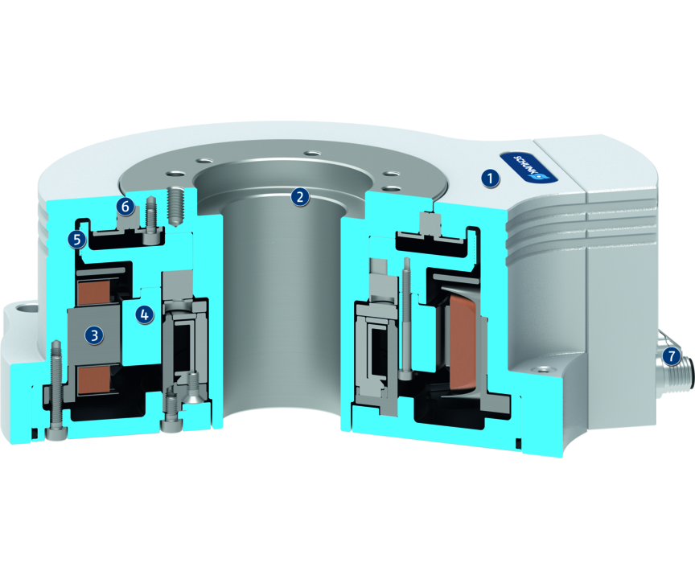
Principle of function
Functional description
The flat and powerful ERT rotary unit is equipped with a large center bore and is based on an integrated permanently energized torque motor. The position is ensured using a cross roller bearing, which is designed for high maximum moments. The electric brake is actuated directly via the controller.
1
Housing
2
Rotor with large center bore
3
Torque motor
4
Electric holding brake
5
Magnetic strip
6
Bearing
7
Connection plug

Slide 5
Advantages – Your benefits
Integrated torque drive for high torque and flexible use by controlled position, velocity and torque
Extremely flat design for minimal interfering contours and for use in confined spaces
With absolute position measurement system Less programming effort and time saving when commissioning and in operation
Optionally certified safety devices according to SIL2/PLd with the DRIVE-CliQ interface for applications with high requirements in the area of machine safety
Optional electric brake for maintaining the position in downtime
Large center bore for feed-through lines and media hoses
Versatile actuation options for simple integration into existing control concepts using different external third-party controllers (e.g. Bosch Rexroth IndraDrive or Siemens SINAMICS)

Slide 6
Technical data
Technical data overview
Size | Nominal torque | Peak torque | Max. mass moment of inertia | Repeat accuracy | Weight
 | [Nm] | [Nm] | [kgm²] | [°] | [kg]
12 | 1.4 .. 1.52 | 4.17 | 0.07 | 0.01 | 2.4 .. 2.85
50 | 7.04 .. 7.8 | 20.1 | 0.39 | 0.01 | 5.74 .. 6.84
300 | 31 .. 32 | 76 | 5.53 | 0.01 | 19.5 .. 25.2

