Slide 1
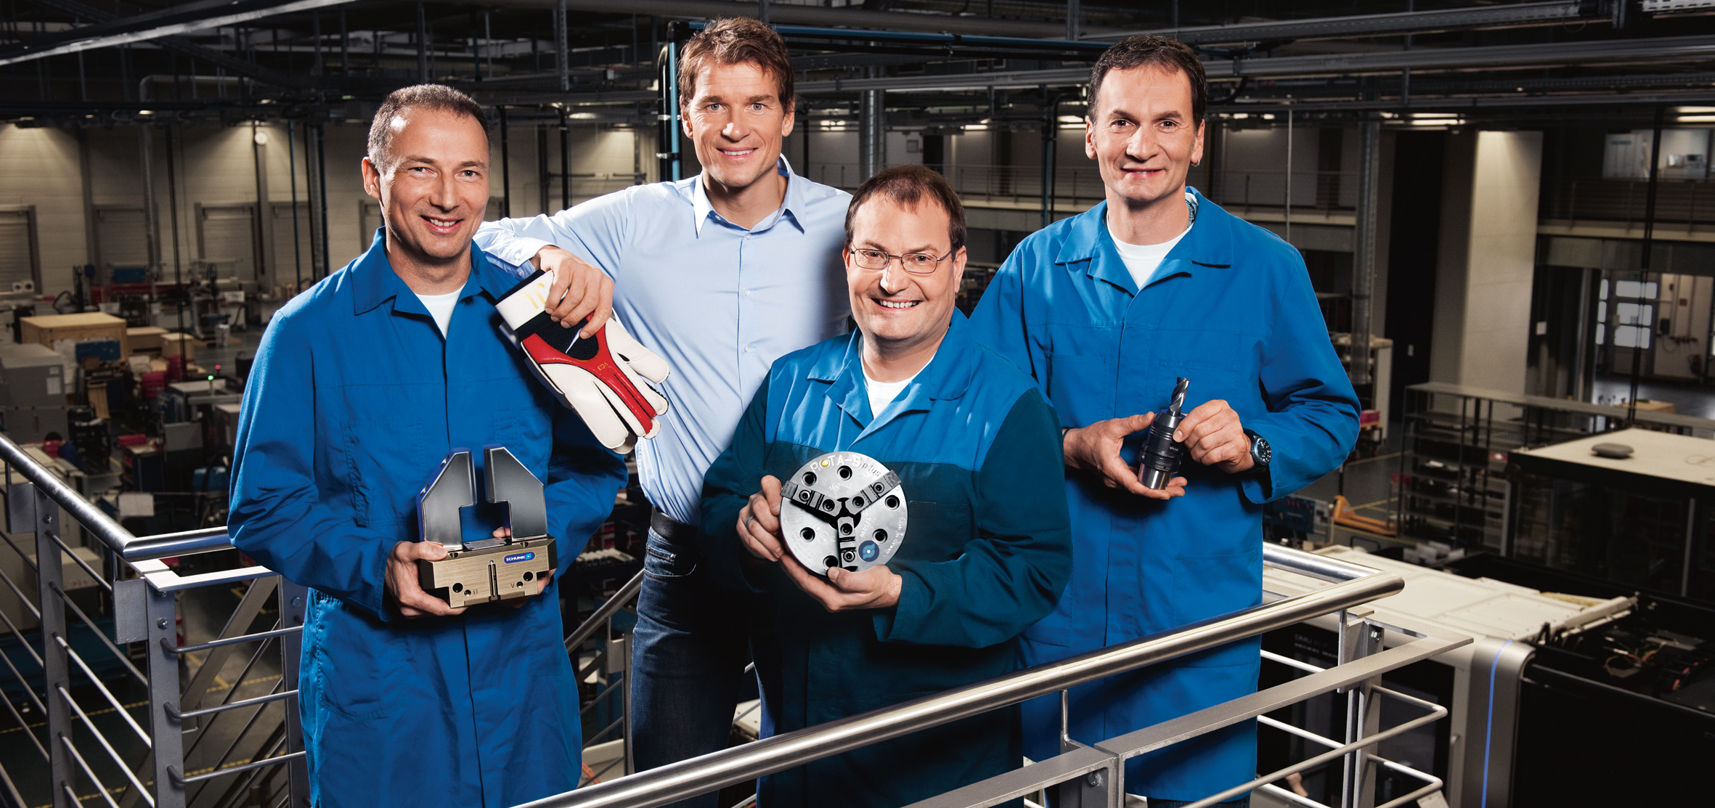
Design tool for SCHUNK grippers
Practical Training 2019 - Hausen
Dietrich | Muras | Link

Slide 2
Introduction into the calculation and design tool for SCHUNK grippers
HTML based and accessible via web browser
Current data and news
Access to the calculation logic
Calculation files can be saved
Auxiliary drawing

Slide 3
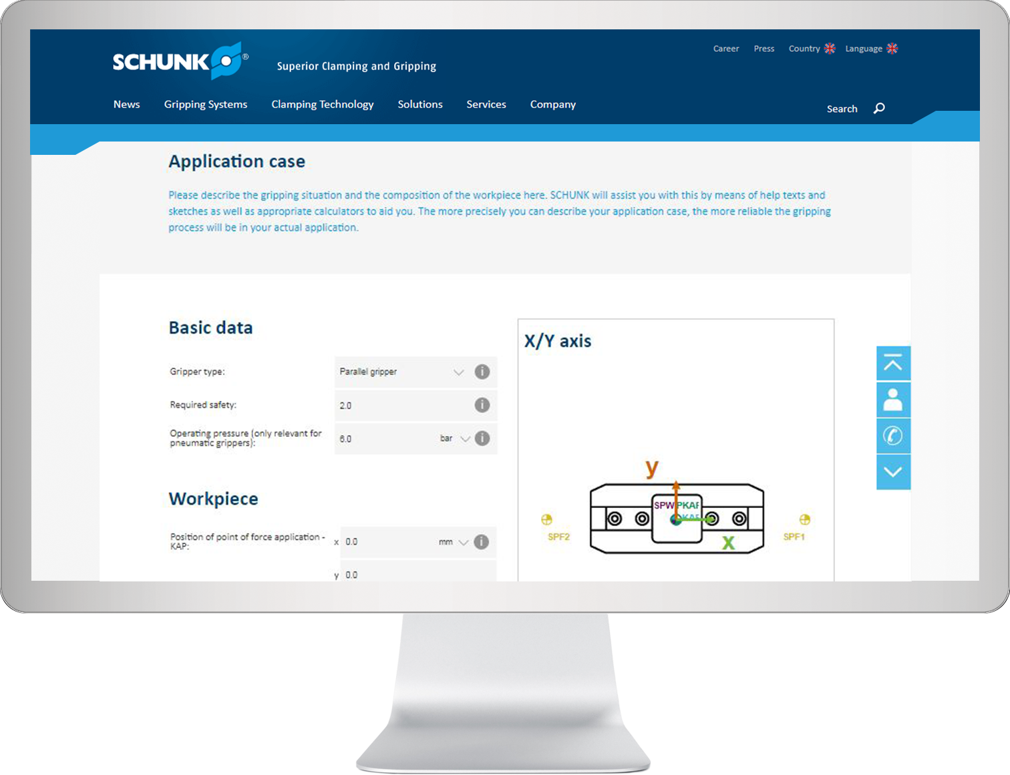
Design tool for SCHUNK grippers
calculation and design based on the world´s largest standardized gripper portfolio
Your (customer-) BENEFITS –
Our SERVICES
Design in less than 8 min in self service and 24/7
… in another 2 minutes to order
Worldwide available online design tool
Proof for end customers and that with manufacturer knowhow
Always the latest products with up-to-date and manufacturer-design know-how

Slide 4
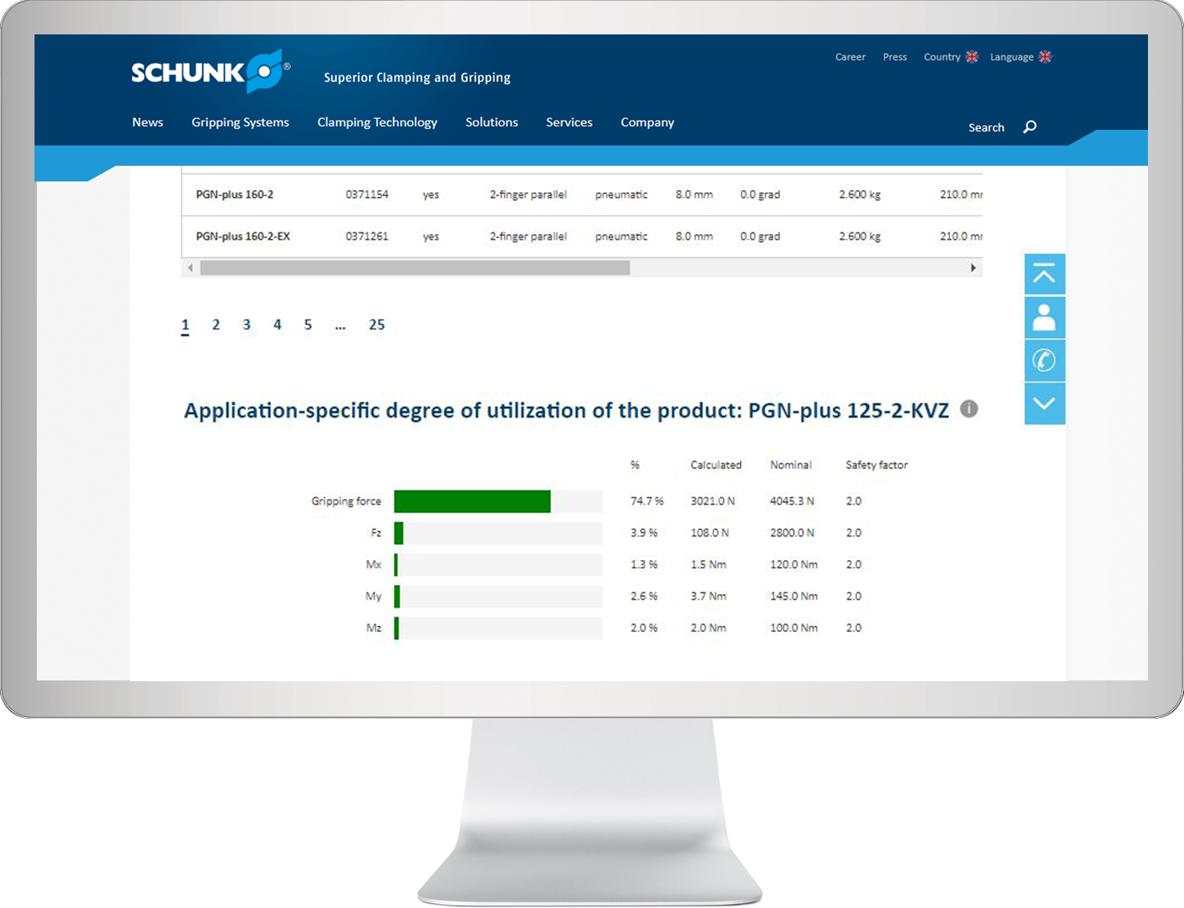
Calculation and design tool for SCHUNK grippers
calculation and design based on the world´s largest standardized gripper portfolio
Your (customer-) BENEFITS –
Our SERVICES
Display of a specific degree of utilization
Save, archive and open the calculation is possible any time
Perfect inquiry input for fast, qualified support by specialists
Also suitable for recalculations in a few minutes

Slide 5
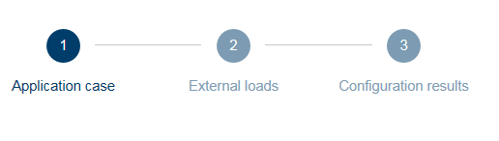
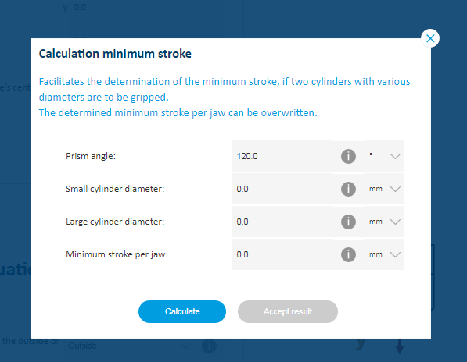

Basic functions
Three different „index tabs“
Loading and saving the calculation
Auxiliary computer for support

Slide 6
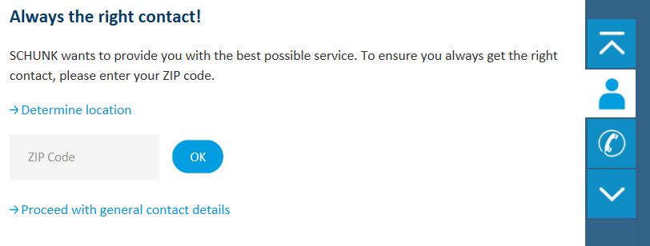
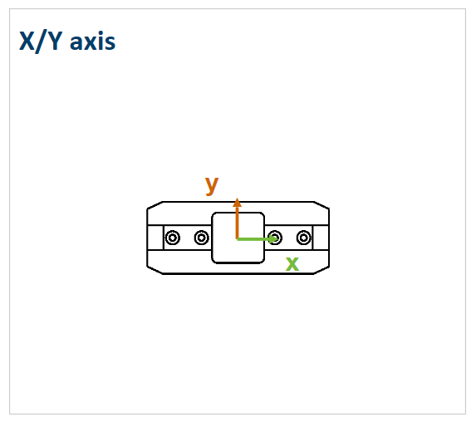
Basic functions
Contact widget
Auxiliary drawing for different moments and loads

Slide 7
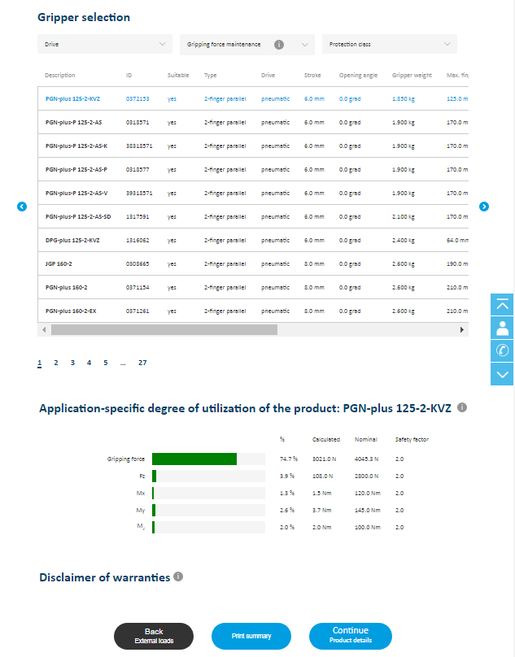
Basic functions
Hit list with corresponding capacity utilization
List sorted by mass of the gripper and then alphabetically

Slide 8
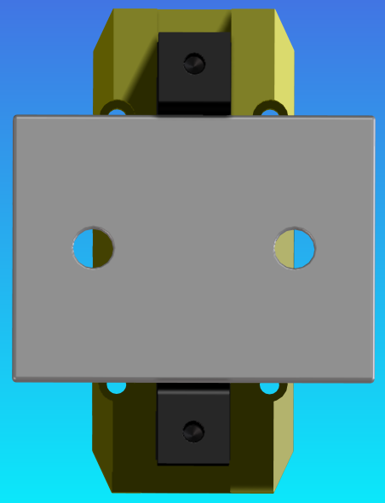
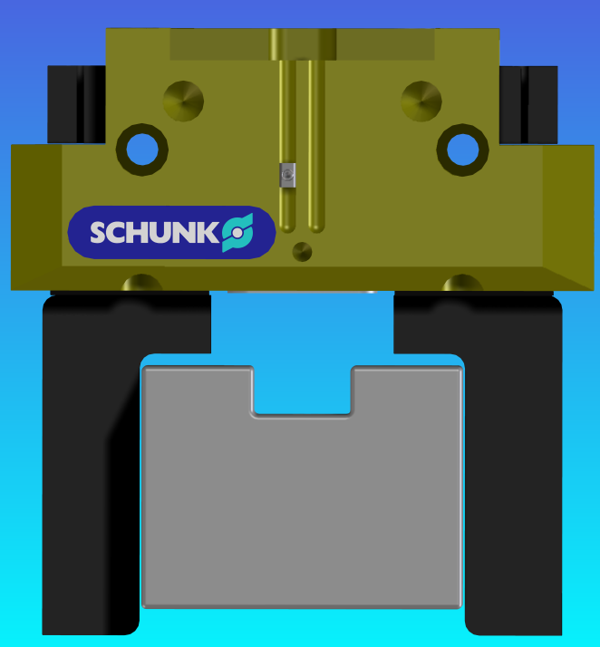
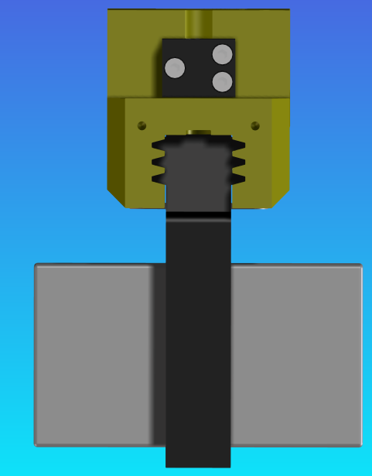
Sample calculation – handling object

Slide 9
Sample calculation – Technical data
Using the calculation and design tool gripping systems and select a suitable parallel gripper for the following application:
given:
m = 7 kg
p = 6 bar
s = 2
Type of gripping = force fit
Grip the workpiece from the outside or side = outside
Orientation of the gripped cylinder= parallel z-axis
Minimum required stroke per jaw = 0 mm
Coefficient of friction µ = 0,1
Process forces = no
Position of the gripper in the room = z-axis in the direction of earth gravity
External Acceleration (robot):
X = 5 m/s²
Y = 5 m/s²
Z = 5 m/s²
searched:
Force application point?
Center of gravity of the workpiece?
Focus of the fingers?
Length of contact area in Y & Z?
Workpiece length (X-direction)?
Finger mass?

Slide 10
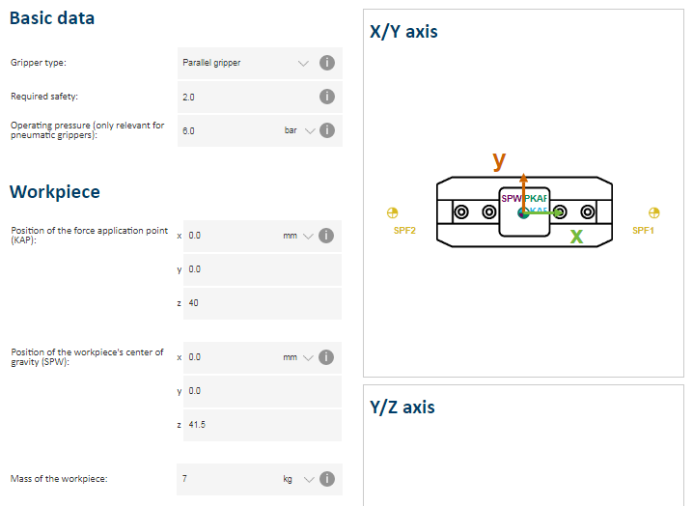
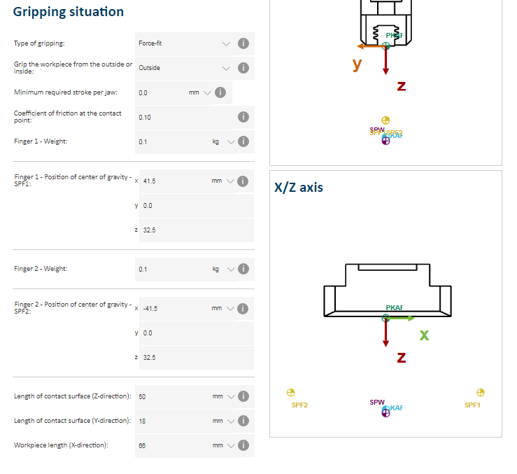
Sample calculation – Input parameter application case

Slide 11
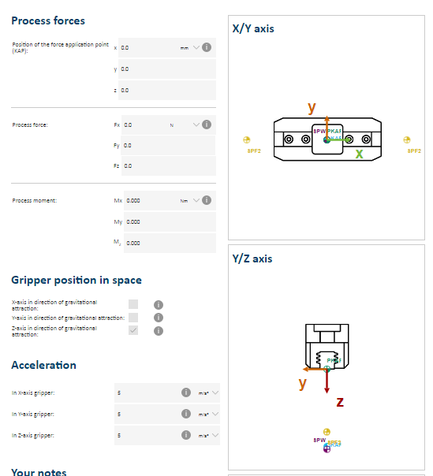
Sample calculation – Input parameters external loads

Slide 12
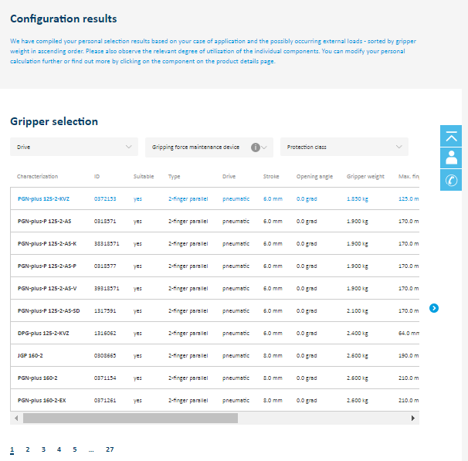
Sample calculation – hit list

Slide 13
Sample calculation – calculation file

Slide 14
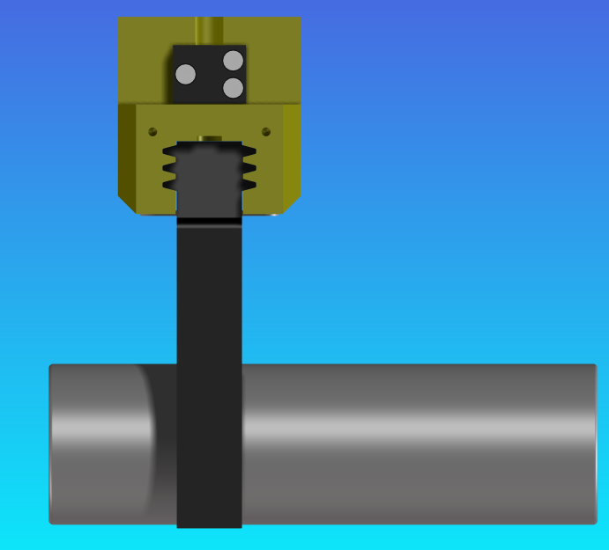
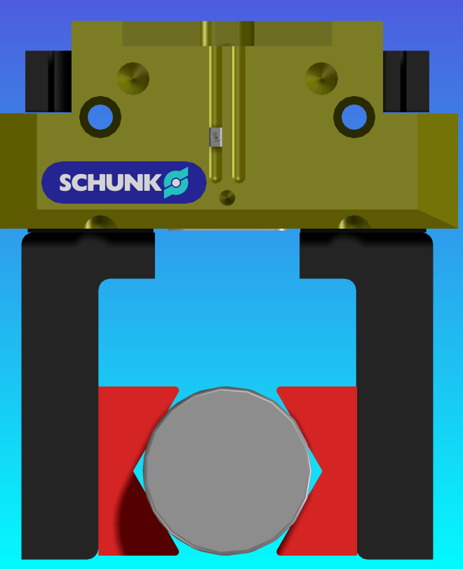
Sample calculation – handling object

Slide 15
Sample calculation – Technical data
Using the calculation and design tool gripping systems and select a suitable parallel gripper for the following application:
given:
m = 6 kg
p = 6 bar
s = 2
Type of gripping = form fit
Grip the workpiece from the outside or side = outside
Orientation of the gripped cylinder = perpendicular to the z-axis
Minimum required stroke per jaw = 0 mm
Coefficient of friction µ = 0,3
Process forces = no
Position of the gripper in the room = z-axis in the direction of earth gravity
External Acceleration (robot):
X = 3 m/s²
Z = 3 m/s²
searched: (specification by the customer or by CAD model)
Finger mass?
Prism angle?
Prism width?
Clamping diameter?
Force application point?
Center of gravity of the workpiece?
Focus of the fingers?
Length of contact area in Y & Z?
Workpiece length (X-direction)?

Slide 16
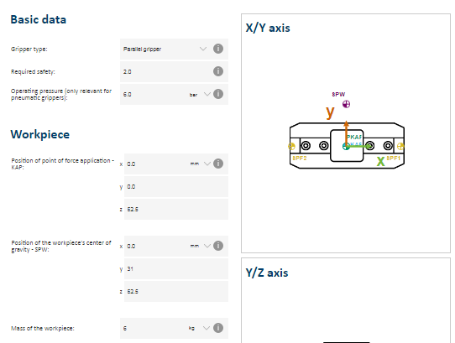
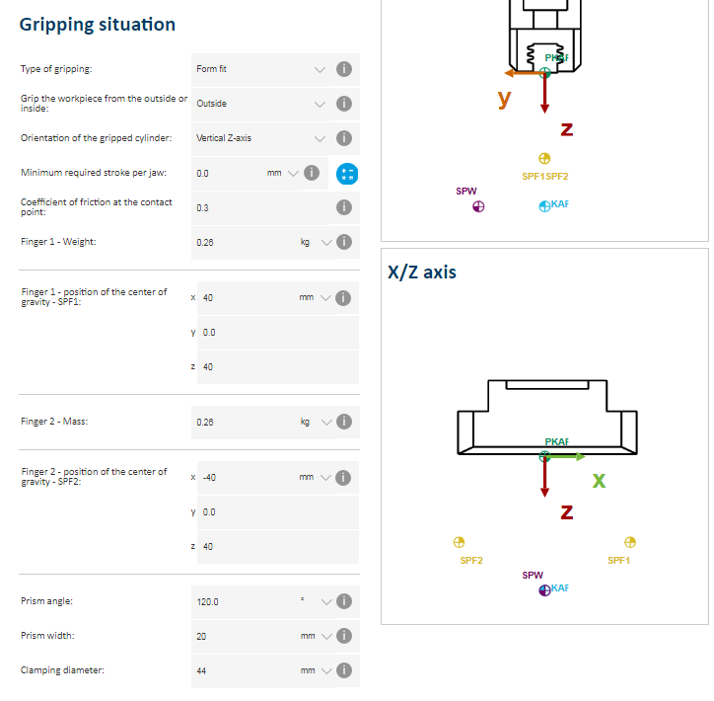
Sample calculation – Input parameter application case

Slide 17
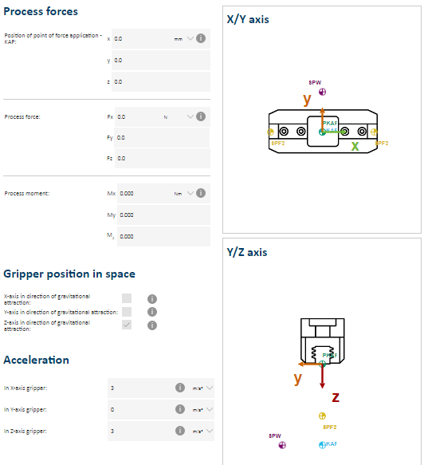
Sample calculation – Input parameters external loads

Slide 18
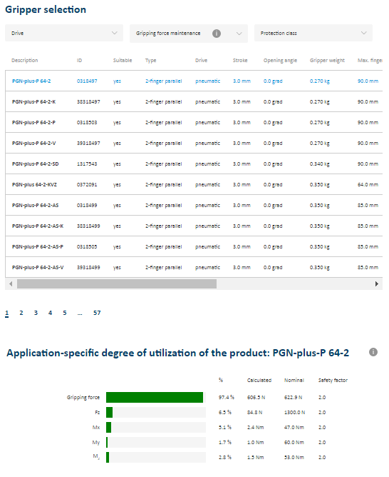
Sample calculation – hit list

Slide 19
Sample calculation – calculation file

Slide 20
Contact persons
Product Line Pneumatic Gripping:
Marcel Dietrich | Tel: 2883 | marcel.dietrich@de.schunk.com
Timo Muras | Tel: 3124 | timo.muras@de.schunk.com
Digital Products & product-related Services
Marian Link | Tel: 3294 | marian.link@de.schunk.com

Slide 21
Thank you for your attention!

