Slide 1

Product presentation
EGH
Universal gripper

Slide 2
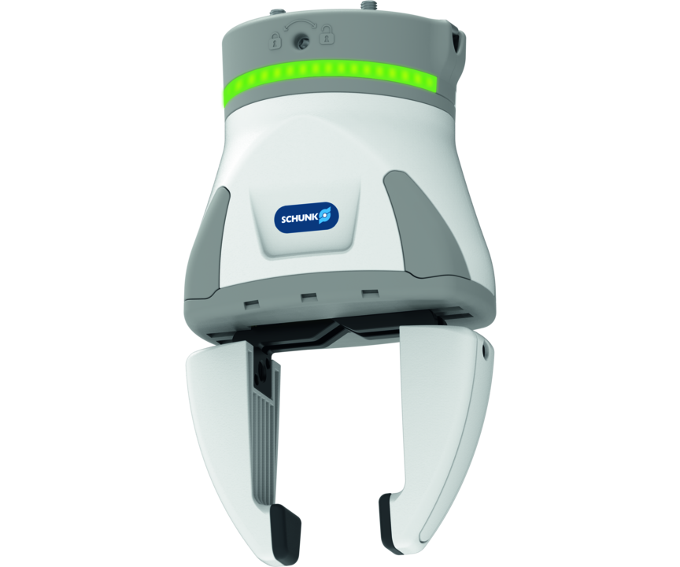
Universal gripper
Flexible gripper with long, adjustable stroke for simple automation with cobots
The simplest, flexible SCHUNK gripper for cobots – now also for FANUC robots!
Ready-to-work in 30 mins

Slide 3

Easy. Flexible. Plug & work.
Plug & Work for Cobots
Long adjustable gripper stroke
Integrated status display
Starter package available
Flexible fingers for direct attachment

Slide 4
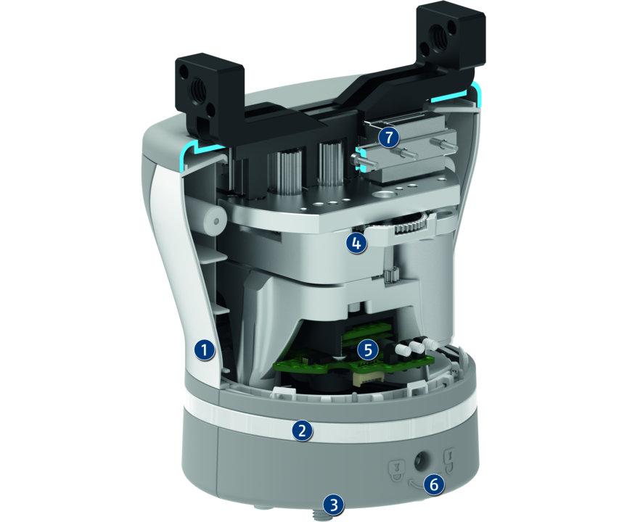
Principle of function
Functional description
The multi-stage gear transmission is driven by a brushless servomotor. The base jaws of the gripper are driven by three parallel output pinions, which have integrated gear racks for this purpose. The jaws are therefore driven by the rack-and-pinion principle, which converts the rotary movement of the servomotor and the gear into the linear movement of the base jaws.
1
Gripper housing
2
LED strip light
3
ISO flange
4
Drive unit
5
Integrated electronics
6
Locking mechanism
7
Base jaw with linear guide

Slide 5
Advantages – Your benefits
Long and freely programmable stroke for flexible workpiece handling
Plug & Work for a quick and simple start of production
Integrated status display For a visual indicator of the application state
Control via IO-Link enables the prepositioning of the gripper finger and the evaluation of the gripper condition
Gripping movement with parallel kinematics for constant gripping force over the entire stroke
Easily accessible assembly quick-release fastener for quick and easy attachment of the gripper to the robot
Optionally attachable flexible fingers for increased flexibility and the gripper's range of application

Slide 6
Technical data
Technical data overview
Size | Description | Stroke per jaw | Min. gripping force | Max. gripping force | Max. permissible finger length | Recommended workpiece weight | Weight | Nominal voltage
 |  | [mm] | [N] | [N] | [mm] | [kg] | [kg] | [V]
80 | EGH 80-IOL-N-UREK Starter | 40 | 50 | 100 | 70 | 0.5 | 0.95 | 24
80 | EGH 80-IOL-N-TMEK Starter | 40 | 50 | 100 | 70 | 0.5 | 1.06 | 24
80 | EGH 80-IOL-N-FCRXEK Starter | 40 | 50 | 100 | 70 | 0.5 | 0.95 | 24

