Slide 1
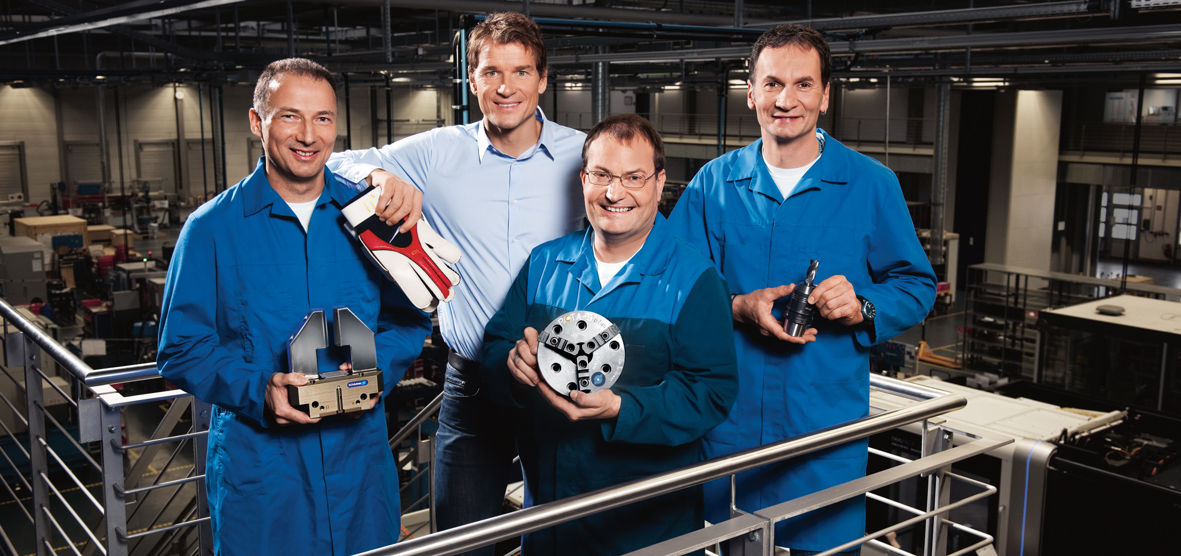
Examples of Applications for Deburring Spindles
For internal use only since some pictures are confidential

Slide 2
Introduction
What is driving an increase in demand for automated deburring?
Manual work: Dull, Dirty, Dangerous
Quality and consistency
Efficiency / throughput
2nd usage of robot for machine loading
Reducing cycle time for milling machine
What are the potential applications for deburring?
Castings: transmission/engine housings, gears, suspension & chassis parts
Forgings: hand tools, engine components, hydraulic fittings
Aerospace: turbine blades, carbon fiber parts
Injection molding: non-metallic molded parts

Slide 3
Introduction
Automation Challenges
Part variation
Repeatability of fixtures
Burr / flash variation
Complex geometry
High mix + low volume
Standard robots cannot “see” or “feel”
=> It is required to have sensing or even better a Compliance function
Value of Compliance
Compensates for positional inconsistencies
Provides range of motion to make programming easier
Consistent force applied to parts despite variability
Extends brush life and self adjusts for brush wear

Slide 4
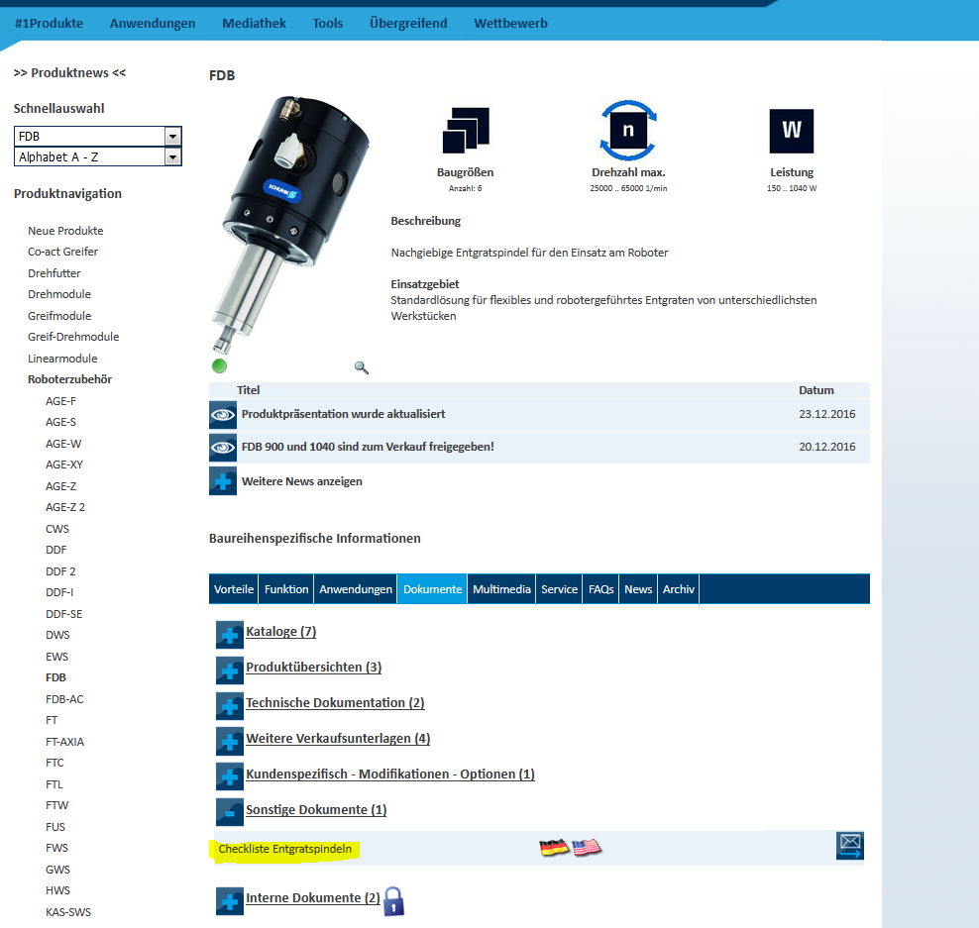
Choosing the right product for your application
Due to the variety of different applications and the differences in the products it is mandatory to have a close look to the application in advance. The most important things to know are:
Filled in checklist from STB
Information about workpiece and specified condition
Information about the manufacturing process
Information about the recent deburring process
Pictures, Drawings, Sketches
Checklist is asking for all the other information listed

Slide 5
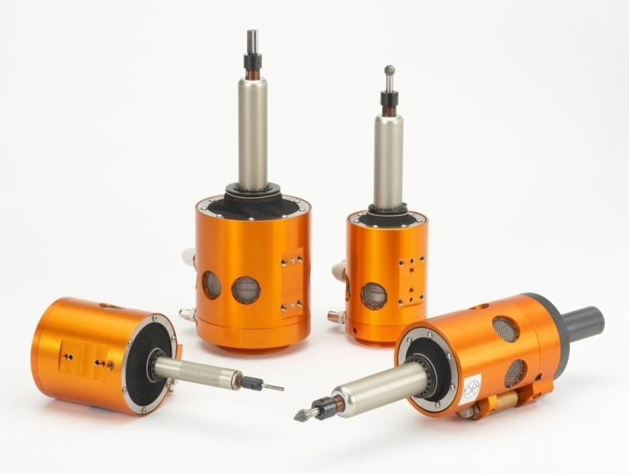
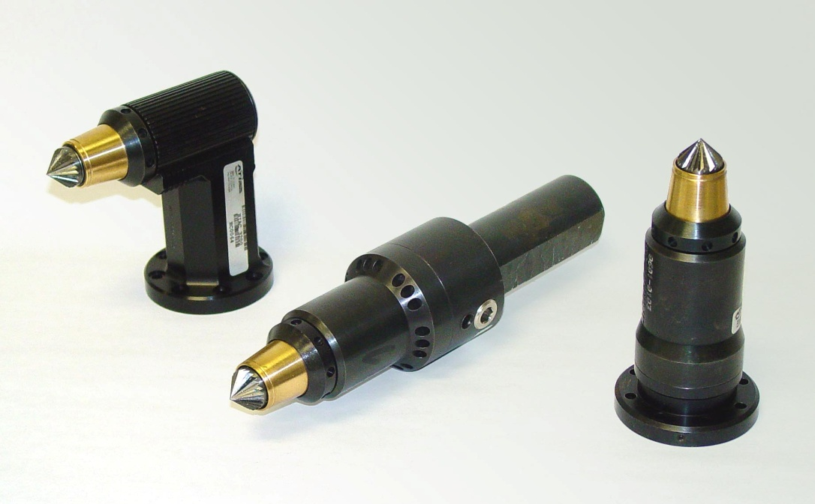
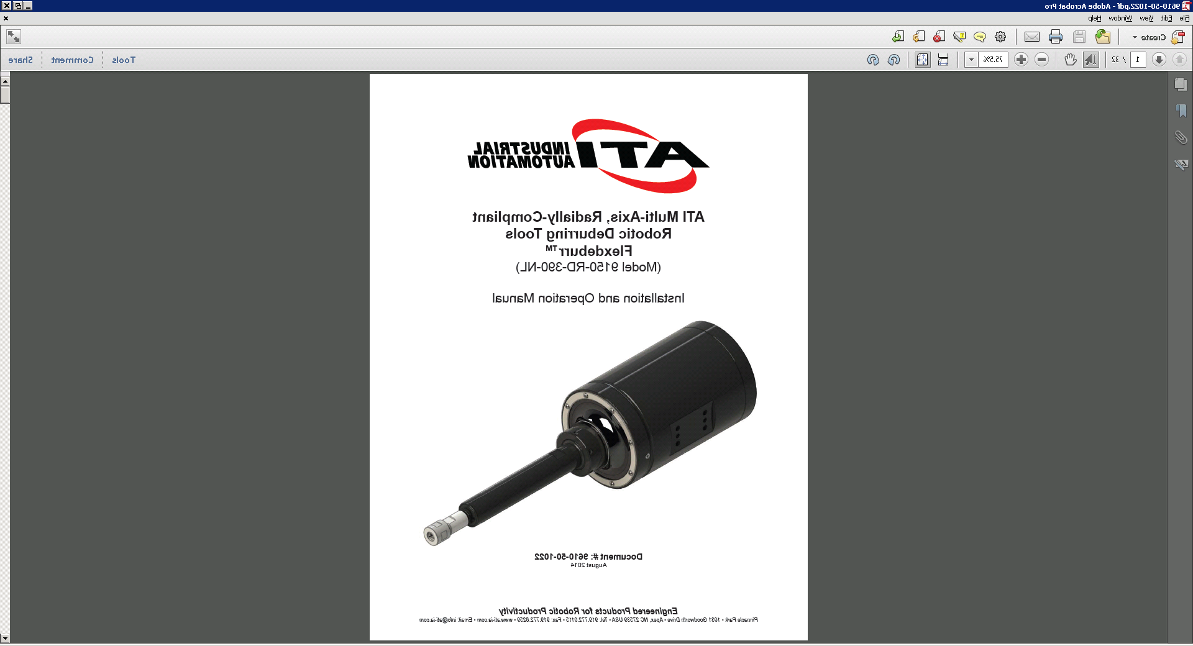
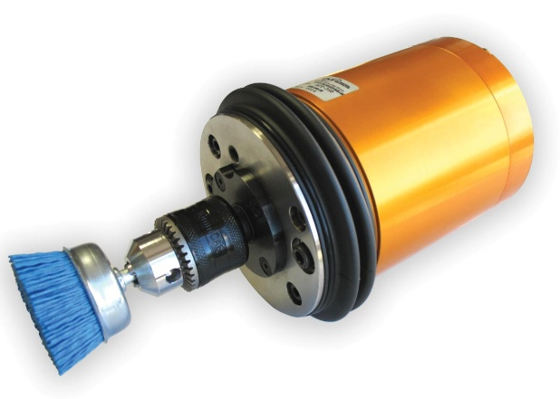
Portfolio
Axially-Compliant
Deburring Tools (AC)
Radially-Compliant Deburring Tools
(FDB, MFT-R)
Axially-Compliant
Finishing Tools (MFT)

Slide 6
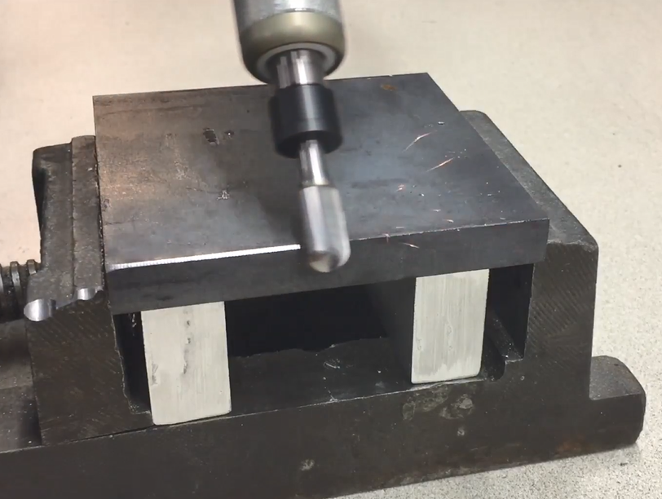
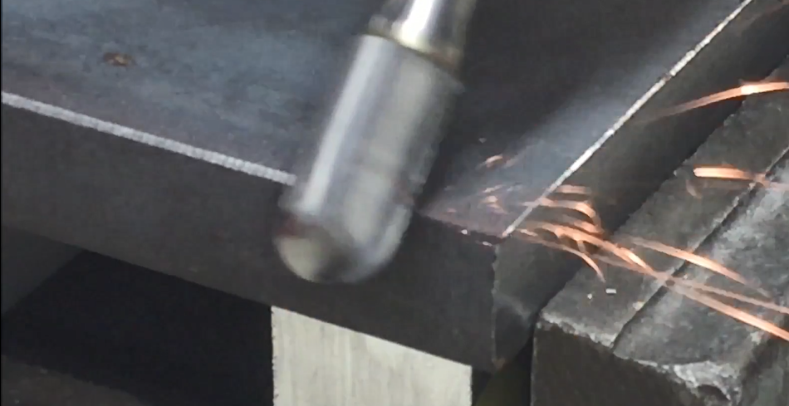
Demo Application with UR5 Robot
For internal use only
SCHUNK Product: FDB-340
Workpiece: steel demo part
Application: Removal of secondary burrs and chamfering

Slide 7
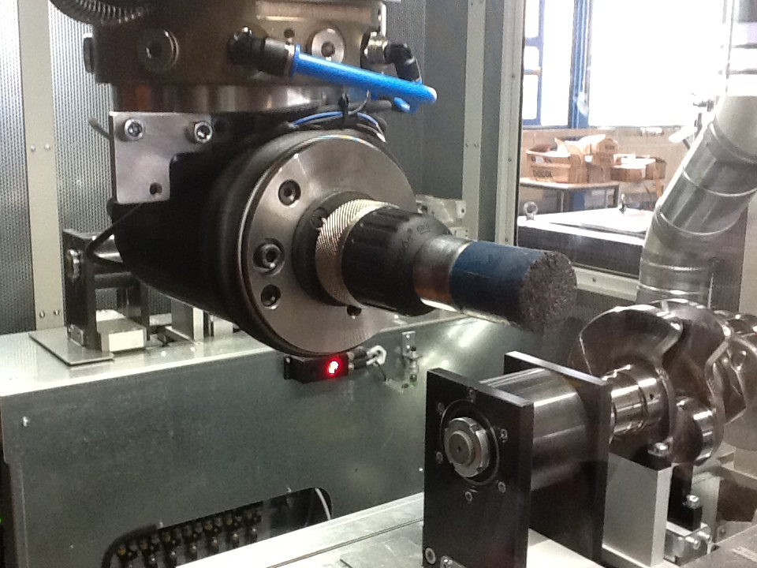
Removing secondary burr with brush
SCHUNK Product: MFT
System integrator: SHL
Final Customer: Audi
Workpiece: Crankshaft
Application: MFT mounted on a KUKA robot is removing secondary burrs on the counterweights with a cup brush. The complaint MFT is compensating the wear of the brush, tolerances of the position of workpiece and tooling and is reducing the effort for robot programming.

Slide 8
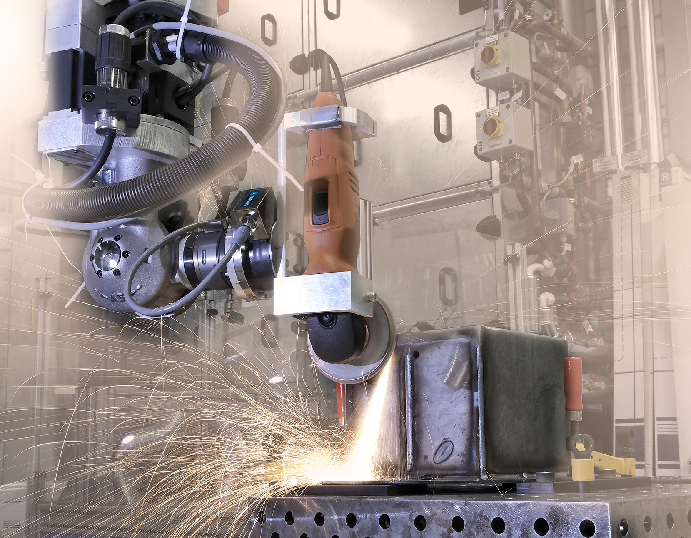
Finishing of weld seams
SCHUNK Product: FTN 6 Axis Sensor
System integrator: Reis / University Aschaffenburg
Workpiece: Metal housing
Application: Weld seams are machined with a angle grinder to achieve a smooth finish. Due to the FT Sensor they are able to compensate the variety in geometry of the workpiece and the wear of the grinding disk. This is helping to increase the lifetime of the tooling and the quality of the surface finish.

Slide 9
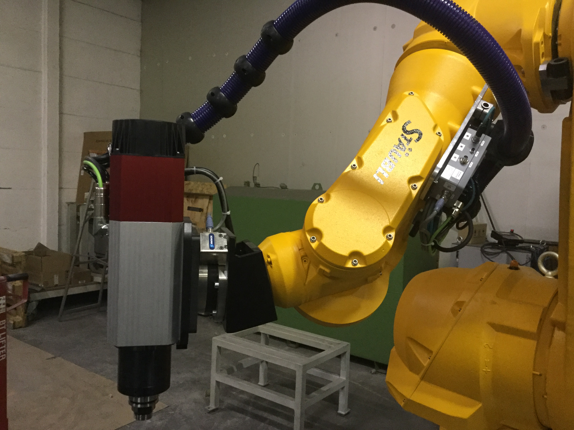
Milling with 6-axis robot
For internal use only
SCHUNK Produkt: FTN 6 Axes Sensor Omega160 IP60
System integrator: VDS Belgium
Workpiece: small metal workpieces
Application: Workpieces made of steel are milled with a electrical spindle mounted on the FT Sensor. Force measuring is helping to improve the surface finish.

Slide 10
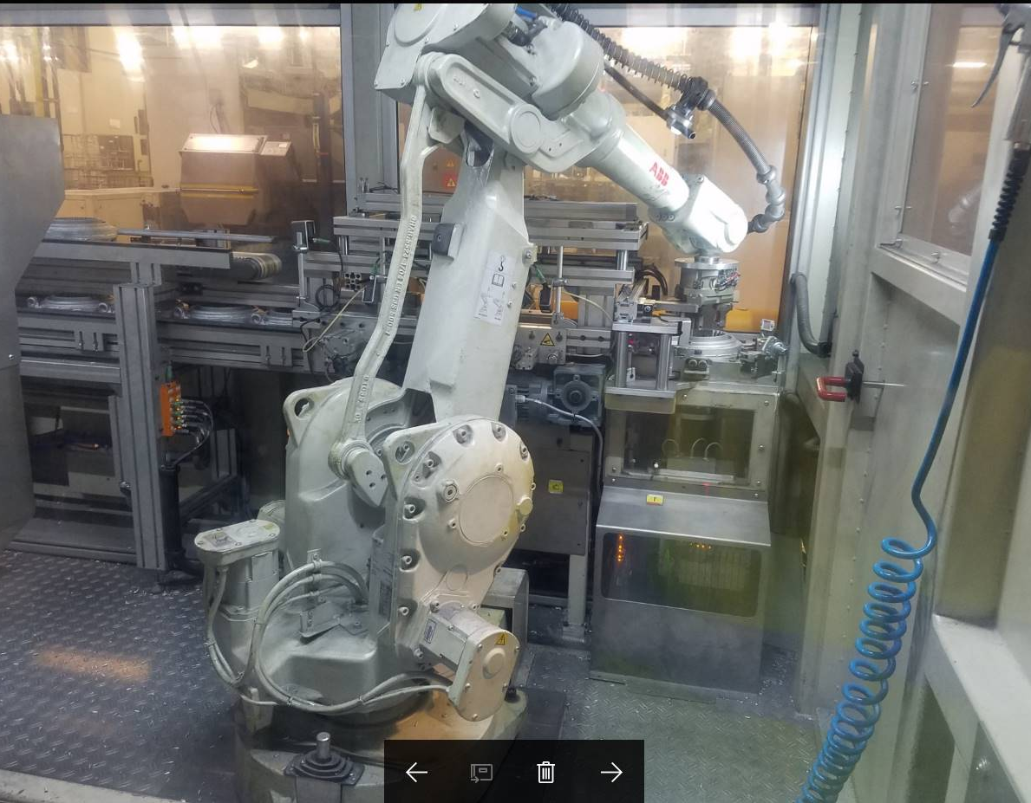
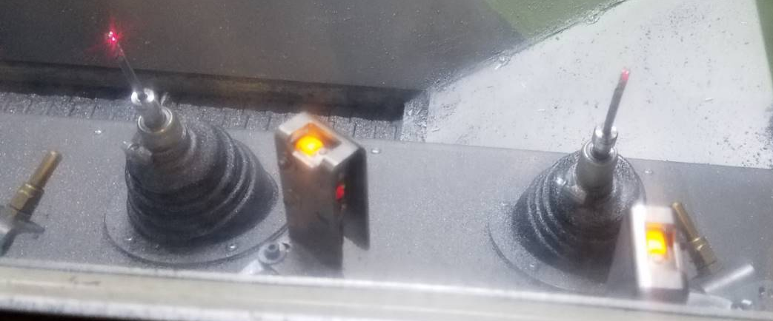
Deburring of casted gear housing
For internal use only
SCHUNK Product: FDB, MFT und PZN
System integrator: Opteamum (France)
Final Customer: ZF
Workpiece: Housing of a gear
Application: Parts are picked up by two ABB robots with PZN+ grippers. The parts are treated with 3x FDB with shank cutters and 2x MFT with cup brushed.

Slide 11
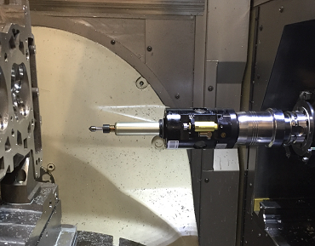
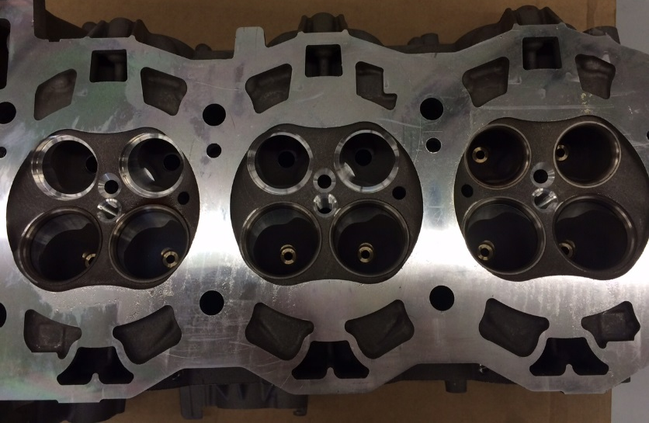
Removing burrs and chamfering cylinder heads
For internal use only
SCHUNK ProduCt: FDB-340-CNC & Tendo
System integrator: GROB
Final Customer: Porsche
Workpiece : Zylinderkopf
Application: Burr removal and chamfering of the outer conture and the cooling channels of a cylinders head of a six-cylinder flat engine. Compliance mechanism is dealing with the variety of burrs and tolerances of position of the casted workpiece.

Slide 12
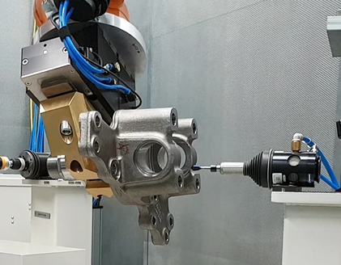
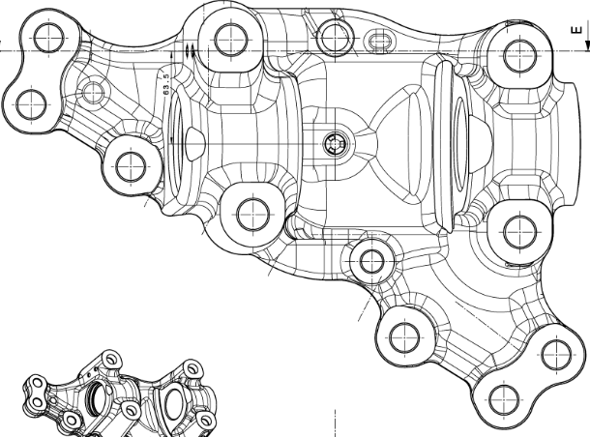
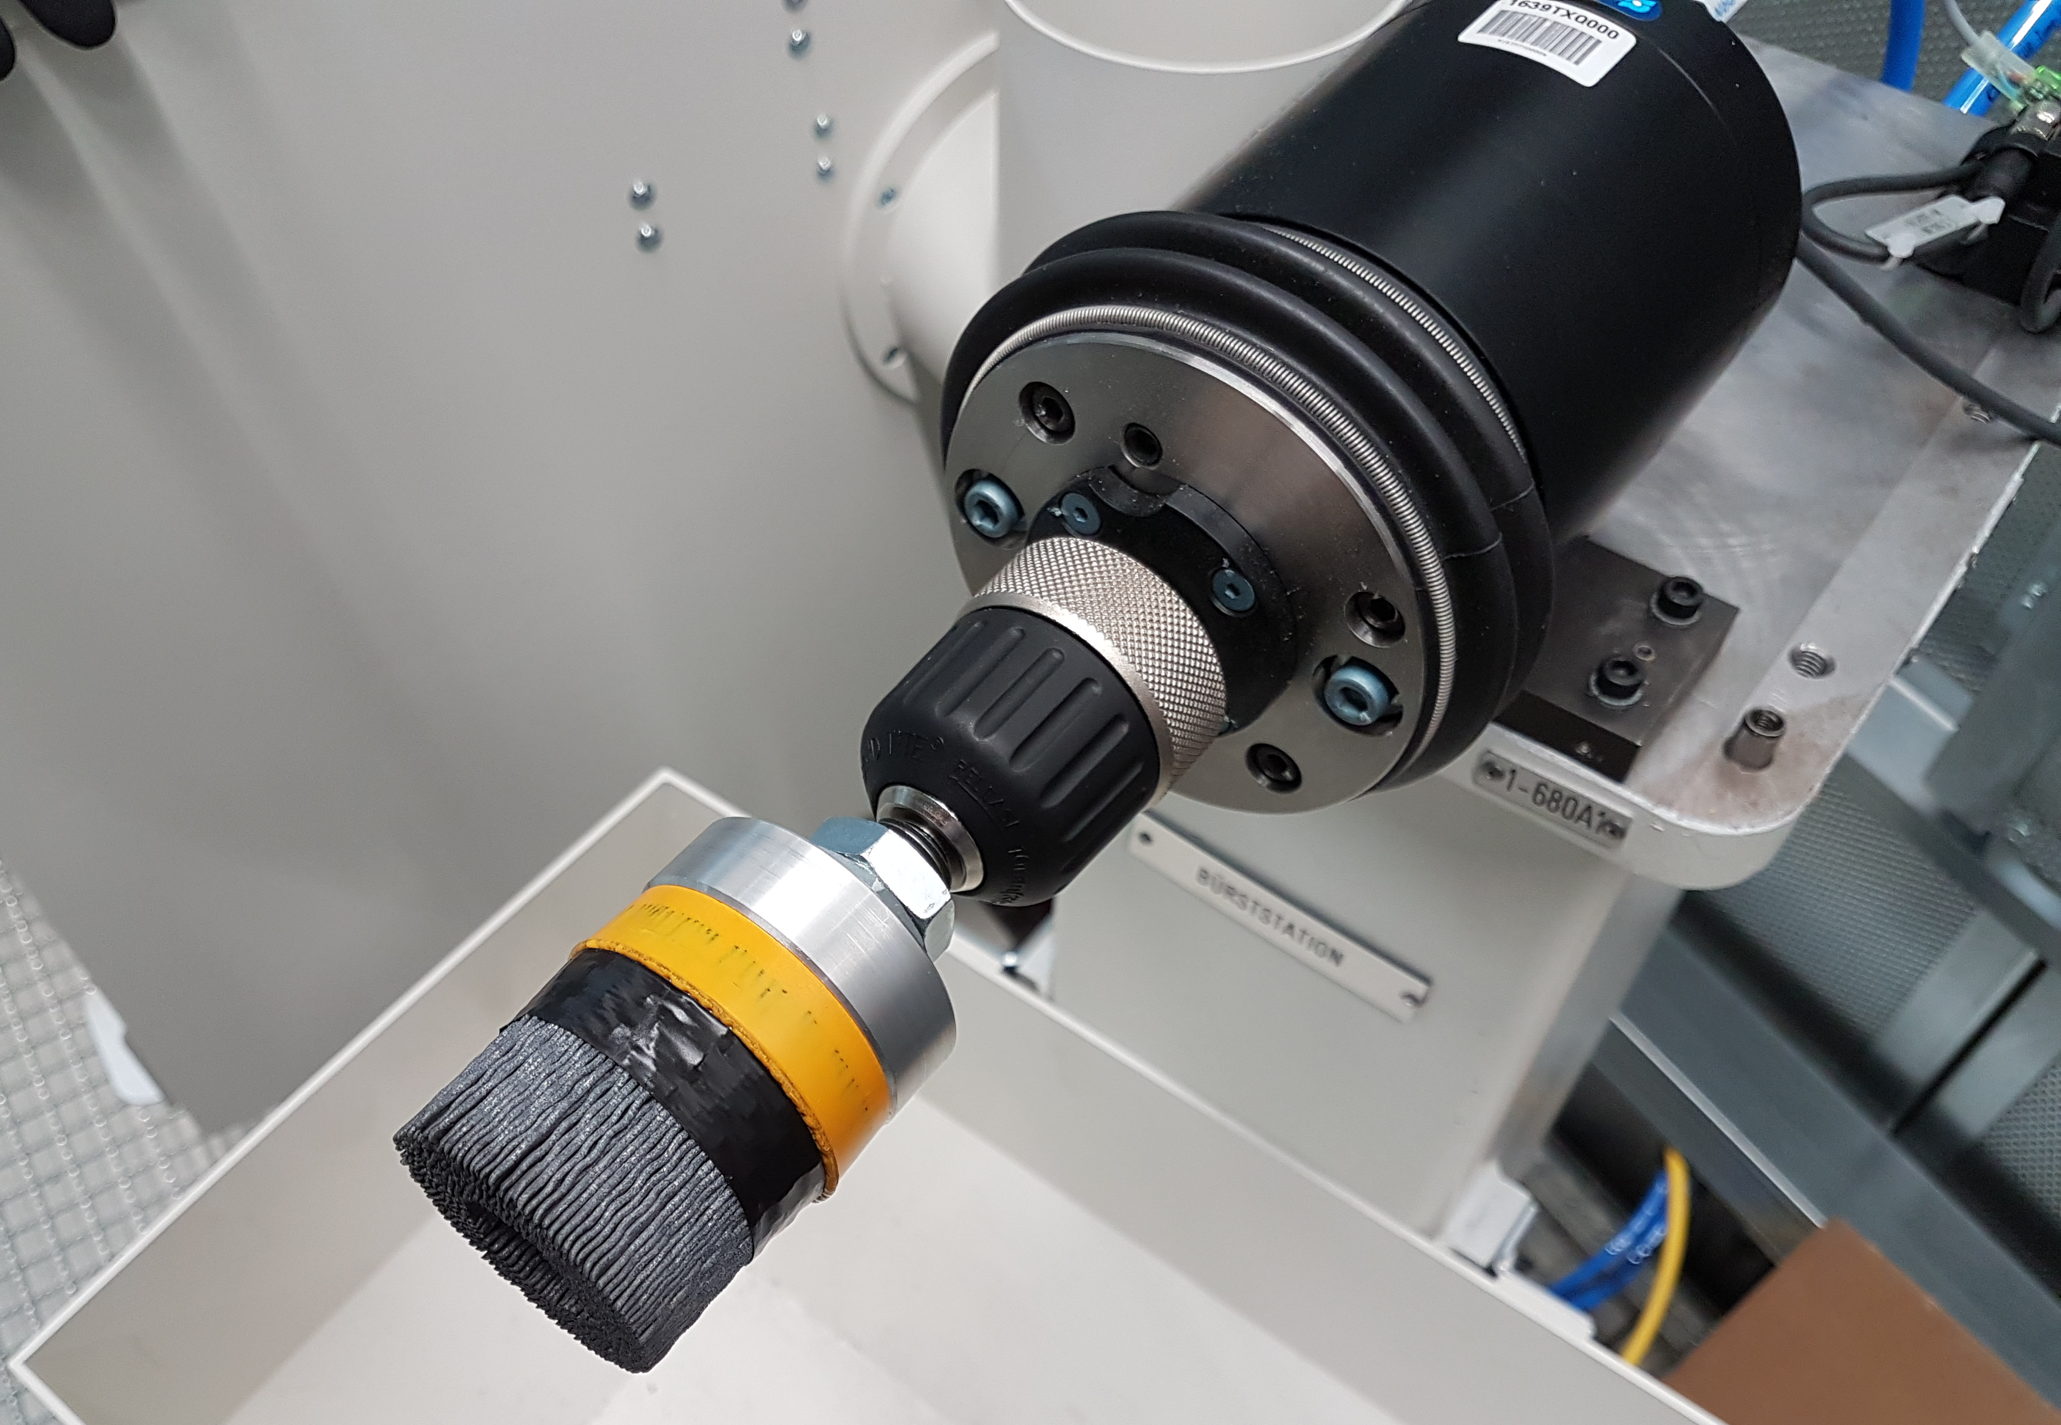
Removal of secondary burrs on steering knuckle
For internal use only
SCHUNK Product: FDB-340 and MFT-390
System integrator: Felsomat
Final Customer: MAN
Workpieces: steering knuckles for trucks
Application: Removal of secondary burrs caused by milling of the casted parts. Parts made of hardened and tempered steel

Slide 13
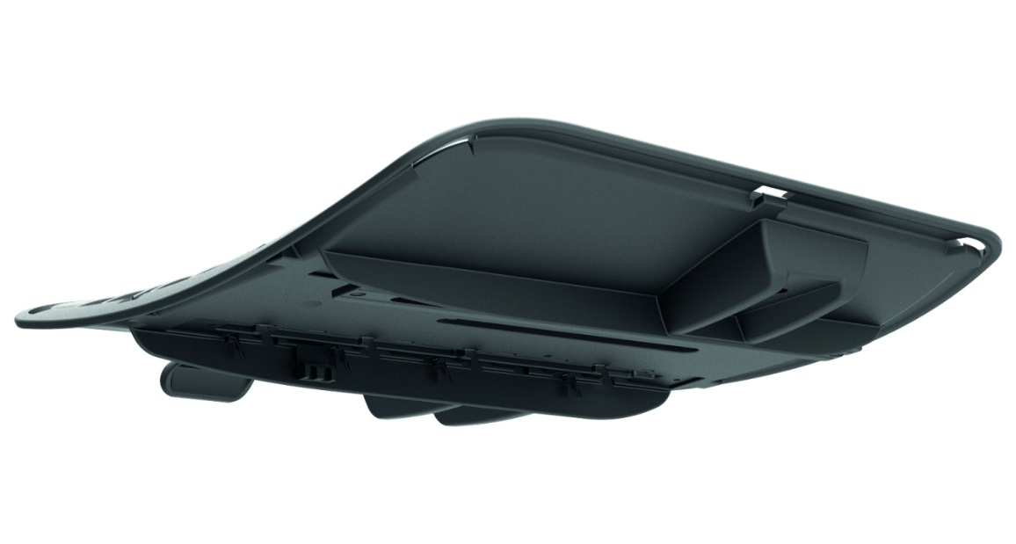
Burr and flash removal on part of office chair
For internal use only
SCHUNK Product: FDB-150
System integrator: Bock 1
Final Customer: Bock 1
Workpiece: parts of office chairs
Application : The casted polyurethane part is deburred and flash from casting is removed

Slide 14
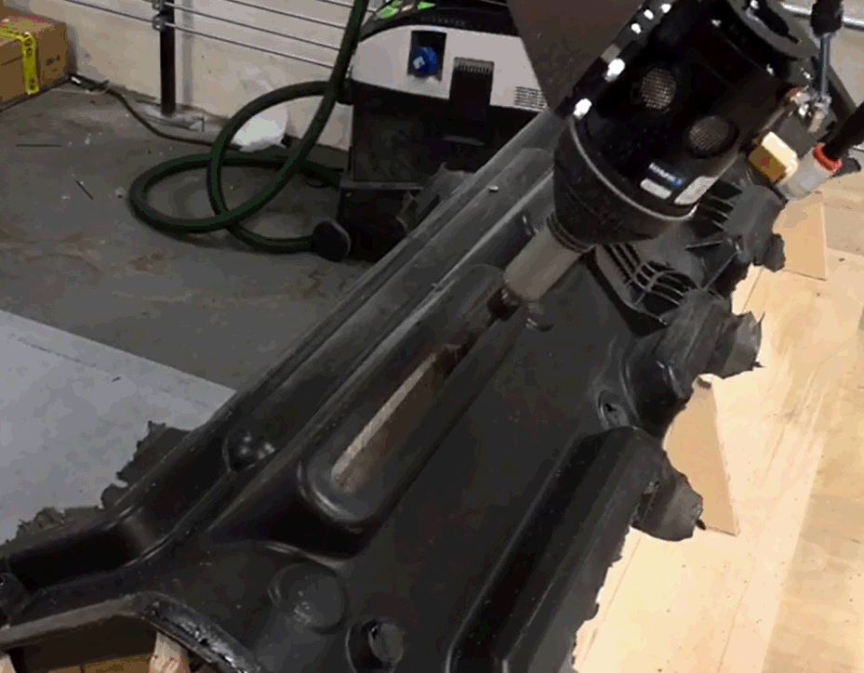
Burr and flash removal on dash board
For internal use only
SCHUNK Product: FDB-300
Customer: Intec CZ
Work piece: Dashboard
Material: Plastic foam PDCPD
Application: Removal of burrs and flash on the injection molded dash board

Slide 15
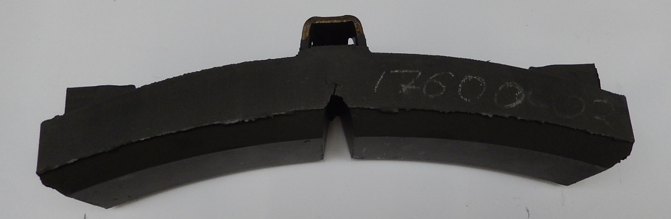
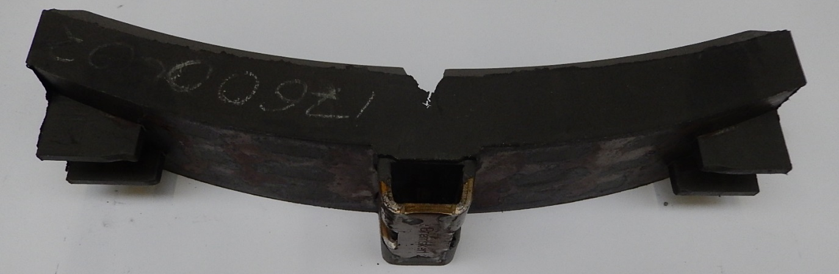
Burr removal on brake pad
For internal use only
SCHUNK Product: FDB-1040
System integrator: AUT-FOT
Final Customer: Bremskerl – Reibbelag Werke
Workpieces: brake pad for industrial use
Application: Removal of secondary burrs caused by milling the chamfer and the center groove

Slide 16
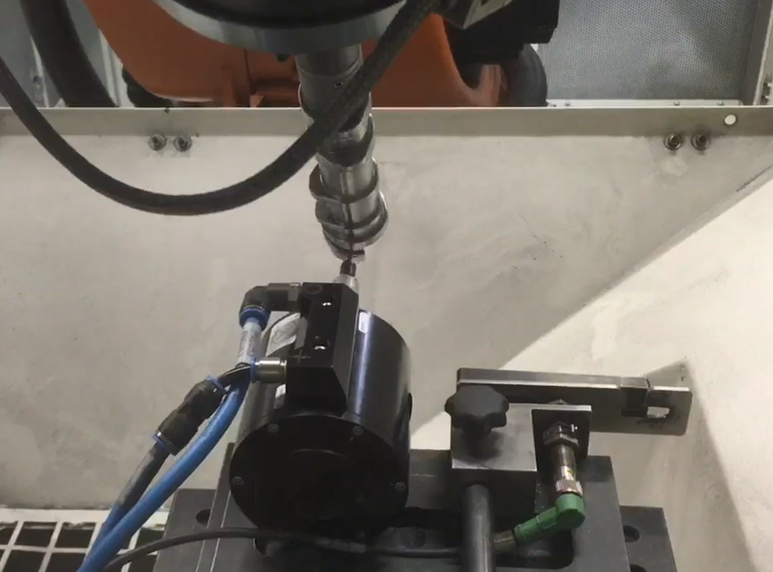
Burr removal on cam shaft
For internal use only
SCHUNK Product: FDB-150
Final Customer: Daimler – Berlin
Workpieces: cam shaft made from steel
Application: Removal of secondary burrs from previous machining

