Slide 1

Product presentation
AGE-U
Compensation unit XYZ

Slide 2
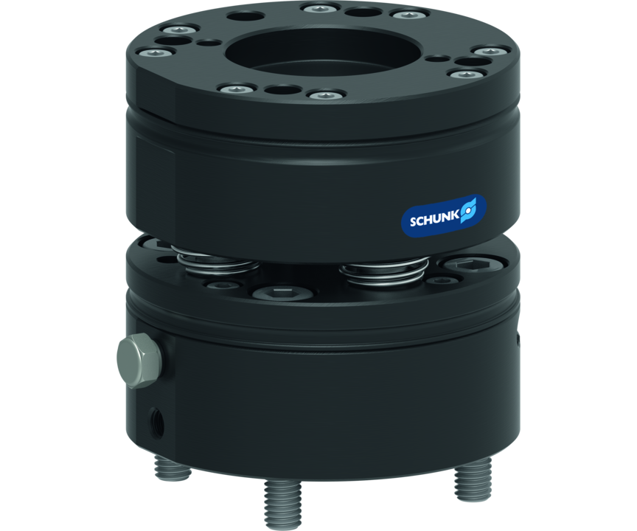
Compensation unit XYZ
Compensation unit with rotation and angle compensation for adaptation of end effector to the position of the component
The world's first angular adjustment unit for robots for simultaneous rotational and angular adjustment.
Compensation in all 6 degrees of freedom

Slide 3

Flexible. Compact. Robust.

Slide 4
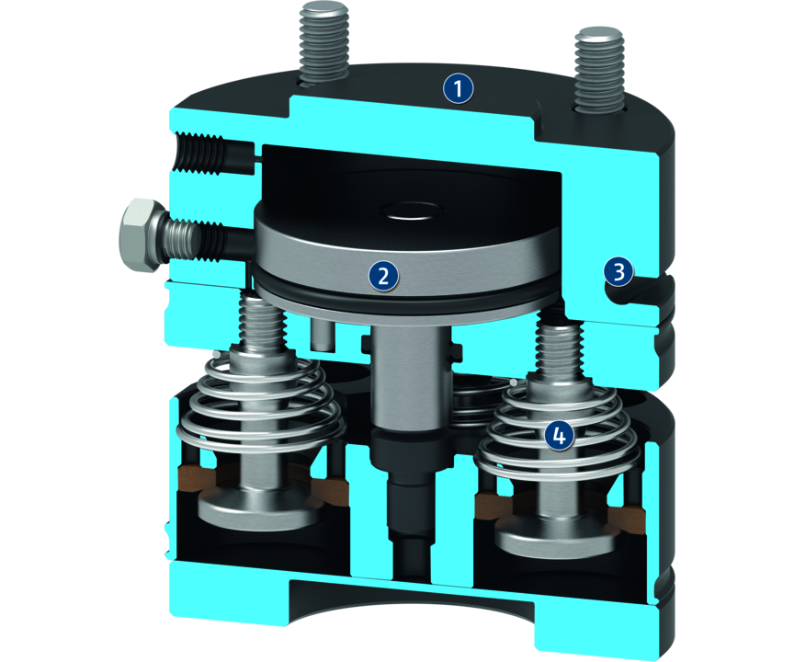
Principle of function
Functional description
The compensation unit enables compensation of angle and rotation. Workpieces can be gripped despite positional offset and locational uncertainty. The flexibility of the unit can be pressurized with compressed air and adjusted via the air connection. The unit can be locked centrally and rigidly at maximum pressure.
1
Housing
2
Locking piston
3
Integrated piston stroke monitoring
4
Spring for pre-clamping

Slide 5
Advantages – Your benefits
Deflection both while in rotation and at an angle compensate for inaccuracies in the position of the workpiece and saves time, cost and effort by simplifying robot programming
Centric reset allows components to be placed in a defined position
Spring-supported reset of the unit can be adjusted via compressed air for optimum deflection
ISO mounting pattern equipped with ISO standard both robot-side and tool-side A direct screw connection to conventional robot types is possible without an additional adapter plate
Monitoring of locking increases the process reliability and simplifies commissioning

Slide 6
Technical data
Technical data overview
Size | Compensation XY | Compensation Z | Angular deflection | Deflection rotatory | Weight
 | [mm] | [mm] | [°] | [°] | [kg]
50 | 2.7 | 6.1 | 3 | 8 | 0.6

