Slide 1

Product presentation
Co-act EGL-C
Collaborating long-stroke gripper

Slide 2
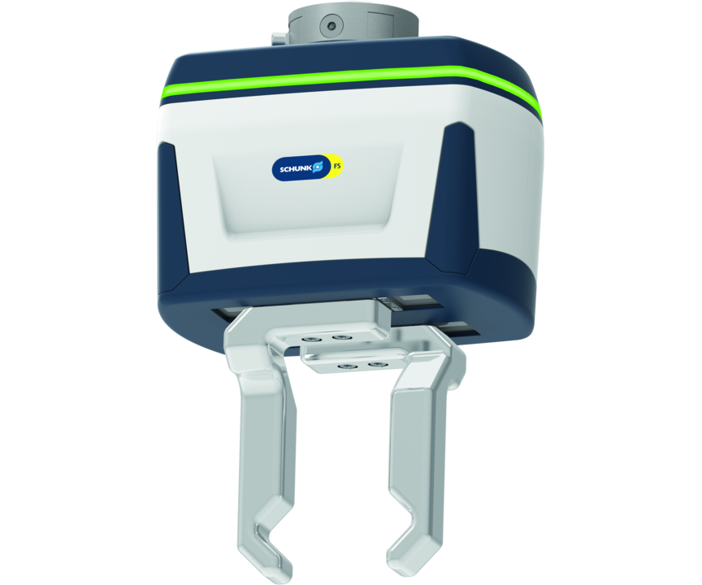
Collaborating long-stroke gripper
Electric 2-finger parallel gripper certified for collaborative operation with actuation via 24 V
The world’s first certified industrial long-stroke gripper for collaborative operation.
Secure gripping with up to 450 N of gripping force

Slide 3

Collaborative. Powerful. Certified.

Slide 4
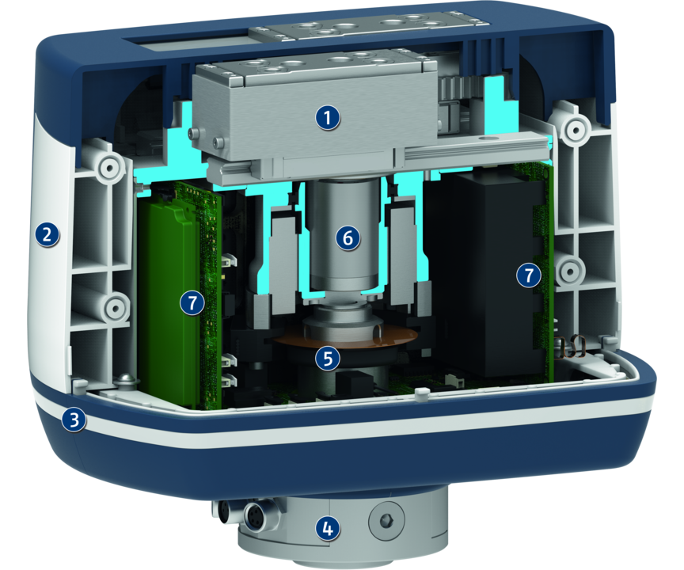
Principle of function
Functional description
1
Force-measuring jaws
2
Collision protection
3
LED strip light
4
Flange
5
Stroke measuring system
6
Drive with gear
7
Electronics

Slide 5
Advantages – Your benefits
Certified gripping unit saves effort for safety assessment of the application
Safe gripping for workpiece weights of up to 2.25 kg guaranteed by integrated force and distance measurement
Pre-assembled gripping unit with robot interface for a easy and fast integration
Integrated status display to the visibility of the application state at the operator’s eye level
Actuation via various bus systems for easy commissioning and rapid integration into existing systems

Slide 6
Technical data

Slide 7
Jens Lehmann, German goalkeeper legend, SCHUNK brand ambassador since 2012 for safe, precise gripping and holding.
schunk.com/Lehmann

