Slide 1

Product presentation
EGI
Gripper for small components

Slide 2
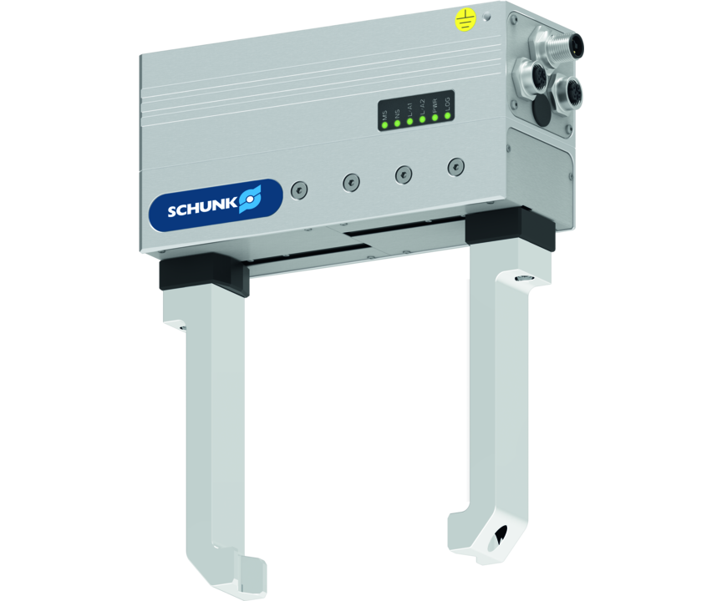
Gripper for small components
Servo-electric 2-finger parallel gripper with sensitive gripping force control and long stroke
The electric gripper with the easiest commissioning and most reliable maintenance of gripping force capability on the market
Over 90% of gripping force maintained in the event of a voltage drop

Slide 3

Intelligent. Sensitive. Reliable.
New gripper size EGI 40
Available interfaces: PROFINET, EtherNet/IP and EtherCAT
Long stroke and finely adjustable gripping force
Newly developed gripping force maintenance for size 80
Integrated web server for variants with PROFINET and EtherNet/IP

Slide 4
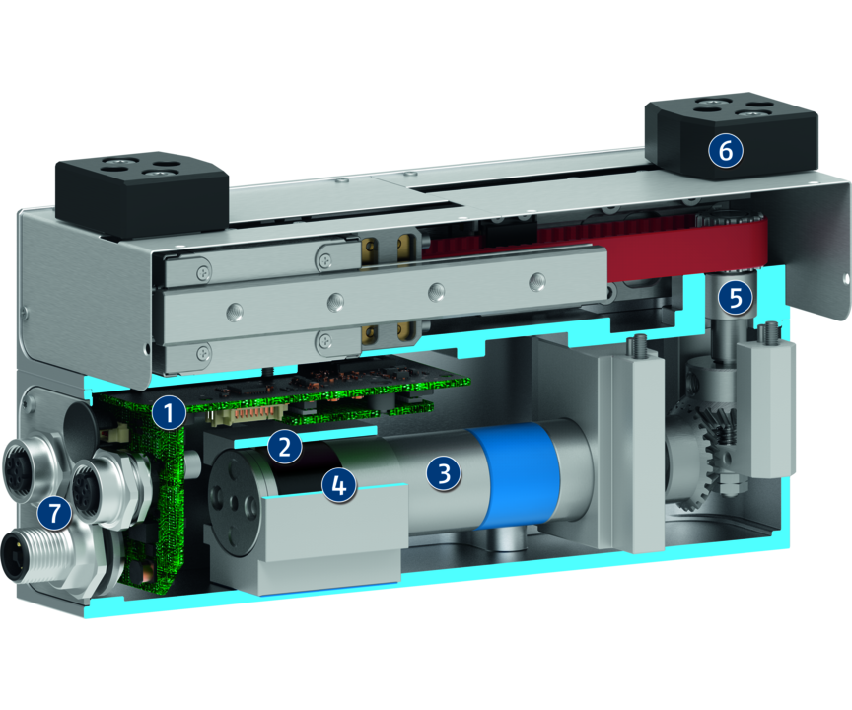
Principle of function
Functional description
The brushless servomotor drives the toothed belt drive via the bevel gear. The base jaws mounted on the profiled rail guides are connected to the toothed belt. The rotary motion is transferred into a linear movement of the base jaws via the gear and the toothed belt. A brake installed in gripper size 80 ensures that the gripping force is maintained.
1
Integrated electronics
2
Encoder
3
Drive
4
Brake
5
Kinematics
6
Finger connection
7
Electrical connection

Slide 5
Advantages – Your benefits
Gripping force control for the delicate gripping of sensitive workpieces
Long and freely programmable stroke for flexible workpiece handling
Almost complete gripping force maintenance with minimal brake retardation for a high process reliability
Browser-based integrated web server For easy and intuitive commissioning, parameterization, and functional test of the gripper (applies to PROFINET and EtherNet/IP only)
Fully integrated control and power electronics for creating a decentralized control system
Connectors in industrial standard for easy electrical connection

Slide 6
Technical data
Technical data overview
Size | Stroke per jaw | Min. gripping force | Max. gripping force | Max. permissible finger length | Recommended workpiece weight | Weight | Nominal voltage
 | [mm] | [N] | [N] | [mm] | [kg] | [kg] | [V]
40 | 40 | 25 | 70 | 150 | 0.35 | 1.02 | 24
80 | 57.5 | 25 | 100 | 200 | 0.5 | 1.55 | 24

