Slide 1

SCHUNK Lean Automation / Application examples

Slide 2
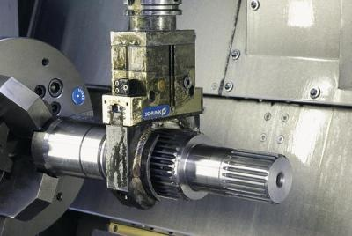
SCHUNK Lean Automation / Application examples
Effectors for automation optimized with shaft interface for use in combination with toolholders
Benefits
Autonomous change of workpiece by the machine tool itself
Cleaning of workpiece
Set-up time minimizing
Increase of utilisation rate of the machine tool

Slide 3
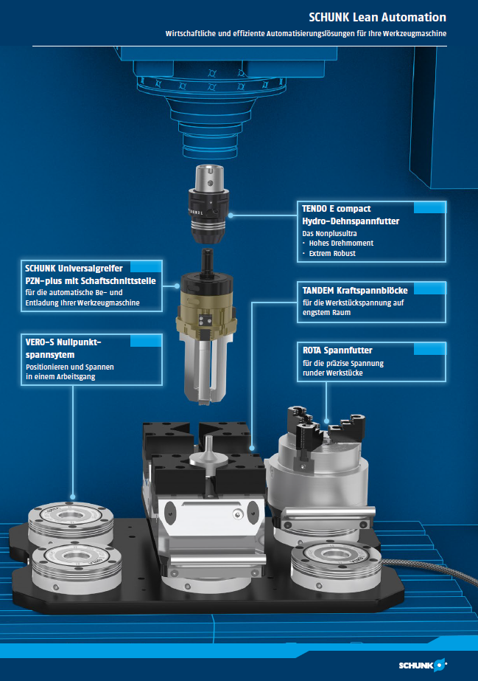
Requirements for the machine
(Requirements for the use of a spindle gripper)
- Spindle feed-through (spindle with controllable
media feed-through air / coolant lubricant)
- Spindle size (can the spindle handle the
workpiece weight)
- backflow through the spindle must be guaranteed.
- pressure range
Standard 20/50 bar
Special < 20 bar (possible)
Special > 50 bar (possible)
Or pressure adjustable at the machine
- Space in Tool Magazine
- Space in machine room (height)
- Free M-Function in the program
- Orientation of the spindle advantageous
# Storage system / removal for workpieces
# Control of (automated) clamping devices

Slide 4
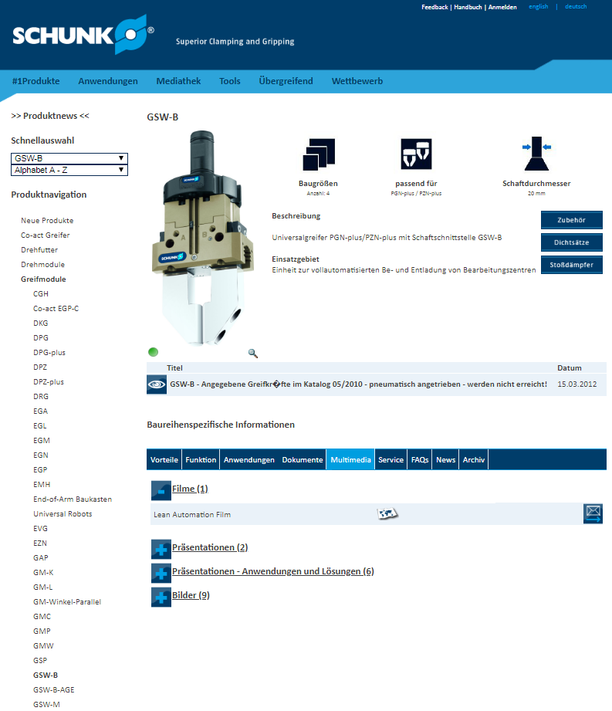
Additives / Information Lean Automation
Link: Video Lean-Automation
Link: Catalogue GSW-B / GSW-B-AGE
http://www.schunk.int/pimexport/IM0004260.PDF
http://www.schunk.int/pimexport/IM0018106.PDF
Link: Catalogue RGG
http://www.schunk.int/pimexport/IM0004264.PDF
Link: Stationary Workholding
http://www.schunk.int/schip/salestoolbox/index.php?lngCode=de&bereich=spanntechnik&prokl=spannsysteme
Link: Toolholders
http://www.schunk.int/schip/salestoolbox/index.php?lngCode=de&bereich=spanntechnik&prokl=werkzeughalter

Slide 5
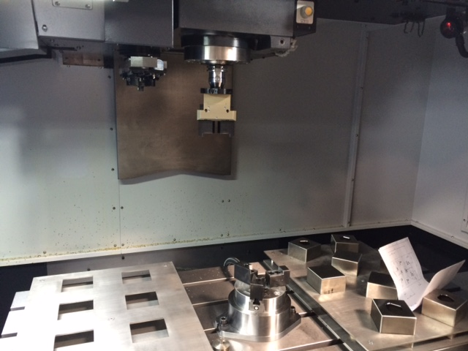
SCHUNK Lean Automation / Application examples
Text / Application description
(in progress / Status 02/2019)
_____________________________________
Recommendation of possible SCHUNK products for this application:
Gripping:
e.g. (in progress / Status 02/2019)
Clamping:
e.g. (in progress / Status 02/2019)

Slide 6
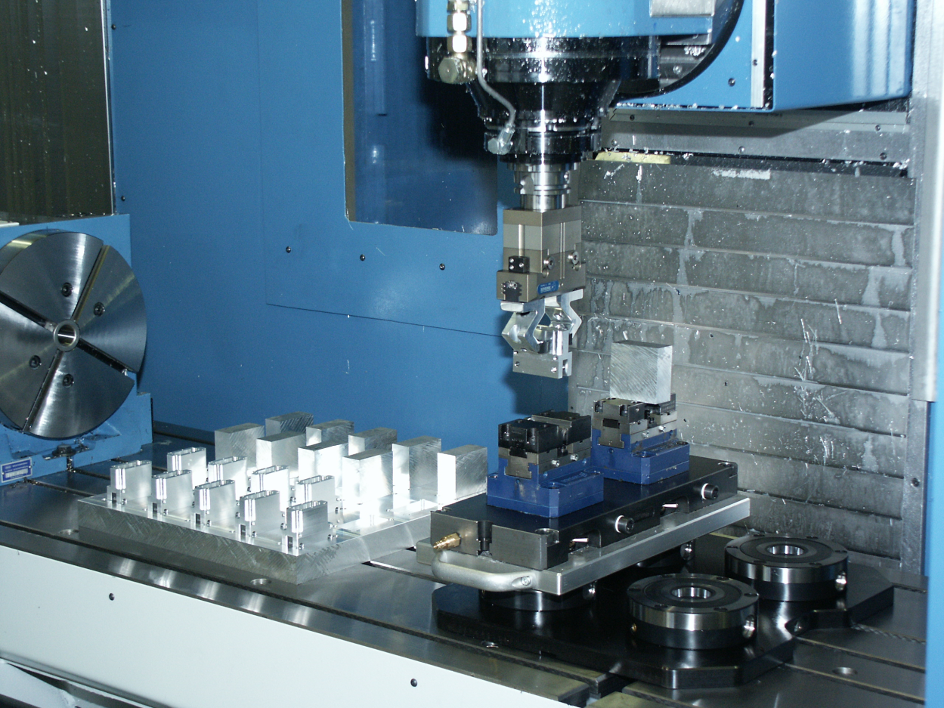
SCHUNK Lean Automation / Application examples
Text / Application description
(in progress / Status 02/2019)
_____________________________________
Recommendation of possible SCHUNK products for this application:
Gripping:
e.g. (in progress / Status 02/2019)
Clamping:
e.g. (in progress / Status 02/2019)

Slide 7
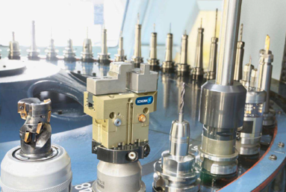
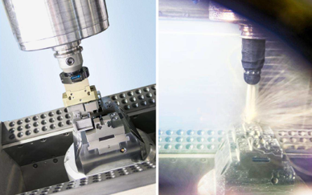
SCHUNK Lean Automation / Application examples
Text / Application description
(in progress / Status 02/2019)
_____________________________________
Recommendation of possible SCHUNK products for this application:
Gripping:
e.g. (in progress / Status 02/2019)
Clamping:
e.g. (in progress / Status 02/2019)

Slide 8
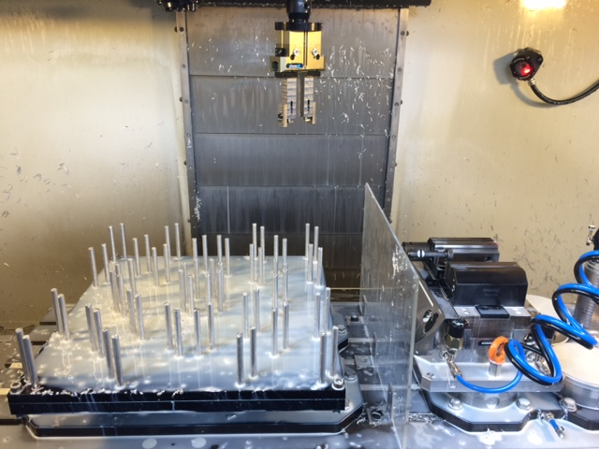
SCHUNK Lean Automation / Application examples
Text / Application description
(in progress / Status 02/2019)
_____________________________________
Recommendation of possible SCHUNK products for this application:
Gripping:
e.g. (in progress / Status 02/2019)
Clamping:
e.g. (in progress / Status 02/2019)

Slide 9
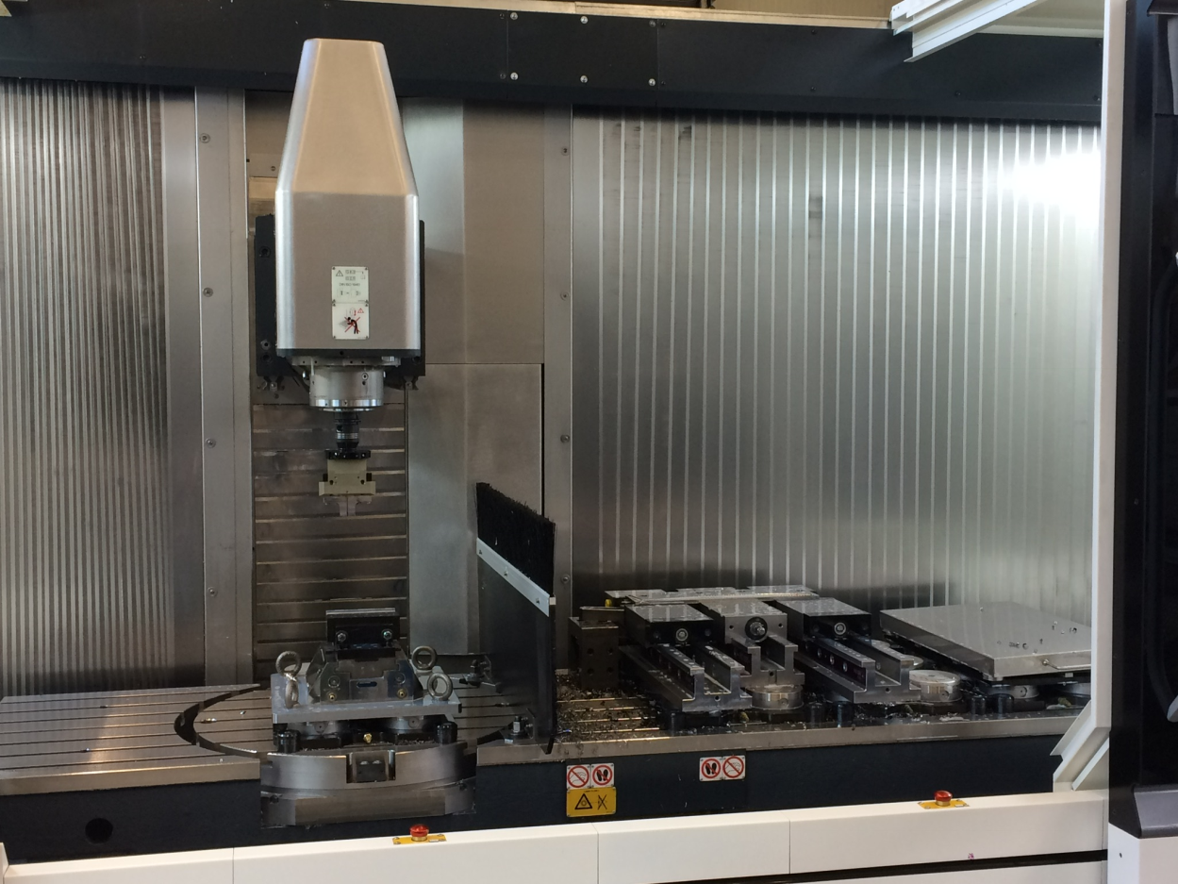
SCHUNK Lean Automation / Application examples
Text / Application description
(in progress / Status 02/2019)
_____________________________________
Recommendation of possible SCHUNK products for this application:
Gripping:
e.g. (in progress / Status 02/2019)
Clamping:
e.g. (in progress / Status 02/2019)

Slide 10
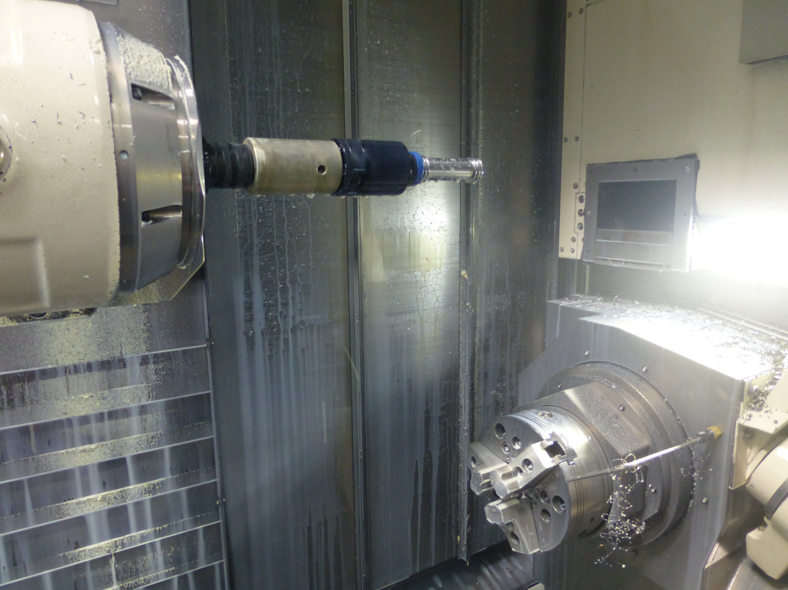
SCHUNK Lean Automation / Application examples
Text / Application description
(in progress / Status 02/2019)
_____________________________________
Recommendation of possible SCHUNK products for this application:
Gripping:
e.g. (in progress / Status 02/2019)
Clamping:
e.g. (in progress / Status 02/2019)

Slide 11
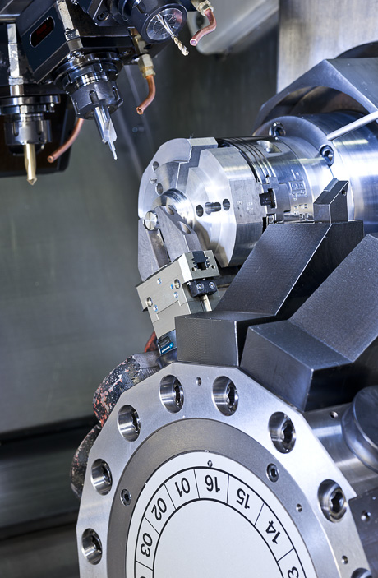
SCHUNK Lean Automation / Application examples
Text / Application description
(in progress / Status 02/2019)
_____________________________________
Recommendation of possible SCHUNK products for this application:
Gripping:
e.g. (in progress / Status 02/2019)
Clamping:
e.g. (in progress / Status 02/2019)

Slide 12
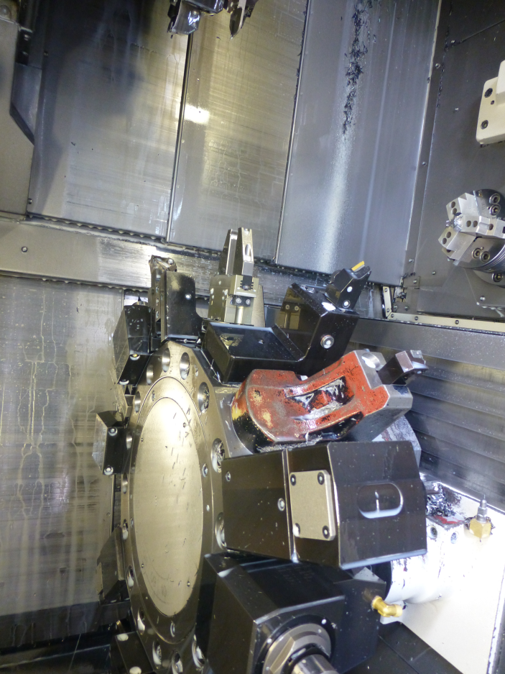
SCHUNK Lean Automation / Application examples
Text / Application description
(in progress / Status 02/2019)
_____________________________________
Recommendation of possible SCHUNK products for this application:
Gripping:
e.g. (in progress / Status 02/2019)
Clamping:
e.g. (in progress / Status 02/2019)

Slide 13
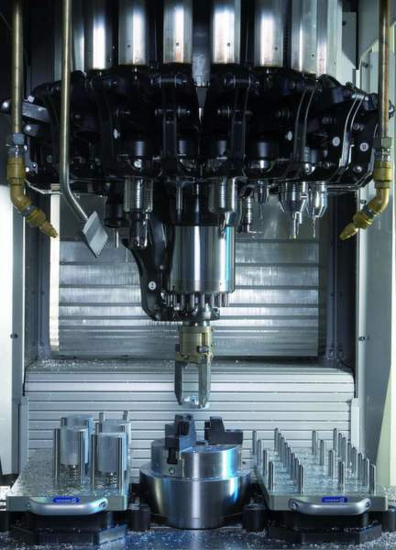
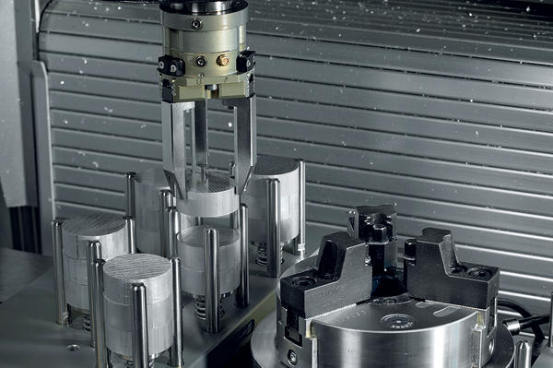
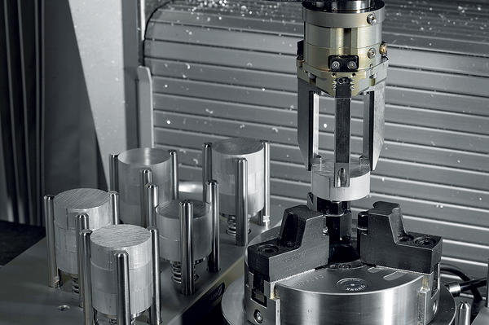
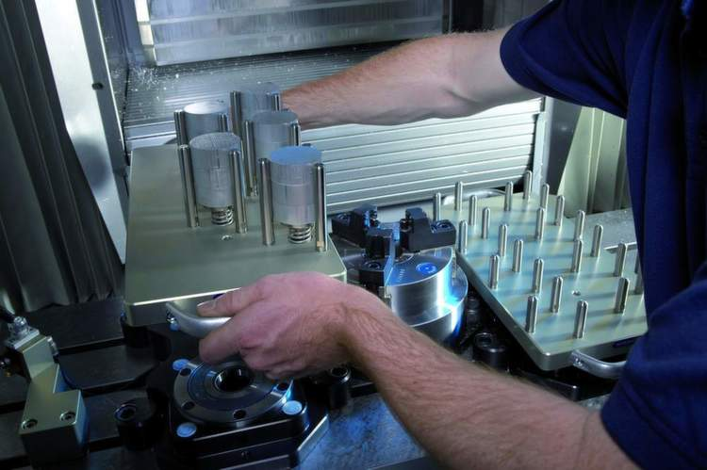
SCHUNK Lean Automation / Application examples
Text / Application description
(in progress / Status 02/2019)
_____________________________________
Recommendation of possible SCHUNK products for this application:
Gripping:
e.g. (in progress / Status 02/2019)
Clamping:
e.g. (in progress / Status 02/2019)

Slide 14

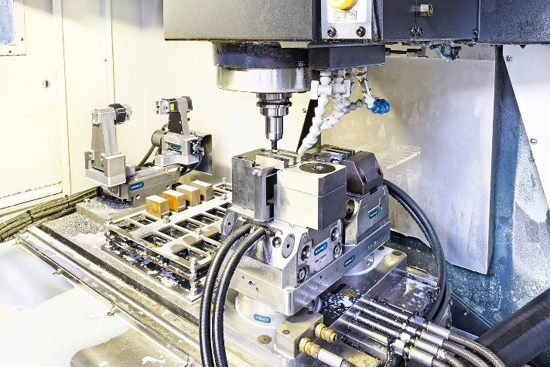
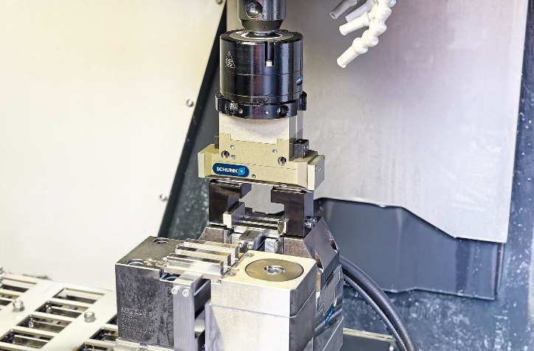
SCHUNK Lean Automation / Application examples
Text / Application description
(in progress / Status 02/2019)
_____________________________________
Recommendation of possible SCHUNK products for this application:
Gripping:
e.g. (in progress / Status 02/2019)
Clamping:
e.g. (in progress / Status 02/2019)

