Slide 1

SCHUNK Lean Automation
- gripper with shaft-interface (standard)
- gripper with spindel-interface (semi-standard)

Slide 2
Content
Gripper with shaft-interface (standard) GSW-B
Gripper with shaft-interface and balancing unit (standard) GSW-B-AGE
Gripper with spindel-interface (semi-standard)
Gripper with spindel-interface und TCU compensation (semi-standard)
Solutions
Finger exchange
Zweite Überschrift– 20 pt
Text – min. 14 pt
Zwischenüberschrift– 20 pt
Fließtext – min. 14 pt
gripper shaft interface JD FJM

Slide 3
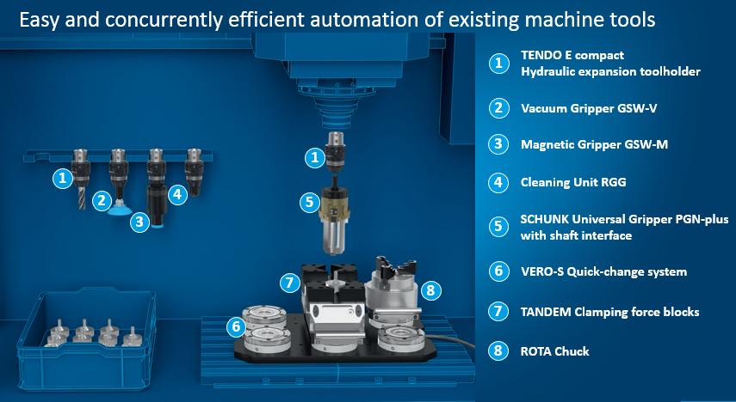
SCHUNK Lean Automation

Slide 4
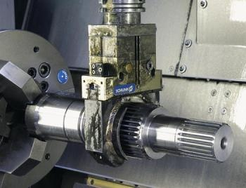
SCHUNK Lean Automation
Effectors for automation optimized with shaft interface
for use in combination with toolholders
Benefits
Autonomous change of workpiece by the machine tool itself
Cleaning of workpiece
Set-up time minimizing
Increase of utilisation rate of the machine tool
Notes:
Einfache und kostengünstiger Einstieg in die Automatisierung
Hohe Effizienzeffekte durch automatischem Werkstückwechsel und -reinigung)
Minimierung Rüstzeiten und höher Nutzungsgrad

Slide 5
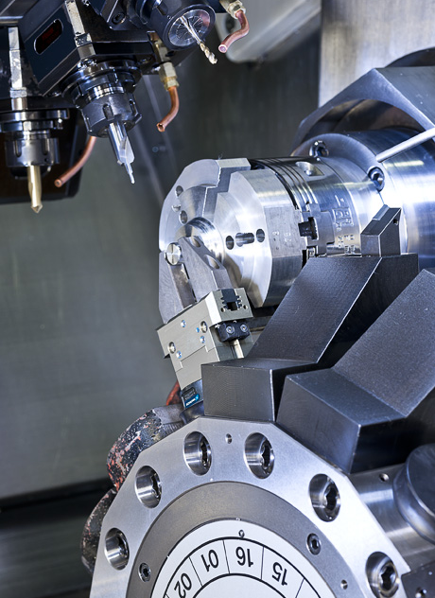
SCHUNK Lean Automation
Notes:
gripper auf Werkzeugmagazin, auch with Spindelinterface und Betätigung über Kühlschmierwithtel

Slide 6
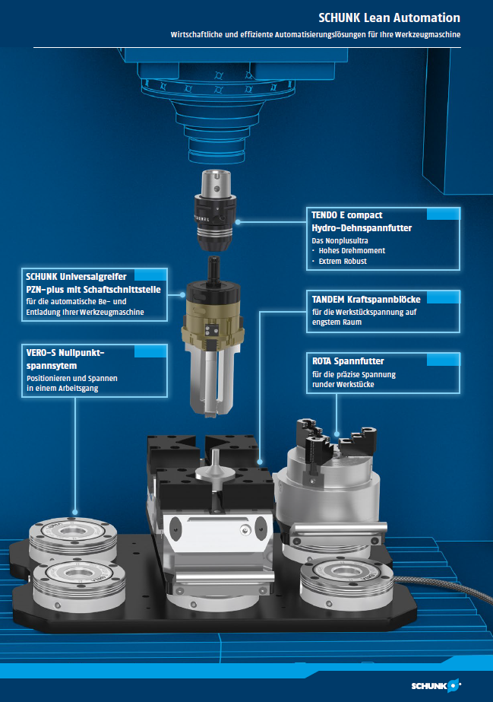
Requirements for the machine
(Requirements for the use of a spindle gripper)
- Spindle feed-through (spindle with controllable
media feed-through air / cooling lubricant)?
- Spindle size (can the spindle handle the
workpiece weight)?
- backflow through the spindle must be guaranteed.
- pressure range
Standard 20/50 bar
Special < 20 bar (possible)
Special > 50 bar (possible)
Or pressure adjustable at the machine
- Space in Tool Magazine
- Space in machine room (height)
- Orientation of the spindle favourable
# Storage system / removal for workpieces
# Control of (automated) clamping devices
gripper shaft interface JD FJM

Slide 7
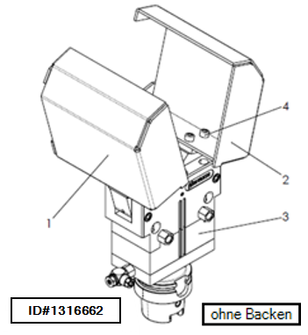
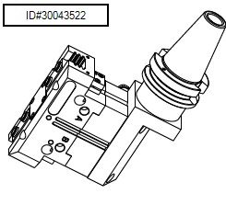
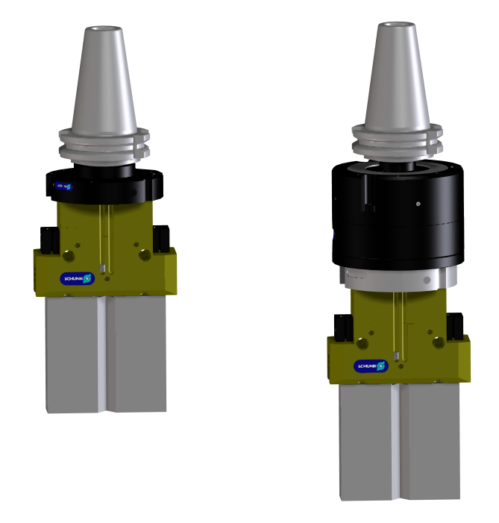
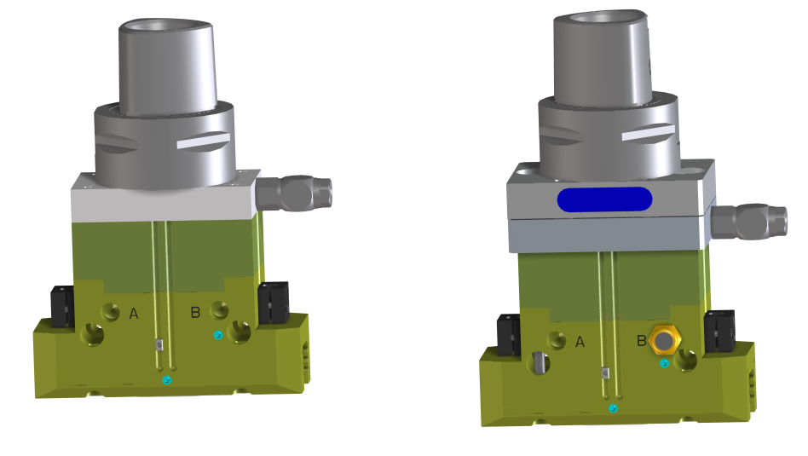
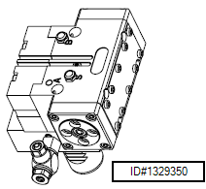
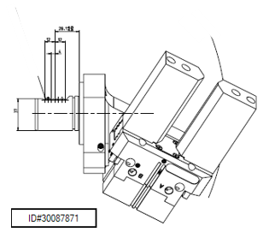
Standard / Semi-Standard / Specials
SCHUNK Solution Standard
SCHUNK Solution Semi-Standard
SCHUNK Solution Special
Standard- Adapter
with Shaft-Interface
GSW-B
w/o compensation
- PGN+ Parallel Gripper
- PZN+ Centric Gripper
- PWG+ Angular Gripper
Standard- Adapter
with Shaft-Interface
GSW-B-AGE
with X/Y/Z- compensation
- PGN+ Parallel Gripper
- PZN+ Centric Gripper
- PWG+ Angular Gripper
Semi-Gripper
with
Spindle-Interface
w/o compensation
Semi-Gripper
with
Spindle-Interface
with (TCU) compensation
Examples
with different Spindle interfaces

Slide 8
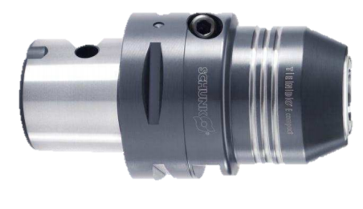
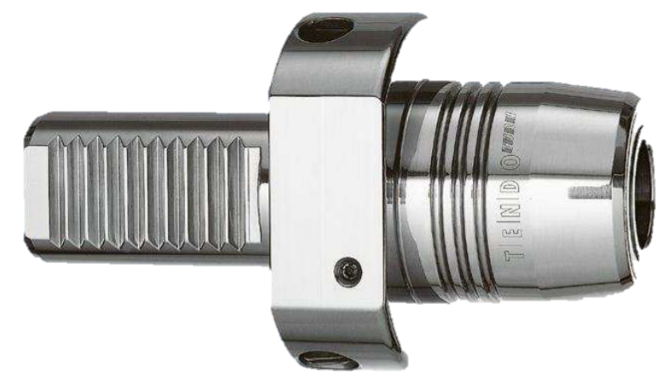
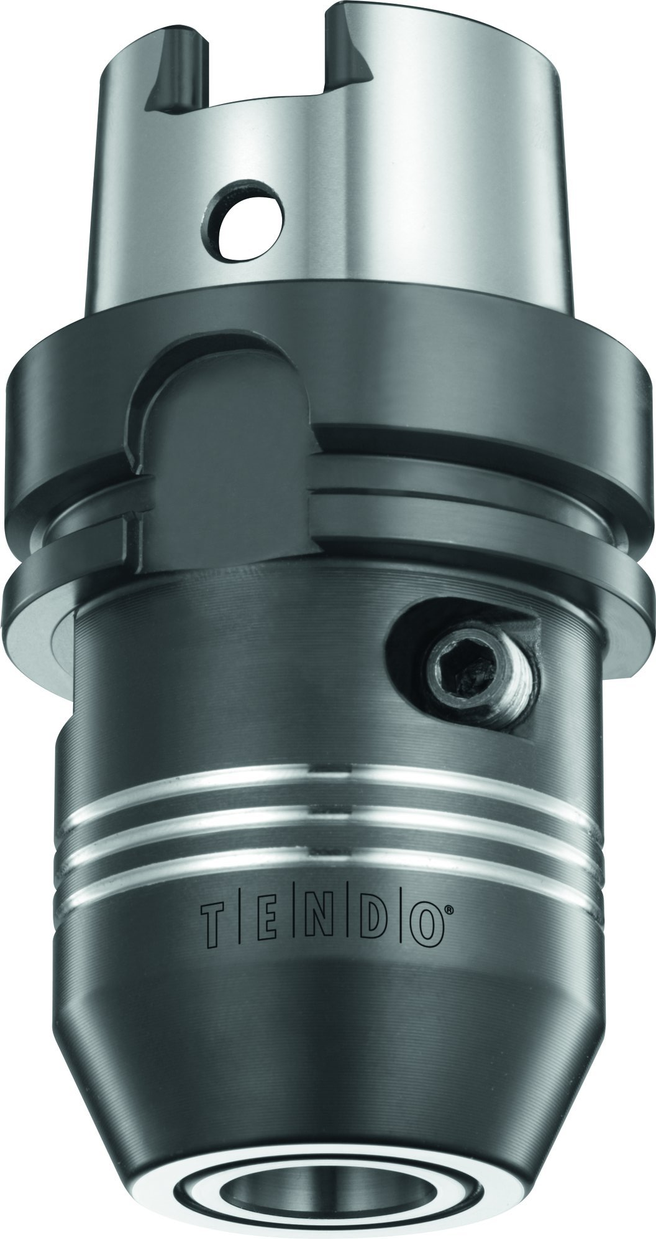
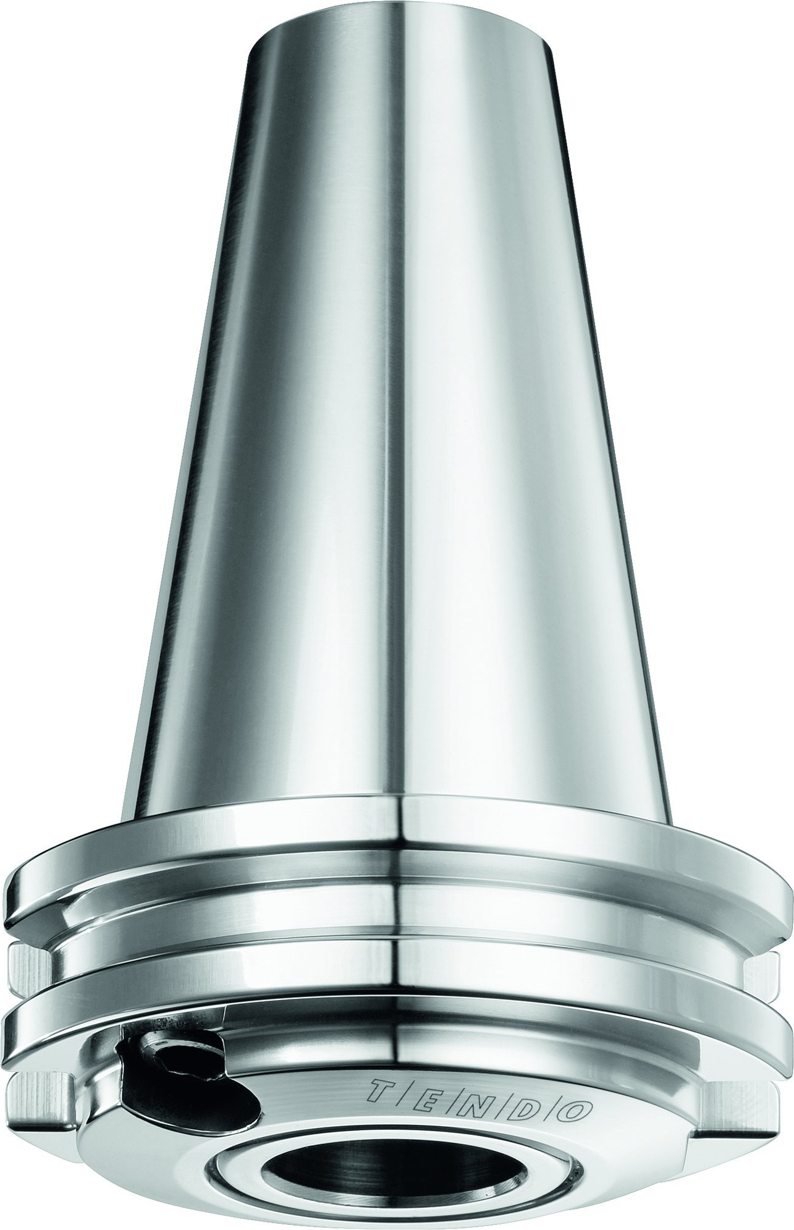
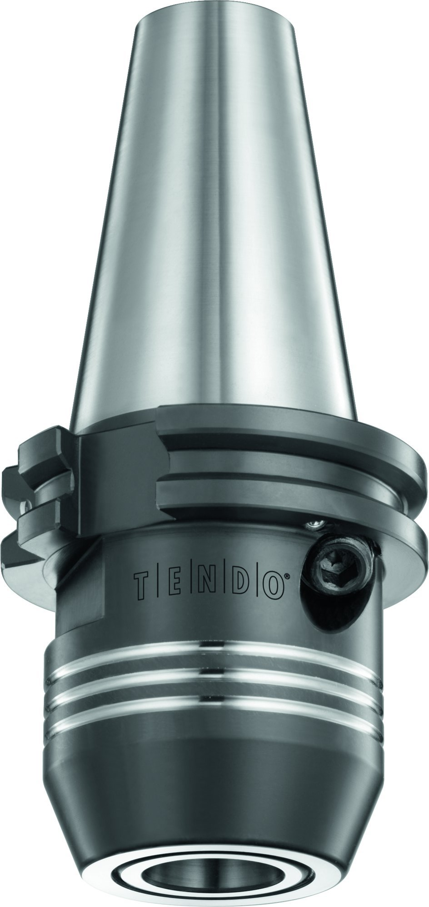
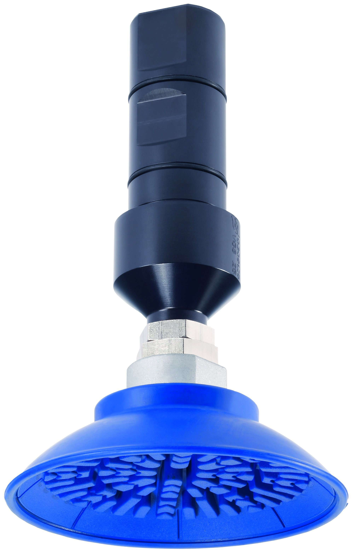
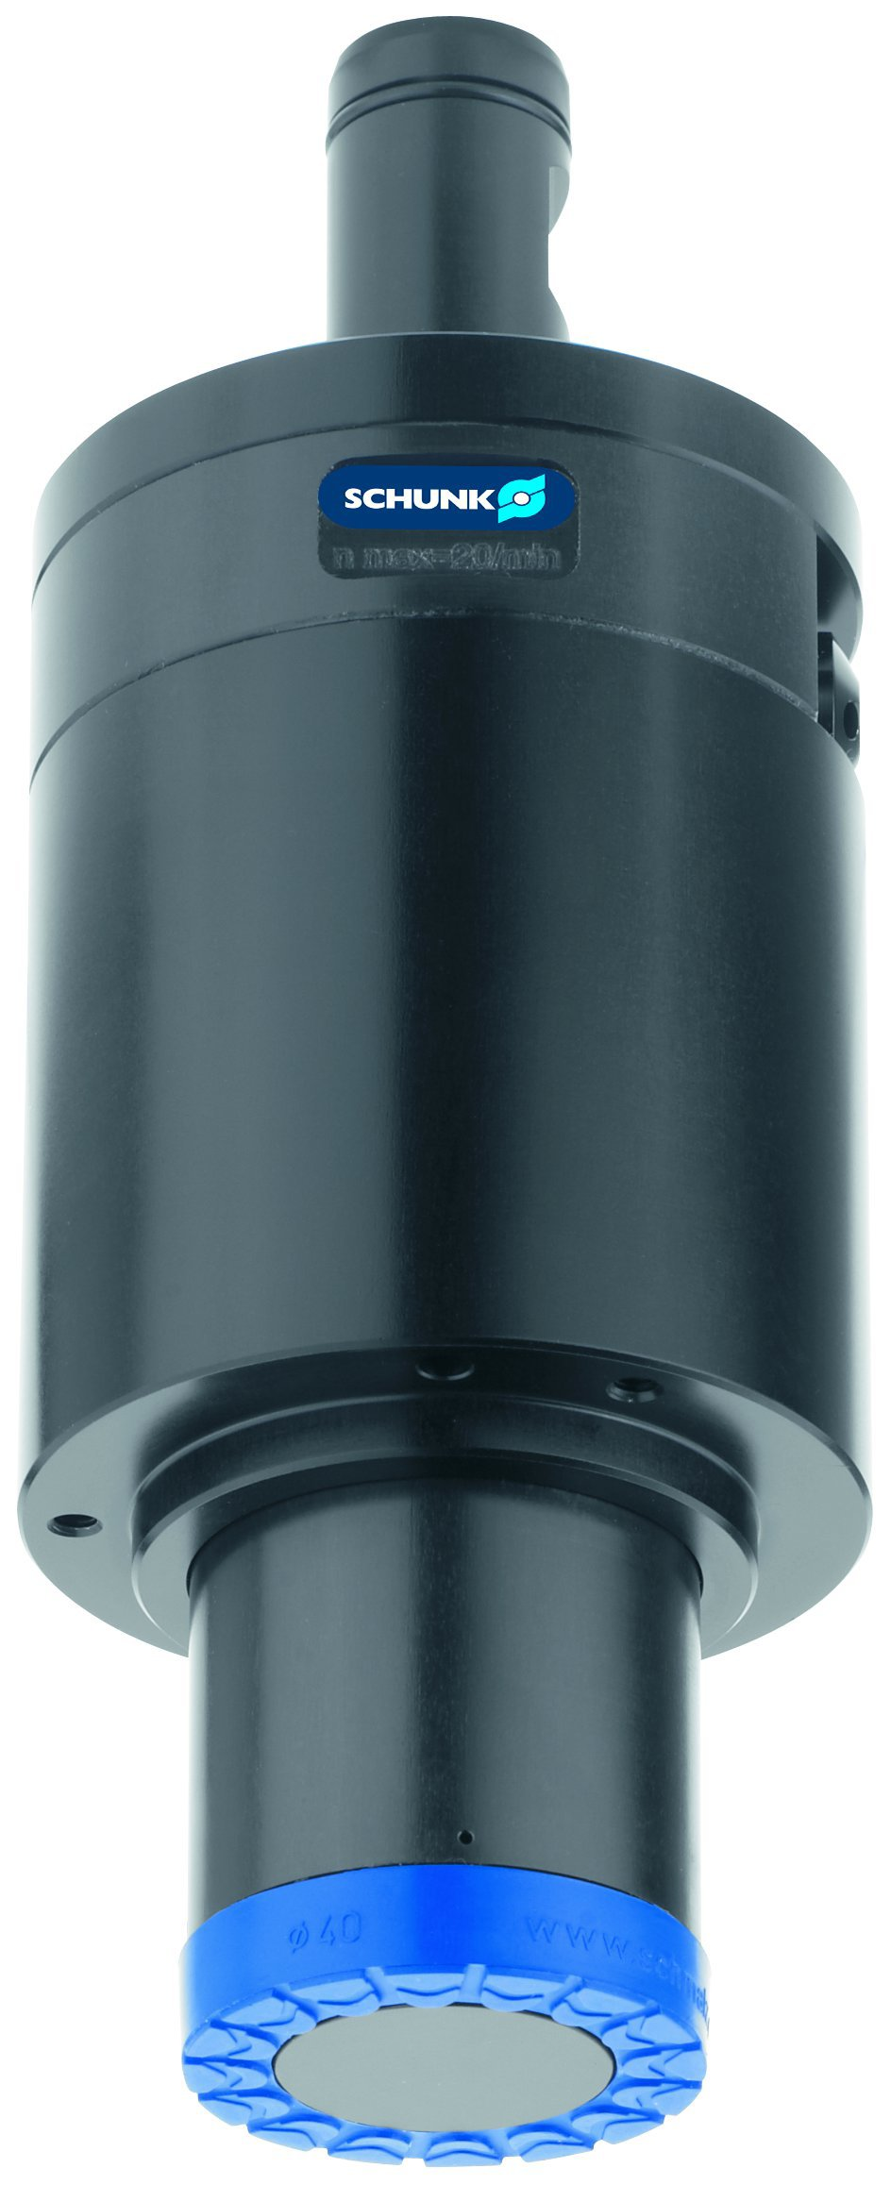
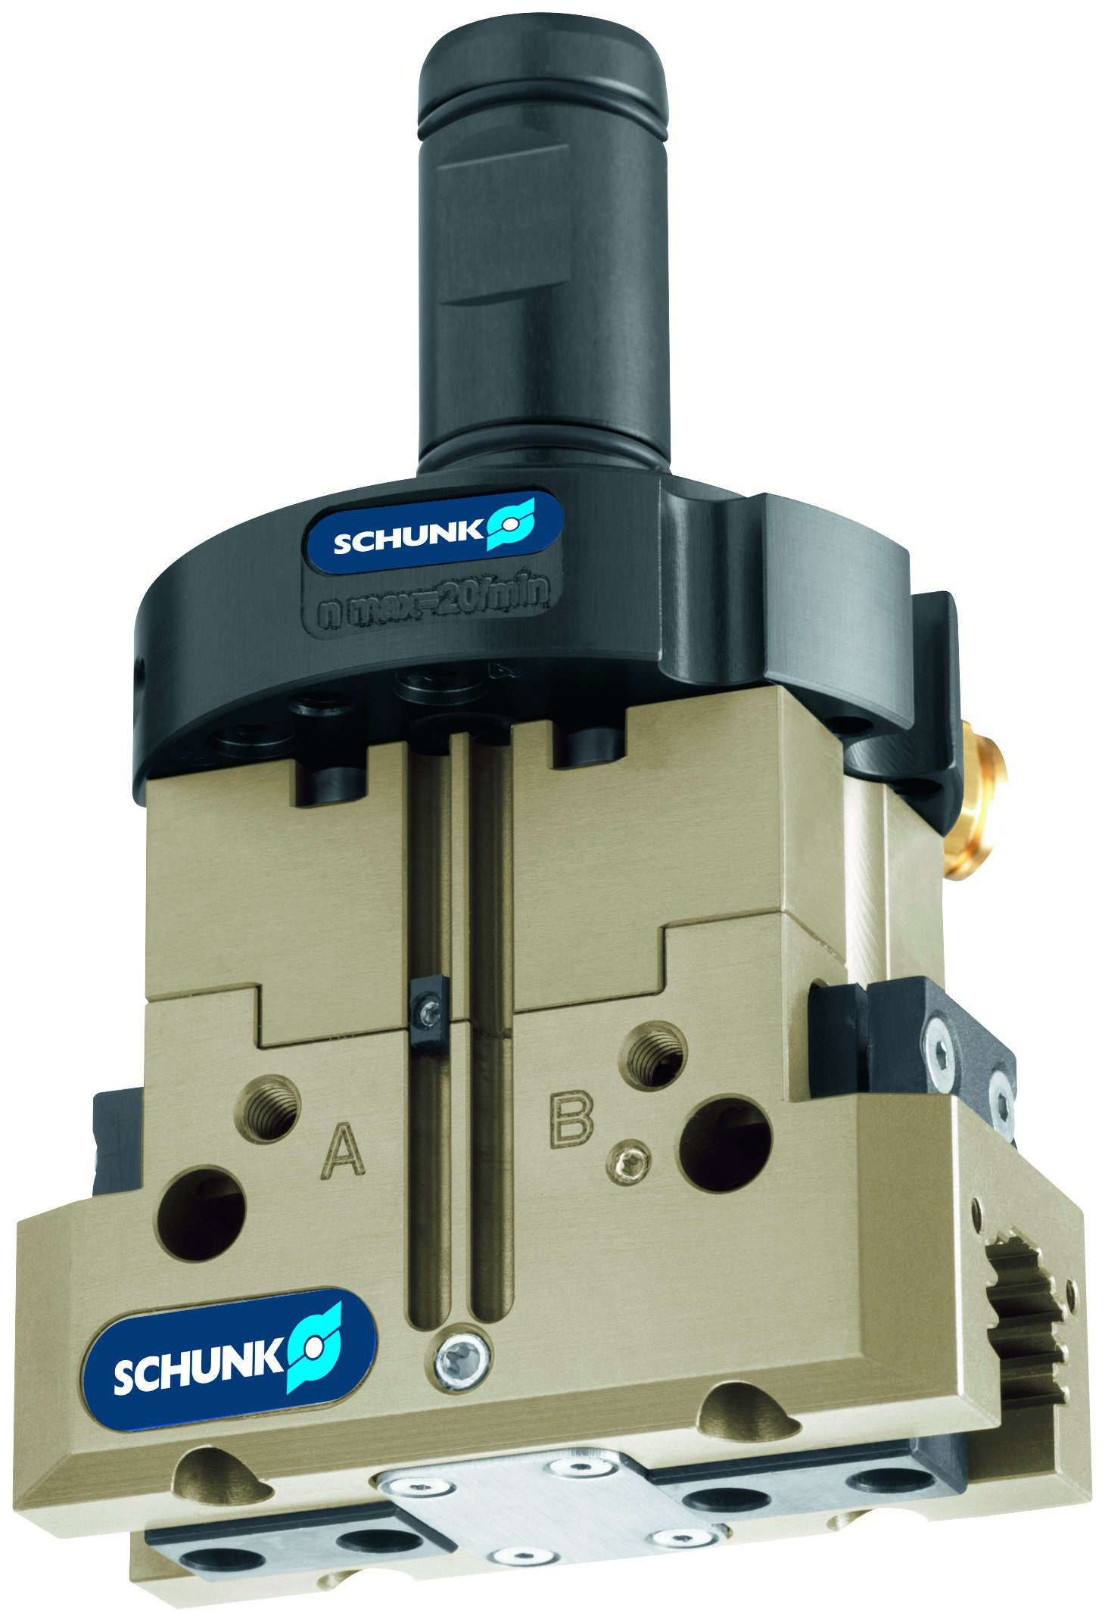
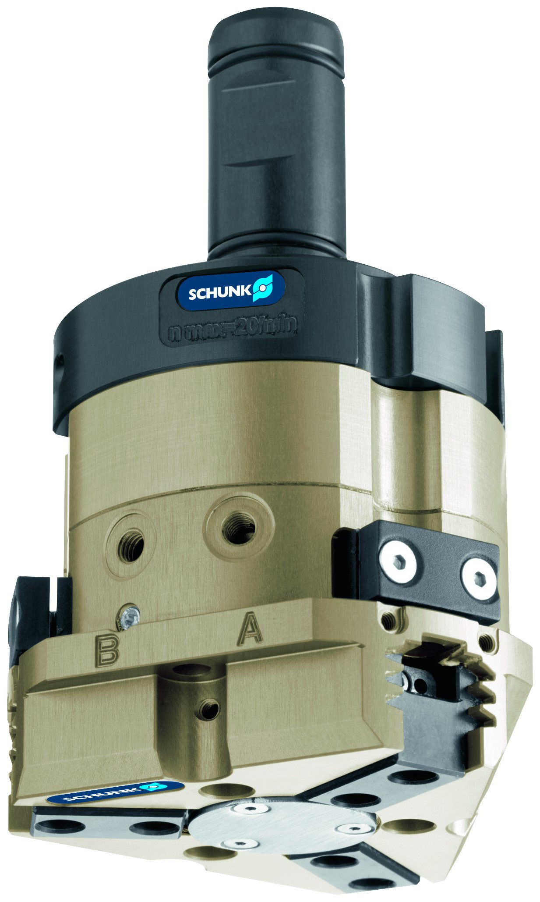
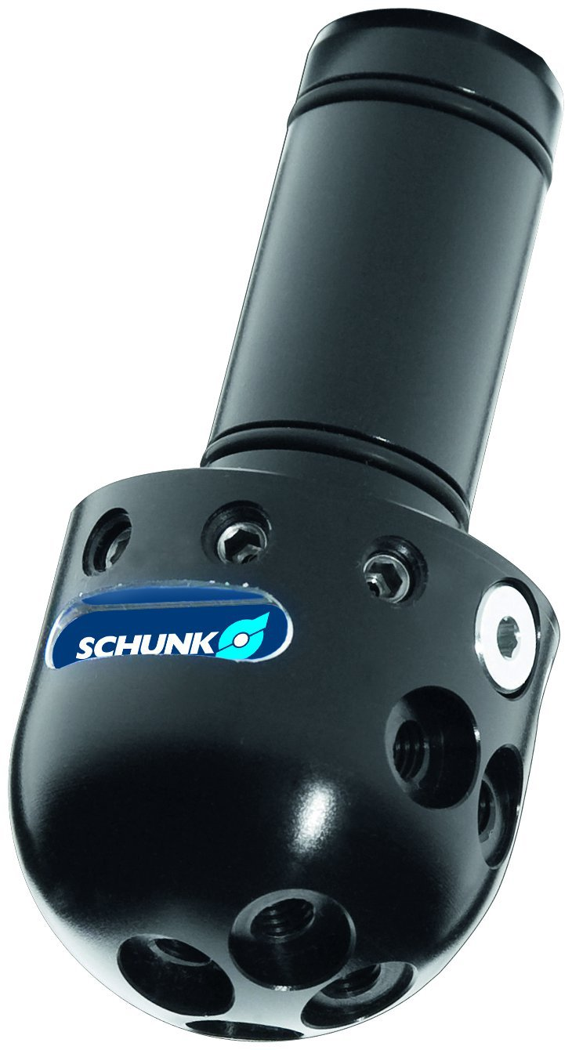
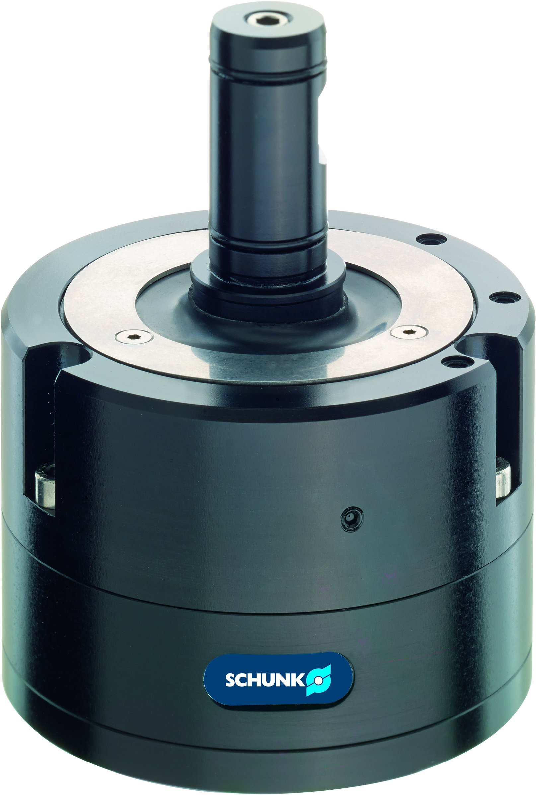
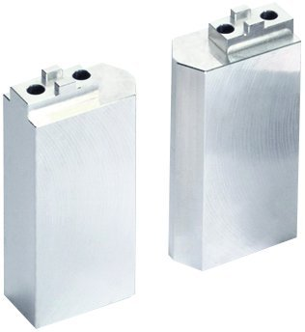
Lean Automation Standard
Gripping Systems
Clamping Technology
Capto
VDI
HSK
SK short
SK standard
GSW – B V
GSW - M
GSW – P PGN
GSW – B PZN
RGG
GSW – B AGE
ABR / SBR
gripper shaft interface JD FJM

Slide 9
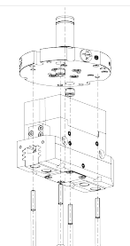
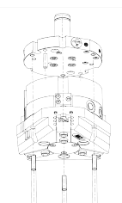
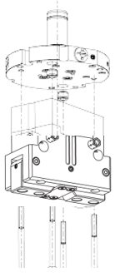
SCHUNK standard
standard-adapter GSW-B
- PGN+ Parallelgripper - PZN+ Centricgripper - PWG+ Angulargripper

Slide 10
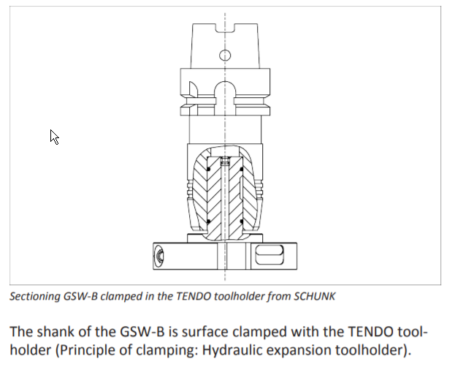
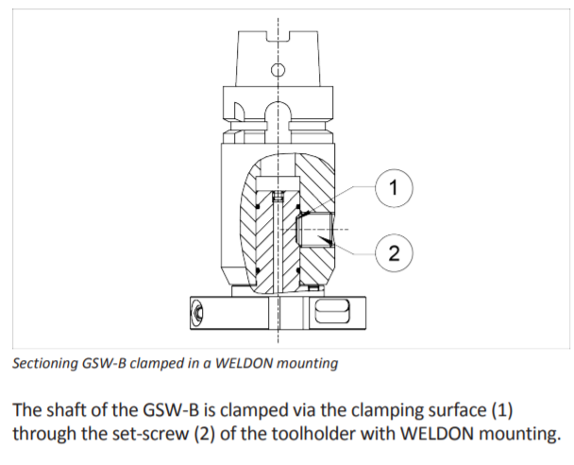
SCHUNK standard
standard-toolholder
- Tendo - Weldon

Slide 11
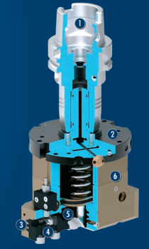
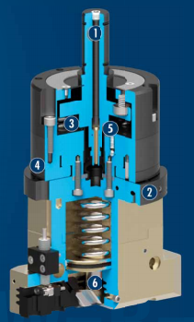
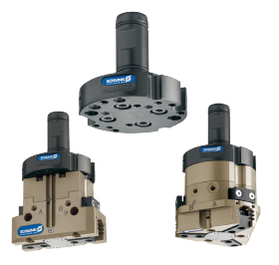
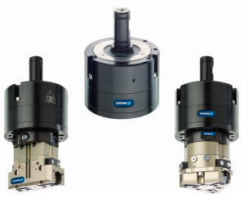
SCHUNK standard
standard-adapter GSW-B
w/o compensation
- PGN+ Parallelgripper
- PZN+ Centricgripper
- PWG+ Angulargripper
standard-adapter GSW-B-AGE
with X/Y/Z compensation
- PGN+ Parallelgripper
- PZN+ Centricgripper
- PWG+ Angulargripper

Slide 12
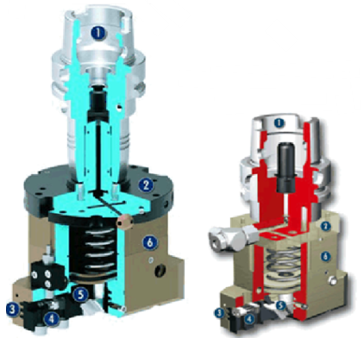
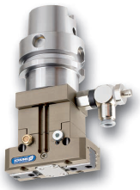
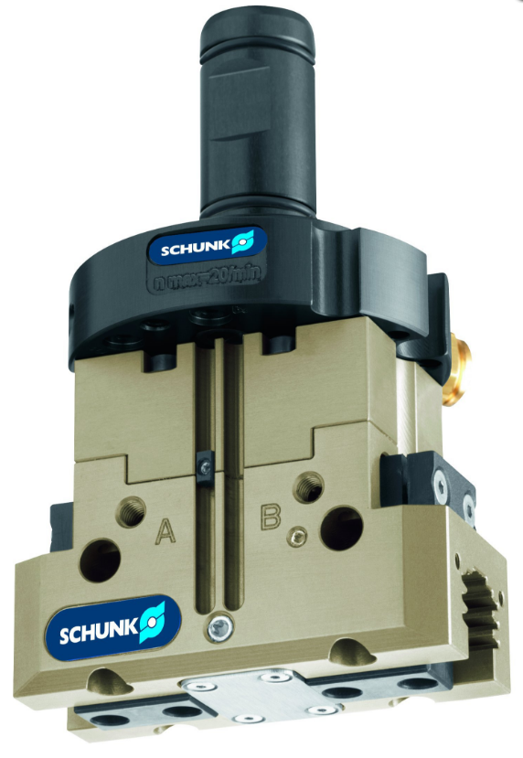
SCHUNK Semi-standard
Comparison standard / semi-standard → difference in height
standard = tool holder / adapter with shaft / gripper
semi-standard = tool holder / gripper

Slide 13
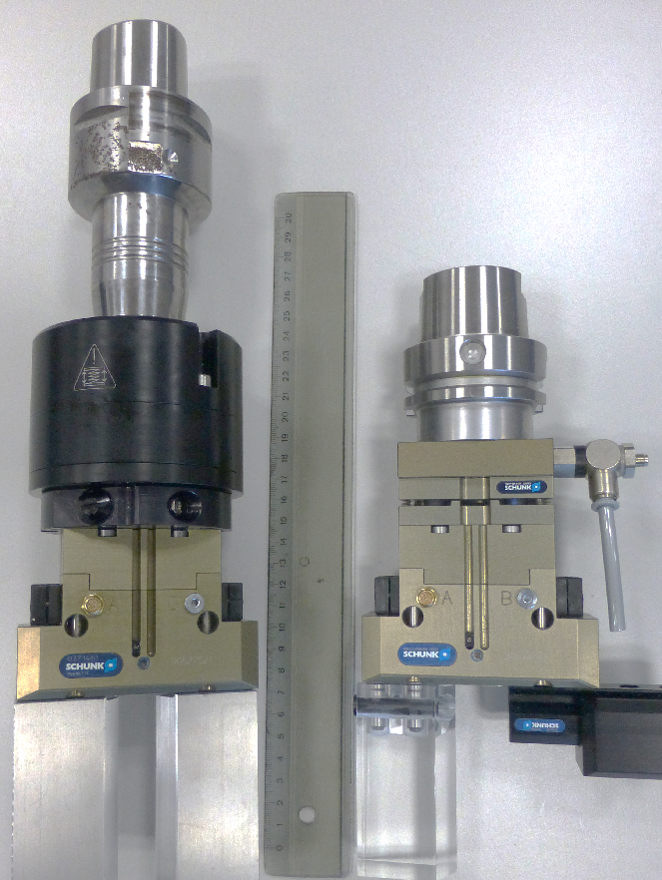
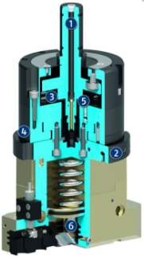
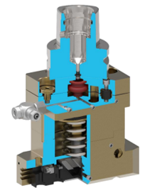
SCHUNK Semi-standard with compensation
comparison standard / semi-standard ==> difference in height
Standard
GSWB-AGE
Gripper with shaft interface
and compansation unit
Semi- Standard
e.g. GEI Capto/TCU-S/Adapter/PGN+080-1-IS
Gripping unit:
Gripper with shaft interface and special-compansation unit (with fluid feed-through)

Slide 14
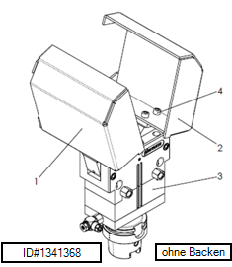
Special solutions: examples different interfaces
Semi-Standard
GEI HSK-A 63/ PWG+125-AS
Angulargripper PWG+125-AS
with spindle interface HSK-A 63
(top jaws made by customer)
Special
GEI VDI / PGN+100-1-AS
Parallelgripper PGN+100-1-AS
with spindle interface similar VDI
with top jaws

Slide 15
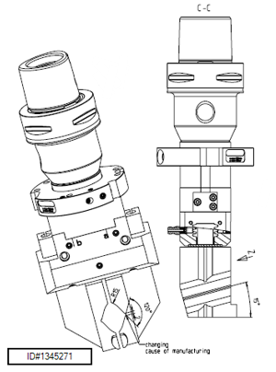
Special solutions: examples different interfaces
Special
GEI VDI 30/ DPG+080-1-AS
Parallelgripper DPG+80-1-AS
with spindle interface VDI 30
Special
GEI Capto C6 / GSWB 80-PZ / PGN+080-1-IS
Parallelgripper PGN+80-1-IS with
shaft interface GSWB 80-PZ and
toolholder SCHUNK Capto C6 Ø20x65
special top jaws with workpiece contour

Slide 16
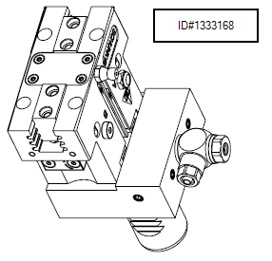
Special solutions: examples different interfaces
Special
GEI BT 40 / PGN+100-1-IS
Parallelgripper PGN+100-1-IS
with spindle interface BT 40
Special
GEI VDI 25/ PGN+P-064-1-IS
Parallelgripper PGN+P-64-1-IS
with spindle interface VDI 25

Slide 17
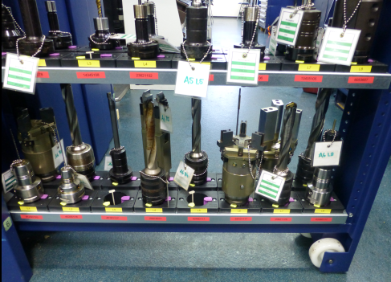
gripper with interface @ SCHUNK

Slide 18
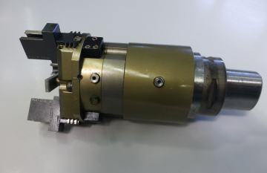
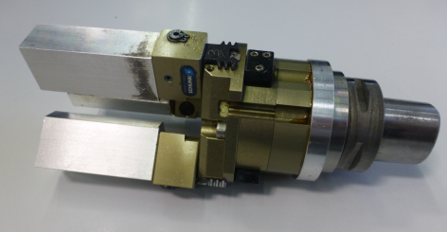
gripper with interface @ SCHUNK
Gripping unit
GEI Capto C6/ APL / PZN+080-1-IS / AUB
Centricgripper PZN+80-1-IS
Special top jaws
extension adapter
spindle interface Capto C6
Gripping unit
GEI Capto C6/ APL / PZN+080-1-IS / BSWS / ABR
Centricgripper PZN+80-1-IS
Jaw quick-change system BSWS-80
Aluminum finger blanks ABR+80
Adapter
spindle interface Capto C6

Slide 19
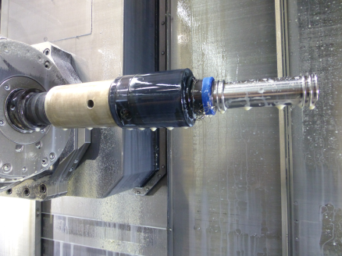
gripper with interface @ SCHUNK
Gripping unit
GEI Capto C6/ APL / GSW-M
Magnetgripper GSW-M
extension adapter
spindle interface Capto C6

Slide 20
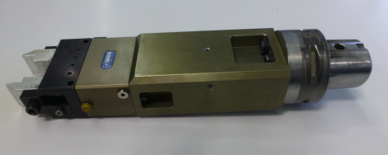
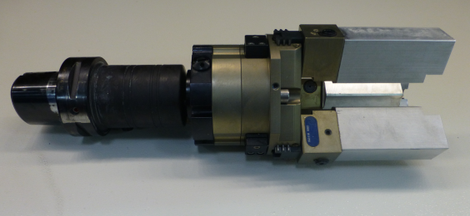
gripper with interface @ SCHUNK
Gripping unit
GEI Capto C6/ APL / MPG 50 / AUB
Parallelgripper MPG 50
Special top jaws
extension adapter
spindle interface Capto C6
Gripping unit
GEI Capto C6 / GWSB 80/ PZN+080-1-IS / BSWS / ABR
Centricgripper PZN+80-1-IS
Jaw quick-change system BSWS-80
Aluminum finger blanks ABR+80
shaft interface GSW-B 80-PZ
spindle interface Capto C6 with extension

Slide 21
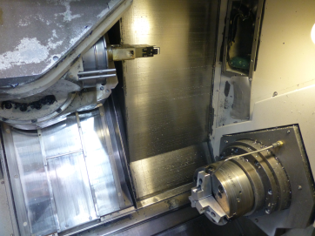
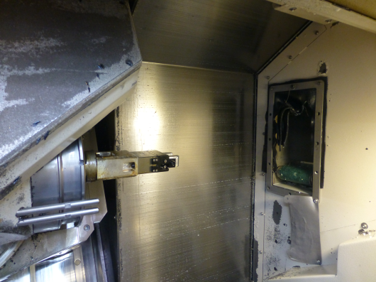
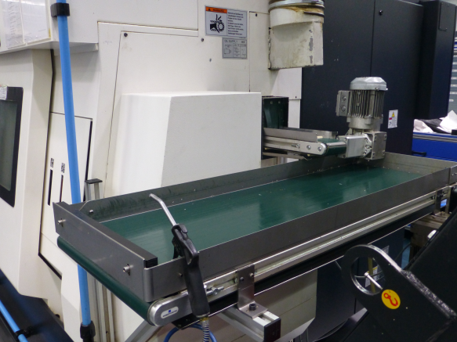
Inside machining centre

Slide 22
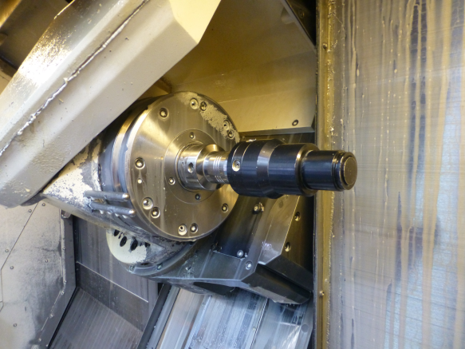

Inside machining centre

Slide 23


Inside machining centre

Slide 24


Inside machining centre

Slide 25


Inside machining centre

Slide 26






Jaw change – SCHUNK standard

Slide 27

Jaw change without tools

