Slide 1

SRU-plus-D
Product information
Creator: S. Höpfl | Version date: 12.12.2018

Slide 2
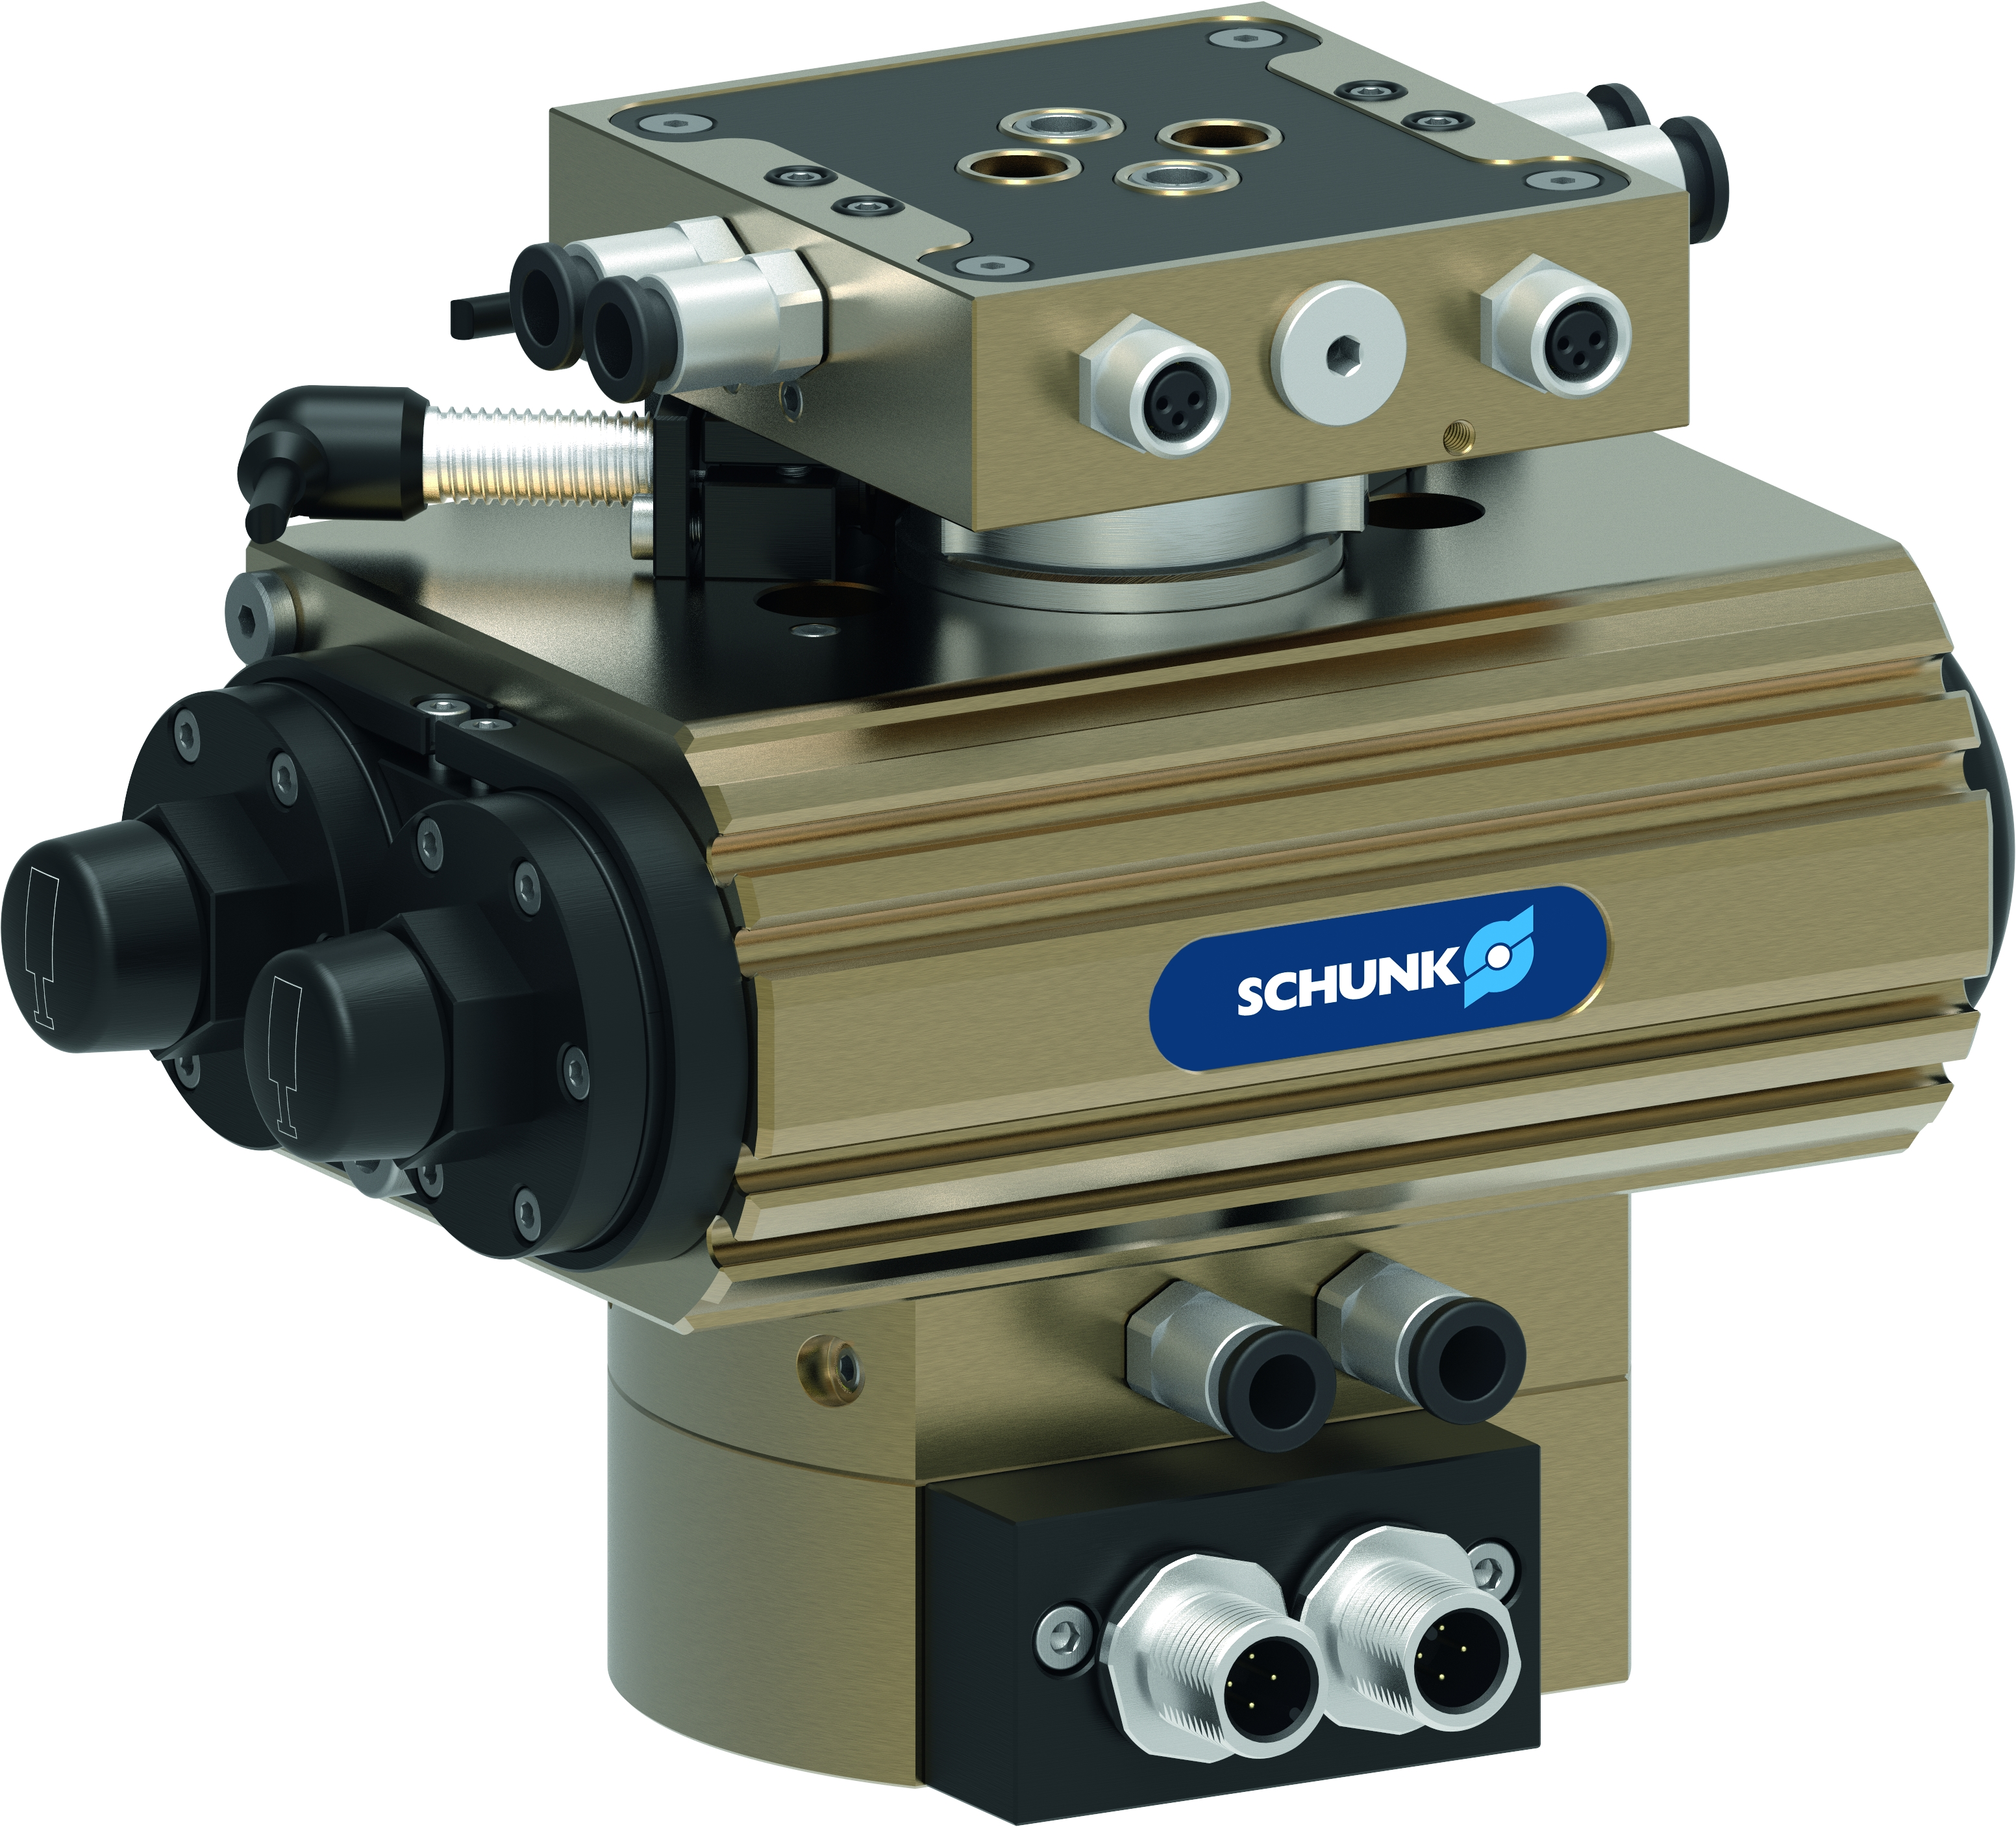
SRU-plus-D
Product information
Universal flat swivel unit optimized for the automobile industry requirements.
The basis is the reliable SCHUNK universal swivel unit SRU-plus.
In addition to the available standard version, various modifications and adjustments according to customer requirements are possible, please contact us.

Slide 3
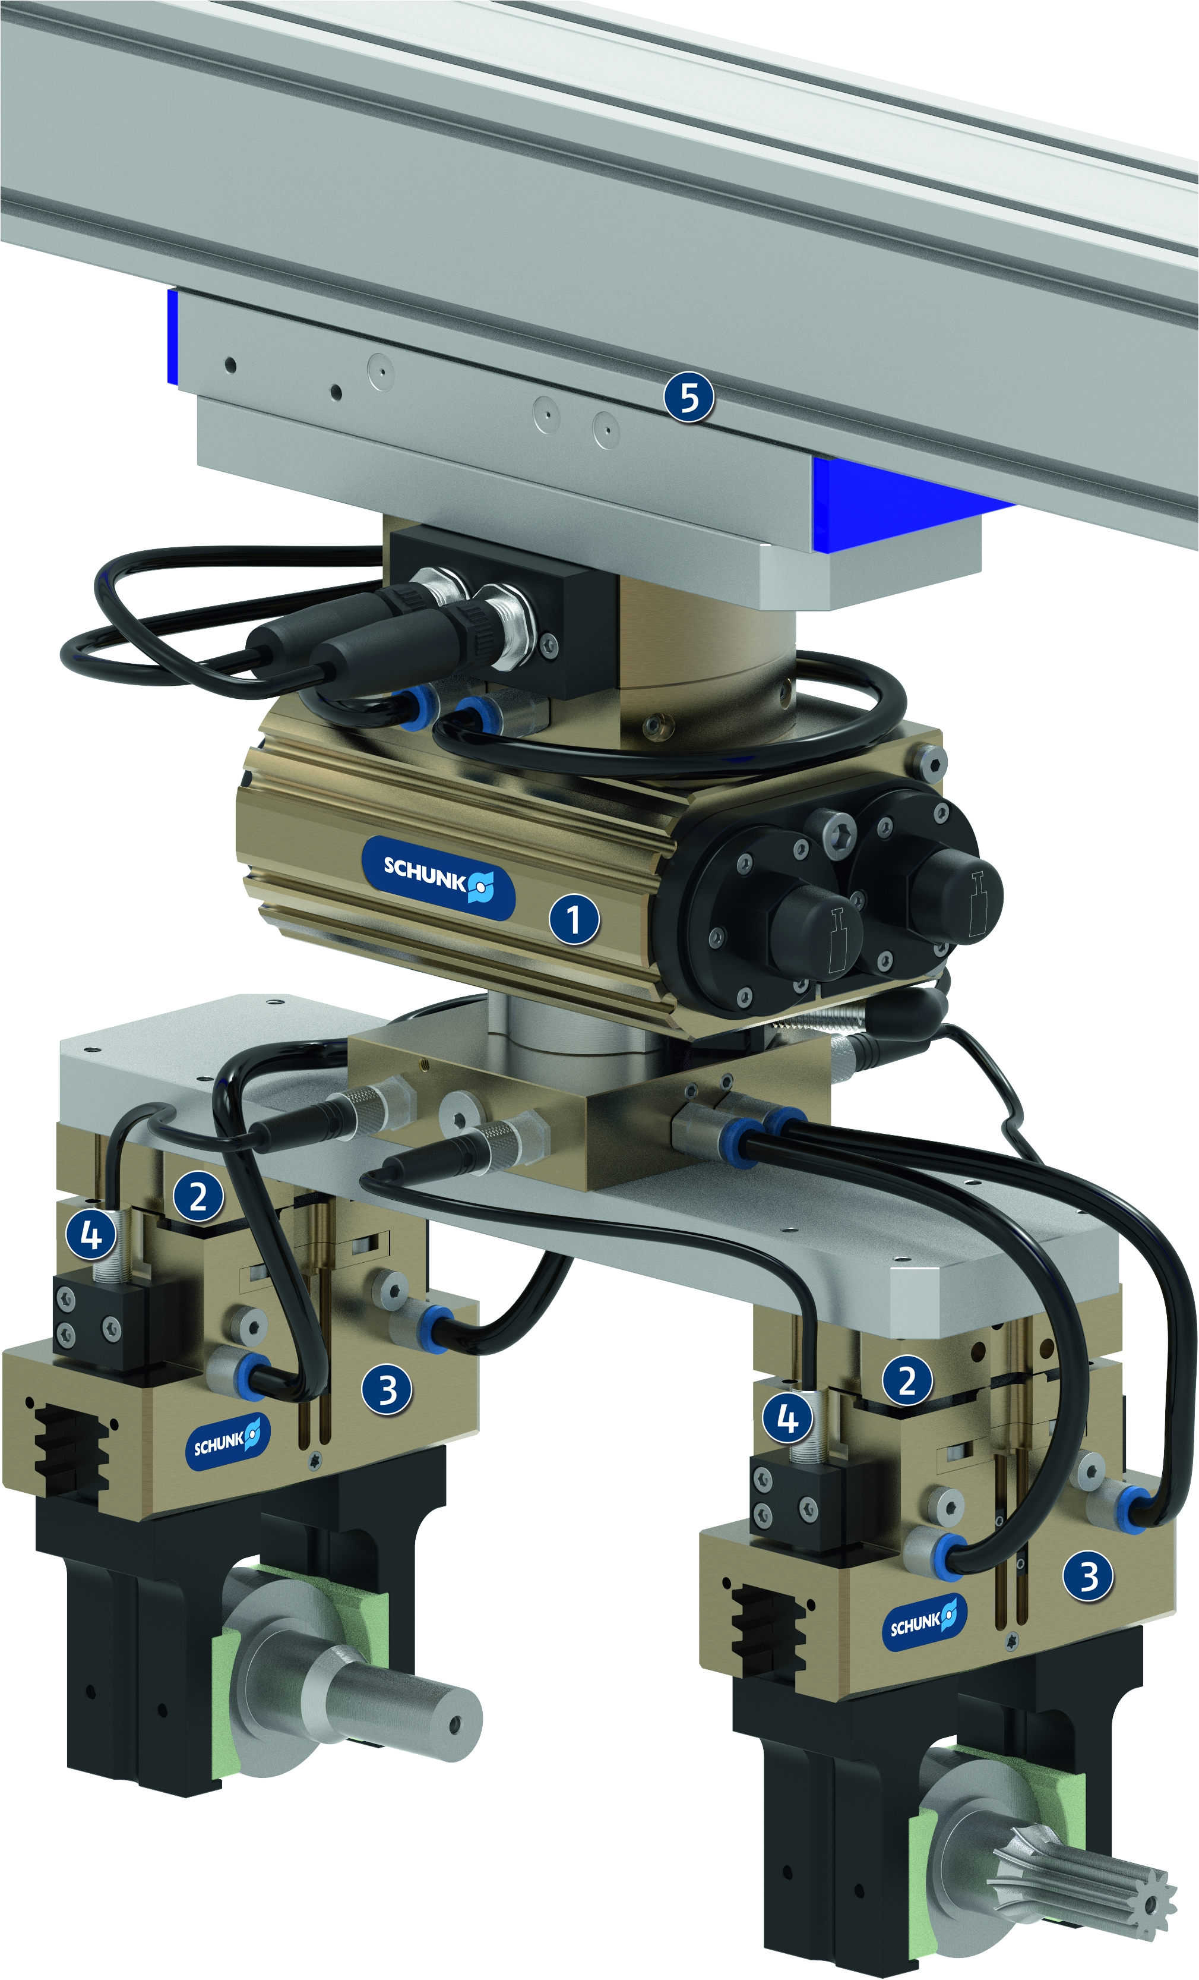
SRU-plus-D
Example application
1
Universal swivel unit SRU-plus-D with EDF (EFT)
Compensation unit TCU
Universal gripper PGN-plus-P
Inductive proximity switches IN
Linear axis BETA
2
3
4
5

Slide 4
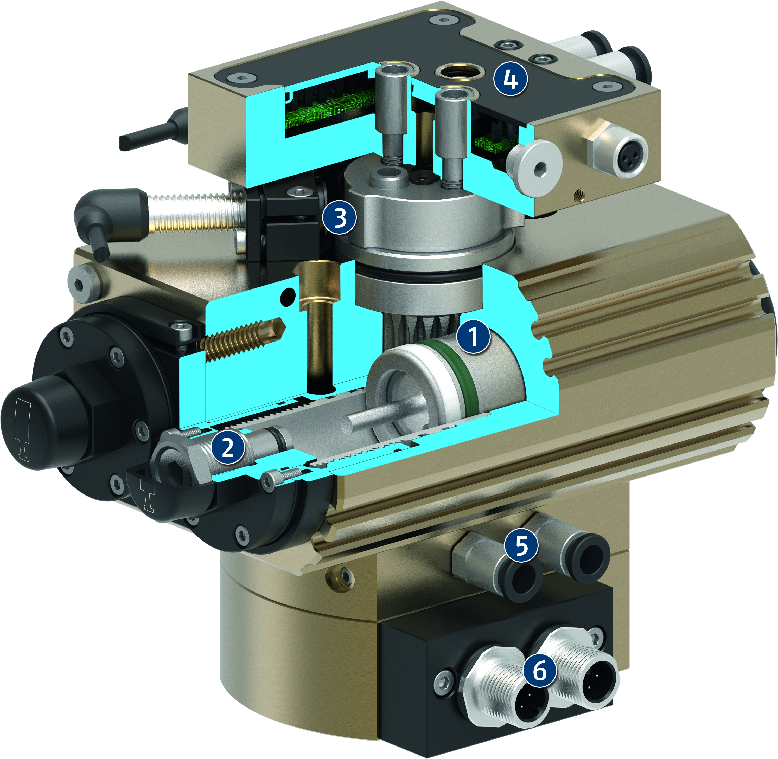
SRU-plus-D
Function
1
Drive
Pneumatic, powerful double-piston drive with rack and pinion kinematics for conversion of the piston movement into a rotational movement
2
Swivel angle adjustment
for fine adjustment of end positions and damping characteristics
3
Inductive monitoring with fixed control cam
for process-reliable monitoring of end positions
4
Electrical rotary feed-through
Fully integrated feed-through for sensor and actuator signals
Connections for fluid feed-through
for direct connection of the pneumatic supply of the swivel set-up to the fixed part of the swivel unit
5
6
Connections for electric rotary feed-through
Standard M12 connector for easy connection and further processing of electric signals

Slide 5
SRU-plus-D
Main differences to series SRU-plus
Inductive position detection with a fixed switch cam
2x/3xM12 plug on drive side (instead of 1xM16)
End position adjustment ±3°

Slide 6
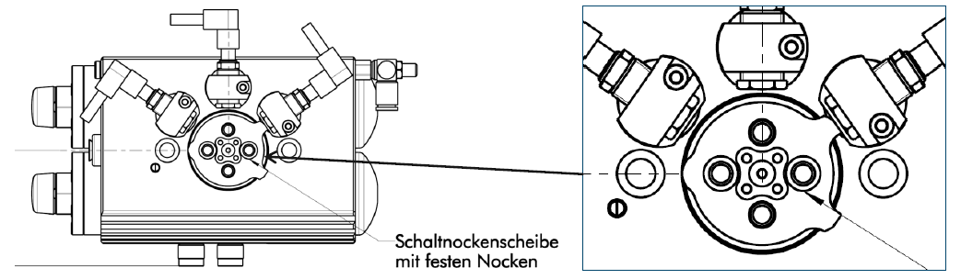
SRU-plus-D
1. Inductive monitoring with fixed control cam
The fixed switching cam allows a detection of three positions
(0°, 90°, 180°).
Therefore, the detection can also be used with middle position variants (M, VM) possible..
Plate with fixed switch cams

Slide 7
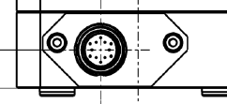
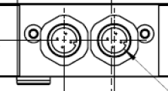
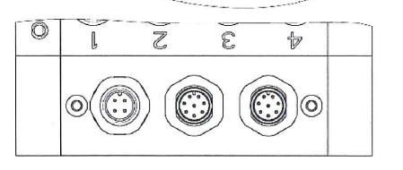
SRU-plus-D
2. Electrical feed-through EDF (1)
 |  | SRU-plus |  | SRU-plus-D/D1
Size |  | Drive side | Output side | Drive side | Output side
20 - 35 |  | 1xM16 – 12pole | 4xM8 – 3pole | 2xM12 - 4pole | 4xM8 – 3pole
40 - 60 | Variant 1 |  | 8xM8 – 3pole 1xM8 – 4pole | 2xM12 - 8pole 1xM12 - 4pole | 8xM8 – 3pole 1xM8 – 4pole
 | Variant 2 |  |  |  | 8xM12 – 4pole 1xM8 – 4pole
Plug drive side
size 20-60
Plug drive side
size 20-35
Plug drive side
size 40-60

Slide 8
SRU-plus-D
2. Electrical feed-through EDF (2)
SRU-plus-D1 40-60 | M12 connector 8pole drive side
Pin | Color | Function
1 | BN | +24 V
2 | WH | 2
3 | BU | 0 V
4 | BK | 1
5 | GY | 3
6 | PK | 4
7 | VT | n.c.
8 | OG | n.c.
SRU-plus-D 40-60 | M12 connector 8pole drive side
Pin | Color | Function
1 | WH | 1
2 | BN | +24 V
3 | GN | 2
4 | YE | 3
5 | GY | 4
6 | - | n.c.
7 | BU | 0 V
8 | - | n.c.
Note:
The size 40-60 will be delivered for new applications exclusively in version D1.
For replacement and repair can be offered the version D, please contact us.­

Slide 9
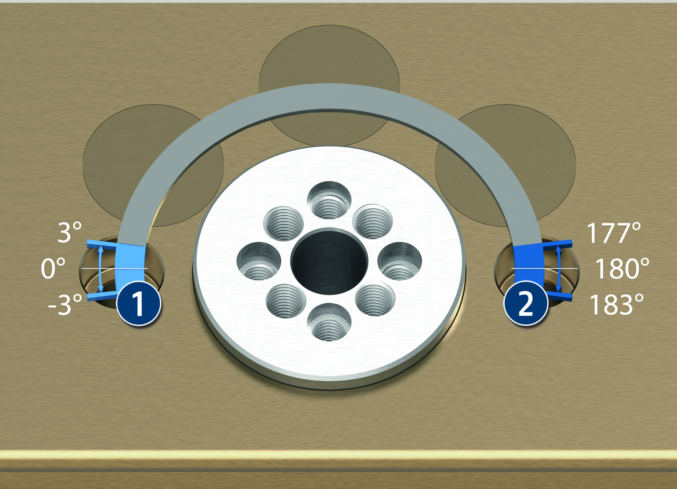
SRU-plus-D
3. End position adjustment ±3°
Adjustability of the end position 0°
Adjustment range of the end
position 180°
1
2
Note:
Also with the middle position variants (M, VM) an end position adjustability of ±3° is possible.

