Slide 1

Product presentation
3D-Online-Configurator gripper swivel units

Slide 2
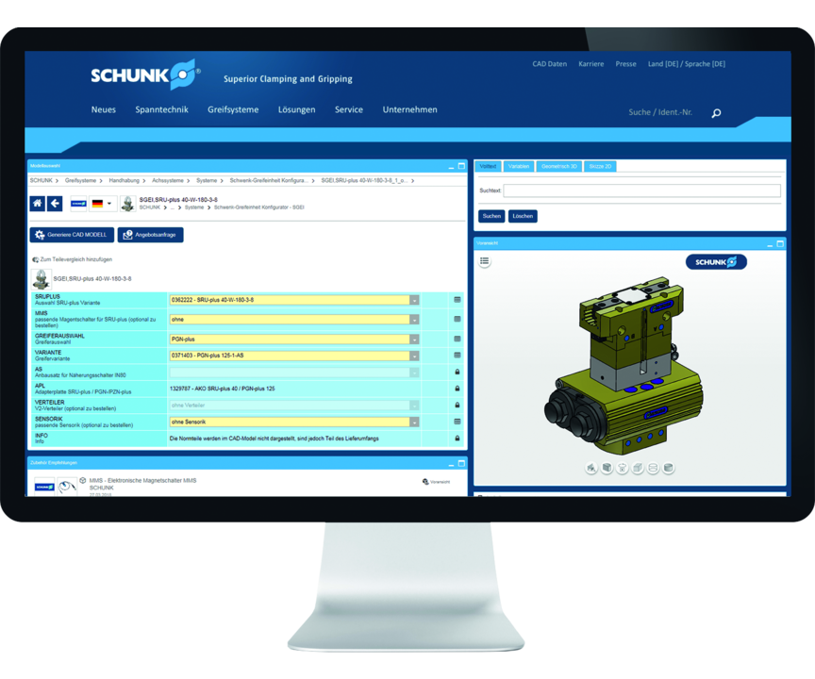
NEW! Also for gripping swivel units
SCHUNK 3D-Online configurator for three-dimensional configuration of gripper swivel units
To the PARTcommunity :
SGEI-Configurator
Swivel units SRU-plus and SRM can be combined with the following SCHUNK grippers:
PGN-plus, DPG-plus, JGP, PWG-plus, PZN-plus, DPZ-plus, JGZ, PZB-plus

Slide 3
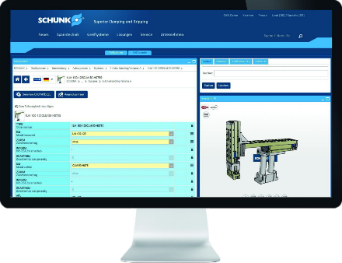
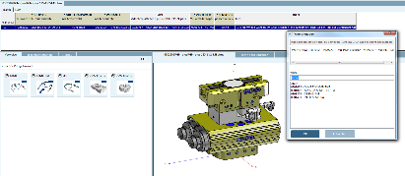
Functional principle
Swivel gripper units configurable in a few clicks based on the SRU-plus and SRM
Standardized adapter plate integrated – creation of parts lists inclusive standard parts
Available in the SCHUNK PARTcommunity worldwide
Suitable sensors selectable
Available in all popular 2D and 3D formats

Slide 4
Advantages – Your benefits
All configurations are available in all common 2D- and 3D variants for simple and fast integration into existing CAD systems. The download of a 3D PDF document facilitates the display of the configuration also without CAD system
Accessories like the sensor system or required adapter plates are automatically integrated into the design. Convenient preview function with live adjustment of changes. Automatic parts list creation of all required products incl. all standard parts. Saving and download function of the created configuration as a finished component
3D-online configurator gripper swivel units simple configuration of gripper swivel units with SCHUNK grippers in combination with the universal swivel unit SRU-plus and SRM
Combinational logic is integrated in the configurator no separate data model SCHUNK Kombibox necessary anymore
Fast and error-free configuration due to integrated combination logistics. Access via the SCHUNK PARTcommunity on the basis of the proven CADENAS technology. Available all over the world free of charge

