Slide 1

Product presentation
The new design tool for SCHUNK grippers

Slide 2

New! Design tool
With the SCHUNK online design and selection tool, the suitable SCHUNK gripper from the complete SCHUNK gripper portfolio can be easily and specifically selected for each use.
Clean documentation and archiving of the design
Consistent shaped design tool with updated logic, online access to current data base
Simple calculation
HTML based – worldwide reachable from all common devices
Customer loyalty – consulting and expert knowledge digitized
Consistent operable
Save selection of components

Slide 3
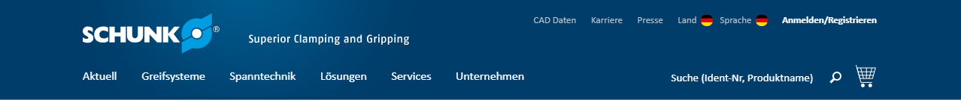
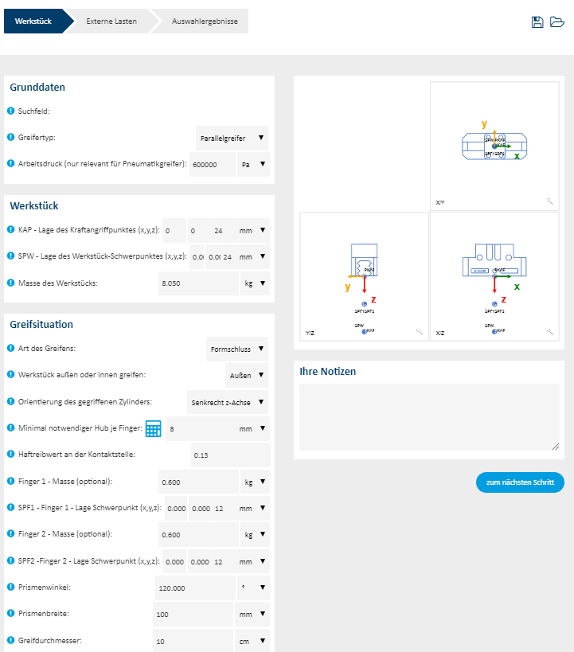
Description of the gripping situation
Inclusive current new products
Inclusive graphical support
Storable
Printable input and results page

Slide 4
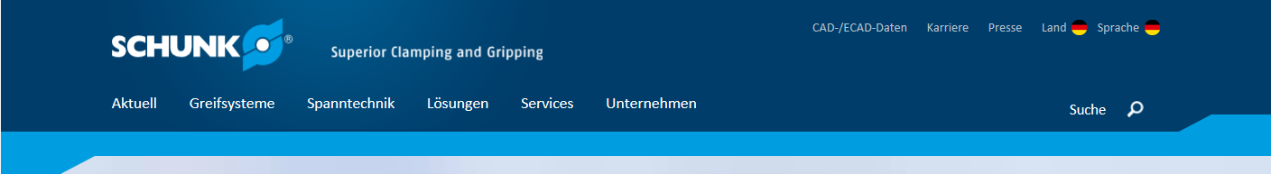
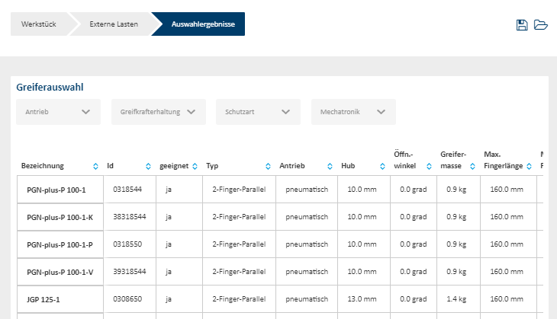
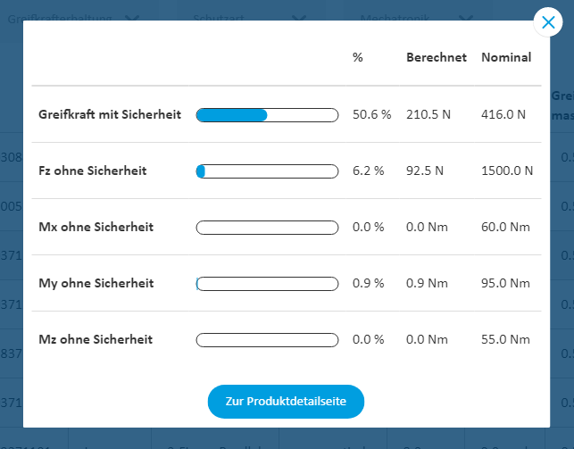
Selection of the appropriate gripper
Hit list
Display of utilization rate incl. utilization reason
Printable input and results page
Direct display of product information such as pictures, documents about the products, etc.
… and much more

Slide 5
Advantages – Your benefits
Design of the suitable SCHUNK gripper for each individual application case due to many years of experience and proven calculation logic
Simple and consistent user guidance with visual support for data entry of all relevant parameters for calculating and designing SCHUNK grippers
Users receive a hit list with suitable SCHUNK grippers for convenient and safe selection of the suitable SCHUNK product.
Specific utilization ratio in accordance with the application scenario of the SCHUNK gripper is displayed in a hit list. In addition to the hit list, the specific utilization criteria for the respective components is specified
Globally online available design tool on all end devices due to HTML-based user interface
Current SCHUNK product portfolio and the associated data is always up to date. This increases the safety and efficiency when selecting components
Archiving, opening the calculation or design for viewing the entry parameters and calculation results again later

Slide 6
2018-05-30 10:39:42
Jens Lehmann, deutsche Torwartlegende, seit 2012 SCHUNK-Markenbotschafter für sicheres, präzises Greifen und Halten.
schunk.com/Lehmann

