Slide 1

Product presentation
FT-AXIA
6-axis force/torque sensors

Slide 2
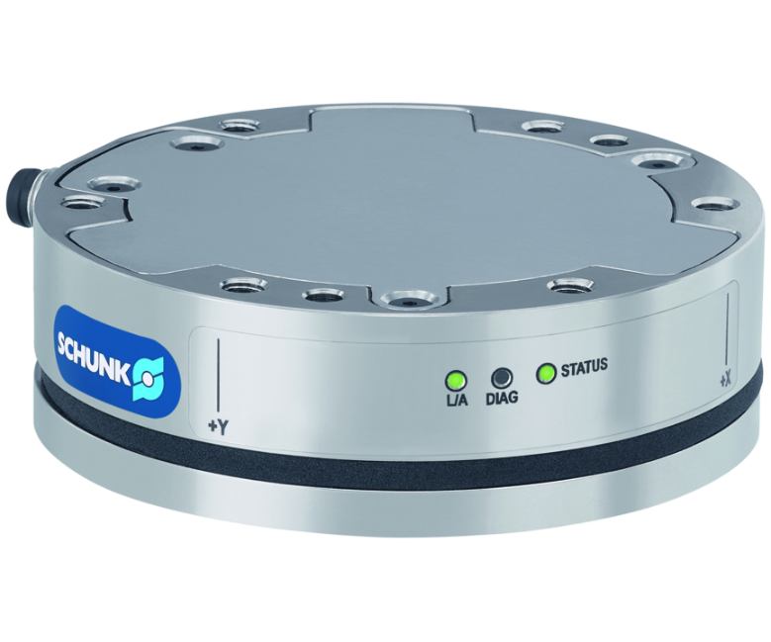
6-axis force/torque sensors
Rigid 6-axis force/torque sensor for precision measuring in all six degrees of freedom
The first compact force/torque sensor with two calibrations and integrated electronics.
2 measurement ranges for selection

Slide 3

Precise. Reliable. Robust.
Compact design due to completely integrated electronics and status display via LEDs.
Simple configuration - two calibrations can be controlled in the sensor via web interface.
Plug & Work directly compatible for KUKA and Universal Robots via software module
Robust and durable even with short-term overloading, the sensor is protected from damage

Slide 4
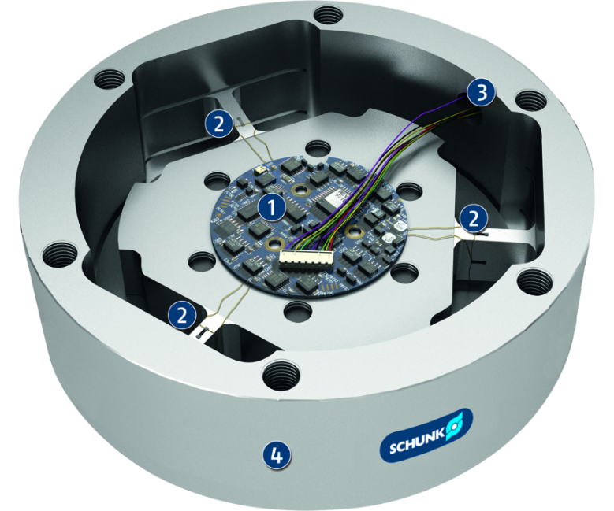
Principle of function
Functional description
The strain gauges (DMS) of the 6-axis force/torque sensors measure the strain applied in all six degrees of freedom (Fx, Fy, Fz, Mx, My and Mz). The signals of the DMS are evaluated in the sensor and provided.
1
Electronics
2
Resistance strain gauges
3
Interfaces
4
IP protection class

Slide 5
Advantages – Your benefits
Compact design due to space-saving set-up with integrated electronics
Two calibrations are available whereby two measurement ranges can be controlled via web interface
Plug & Work directly compatible for KUKA and Universal Robots via software module
Cost saving despite high precision due to optimized manufacturing
Robust design ensures due to a high overload range with protection against damage even with short-term overload
Version with LED display for status display on the sensor without evaluation via the controller

Slide 6
Technical data
Technical data overview
evaluation via | Weight | Calibration 1 | Range of measurement Fx, Fy | Range of measurement Fz | Range of measurement Mx, My | Range of measurement Mz | Calibration 2 | Max. range of measurement Fx, Fy | Range of measurement Fz | Range of measurement Mx, My | Range of measurement Mz
 | [kg] |  | [N] | [N] | [Nm] | [Nm] |  | [N] | [N] | [Nm] | [Nm]
EtherNet | 0.28 .. 1.88 | SI-75-4 .. SI-4000-300 | 75 .. 4000 | 235 .. 6000 | 4 .. 300 | 4 .. 300 | SI-150-8 .. SI-1200-50 | 150 .. 1200 | 470 .. 2000 | 8 .. 50 | 8 .. 50
EtherCAT | 0.28 .. 1.88 | SI-75-4 .. SI-4000-300 | 75 .. 4000 | 235 .. 6000 | 4 .. 300 | 4 .. 300 | SI-150-8 .. SI-1200-50 | 150 .. 1200 | 470 .. 2000 | 8 .. 50 | 8 .. 50
serial interface (RS-485) | 0.28 .. 1.88 | SI-75-4 .. SI-4000-300 | 75 .. 4000 | 235 .. 6000 | 4 .. 300 | 4 .. 300 | SI-150-8 .. SI-1200-50 | 150 .. 1200 | 470 .. 2000 | 8 .. 50 | 8 .. 50
serial interface (RS-422) | 0.744 .. 1.88 | SI-1000-50 .. SI-4000-300 | 1000 .. 4000 | 2000 .. 6000 | 50 .. 300 | 50 .. 300

