Slide 1

Product presentation
SWS
Quick change system

Slide 2
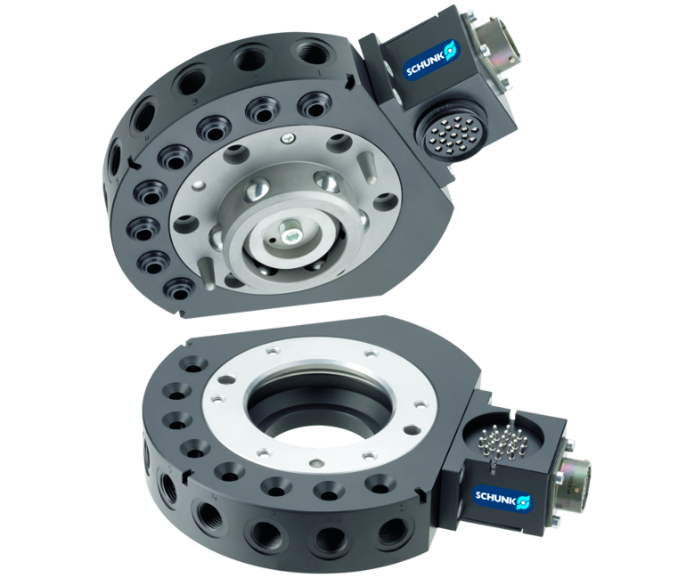
Quick change system
Pneumatic tool changing system with patented locking system
Compact quick-change system with patented no-touch locking system.
Up to 10 integrated air feed-throughs on pneumatic grippers

Slide 3

Modular. Robust. Flexible.
Simple direct connection with robot flange without additional adapter plate.
Integrated pneumatic feed-through
Integrated piston stroke monitoring
Patented fail-safe locking mechanism
Portfolio expansion - new size 007

Slide 4
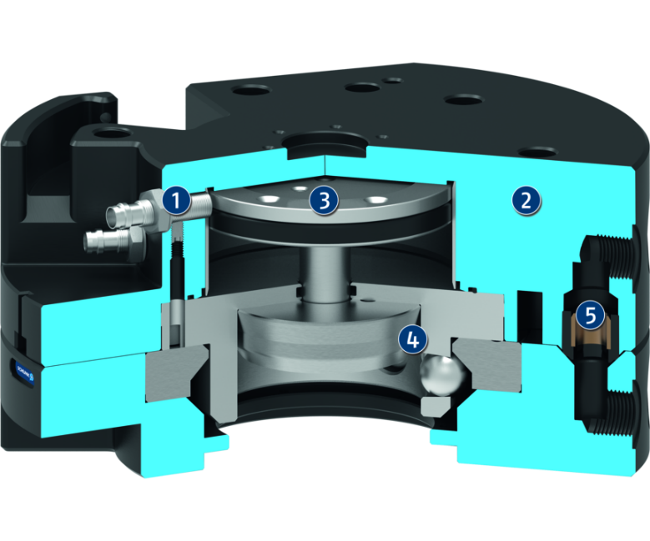
Principle of function
Functional description
Automatic exchange of the end effector (e.g. gripper, pallets, vacuum gripping systems, pneumatically or electrically driven tools, welding guns, etc.) increases the flexibility of your robot.
The quick-change system (SWS) consists of a quick-change master (SWK) and a quick-change adapter (SWA). The SWK is mounted onto the robot, and couples the SWA mounted onto your tool. A pneumatically driven locking piston, with its patented design, ensures that the connection is secure. After coupling, pneumatic and electric feed-throughs automatically supply your robot tool.
1
Sensor monitoring of the locking device
2
Housing
3
Drive
4
Locking mechanism
5
Air feed-through

Slide 5
Advantages – Your benefits
Complete series of 14 sizes for optimal size selection and a broad application range
Patented fail-safe locking mechanism for secure connection between the quick-change master and adapter
Manual emergency unlocking possible no counter-forces from springs
All functional components made from hardened steel for high mechanical resilience of the changing system
Wide range of electric, pneumatic, and fluid modules for universal energy transmission possibilities
Integrated pneumatic feed-through for a safe power supply of the handling modules and tools
Possibility of transmission of fluid systems with self-sealing couplings possible
Adapter side coding via plug connector possible
Suitable storage racks for all sizes to ensure the optimum adaption to each application
ISO mounting pattern for easy assembly to most types of robots without needing additional adapter plates

Slide 6
Technical data
Technical data overview
Size | Recommended handling weight | Locking force | Weight | Air connection thread pneumatic feed-through | Lock/unlock main connection | Max. distance when locking
 | [kg] | [N] | [kg] |  |  | [mm]
1 | 1.4 | 170 | 0.02 .. 0.08 | 4x M5 | M3 | 1
5 | 8 | 690 | 0.09 .. 0.27 | 6x M5 | M5 | 3
7 | 16 | 1100 | 0.08 .. 0.16 | 5x M5 | M5 | 3
11 | 16 | 1100 | 0.09 .. 0.29 | 6x M5 | M5 | 3
20 | 25 | 2300 | 0.32 .. 0.69 | 12x M5 | M5 | 3
21 | 25 | 2300 | 0.3 .. 0.7 | 8x G1/8" | M5 | 3
40 | 50 | 4500 .. 5650 | 0.6 .. 1.27 | 8x G1/8" | G1/8" | 3
41 | 50 | 4500 | 0.7 .. 1.4 | 6x G3/8" | G1/8" | 3
46 | 50 | 5800 | 1.03 .. 1.95 |  | G1/8" | 2.5

Slide 7
Technical data
Technical data overview
Size | Recommended handling weight | Locking force | Weight | Air connection thread pneumatic feed-through | Lock/unlock main connection | Max. distance when locking
 | [kg] | [N] | [kg] |  |  | [mm]
60 | 75 | 7400 | 0.7 .. 1.3 | 8x G1/8" | G1/8" | 3
71 | 79 | 8100 | 1.3 .. 1.8 | 8x G1/4" | G1/8" | 3
76 | 100 | 12000 | 1.4 .. 2.25 | 5x G3/8" | G1/8" | 2
110 | 150 | 12000 | 2.2 .. 4 | 8x G3/8" | G1/8" | 3
160 | 300 | 31000 | 2.86 .. 6.44 | 5x G3/8" | G1/8" | 2.54

