Slide 1

Product presentation
Plug & Work Portfolio Universal Robots
Modular System

Slide 2
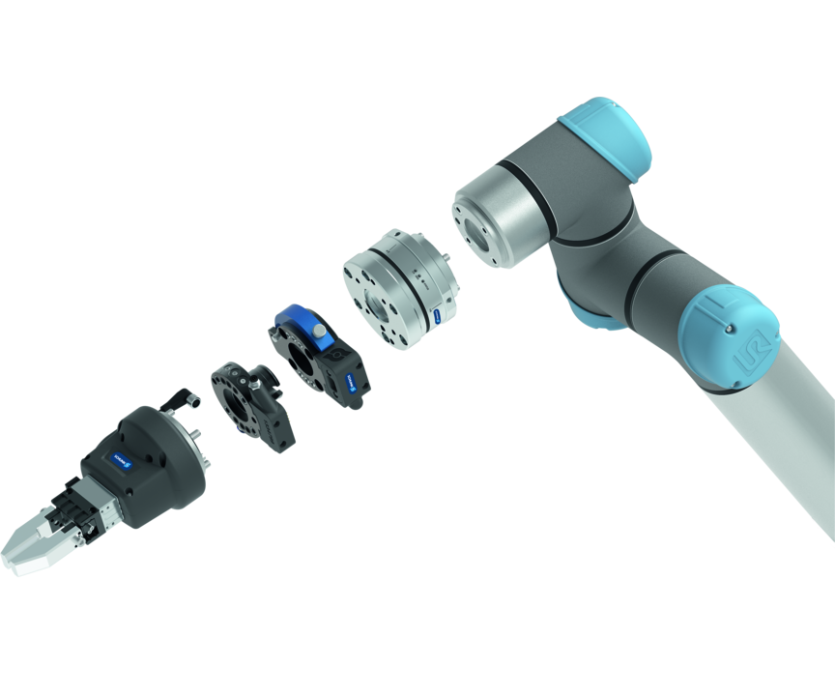
Modular System
The Plug & Work portfolio consists of electrically and pneumatically actuated grippers, quick-change modules and force/moment sensors that are specifically adapted to robot arms from Universal Robots.
The portfolio with the fastest integration into any Cobot application
Ready for operation in 10 minutes

Slide 3

Modular. Flexible. Easy.
Plug-in and customized interface for the cobots from Universal Robots
For collaborative operation or conventional automation
Sensor technology and change system for applications with high requirements on accuracy or flexibility
Different SCHUNK grippers for a variety of applications
Different components can be combined with each another

Slide 4
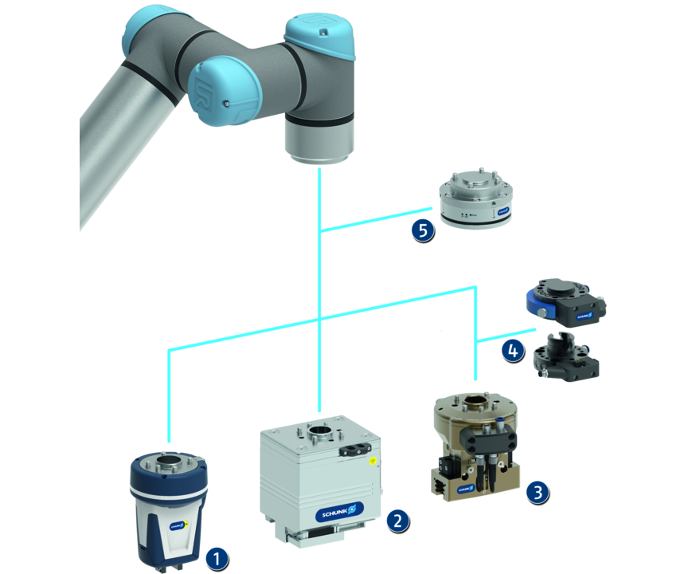
Principle of function
Functional description
All the Plug & Work components are prepared for mechanical and electrical direct connection to Universal Robots sizes 3, 5, 10, and 16. Depending on requirements, various grippers and end-of-arm components can be selected. The pneumatic gripping units are additionally equipped with micro valves meaning no external valves are required.
1
Co-act Gripper
2
Electric gripper
3
Pneumatic grippers
4
Change systems
5
Force/torque sensor

Slide 5
Advantages – Your benefits
Comprehensive portfolio consisting of various components and grippers for different applications for fast and easy entry into automation
Pre-assembled gripping unit with robot interface therefore no mounting kits or external valves required
Plug & Work with the interfaces suitable for all robots from Universal Robots
Software modules for robot control are included in the scope of delivery for fast and easy commissioning
Certified SCHUNK Co-act grippers For quick and easy entry into th world of collaborative applications
Electric grippers with a long adjustable stroke and force range for flexible workpiece handling
Pneumatic grippers For a high power density and simple integration

Slide 6
Technical data
Technical data overview
Description | Stroke per jaw | Max. gripping force | Weight | Recommended workpiece weight
 | [mm] | [N] | [kg] | [kg]
- Collaborative Gripping | 3 .. 10 | 40 .. 230 | 0.36 .. 1.38 | 0.2 .. 1.15
- Electric Gripping | 6 .. 42.5 | 140 .. 600 | 0.7 .. 2.63 | 0.7 .. 3
- Pneumatic Gripping | 6 .. 40 | 175 .. 870 | 1.2 .. 1.8 | 0.9 .. 4.35
- Sensing |  |  | 0.51
- Changing |  |  | 0.14 .. 0.35 | 11

