Slide 1

Product presentation
EMH
Magnetic gripper

Slide 2
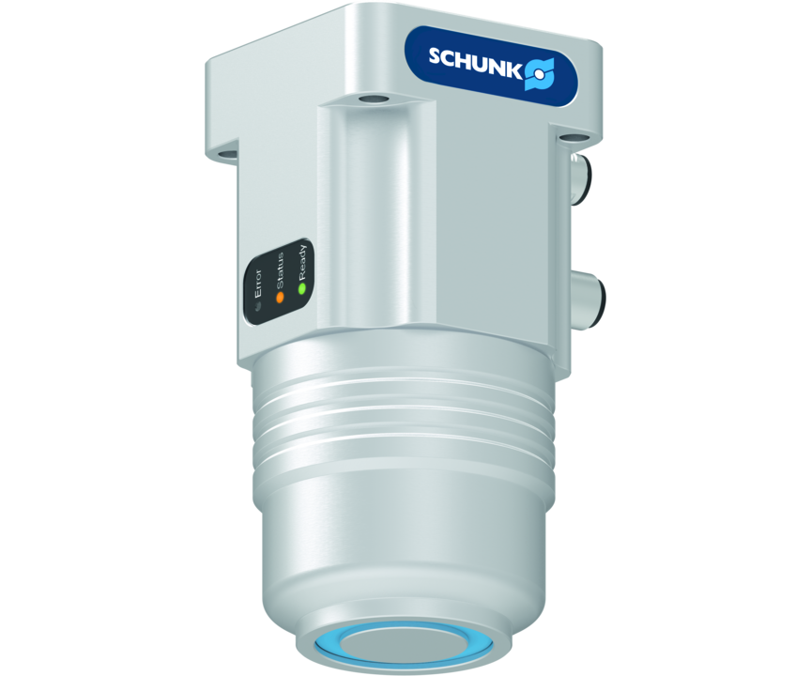
Magnetic gripper
Electro-permanent magnetic gripper for energy-efficient handling of ferromagnetic workpieces with integrated electronics and feedback function
The first compact electropermanent magnetic gripper with integrated electronics.
3:1 ratio of workpiece weight to dead weight

Slide 3

Compact. Strong. Fast.
Integrated electronics reduces the interfering contour. No external controllers required.
Response on magnetization condition and workpiece presence
Control via 24 V power supply
Short cycle time! Magnetization in just 200 ms for more gripping cycles in less time.

Slide 4
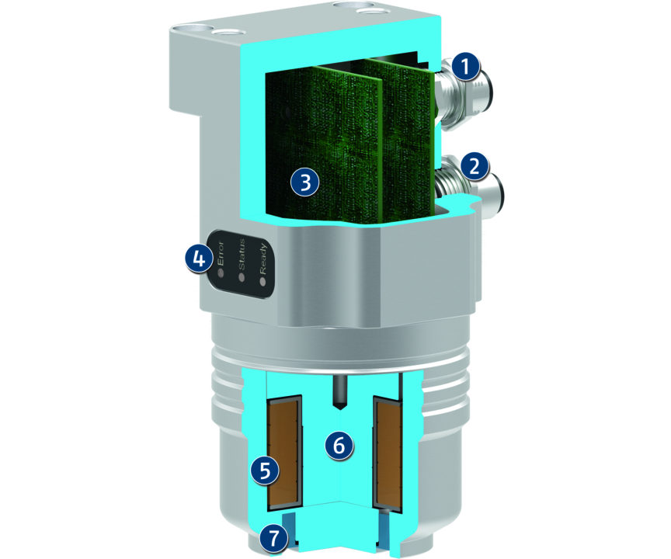
Principle of function
Functional description
The function of the magnetic gripper bases on the combination of AlNiCo and neodymium magnets. The magnetic flux of the AlNiCo magnets passes the neodymium magnet in the deactivated state, and closes the magnetic circuit over the gripper base body made of steel. To activate the system, an electric current pulse is conducted through the coil, which reverses the polarity of the AlNiCo magnets accordingly.
1
Connecting plug for PLC
2
Connection plug
3
Control electronics
4
LED display
5
Copper coil
6
Polarity reversible AlNiCo-magnet
7
Non-pole reversing neodymium permanent magnets

Slide 5
Advantages – Your benefits
High holding forces at lowest space for reliable part handling in compact machines
Integrated electronics Compact design, as no additional controller is required
Low weight for high dynamics in challenging applications
Reliable holding force maintenance to ensure process reliable operation even in scenarios with emergency stop
The gripping force can be adjusted in four stages ensures gripping of various workpieces
Control via 24 V power supply saves energy and simplifies the connection and the wiring
Workpiece accessibility from five sides free from interfering contours by unnecessary gripper fingers
Response on magnetization condition and workpiece presence saves time and simplifies the programming
NEW: Sizes EMH-MP and EMH-DP as a solution for special requirements

Slide 6
Technical data
Technical data overview
Size | Weight | Payload for horizontal magnet surface | Nominal voltage | Activation time
 | [kg] | [kg] | [V] | [ms]
DP 080 | 3 | 19 | 24 | 500
MP 060 | 2 | 14 | 24 | 200
RP 036 | 1 | 8.5 | 24 | 300
RP 045 | 1.5 | 22.5 | 24 | 300
RP 084 | 6.5 | 89 | 24 | 500
RP 114 | 8 | 175 | 24 | 700

