Slide 1

Product presentation
ERP
Universal swivel unit

Slide 2
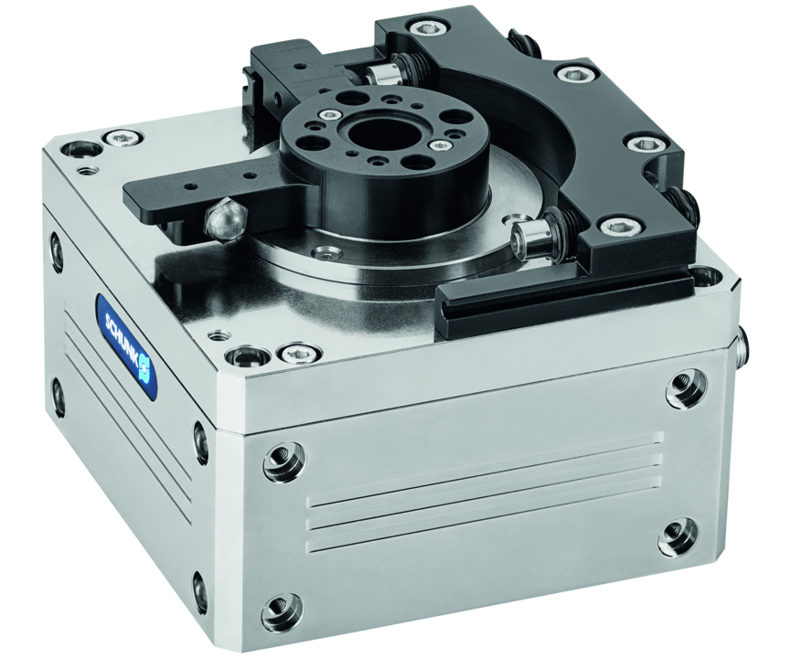
Universal swivel unit
Electrical universal swivel unit with direct drive and integrated control for angles of rotation of 45°, 90° or 180°
No other electric swivel unit on the market is as easy to adjust
Ready for takeoff in only 2 work steps!

Slide 3

Easy. Fast. Reliable.
Control via digital I/O
Revolutionary auto-learn function with storable movement profile
Speed can be adjusted in 10 stages for both rotational directions
Rotary switch optically improved
Pinion and fastening identical to the pneumatic swivel unit SRM

Slide 4
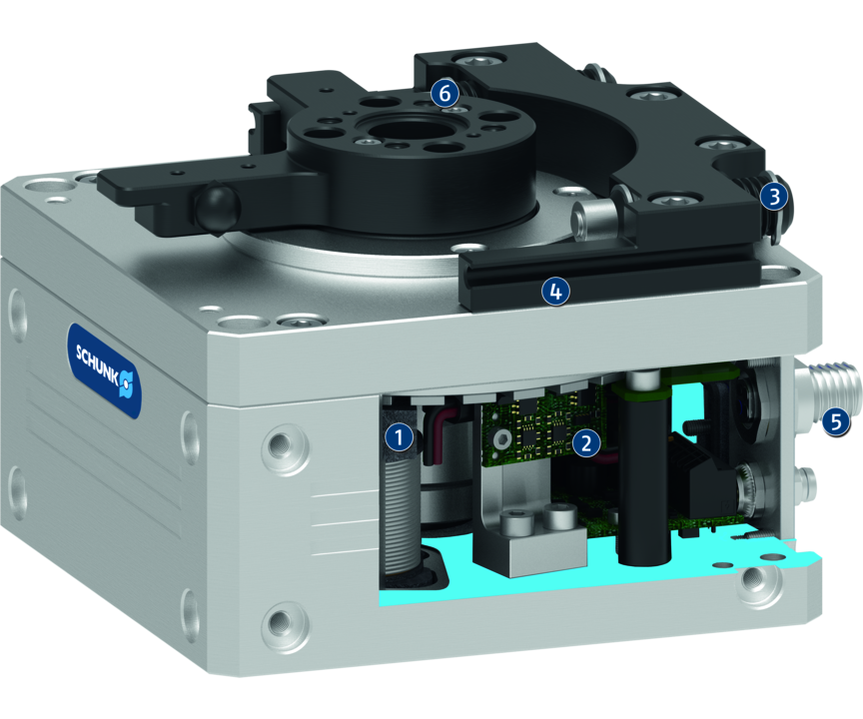
Principle of function
Functional description
The electric drive consists of a primary part (motor coil) and a secondary part (permanent magnets). Inside the controller the phase and amplitude of the applied electric current are controlled. This causes the rotary table, which is fitted with magnets, to move.
1
Drive
2
Control electronics
3
End position adjustment
4
Sensor system
5
Connection plug
6
Output flange

Slide 5
Advantages – Your benefits
Control via digital I/O for easy commissioning and rapid integration into existing systems.
Speed can be adjusted in 10 stages for both rotational directions for high flexibility in cycle times
Direct drive for almost wear-free use and a long service life
Large center bore for feed-through of cables and hoses with the same unit height
The swivel angle can be selected as either 45°, 90° or 180° complete flexibility in selecting the angle of rotation, application-specific angles possible on request
Maintenance-free for high machine uptime and low operating costs
Modular attachment to various options for individual adjustment to various cases of application

Slide 6
Technical data
Technical data overview
Size | Torque | Swivel angle | Mass moment of inertia | Weight
 | [Nm] | [°] | [kgm²] | [kg]
25 | 2 | 45 .. 180 | 0.1 | 3.95 .. 3.97

