Slide 1

Product presentation
MPC
Gripper for small components

Slide 2
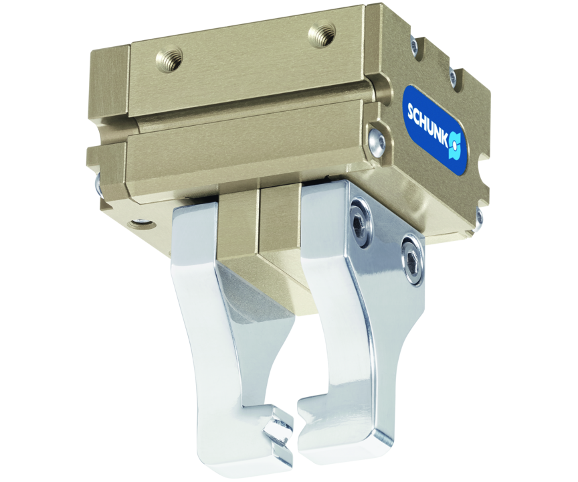
Gripper for small components
Easily built up 2-finger parallel gripper with good price-performance ratio
The most affordable SCHUNK gripper for small components for handling and assembly
6 sizes for workpiece weights of up to 1.85 kg

Slide 3

Easy. Economical. Cost-effective.
Variety of sizes
Cost-efficient basic gripper with basic functionalities
Low-cost sensor system

Slide 4
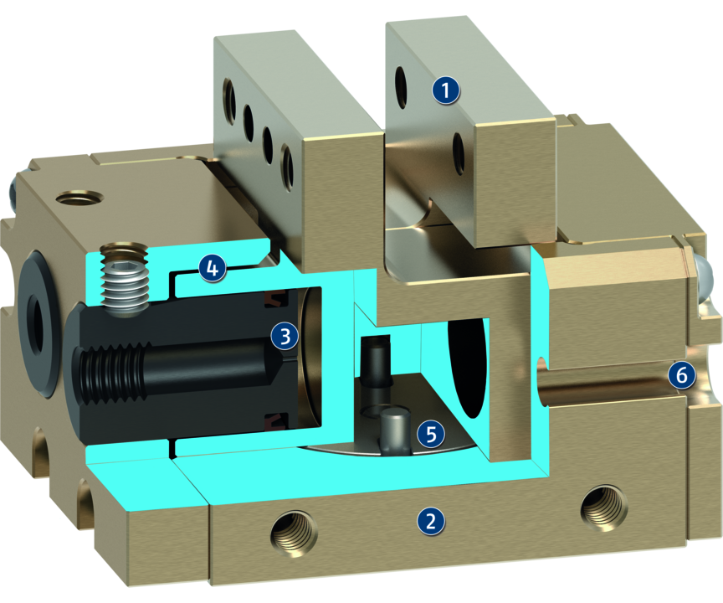
Principle of function
Functional description
The base jaws are actuated with compressed air by the fixed piston and in turn the gripper is opened or closed. The kinematics synchronizes the movement of the base jaws.
1
Base Jaw
2
Housing
3
Drive
4
Guidance
5
Kinematics
6
Sensor system

Slide 5
Advantages – Your benefits
Cost-efficient basic gripper with basic functionalities specially suitable for simple applications in small components handling
Series with six unit sizes for a broad range of applications from small to mid-sized workpieces
Technically and financially compatible sensor system for a simple, functional gripping system completely from a single source
Housing and guidance made of high-strength aluminum therefore exposed to high physical loads and is weight optimized

Slide 6
Technical data
Technical data overview
Size | Stroke per jaw | Closing force | Opening force | Recommended workpiece weight | Weight | Max. permissible finger length
 | [mm] | [N] | [N] | [kg] | [kg] | [mm]
25 | 2.5 | 16 | 16 | 0.08 | 0.05 | 30
40 | 4 | 50 | 50 | 0.25 | 0.14 | 35
75 | 7.5 | 110 | 110 | 0.55 | 0.21 | 35
100 | 10 | 170 | 170 | 0.85 | 0.34 | 40
120 | 12 | 240 | 240 | 1.2 | 0.54 | 45
150 | 15 | 370 | 370 | 1.85 | 0.94 | 60

