Slide 1

Universalgreifer PGN-plus-E
NEU: Variante mit IO-Link

Slide 2
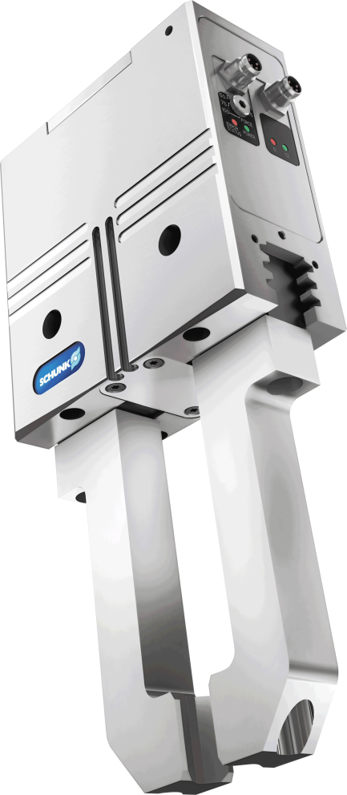

Universal gripper
Universal, electric 2-finger parallel gripper with permanent lubrication, high gripping force, and high maximum moments due to multi-tooth guidance.
The first electric gripper with most time-proven multi tooth guidance.
With permanent lubrication in the multi-tooth guidance, digital controller, and 24 V drive.

Slide 3
Reliable. Robust. Versatile.
New multi-tooth guidance
Lubrication pockets in the multi-tooth guidance
Time-proven wedge hook kinematics
Controlled via digital I/O
NEW: Version with IO
Integrated sensors

Slide 4

Your advantages and benefits
Robust multi-tooth guidance for precise handling
High maximum moments make it suitable for use with long gripper fingers
Manually adjustable gripping force by means of an integrated rotary knob allows adjustment of the gripping force in four stages to 100%, 75%, 50% and 25%.
Lubricant pockets with flat lubrication wedge throughout the entire multi-tooth guidance contour ensure high process reliability and extended maintenance intervals
Easy commissioning and fast integration in existing systems
Brushless DC servomotor for virtually wear-free use ensures a long life cycle
Control via digital I/O for easy commissioning and fast integration in existing systems
IO-Link Version for more flexibility and higher user comfort
Mounting on two gripper sides in three screw connection directions for universal and flexible mounting of the gripper
Integrated sensors and extensive sensor accessories for diverse monitoring capabilities including monitoring of the stroke position

Slide 5
Your advantages and benefits
Multi-level adjustment of the gripping force via control signals for higher user comfort and higher variety of versions
Prepositioning of the gripping fingers due to approachable intermediate positions for shorter opening and closing times
Possibility to analyze the condition of the gripper for highest process reliability

Slide 6
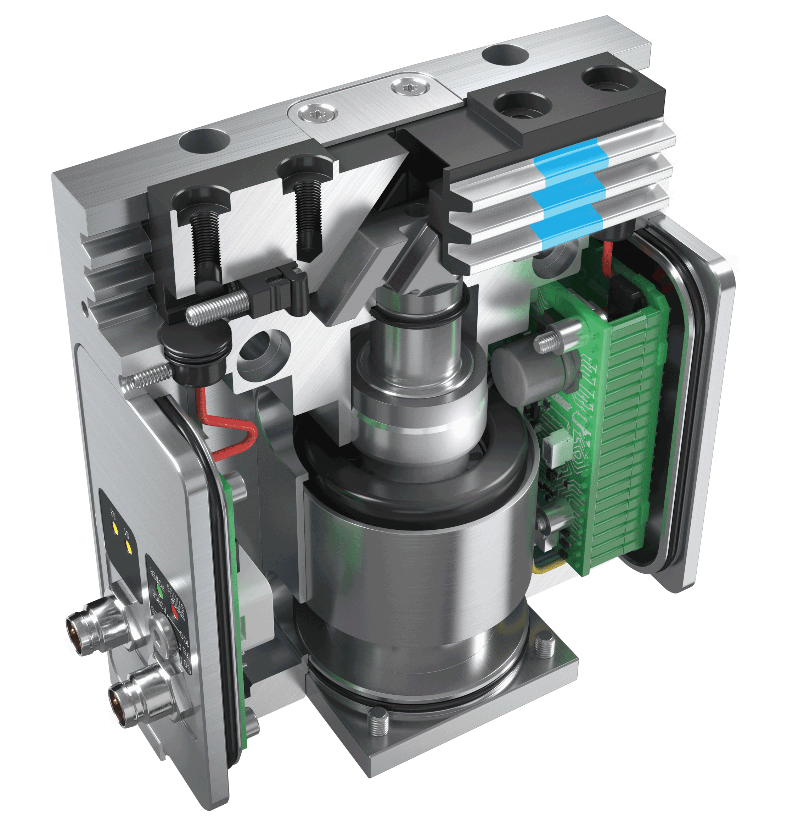
1
Multi-tooth guidance
Technical data
2
Base jaw
3
Sensor systems
4
Housing
5
Centering and mounting options
6
Wedge-hook design
Technical data
Size | 80
Weight [kg] | 1,01
Gripping force [N] | 570
Stroke per jaw [mm] | 8
Workpiece weight [kg] | 3,0
7
Control electronics
4
2
1
3
6
5
7

Slide 7
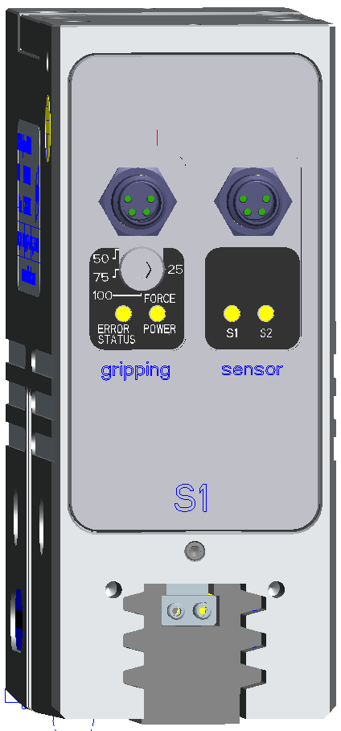
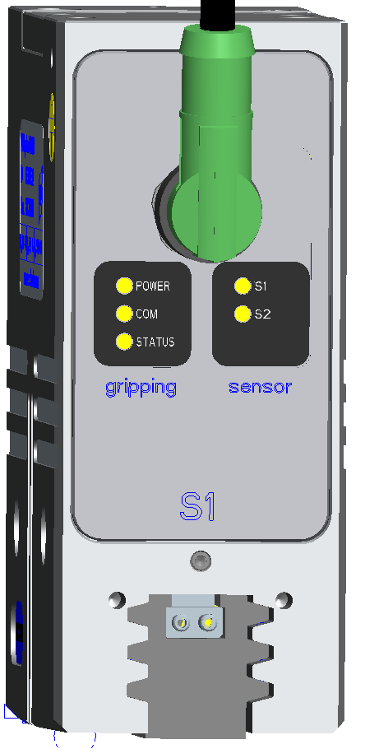
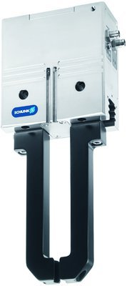
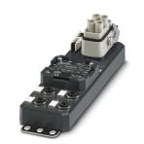
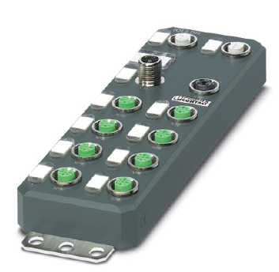
Product requirements PGN+E IO-Link
Electrical connection
Digital I/O
IO-Link
IO-Link supply concept = Plug & Play
IO-Link Port Class B
M12 (5 pole, A-coded)
Power switches
Fieldbus
IO-Link Master (IP 65/67)
2xM8
(4 pole)
1xM12
(5 pole, Class B)
Notes:
Welche IO-Link Master verwenden Sie?

Slide 8
Product requirements PGN+E IO-Link
More flexibility and control
 | PGN+E 080-1 | PGN+E 080-1-IOL
Gripping | ☑ (force manually adjustable) | ☑ (force via IO-Link adjustable)
Release | ☑ | ☑
Stop (Downtime) | ☑ | ☑
Positioning (absolute) | ☒ | ☑
Positioning (relative) | ☒ | ☑
Notes:
Was sind die wichtigste Prozessdaten zum Überwachen bzw. Messen? Position, Aufprallgeschwindigkeit, Strom (Kraft) etc. ?
Wie genau müssen die Positionsmessungen sein?

Slide 9
Product requirements PGN+E IO-Link
optimized process monitoring
 | PGN+E 080-1 | PGN+E 080-1-IOL
Position [mm] | ☒ | ☑
virtual position switch [1/0] | ☒ | ☑ 8x
inductive proximity switch [1/0] | ☑ 2x (via digital outputs) | ☑ 2x (via IO-Link)
Voltage [V DC] | ☒ | ☑
Power [A] | ☒ | ☑
Temperature [°C] | ☒ | ☑
General state of the module | ☑ (via LEDs) | ☑ (via IO-Link)
Notes:
Was sind die wichtigste Prozessdaten zum Überwachen bzw. Messen? Position, Aufprallgeschwindigkeit, Strom (Kraft) etc. ?
Wie genau müssen die Positionsmessungen sein?

