Slide 1
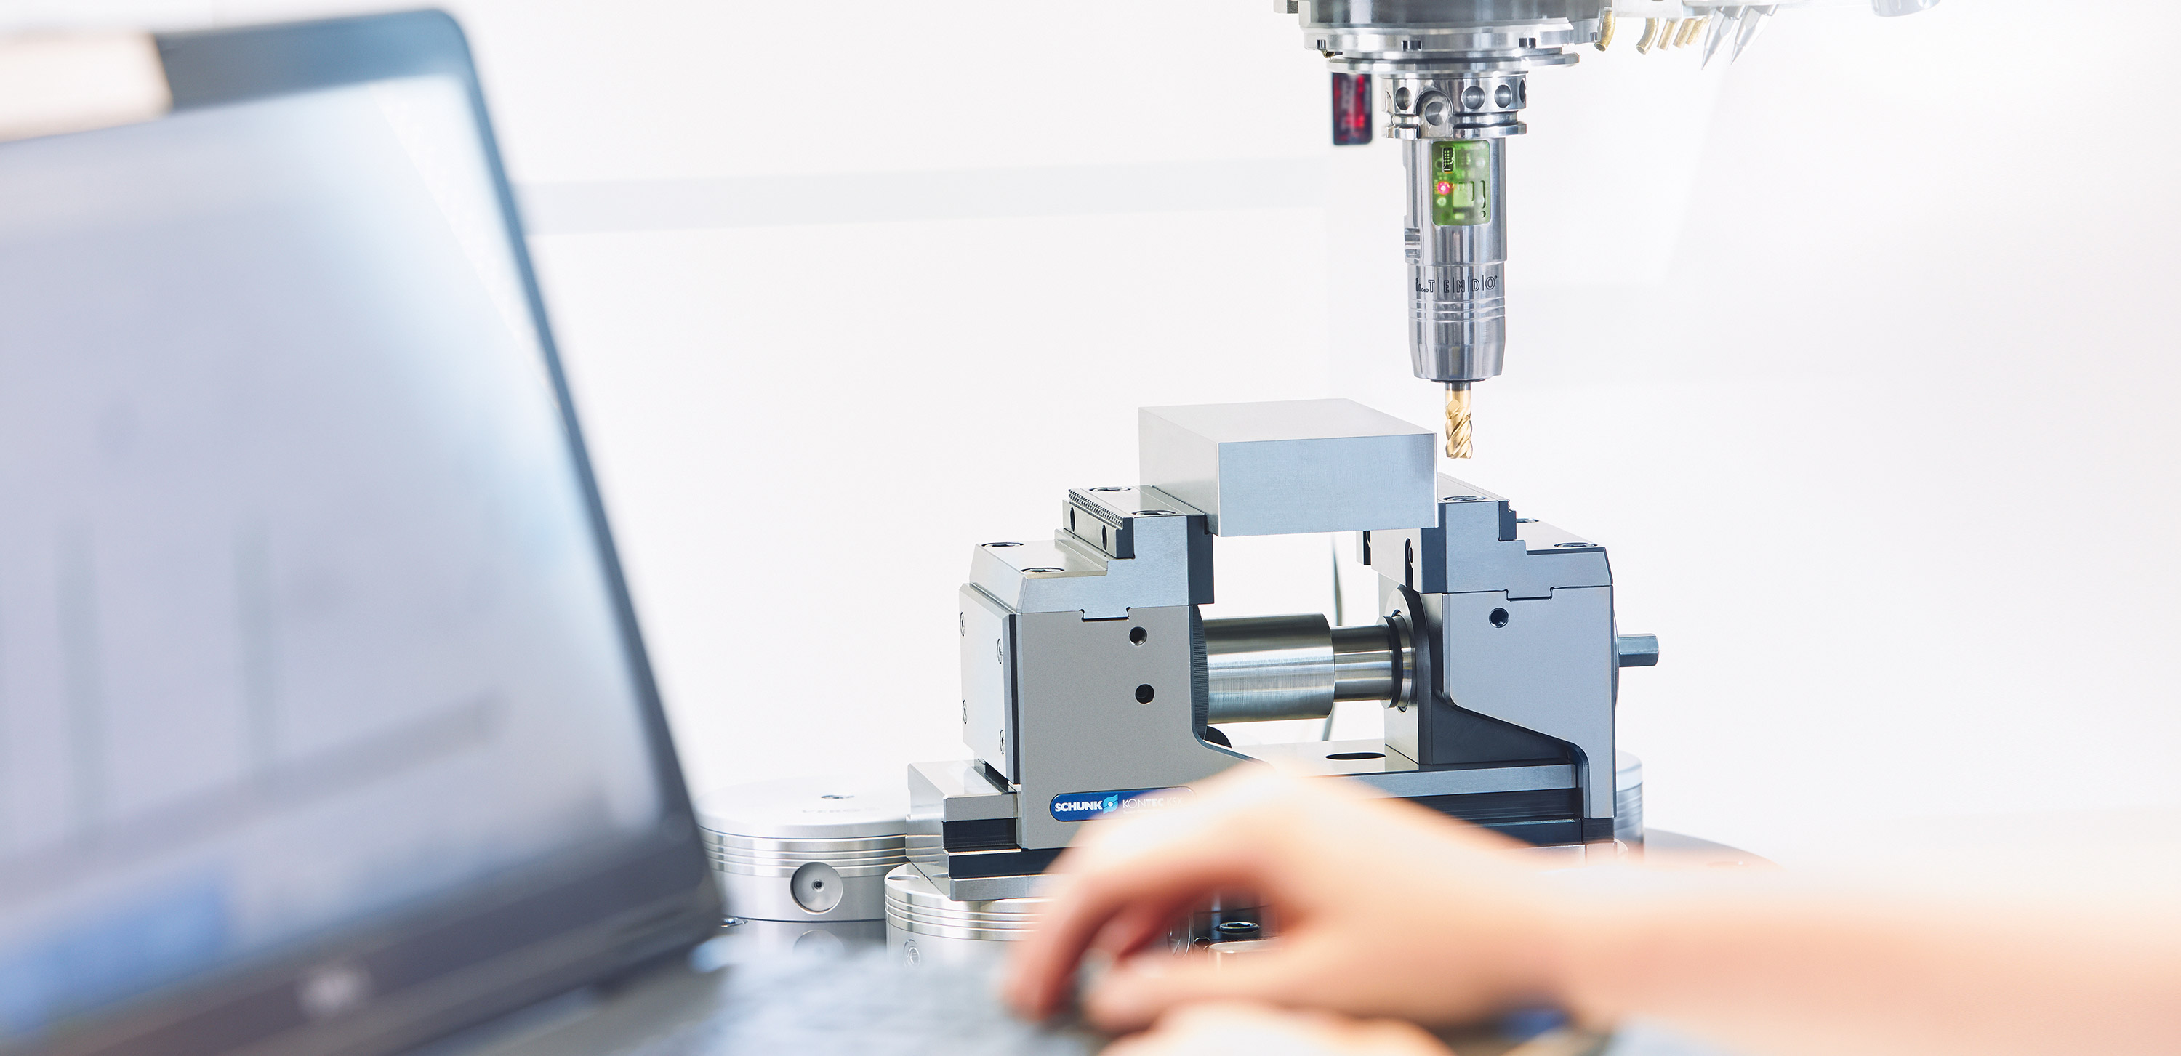
Chuck jaw program

Slide 2
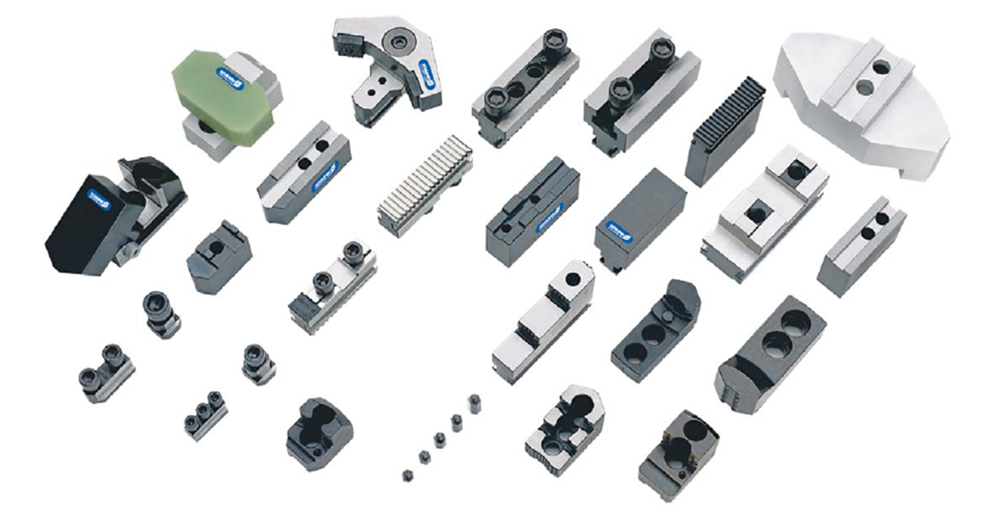
Chuck jaws from SCHUNK

Slide 3
Chuck jaws from SCHUNK
Convincing in standard – as well as special designs
More than 1,200 different types
The world´s largest standard chuck jaw program
Since 1966 SCHUNK has sold more than 16 Mio. standard-chuck jaws which are in use worlwide
Appr. 60.000 individual solutions copmlete the performance portfolio
SCHUNK is chuck jaw-partner for SCHUNK-chucks or chucks from other providers
Base, intermediate and top jaws from one source
SCHUNK offers you the solution for your clamping tasks:
dynamic - precise – reliable
Know-how out of 60 years chuck jaw-competence

Slide 4
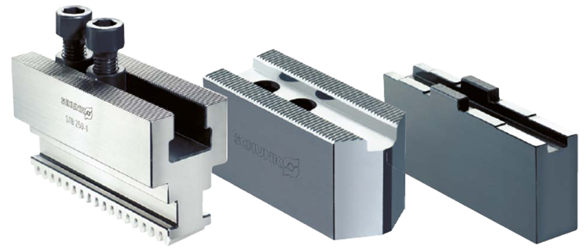
Chuck jaws from SCHUNK
Standard in quality, technology and product variety
Grinding the slot and fine serration of hard chuck jaws and top jaws
We achieve an improved repeat accuracy
The base jaws are subject to less wear and last much longer
Soft top jaws are milled evenly in height at the supporting face, in on set-up within 0.02 mm
Fine milled tongue and groove
Base jaw with fine serration
Ground serration

Slide 5
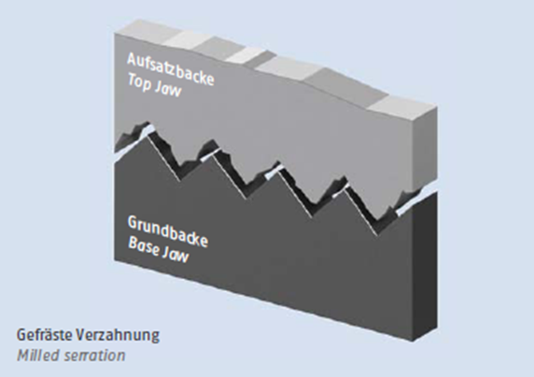
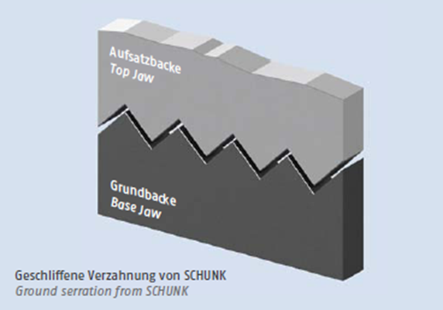
Standard in quality, technology und product variety
  A ground serration is more precise and has a more exact fit than a milled serration

Slide 6
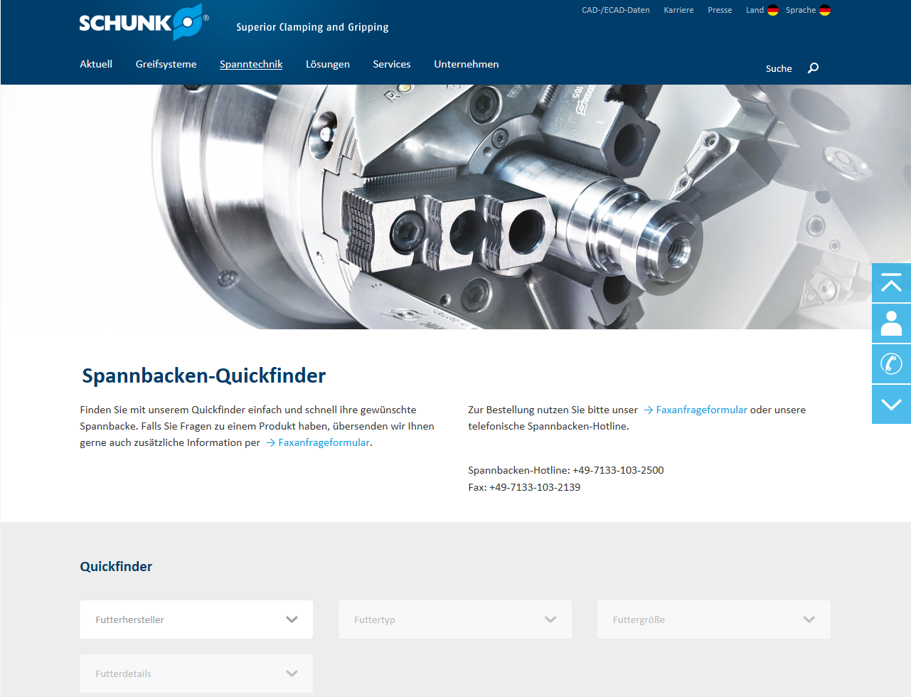

SCHUNK Chuck Jaw Quick Finder on the Internet
More than 1.200 different chuck jaw types
All products of the common lathe chucks manufactors including accessories
Prescribe selection menus facilitate the search
Suitable chuck jaws with the associated accessory products are presented
An online form enables a clear enquiry
Quotations for standard chuck jaws are guaranteed within 55 minutes after receipt of the enquiry on all workdays between 7 a.m. and 5 p.m.
Information retrieval and requests are possible online 24 hours a day
https://schunk.com/de_en/clamping-technology/quickfinder/#//

Slide 7


The SCHUNK chuck jaw app for smart devices
Any time available via mobile phone or tablet pc
Complete SCHUNK clamping jaw range always at hand and quickly ordered
Faster through guided product search
Find the right jaw faster
A faster standard chuck jaw quotation
Downloads at iTunes or Android

Slide 8
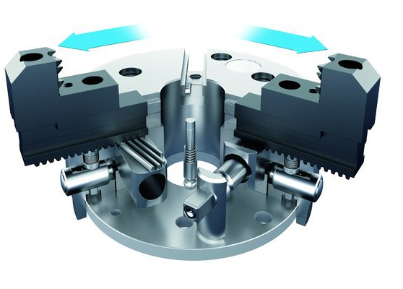
SCHUNK Claw Jaws
  Covers a 50% larger
  clamping range now
  The combination possibilties of base, intermediate and top jaws expand the application range of standard components by up to 50%

Slide 9
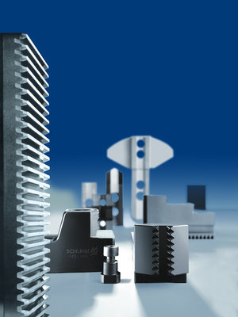
Flexibility from the modular system
  Favorable in price, variable applications
  Other suppliers can only offer cost-intensive special solutions for covering a large clamping range
  SCHUNK achieves a maximum possible clamping range with just one claw jaw
  Clamping ranges can be achieved immediately and affordably with a minimal investment in chuck jaw sets
  Time-consuming conversion of chuck jaws is cancelled
  New clamping range can be easy and direct produced in the machine
  Specifiy the rotary chuck data plus the various workpiece geometries
  SCHUNK provides the modular chuck jaw solution

Slide 10
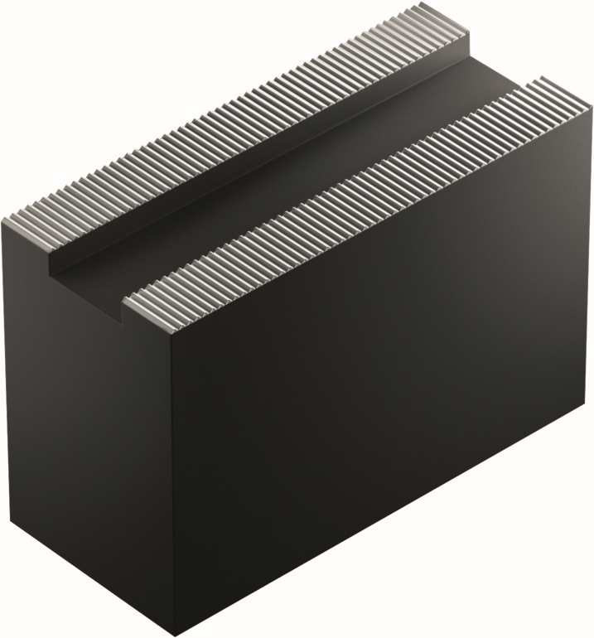
Jaw Blanks
  For universal use according to custom measurements
  Drillied or undrilled
  With a ground slot and serration for the highest demands on precision and concentrity

Slide 11
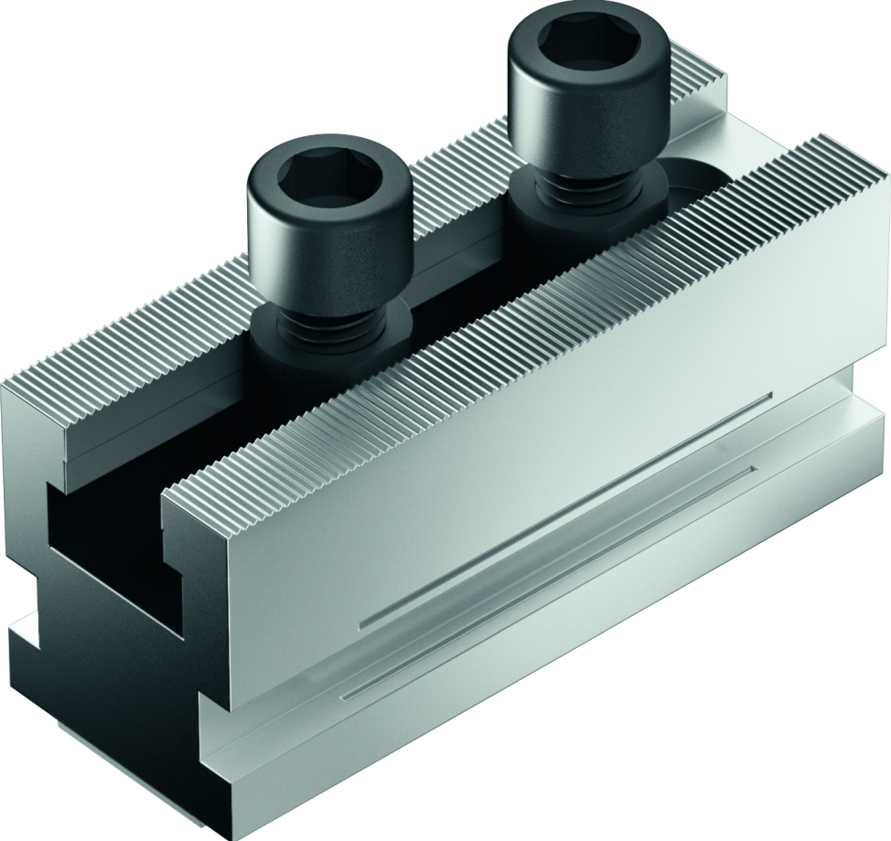
Base Jaws
  For the use of fine serrated top jaws
  Hardened, precision ground base jaws for maximum repeat accuracy and perfectly adapted power transfer
  Absolute precision guarantees the precise connection and prevents the top jaw from tilting during use
  Results: optimum connection, no distorion by full area, powerful clamping, reduction of turning effort from top jaws, increasing service lives

Slide 12
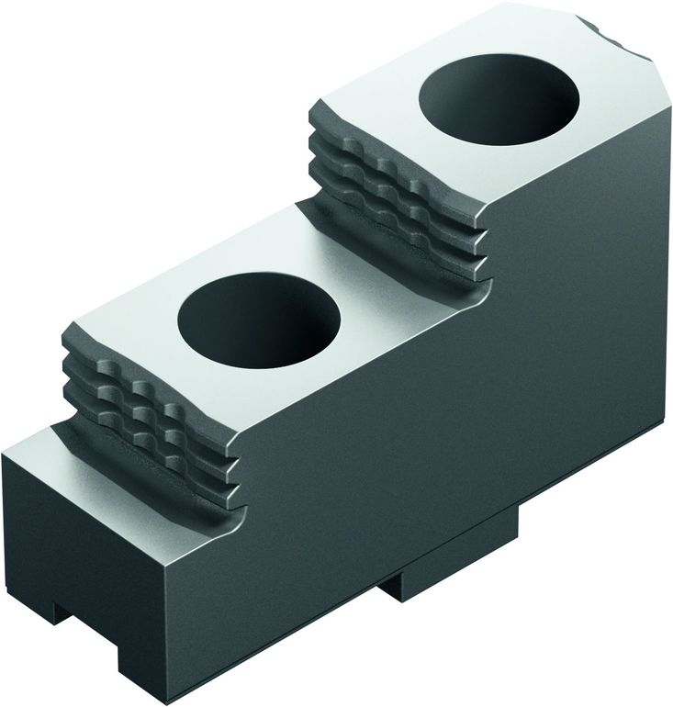
Hard Stepped Top Jaws
  Universal application for O.D., I.D. and bar clamping
  Gentle clamping through
  diamond serration, in which the clamp teeth only slightly ‚bite‘ into the workpiece

Slide 13
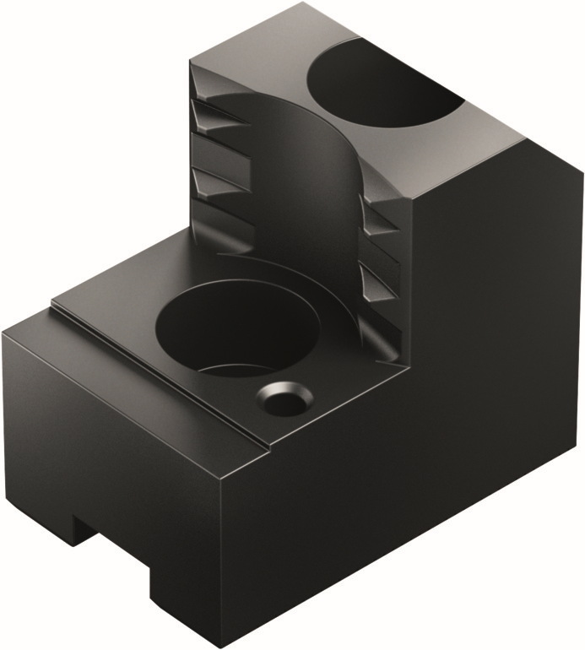
Claw Jaws
  Provide the right bite for secure and low-wear tool clamping
  Fine serrations quickly dig into the workpiece surface and secure clamping reducted to just one work process
  High flexibility of the clamping areas leads to considerably lower investment costs
  Vast product range for I.D. and O.D. clamping
  From chuck diameter 200 mm SCHUNK offers for outer clamping, claw jaws with a third tooth row

Slide 14
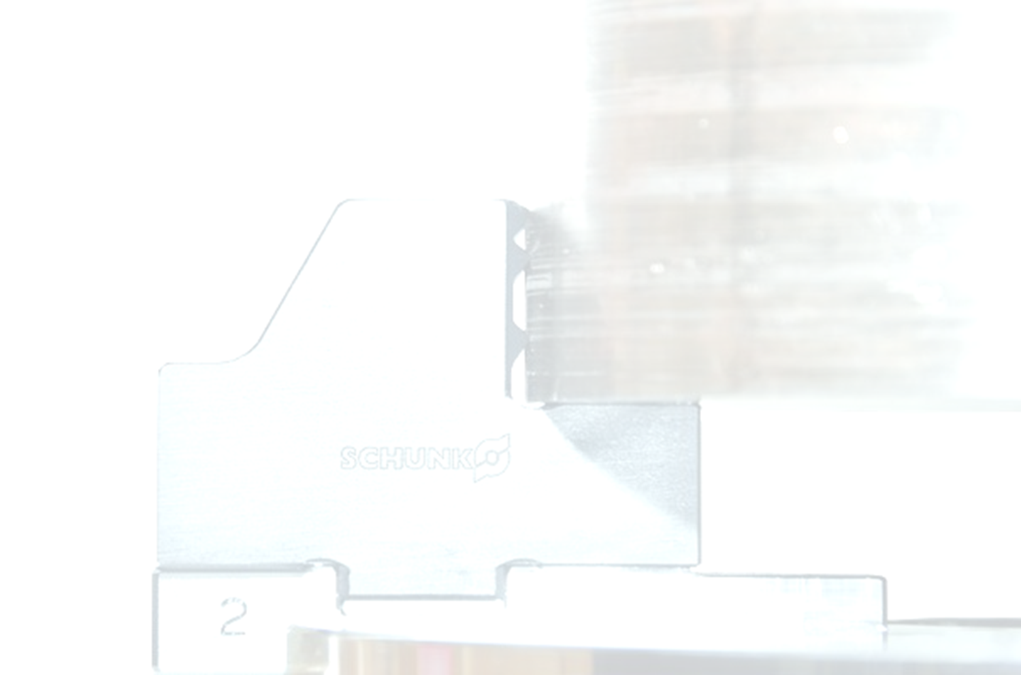
Claw Jaws
  More bite in the workpiece surface through enhanced tooth contour
  Optimized tooth shape with an additional thrid tooth row ensures higher cutting data (feed rate, clamping depth, etc.) at an „on-the-fly machining.“
  Compared to common clamping with hard jaws: form-fit hold of the workpiece at a higher cutting performance and optimum clamping force
  By the use of lower weight reduced centrifugal force: further increase of cutting speed possible
  Case hardened claw jaws are subject to less wear and reduce investment expenditure

Slide 15
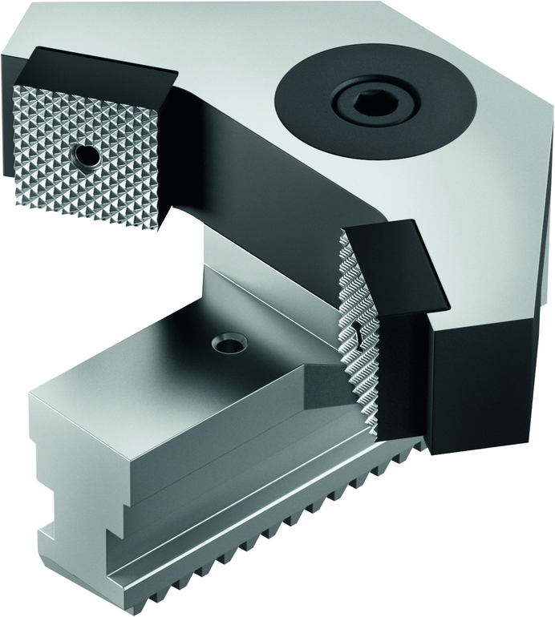
Pendulum Jaws
  Standardized pendulum jaws from SCHUNK enable affordable and secure clamping of thin- walled workpieces which are at risk of deformation
  The flexibilitiy of the jaws is only matched by the efficiency of the solutions
  Conventional three-jaw chucks can be affordably converted to six-point clamping
  Special constructions with pendulum jaws offer many possibilities to master extraordinary clamping tasks confident

Slide 16
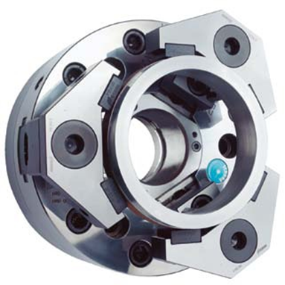
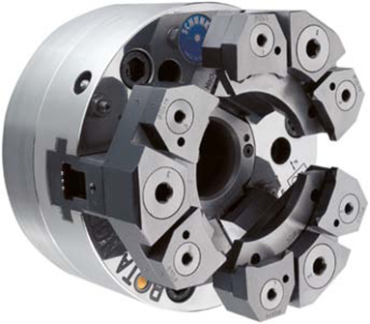
Pendulum Jaws
6-Point-Pendulum
  Pendulum jaws are used to clamp thin-walled workpiece
  Deformation of the workpiece is significantly reducedd by the uniform arrangement of the clamping points on the perimeter (6 x 60°)
12-Point-Pendulum
  For workpieces with even thinner walls
  Technical consultants use clculation programs to determin whether a 6-point or a 12-point pendulum jaw should be used

Slide 17
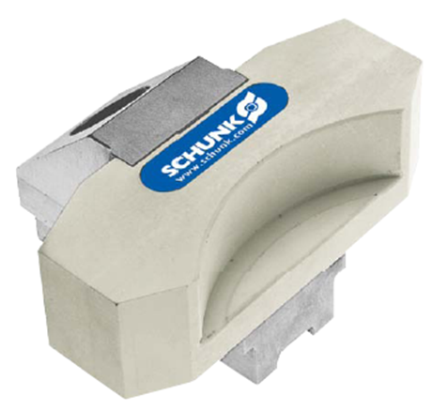
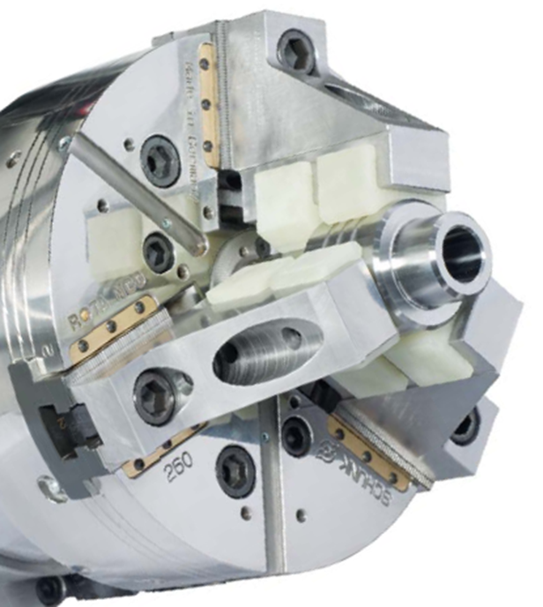
QUENTES Fiberglass Jaws
  Powerful hold with minimal impact on the surface
  The fiberglass comosite material enables a high friction coefficient and prevents the formation of clamp marks on th eworkpiece surface
  No trace of the clamping is left behind

Slide 18
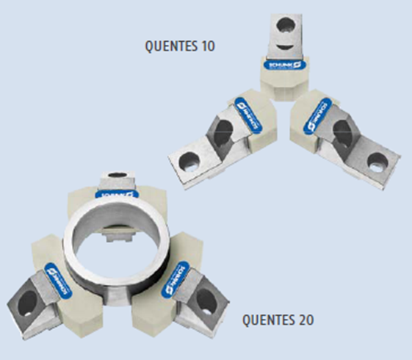
QUENTES Fiberglass Jaws
  High coefficient of friciton due to the use of glass fiber reinforced Poly-A (appr. 0.3 to 0.4)
  Perfectly suitable for ground or surface treated parts
  Cost effective due to the interchangeable clamping insert
  High stability through aluminium suppurting jaws
  Light weight and stable design for very high RPM
  Large bearing surface for low-deformation clamping

Slide 19
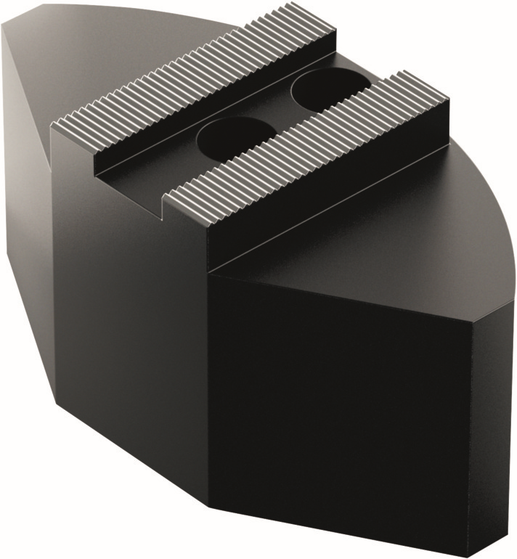
Soft Full Grip Jaws
  Reduced deformation of your workpiece due to force transmission over a large clamping surface
  Reduced centrifugal forces in the weight-reduced aluminium version

Slide 20
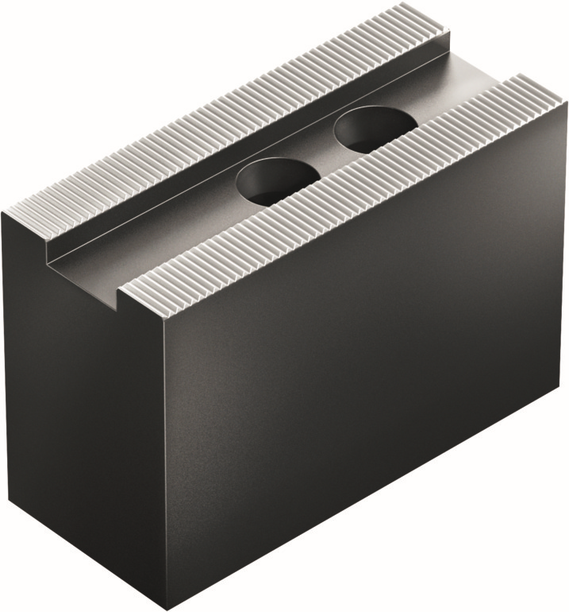
Soft Top Jaws
  Universally applicable for all common manufacturers and types of lathe chucks
  They can be flexibly turned to the desired clamping diameter
  Made of blanks or standard jaws, thereby cost-effective and available at short notice
  Above average service life due to high quality standards in materials and processing

Slide 21
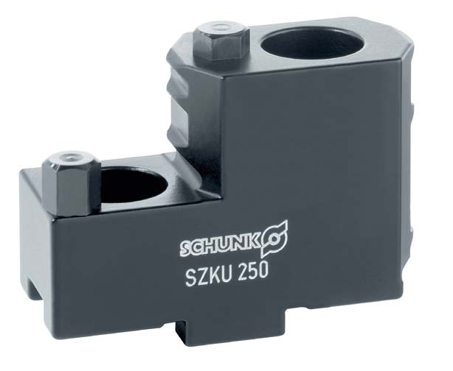
Universal Top Jaws
  With metric tongue
  For all wedge bar power chucks(quick jaw change)
  For inner, outer and bar stock clamping, very large clamping range and many more
  Reduces set-uo time and set-up costs and offers economical production

Slide 22
Universal-Top Jaws
Reduction of the set-up costs
Universal-Top Jaws with metric tongue and groove can be used on all wedge bar lathe chucks (for example quick jaw change chucks ROTA THW plus)
The versatility of the jaws reduces set-up times and therfore also set-up costs, particulary with small and varying lot sizes
Flexibility
Workpieces can be clamped on the internal and external diameter using a set of universal top jaws
Can also be used for bar work
The use of universal top jaws means that up to 5 different application possibilities can be achieved with one set

Slide 23
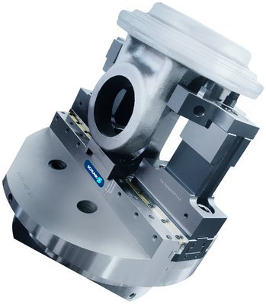
Speciality Chuck Jaws
Perfectly adjusted to the workpiece and machining operation
Individual clamping concepts for perfect finish
Customized solution - For an optimum clamping solution
Complicated clamping problems over 60.000 times solved
As secure as necessary, as gentle as possible

Slide 24
Speciality Chuck Jaws
Complete undamaged workpiece surface, highest run-out and repeat accuracy, as well optimum cutting results
Higher clamping forces due to form fit from raw parts and chuck jaws, to achieve faster and secure clamping from blanks
Clamping solutions from SCHUNK are comprehensive, compared with low-priced implementations ranging from plastic jaws up to the complex special pendulum jaws
No matter if modified standard chuck jaws, special manufacturing for deformation-free clamping, finsihed part or raw parts clamping is concerned – our team of experts develops the right solution for every application

