Slide 1

Product presentation
Co-act EGP-C
Collaborating gripper for small components

Slide 2
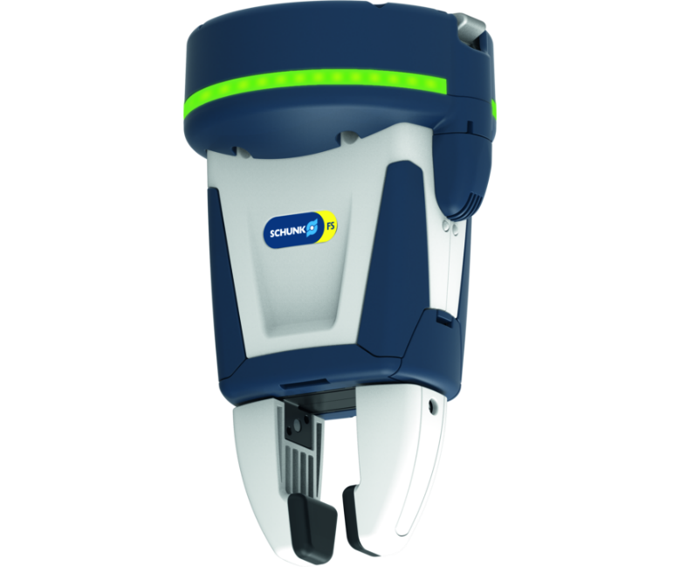
Collaborating gripper for small components
Electric 2-finger parallel gripper certified for collaborative operation with actuation via 24 V and digital I/O
The world's first certified industrial gripper for collaborative operation.
Certified in accordance with ISO/TS 15066.

Slide 3

Collaborative. Powerful. Certified.
Plug & Work! Pre-assembled gripping unit with robot interface for quick and easy assembly. Directly compatible with cobots from Universal Robots, KUKA, FANUC, Techman Robot, OMRON, Doosan Robotics, Mitsubishi and ABB.
Integrated status display
DGUV certified for collaborative operation
Attachment fingers as accessories

Slide 4
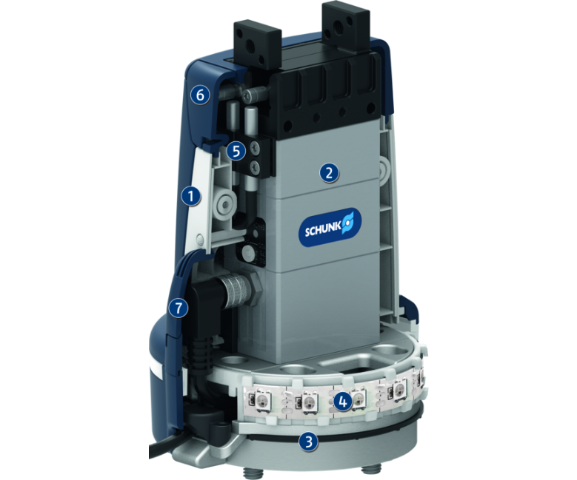
Principle of function
Functional description
The Co-act EGP-C gripper is electrically driven and has an integrated current limitation and collision protective cover. The current limitation ensures that the gripping force does not exceed a defined value. The collision protective cover serves for minimizing the risk of injury during the use in collaborative operations.
1
Collision protection
2
Gripper for small components EGP
3
Flange
4
LED strip light
5
Integrated sensor system
6
Service flap sensor system
7
Service flap gripping force

Slide 5
Advantages – Your benefits
Certified gripping unit saves effort for safety assessment of the application
Plug & Work for a variety of different cobots
Control via digital I/O for easy commissioning and rapid integration into existing systems.
Functional safety ensured due to inherent safety with current limitation
Pre-assembled gripping unit with robot interface for a easy and fast integration
Integrated status display For a visual indicator of the application state
Service flaps in the collision protection cover fitted to adjust the gripping force and the sensor system
Brushless DC servomotor for almost wear-free use and a long service life
Attachment fingers available with three different inserts

Slide 6
Technical data
Technical data overview
Size | Stroke per jaw | Min. gripping force | Max. gripping force | Recommended workpiece weight | Max. permissible finger length | Weight
 | [mm] | [N] | [N] | [kg] | [mm] | [kg]
40 | 6 | 35 | 140 | 0.7 | 50 | 0.59 .. 0.89
64 | 10 | 65 | 230 | 1.15 | 80 | 1.11 .. 1.38

