Slide 1
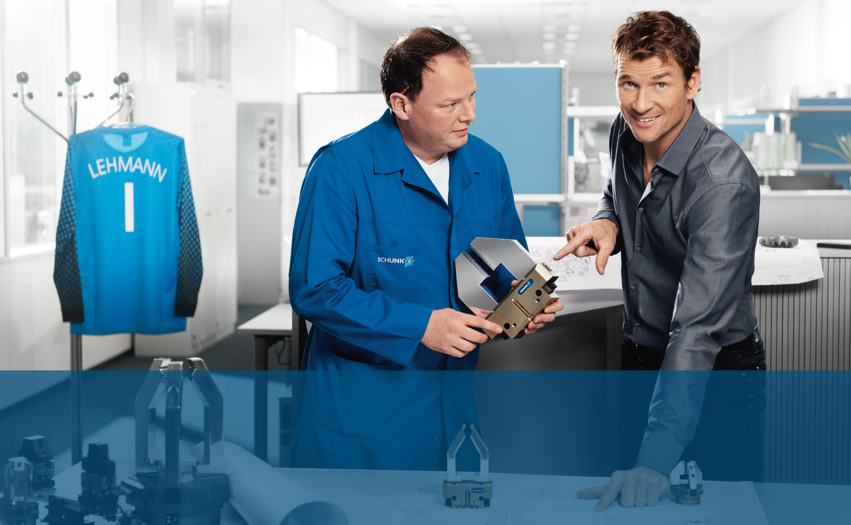
Human-Robot Collaboration
Internal training presentation
Product Management Gripping Systems
Contact person:
A. Jung / B. Janßen

Slide 2

Human-Robot Collaboration
Internal training presentation
Contents
1 | General Information on HRC
1.1 | Definition of Terms
1.2 | Motivation
1.3 | Possibilities for Classification
1.4 | Normative Environment and necessary Steps
2 | HRC from the Perspective of a Gripper Manufacturer
3 | Contact Person and Summary

Slide 3

Human-Robot Collaboration
Definition of Terms
Source: SCHUNK GmbH & Co. KG
What is HRC?
Abbreviation for the term “Human-Robot Collaboration”
Explanation:
Refers to the interaction between an operator [human] and a robot without guards.
Regardless of the kind of collaboration, protecting humans is always the primary focus. In order to ensure safety at all times, collaboration is partially regulated by standards and certifications.
However, some points often remain unclear, leading to uncertainty in the market.

Slide 4
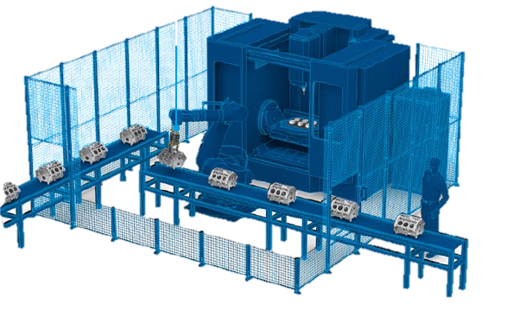
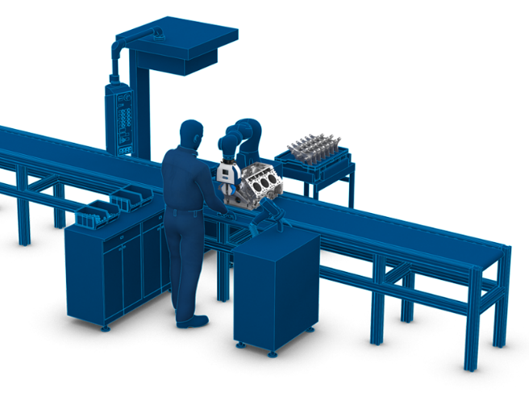
From full Automation to Human-
Robot-Collaboration
Definition
Interaction between an operator [human] and a robot without guards in a shared working space
Advantages
Ergonomic benefit for employees
Flexibility of work processes
Increased efficiency in robot applications
Retrofitting and more flexible logistics, loading, assembly and handling
Image Sources: SCHUNK GmbH & Co. KG
Notes:
Typisch für Vollautomatisierung:
Geringe Teilevarianz
Hohe Stückzahlen
Zusätzlich zu MRK
Platzsparend, daher gerne in bestehende Anlagen eingesetzt

Slide 5
Human-Robot Collaboration
Internal training presentation
Contents
1 | General Information on HRC
1.1 | Definition of Terms
1.2 | Motivation
1.3 | Possibilities for Classification
1.4 | Normative Environment and necessary Steps
2 | HRC from the Perspective of a Gripper Manufacturer
3 | Contact Person and Summary

Slide 6
Jobs that make sense for using direct interaction between humans and machines
Jobs with quality issues
Activities with a high demand for reproducibility, e.g. bonding processes
Activities/jobs with an incidence of errors (e.g. forgotten parts)
Activities requiring documentation (e.g. screwed connections)
Jobs with ergonomic issues
Component weights (4 kg to 12 kg) to be moved at a height or a high total load in one shift
Example: 500 g per minute is 240 kg per shift
Application of joining forces, especially with small surfaces
Working in ergonomically awkward positions (for example, activities performed over the head, bending over far, stooped postures)

Slide 7
Jobs that make sense for direct interaction between humans and machines
Workplaces with an operator capacity of more than 100%
Through automation, plant utilization can be reduced to less than 100%, or the operator can operate several machines
But be careful!
Human-robot collaboration is currently a trending topic, a variety of applications are being referred to as “HRC applications”.
These applications are often easier to realize using existing standard methods.
The topic of cycle time in particular does not apply well in the field of HRC.
→ An open review of “HRC Applications” including all advantages and disadvantages!

Slide 8
Human-Robot Collaboration
Internal training presentation
Contents
1 | General Information on HRC
1.1 | Definition of Terms
1.2 | Motivation
1.3 | Possibilities for Classification
1.4 | Normative Environment and necessary Steps
2 | HRC from the Perspective of a Gripper Manufacturer
3 | Contact Person and Summary

Slide 9

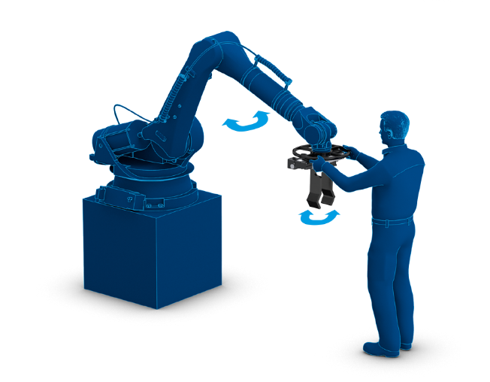
Normative classification of human-robot collaboration
Method 1 – Safe Hold
The robot system works at normal speed, provided that there is free access in the machining area. When a human enters the area this is monitored i.e. by a laser scaner, and the robot system enters into a safety-monitored stop.
Method 2 – Hand Guiding
The robot system is guided by a human.
In order to do so, the system must be able to detect the force of the human e.g. using a force/torque sensor. The robot system only moves when this movement is enabled by the human using a safety switch. Otherwise the robot system is in a safety-monitored stop.
Source: ISO/TS 15066:2016

Slide 10

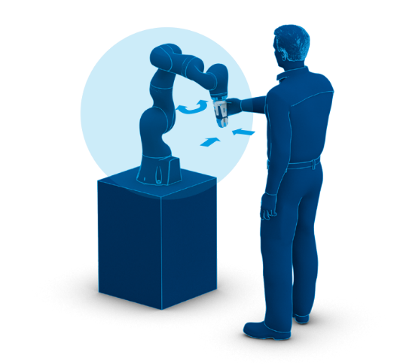
Normative classification of human-robot collaboration
Method 3 – Speed and
Separation Monitoring
The machining area of the robot system is divided up into successive zones. If the entry of a human into one of the first zones is detected for instance by a laser scanner, the robot system goes into a lower speed. When the zone directly next to the robot is entered, the robot system goes into a safety-monitored stop.
Source: ISO/TS 15066:2016
Method 4 – Power and
Force Limiting
The robot system works with limited force and power when collaborating directly with humans. The maximum forces and pressures applied to humans may not exceed the values specified in the technical specifications. This is ensured by an inherently safe design or safety functions.

Slide 11
Classification in the collaboration between human and robot
Coexistence
Synchronized
Cooperation
Collaboration
Duration of the Exposure*
1
Avoiding contact
2
Source: Fraunhofer IAO, 2016
low
high
high
low
* Def. Duration of the Exposure: Length of time that the human is exposed to a hazard.

Slide 12
Human-Robot Collaboration
Internal training presentation
Contents
1 | General Information on HRC
1.1 | Definition of Terms
1.2 | Motivation
1.3 | Possibilities for Classification
1.4 | Normative Environment and necessary Steps
2 | HRC from the Perspective of a Gripper Manufacturer
3 | Contact Person and Summary

Slide 13
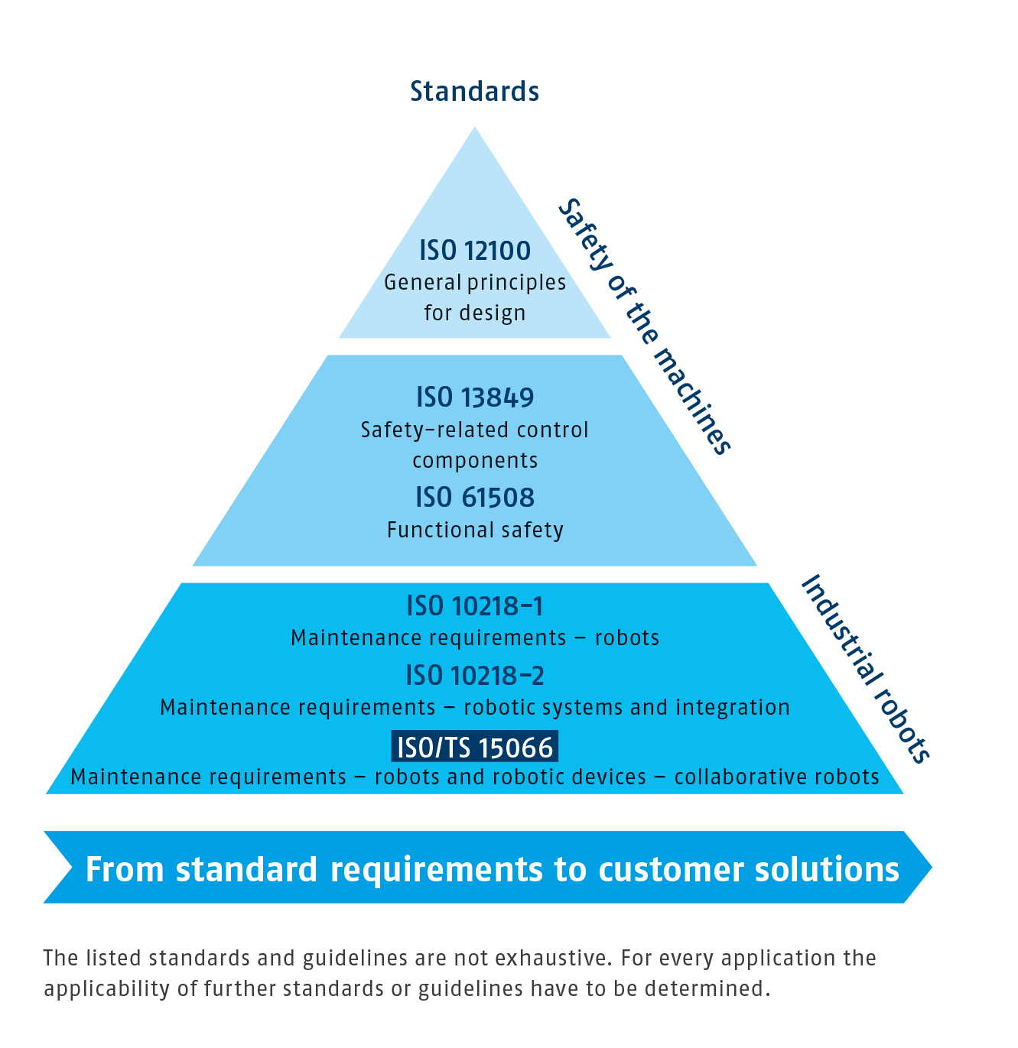
Standards and guidelines
In the context of human-robot collaboration
Source: SCHUNK GmbH & Co. KG
Notes:
Normenpyramid

Slide 14
Recommendation for the implementation of HRC
True to the motto “step-by-step”
Human-Robot Collaboration (HRC) is far more than merely the acquisition and installation of a safe robot:
Step 1: Safety assessment of all the requirements, starting with the robot and the gripper/tool and the workpiece!
Step 2: Clarifying the legal framework for work safety.
Step 3: Introduction of new robot and gripper generation, an innovative project not to be underestimated!
    Humans set the pace!
    Use HRC thoughtfully and with care.
    Take a holistic approach, acting within standards.

Slide 15
Conducting a risk assessment
Specific to applications in the HRC environment
Consideration/determination of risk factors (risk analysis)
Identification of hazards
Elaboration of a comprehensive safety concept (for example, safe work rooms etc.)
Parameterization of the safety functions
Programming the safety features
Validate and document all safety functions
Verification of adherence to the biomechanical limit values set forth in ISO/TS 15066
Completion of risk assessment and documentation
NOTE: The acting company (mechanical engineer or authorized representative) is responsible for these points.

Slide 16
Human-Robot Collaboration
Internal training presentation
Contents
1 | General Information on HRC
2 | HRC from the Perspective of a Gripper Manufacturer
2.1 | Requirements for the Gripper / Gripper manufacturer
2.2 | Selecting the appropriate Gripper
3 | Contact Person and Summary

Slide 17



Gripper safety principles for collaborative applications
Derivation of the requirements from the standards:
Gripper never loses a workpiece
  Gripping force retention even in the case of energy loss or an emergency stop
Gripper always detects human contact
  Covering the gripper and gripper fingers, e.g. with capacitive sensors
  Recognition of the workpiece using prior programming
Gripper never cause injuries when gripping
  Limitation of the gripping force in the collaborative operation to uncritical value
Source: SCHUNK GmbH & Co. KG
  NOTE: A gripper for collaborative applications should have these safety functions implemented, but it is not a must.
Notes:
MUSS/KANN Optionen
Erklärung an

Slide 18

Supported by SCHUNK
HRC application with gripper application
Selection of the right gripper for the application
Co-act team for the design of the appropriate gripper for your application
Operating instructions with comprehensive information
SAC (Safety Application Conditions) → Notes on the risk assessment, implementation of the gripper and part of the overall documentation
Support from SCHUNK Service
Support for the implementation of the product in the robot control and commissioning of the product
Assistance with general application advice or with product acceptance/ safety verification is carried out by service providers.
Image Source: SCHUNK GmbH & Co. KG

Slide 19
Human-Robot Collaboration
Internal training presentation
Contents
1 | General Information on HRC
2 | HRC from the Perspective of a Gripper Manufacturer
2.1 | Requirements for the Gripper / Gripper Manufacturer
2.2 | Selecting the appropriate Gripper
3 | Contact Person and Summary

Slide 20
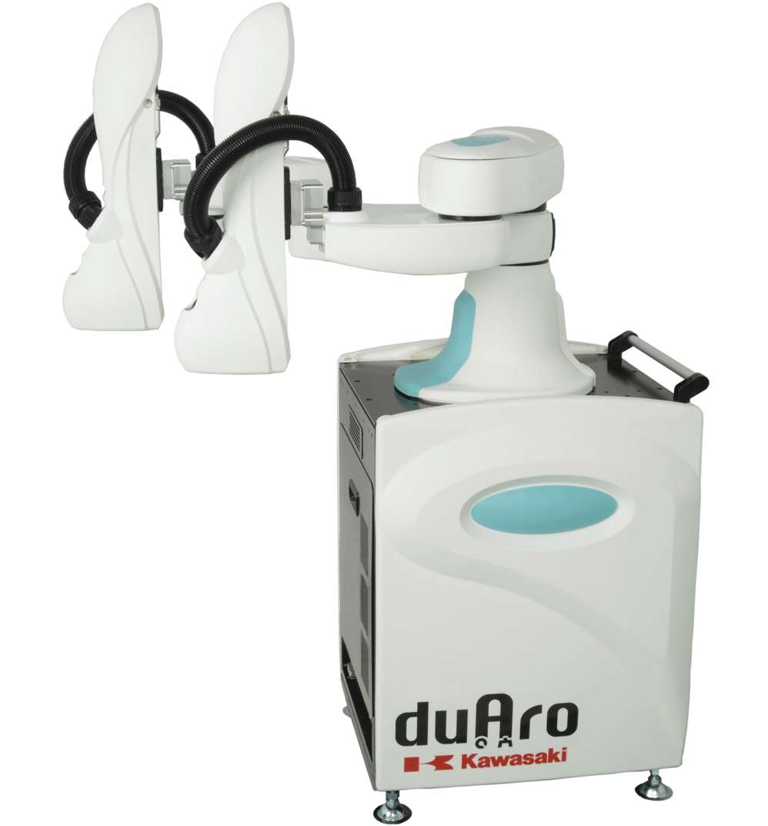
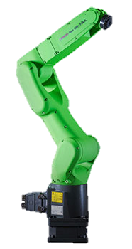
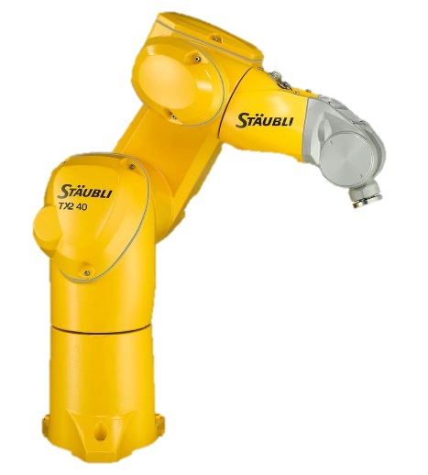
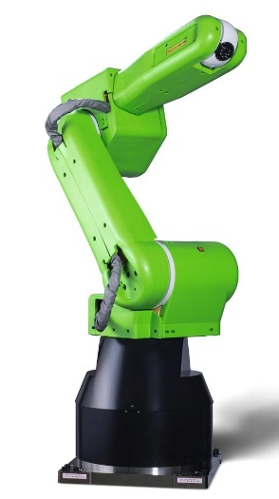
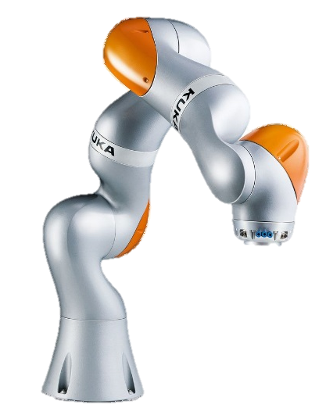
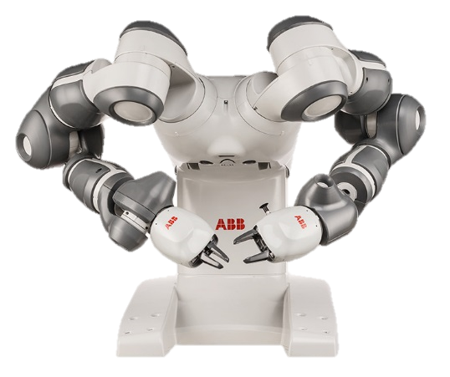
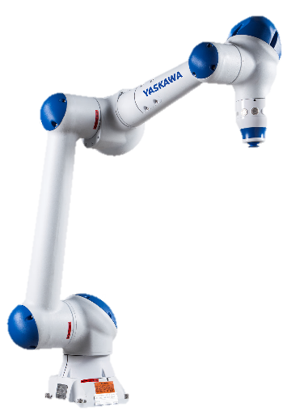
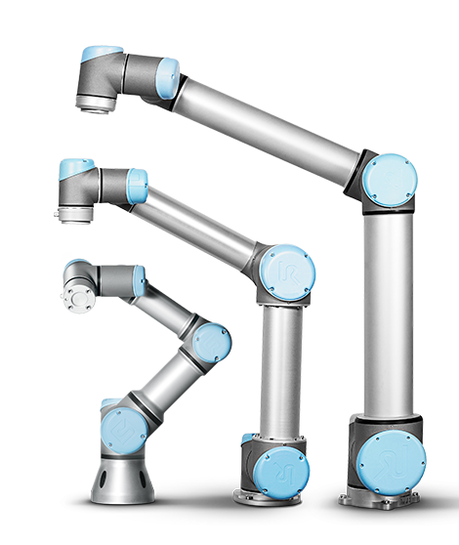
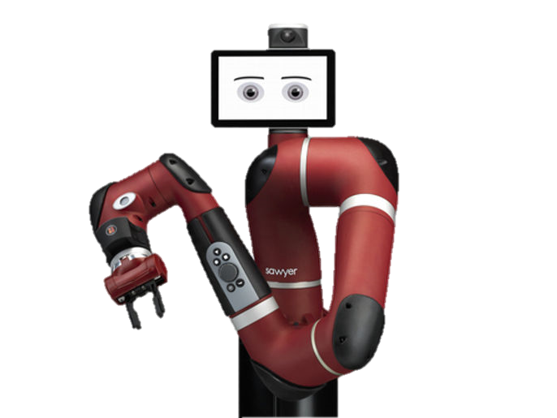
Cobots - Collaborative robots
Basis for end-of-arm-tooling
Robots are the foundational system
of an HRC application.
Here, it is important to consider:
Safety functions
Safety level (PL/SIL)
Controls, incl. connection options
Connection options on the front axles or on the flange
Source: own images, Universal Robots, Fanuc, Rethink Robotics, KUKA, ABB, Stäubli, Yaskawa, Kawasaki

Slide 21



Product selection
Gripper for collaborative applications
Step 1: Task description and feasibility study
→ Are my application/task position and the workpiece suitable for an HRC application?
Step 2: Selection of the robot or cobots
→ Definition of the basic system with mechanical and electrical connection of the peripheral devices.
Step 3: Selection of the gripper
Selection of the gripper together with the co-act-team:
Gripping position (at the workpiece and at the receiving and storage location), necessary gripping force, necessary stroke
Covering the gripper and the moving parts, avoiding clamping or shearing

Slide 22
Product selection
Gripper for collaborative applications
Delivery status scope of delivery
Grippers and gripping systems are considered to be incomplete machines according to the Machine Directive
Construction of the collision protection sleeve is carried out according to BG/BGIA
Indication of the gripping force
Observe the technical data with regard to max./min. gripping forces
View of the impulse forces during gripping movements (4 times for approx. 50 ms)
Gripping forces apply at operating pressure and nominal voltage → safe limitation required!
Considering workpiece loss through loss of the gripping force in the risk assessment
Actuation
Ensuring a defined control (valves or grippers)

Slide 23
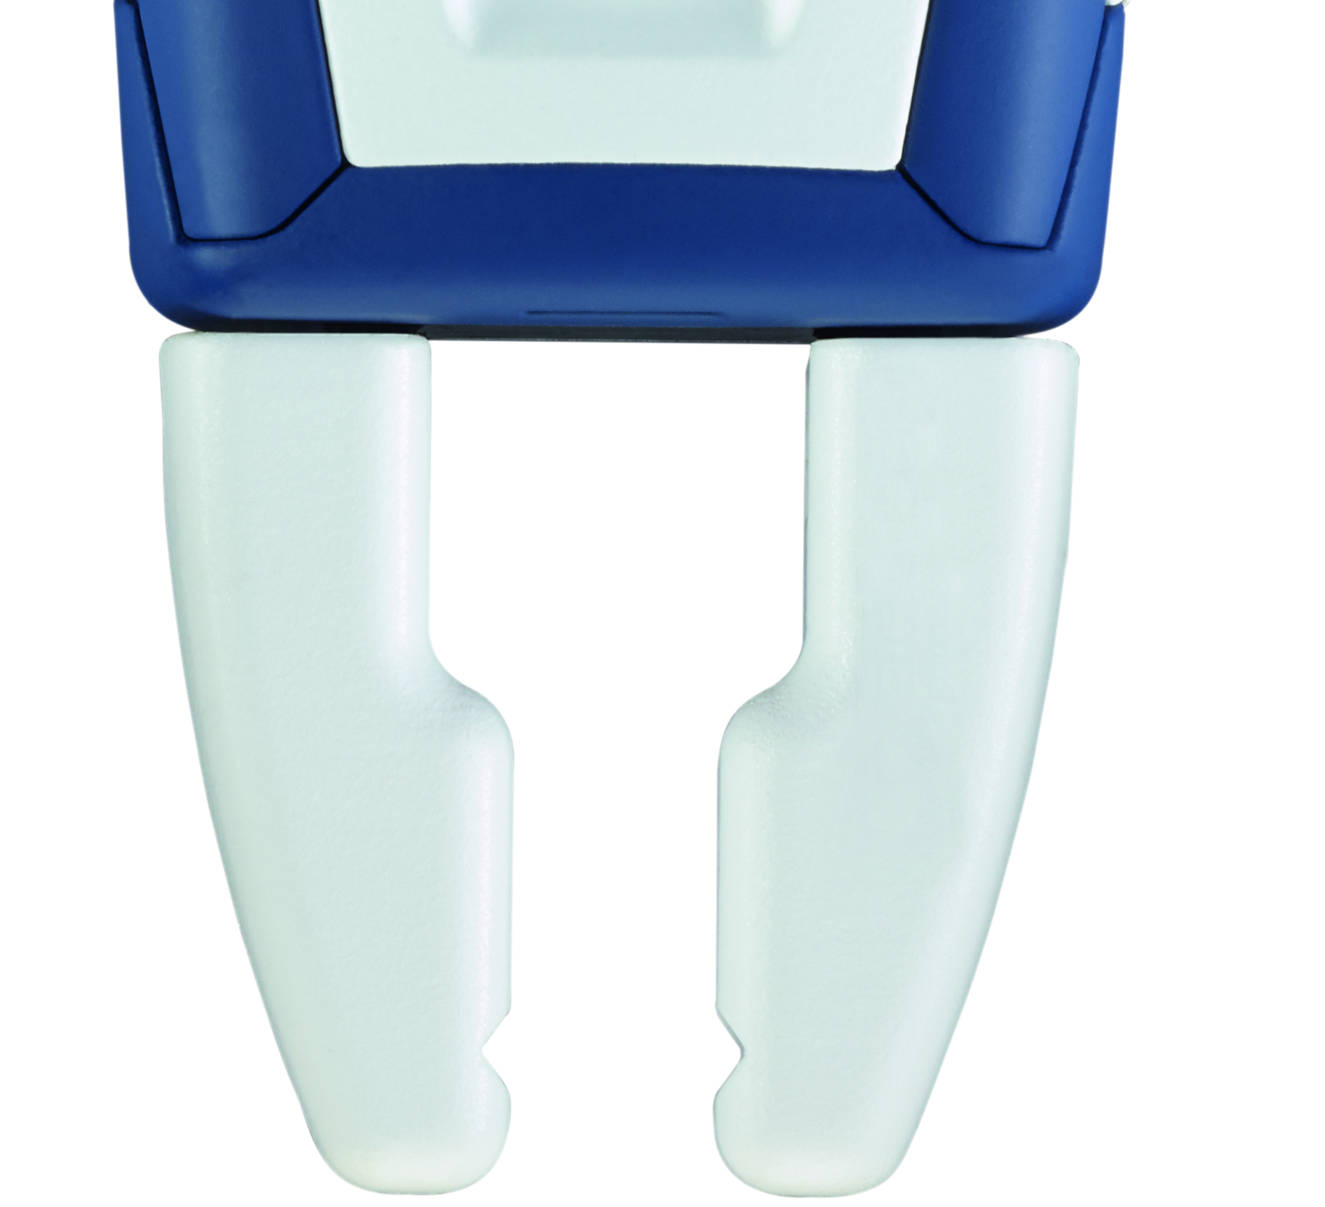
Product selection
Gripper for collaborative applications
Finger design
Top jaws must be provided with radi, also in the Z direction
Please note the outer contour as well as the contour direction of the workpiece
The top jaws have a great influence on suitability for HRC!
The top jaws must also be assessed and observed in the risk assessment and the force/pressure measurement!
Image Source: SCHUNK GmbH & Co. KG

Slide 24
Human-Robot Collaboration
Internal training presentation
Contents
1 | General Information on HRC
2 | HRC from the Perspective of a Gripper Manufacturer
3 | Contact Person and Summary

Slide 25
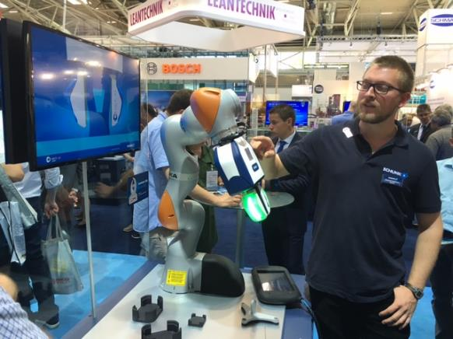
Summary – conclusion
HRC offers advantages, but it is a not to be underestimated, time-intensive change process!
Integration of operational and working safety, standard-setting operation (integration of external partners (for example, BG)
Change of working methods and process landscapes
Basic acceptance by people
First impressions count!
Appearance (visual field), motion sequences (speed, clipping), noise
Mastery of the work processes and intuitive machine operation → Transparency
Humans determine the cycle time now and in the future!
Source SCHUNK GmbH & Co. KG

Slide 26
Superior Clamping and Gripping
Jens Lehmann, German goalkeeper legend, SCHUNK brand ambassador since 2012 for safe, precise gripping and holding.
schunk.com/Lehmann

