Slide 1

Product presentation
SCHUNK Online Commissioning Assistant
Universal gripper EGL

Slide 2
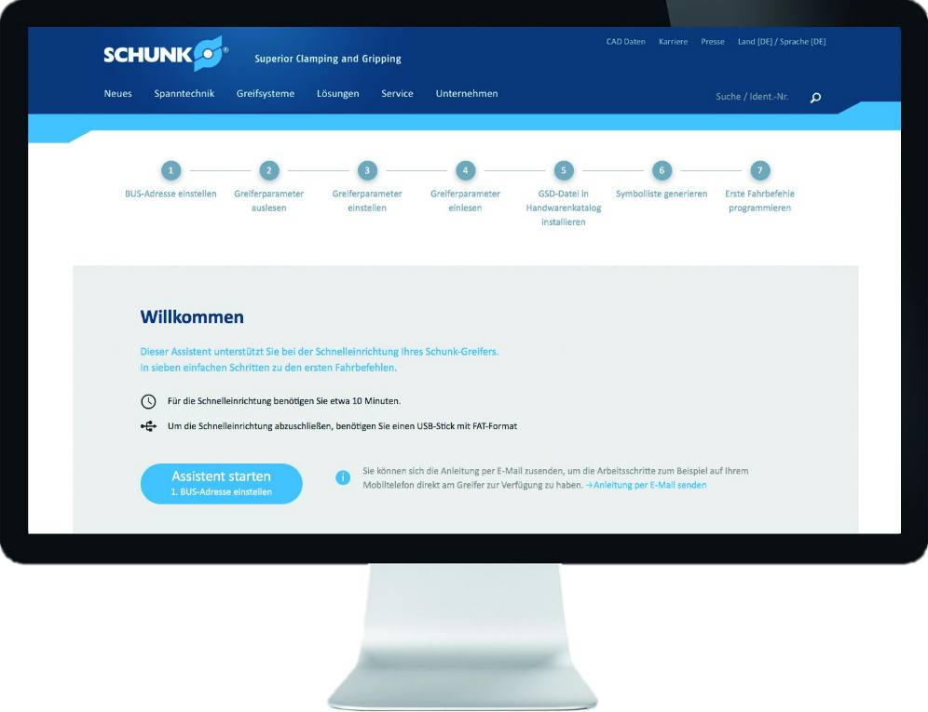
Universal gripper EGL
Interactive tool for simple and fast commissioning of the universal
gripper EGL
Interactive user guidance within the complete commissioning process

Slide 3

Easy. Flexible. Innovative.
Web based user guidance within the complete commissioning process
Interactive step-by-step tutorial
Simple integration of the gripper control into the PLC environment
PROFINET certification of SCHUNK gripper EGL

Slide 4

Your advantages and benefits
Web based interactive user guidance within the complete commissioning process for active support of SCHUNK customers when practically using intelligent SCHUNK grippers
Fast and accurate configuration and parametrization of the hardware for a convenient commissioning and a smooth operation
Support during integration and configuration of necessary data into the PLC at customer site for a direct control and commissioning of the gripper under actual conditions
EGL PROFINET certification for a guaranteed compatibility with industrial standard

