Slide 1

Product presentation
MMS 22-PI1-EX
Sensor system

Slide 2
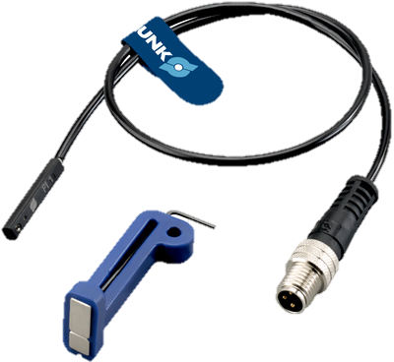
Sensor system
MMS 22-PI1-EX
A ATEX-magnetic switch is used to monitor the status of automation components in explosion-endangered areas.
They detect the approach of a magnet without contact and above a certain switching value, they put out a digital value. The switching value can be programmed.

Slide 3

Benefits & Technical data
Programmable within no time due to non-contact adjustment of the switching points and hysteresis
Adjustable hysteresis for precise position monitoring – even at very low strokes
Suitable for narrow installation spaces due to wired teaching with TeachTool plug
Version with LED display for control of the switching position directly at the sensor
C-slot sensor for space-saving, easy, and fast assembly on the product
Certification suitable for explosion-endangered areas (dust and gas)
MMS 22-PI1-EX
Technical data
Size | MMS 22-PI1-S-M8-PNP-EX | MMSK 22-PI1-S-PNP-EX
Measuring principle | Magnetic | Magnetic
Switching function | Closer | Closer
Switching type | PNP* | PNP*
Teach function | Yes | Yes
Cable connector | M8, 4 pole | open wire strands
* For requests for switching type NPN, a PNP / NPN converter is recommended to the customer.

