Slide 1

Product presentation
MMS 22-IO link

Slide 2
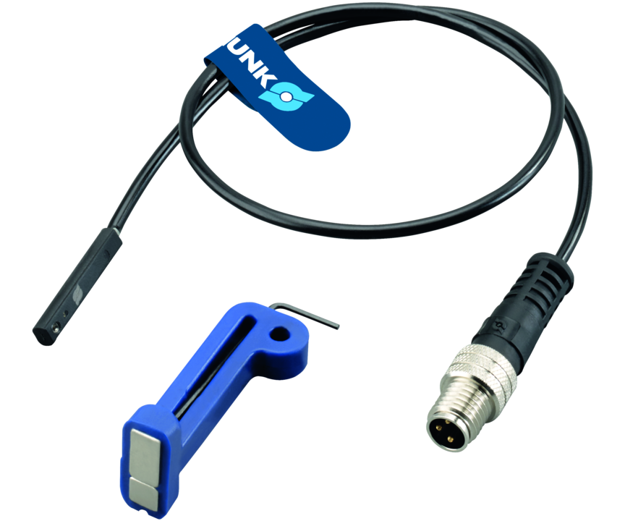
Sensors
A magnetic switch is used for monitoring the status of automation components.They detect the magnets fixed inside the component without contact. In addition to further process data, the sensor outputs the process of the magnetic field via the IO-Link interface.

Slide 3
Advantages – Your benefits
Control via IO-Link for the evaluation of data such as temperature, evaluation quality or the sensor identification
Integrated electronics leads to a compact design and enables the use of cables with standard plug connectors
Suitable for narrow installation spaces due to teaching via IO-Link interface
Version with LED display is used to indicate the status of the IO-Link connection
C-slot sensor for space-saving, easy, and fast assembly on the product

Slide 4
Technical data
Technical data overview
Description | Measuring principle | Cable length | Communication interface | Teach function | Cable connector/cable end
 |  | [cm]
MMS 22-IOL-M08 | magnetic | 30 | IO-Link | 1 | M8, 4-pin Male Connector
MMS 22-IOL-M12 | magnetic | 30 | IO-Link | 1 | M12 connector, 4-pin

Slide 5
Jens Lehmann, German goalkeeper legend, SCHUNK brand ambassador since 2012 for safe, precise gripping and holding.
schunk.com/Lehmann

