Slide 1

Digital Transformation @ SCHUNK
Dr. May, Dr. Elser
05.04.2017
Superior Clamping and Gripping

Slide 2
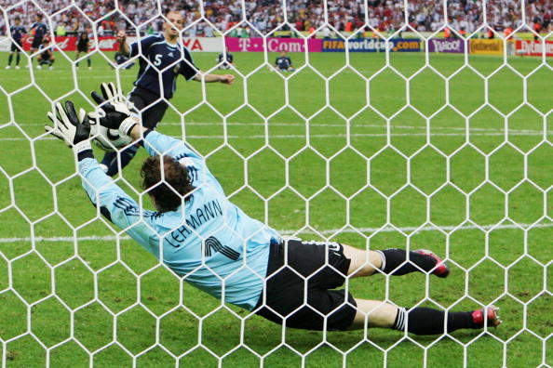
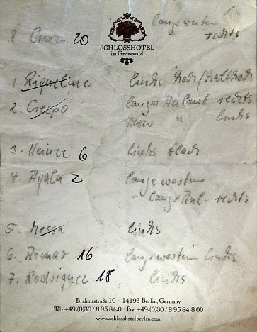
2006

Slide 3

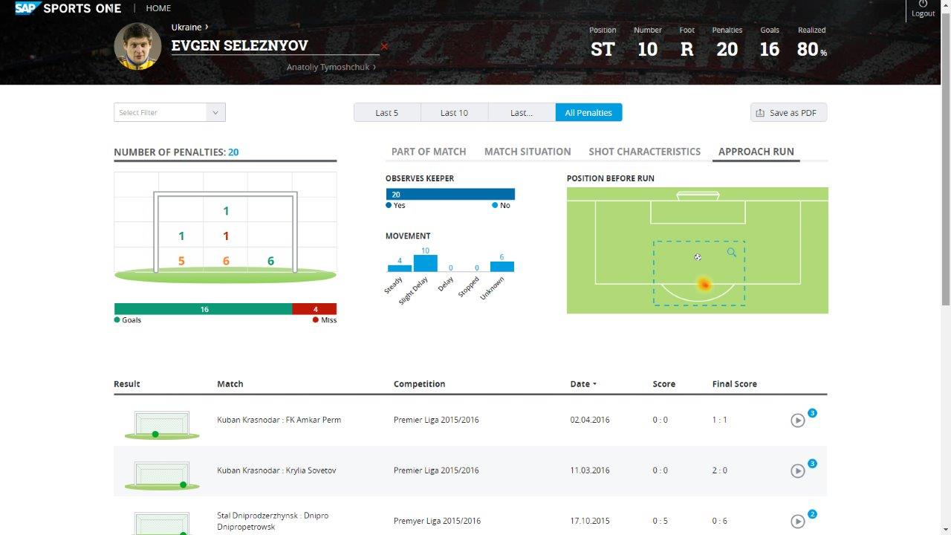
2016

Slide 4
Agenda
1 | Industry 4.0 @ SCHUNK
2 | Digital Product Life Cycle

Slide 5

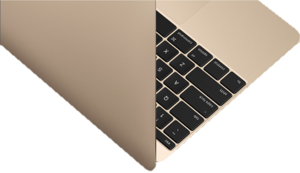
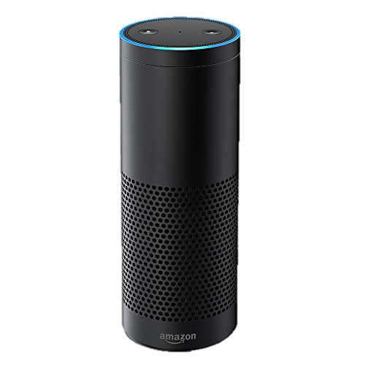
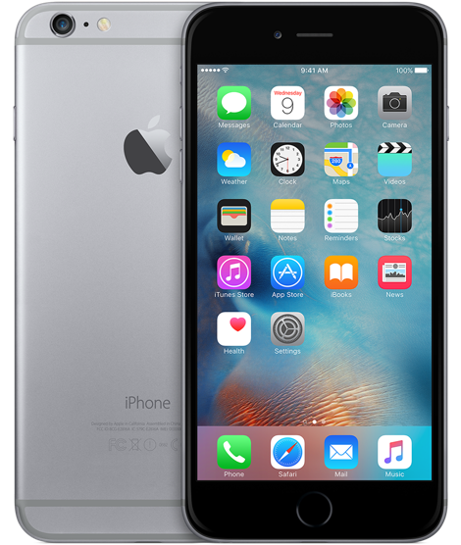
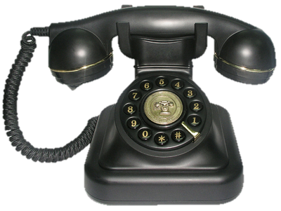
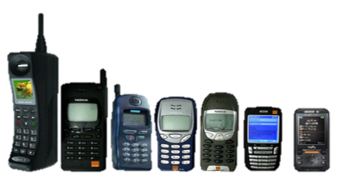
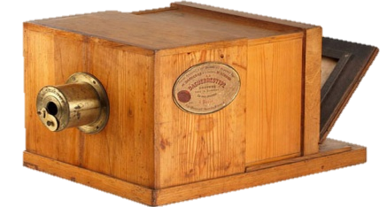
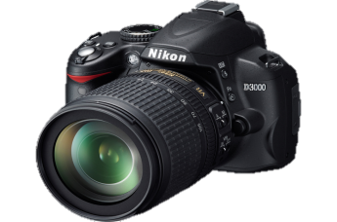
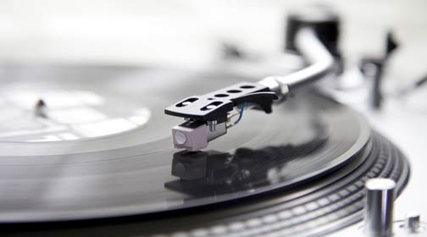
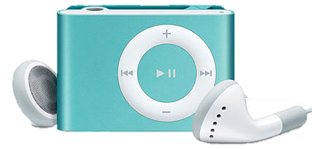
1 | Industry 4.0 @ SCHUNK
Analog, Digital, Integrated Technologies

Slide 6

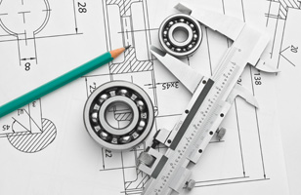
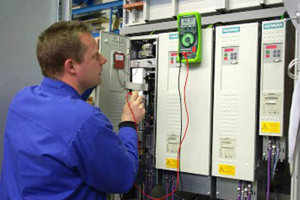

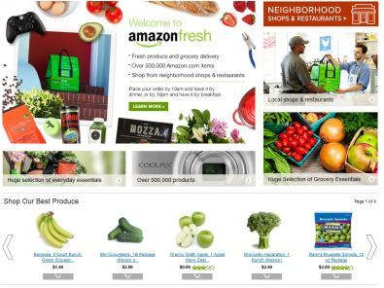
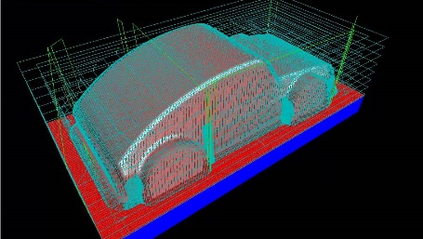
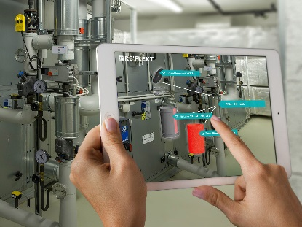


1 | Industry 4.0 @ SCHUNK
Digital Transformation is everywhere
Shopping
Construction
Maintenance
Call Center

Slide 7
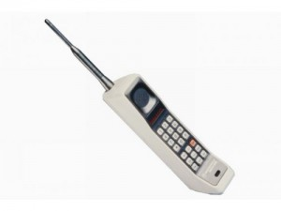



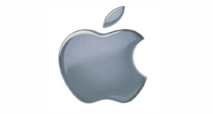



1 | Industry 4.0 @ SCHUNK
Direction of Development is changing
New competitors, new topics of development
New requirements related to speed and flexibility
IT-Field
Old Industry
Consumer
Mobil-Telefon
Service provider
Follower
Competitor
Driver
Google Nest,
Apple car, …
iPAD

Slide 8
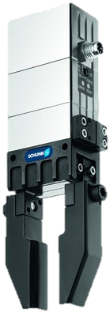
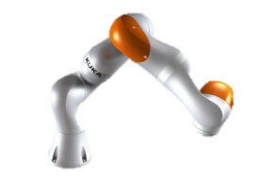
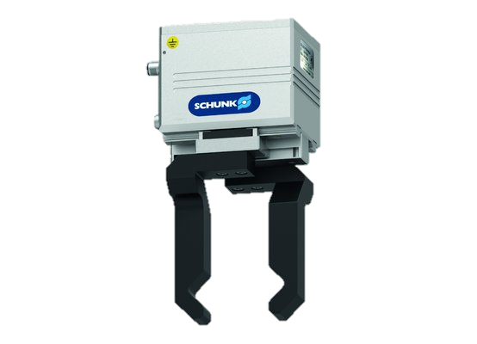
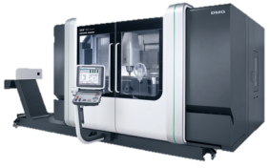
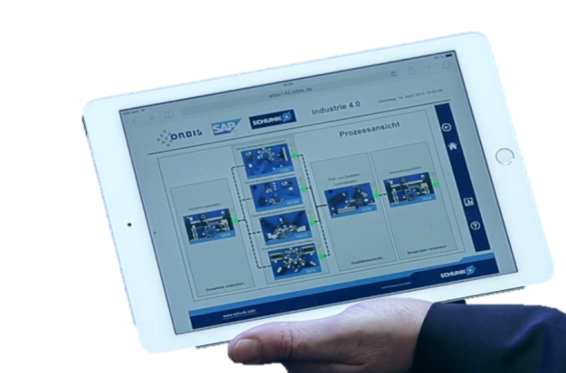
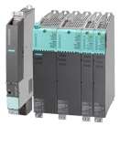
1 | What means Industry 4.0 for SCHUNK
The technology is changing
Hierarchical levels are opening up with a second channel
Continuous data logging in all areas of the classic
Pyramid of automation
ERP
MES
New Channel
SCADA
NC, PLC
Devices
Vernetzung
Hierarchical Automation Systems
Full-Mesh: Internet of Things

Slide 9
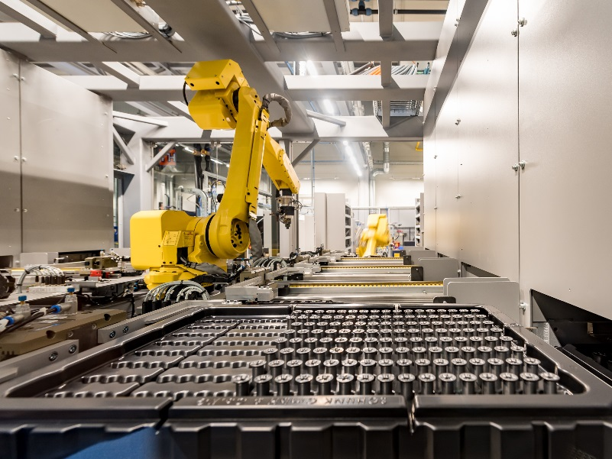
1 | What means Industry 4.0 for SCHUNK
Producing industries will change the same way
Production 2.0 (2017)
Production 4.0
Automation
Optimized Machining
Reduction of Tooling Time
Alarm generation in case of bottlenecks
Geo-tracking of tools and parts
Self-optimizing systems
Basis: Digital Twin of all data from production

Slide 10
Agenda
1 | Industrie 4.0 @ SCHUNK
2 | Digital Product Life Cycle

Slide 11

2 | Digital Product Life Cycle
Production has to adopt to technological changes
Order
Service
Design
Operation
Implementation

Slide 12
2 | Digital Product Life Cycle
Production has to adopt to technological changes
Order
Service
Design
ePlan
3D online
Configuration
Digital Twin
Operation
Implementation

Slide 13
2 | Digital Product Life Cycle
Production has to adopt to technological changes
Order
eGRIP
Service
Design
Operation
Implementation

Slide 14
2 | Digital Product Life Cycle
Production has to adopt to technological changes
Order
Service
Design
Operation
Implementation
PLC Functional Blocks
Plug & Work Assistant
ELP Self-Adjustment

Slide 15
2 | Digital Product Life Cycle
Production has to adopt to technological changes
Order
Service
Design
Operation
Implementation

Slide 16

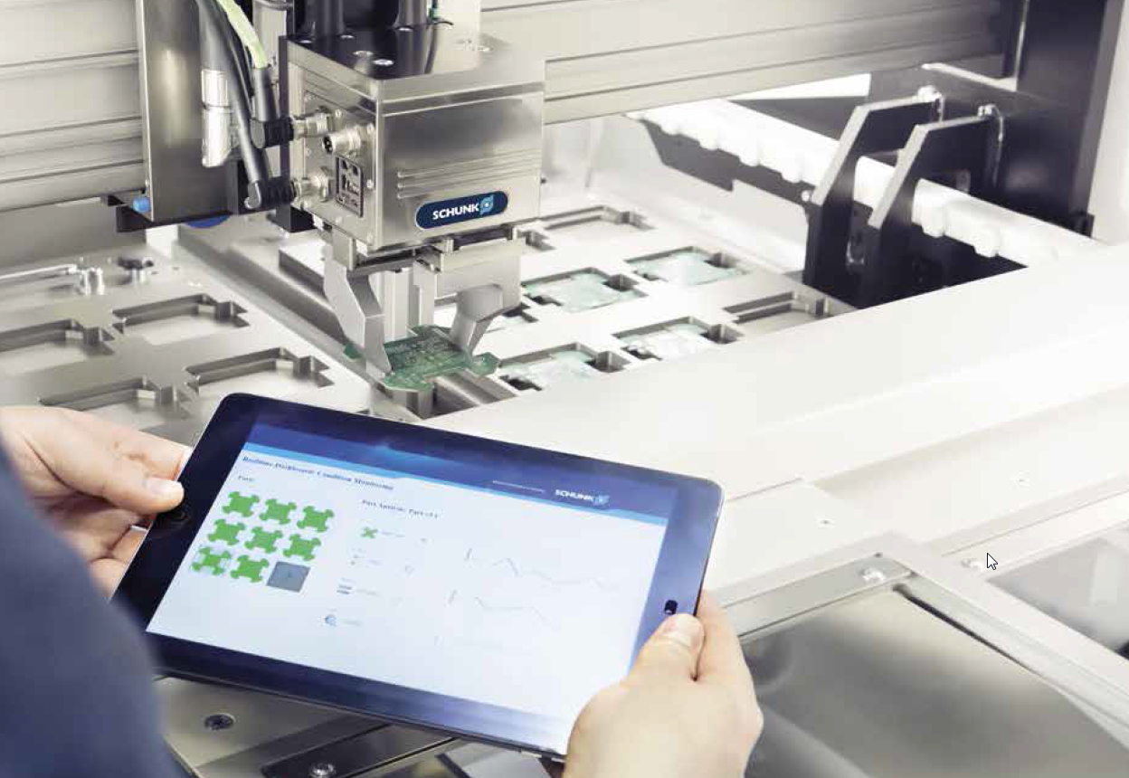
2 | Digital Product Life Cycle
Operation - „Smart Gripping“
SCHUNK integrates force and position measurements into the EGL Profinet gripper and connects the gripper to the SAP Cloud Platform HANA. As the gripper is „closet to the part“, it enables the tool to capture information about the parts and the production process. The retrieved information is analyzed using a cloud-based analytics engine and data is worldwide available through its online platform. The analytics engine derives automatically optimized schedules and process improvements and proposes them to the plant operator.
Functional Integration
Cloud-Computing
Data-Analytics

Slide 17
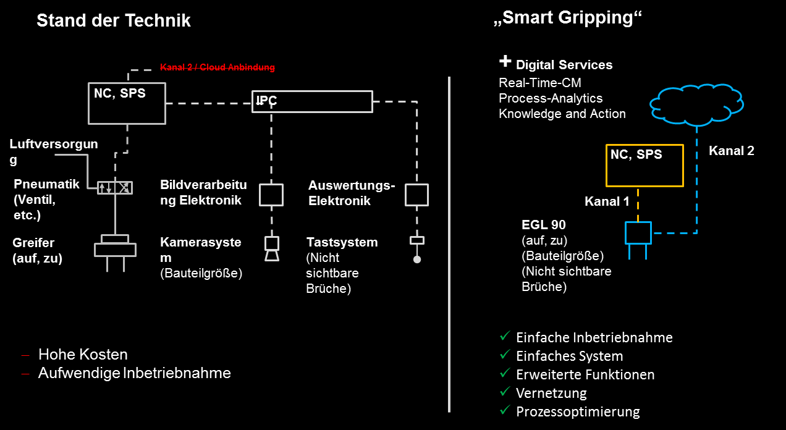
2 | Digital Product Life Cycle
„Smart Gripping“ EGL Prototyp based on EGL 90 Profinet
Profinet communication
Integrated position / size measurement
Integrated force measurement (Prototyp)
Variable Hub

Slide 18

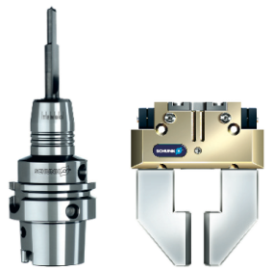

Jens Lehmann, deutsche Torwartlegende,
seit 2012 Markenbotschafter des Familienunternehmens SCHUNK
www.schunk.com

