Slide 1

Product presentation
SCHUNK Online Configurator
Modular Assembly Automation

Slide 2
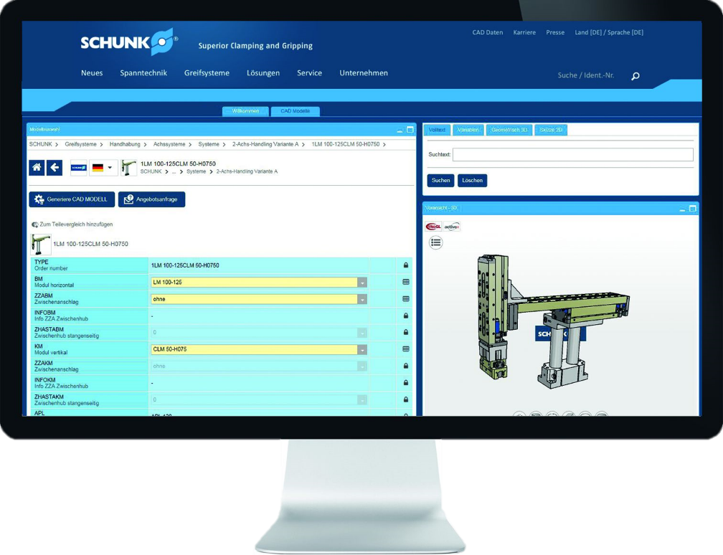
Modular Assembly Automation
SCHUNK Online Configurator for a 3D configuration of different Pick & Place handling constructions for the assembly automation
The most extensive modular system worldwide individually configurable

Slide 3
Easy. Flexible. Innovative.
Configuration of four different Pick & Place handling constructions
Available in all common 2D and 3D CAD formats
Containing electrical and pneumatic modules
Direct coupling with the SCHUNK pillar assembly system
On the basis of CADENAS and available in the SCHUNK PartCommunity

Slide 4

Your advantages and benefits
Fast and accurate configuration of Pick & Place handling constructions for assembly applications for a major time saving during the planning and design phase
Combinational logic is integrated in the configurator no separate data model SCHUNK Kombibox necessary anymore
Available in all common 2D and 3D CAD formats for the universal use in different CAD systems
Electrical and pneumatic modules are contained in the configurator to realize a wide range of applications and to be highly flexible on customer requirements
Download of complete assembly with pillar system, adapter plates as well as norm and connection parts for the creation of a complete parts list out of the CAD model
On the basis of the CADENAS platform for a worldwide complimentary access and a consistent database

