Slide 1

Product presentation
EPLAN
CAE/CAD Data

Slide 2
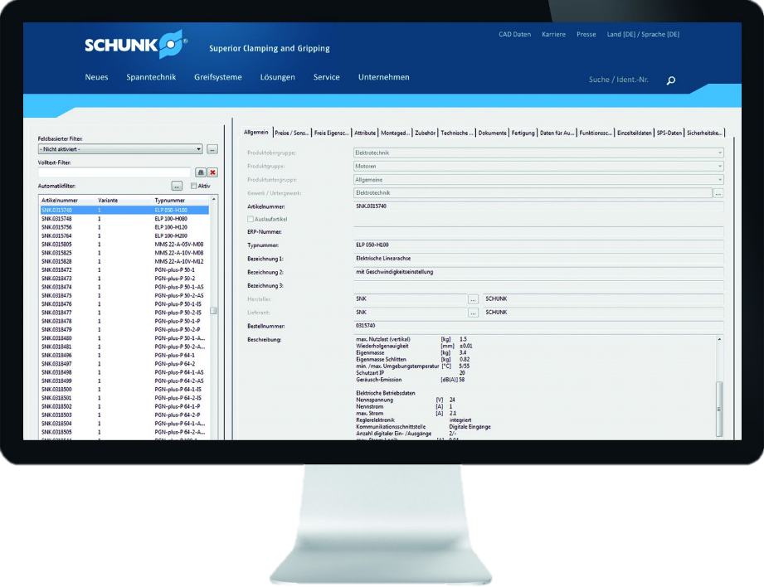
CAE/CAD Data
On the platform Data Portal of the company EPLAN, SCHUNK is providing standardized information for customers for the design of circuit diagrams
Integration of the largest gripper portfolio worldwide into the EPLAN Data Portal

Slide 3
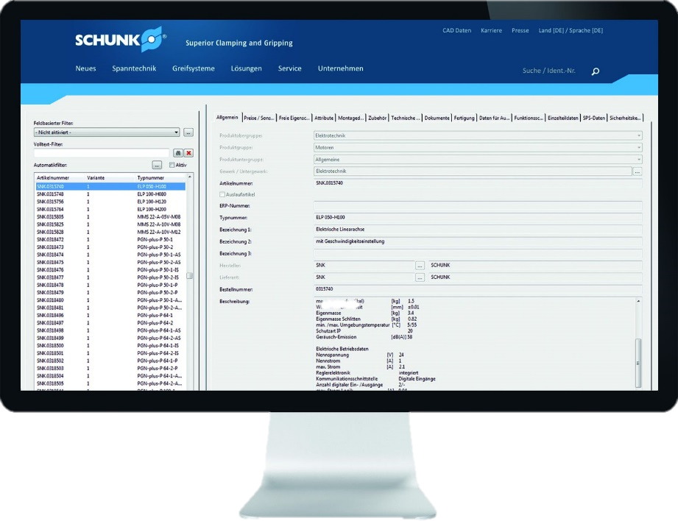

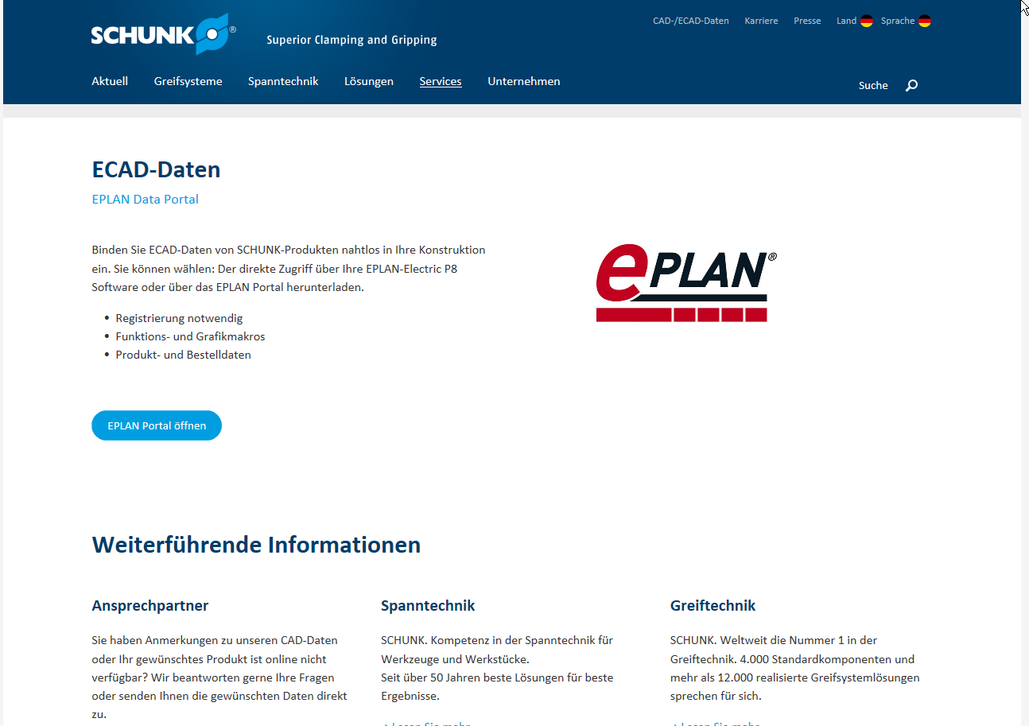
Easy. Fast. Extensive.
Information for circuit diagrams and fluid plans
Direct access via EPLAN Electric P8
Availability of order information, technical data and additional links
Access via SCHUNK Homepage and EPLAN Data Portal
16 product series with more than 800 versions available

Slide 4

Your advantages and benefits
Central, worldwide access to information of SCHUNK products to reduce the effort in project planning and to increase the quality of the plant documentation
Direct access to the EPLAN Data Portal via the software EPLAN Electric P8 or via freely accessible browser version for little effort during integration of macros and higher flexibility for the usage in other CAE software
Easy change management for all EPLAN projects by cross references for improvement of the quality and maintenance of circuit diagrams
Additional linkage of technical data and website links with documentations for complete information about SCHUNK products

