Slide 1

Product presentation
AGE-W
Angular compensation unit

Slide 2
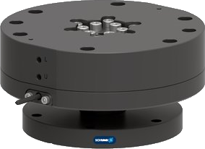
Angular Compensation Unit
Compensation unit for use in assembly, loading and unloading or bin picking. The rotational and angular compensation of the AGE-W allows the end effector to align itself to the orientation of the workpiece.
The first compensation unit for use on a robot for the simultaneous angular and rotational compensation.

Slide 3
Flexible. Compact. Robust.
Angular and rotational compensation
Centric locking
Monitoring of the locked condition via inductive proximity sensor
ISO 9409 mounting pattern

Slide 4

Your advantages and benefits
Angular and rotational compensation compensate for inaccuracies in the position of the workpiece and saves time, cost and effort by simplifying robot programming
Locking components made from hardened steel provide a robust construction and guarantee long life
Centric locking via a proven ball bearing system allows for a robust and precise locking. The unit can be made rigid for following processes
ISO mounting pattern on both the robot side and the tool side. Direct mounting to many robot types without additional adapter plates is possible
Monitoring of the locked condition via an inductive proximity sensor increases process reliability
Optional protective boot increases the durability against external influences such as coolant

Slide 5
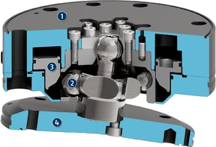
1
Housing
Technical data
2
Locking ball bearings
3
Locking piston
4
Mounting flange
Technical data
Size | 125
Repeat accuracy (mm) | +/- 0,09
Handling weight (kg) | 22,7
Angular X/Y compensation (°) | +/- 13
Rotatory Z compensation (°) | +/- 19
1
3
2
4

