Slide 1


ROTA NCE
Power Lathe Chucks with Through-hole

Slide 2














Product overview
Gripping Systems
Clamping Technology
Chuck Jaws
Stationary Workholding
Lathe Chucks
Toolholders
Hydraulic Expansion Technology
Manual Lathe Chucks
Power Lathe Chucks with Jaw Quick-change System
Power Lathe Chucks with Through-hole
Power Lathe Chucks without Through-hole
Pneumatic Power Chucks
Steady Rests
Quick-change Systems
Customized Solutions

Slide 3
Challenges
Process dynamics
Technnological
progress
time
time
Energy consumption
time
Requirements on the clamping fixture: efficiency, flexibility and…
heute
zukünftig

Slide 4



ROTA overview
Power Lathe Chucks with Through-hole
ROTA NCE
ROTA NCA
ROTA NC plus 2/NCF plus 2
ROTA NCD
ROTA NCK plus

Slide 5
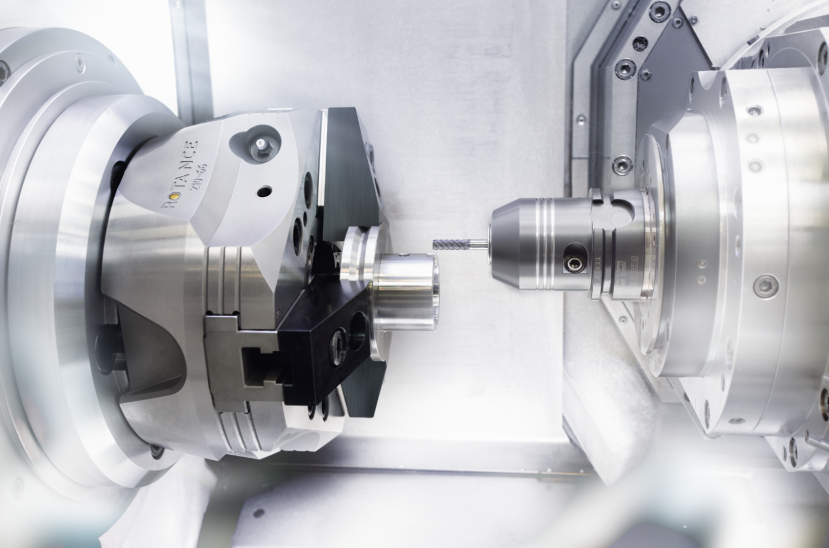
ROTA NCE
Example of application
Clamping device:
ROTA NCE 210 with soft jaws.
Features/Application:
Precise O.T. clamping of aluminium parts with weight-optimized chucks and jaws for highly dynamic metal cutting and reduction of cycle times.

Slide 6
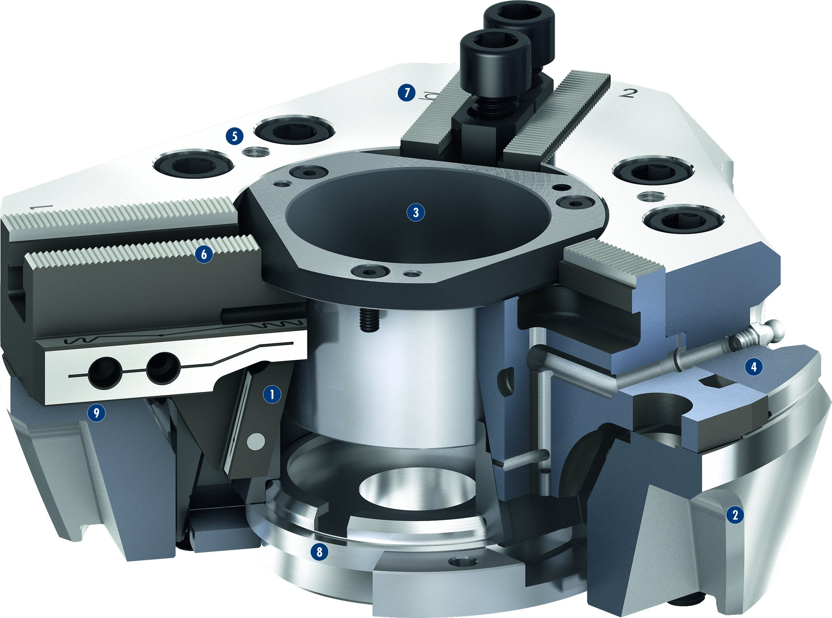
ROTA NCE
7
Wedge hook drive
Hardened and extremely rigid base body
Large through-hole
Optimized lubrication system
Mounting threads
Base jaw serration
Jaw stroke display
Blank draw nut
Weight-optimized design
5
1
2
3
6
3
4
5
4
6
9
1
7
8
2
9
8

Slide 7
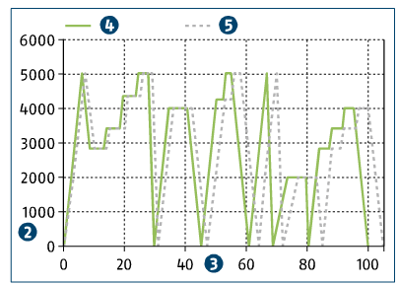
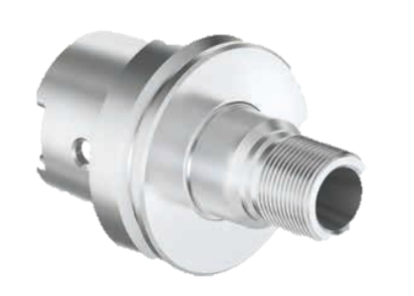
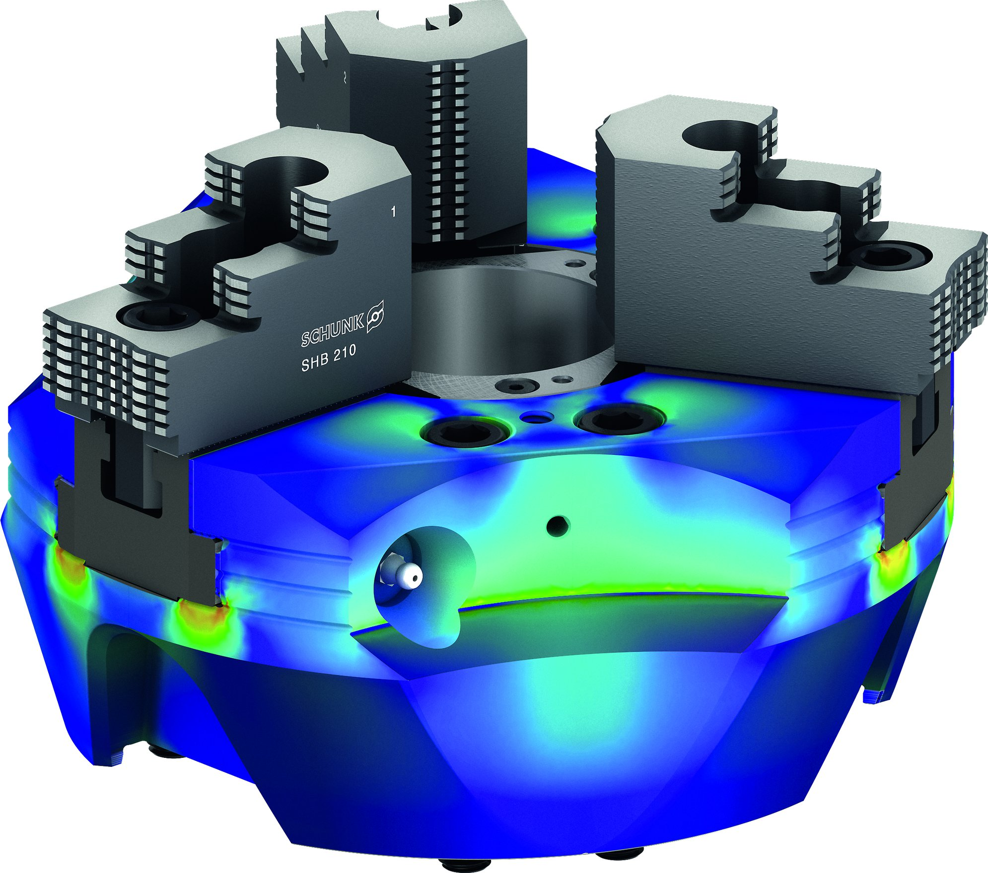
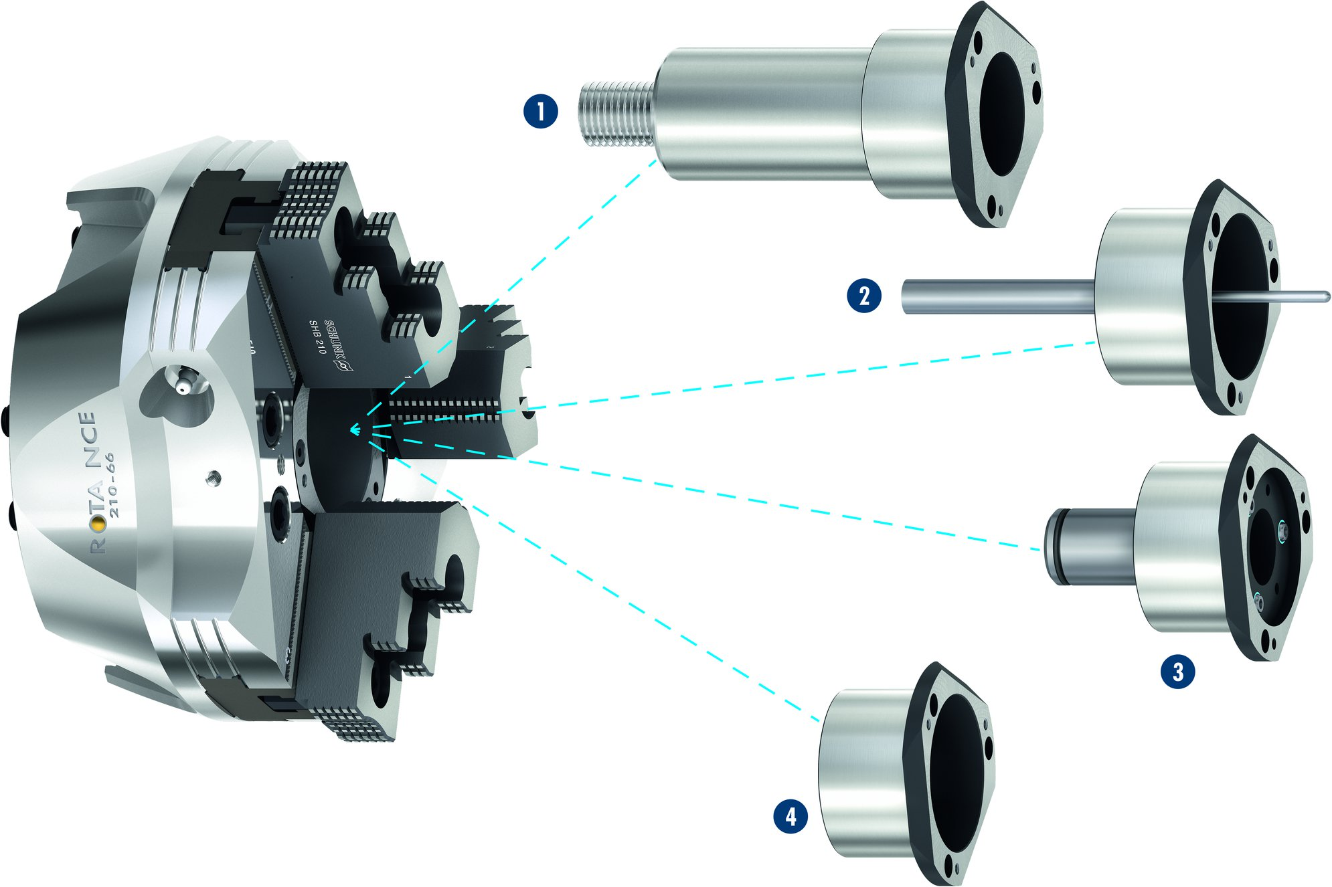
ROTA NCE
Cycle time and energy-efficient processing - toolholder
4
5
1
Toolholder
RPM in min⁻¹
Processing time in %
Speed collective and savings due to the use of a ROTA NCE
Speed collective of a conventional lathe chuck
2
3
4
1
5
2
3
Weight-optimized Power Lathe Chuck
Modular Center Sleeve System
1
1
Adjustable stop in the center sleeve
Part ejector in the center sleeve
Coolant nozzles in the center sleeve
Closed center sleeve
2
2
3
3
4
4

Slide 8
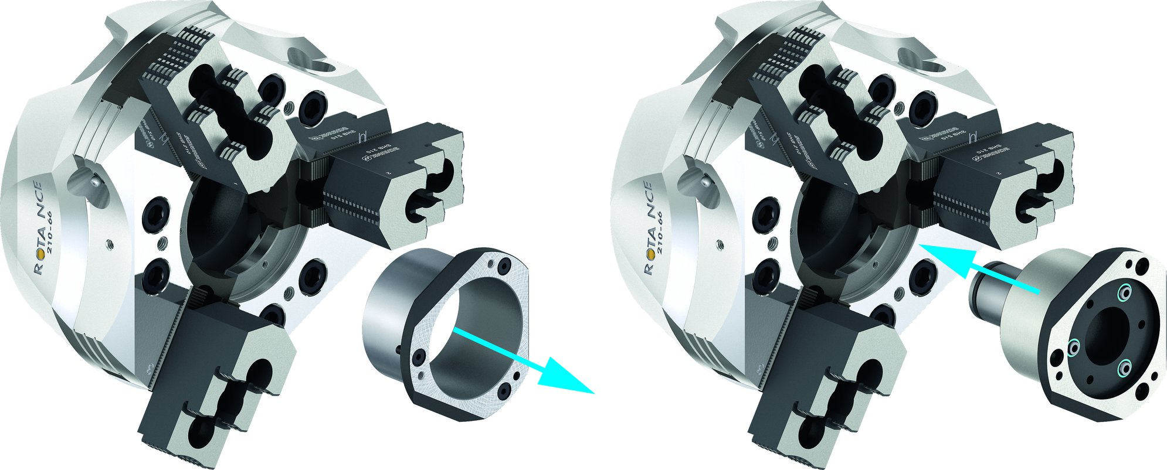
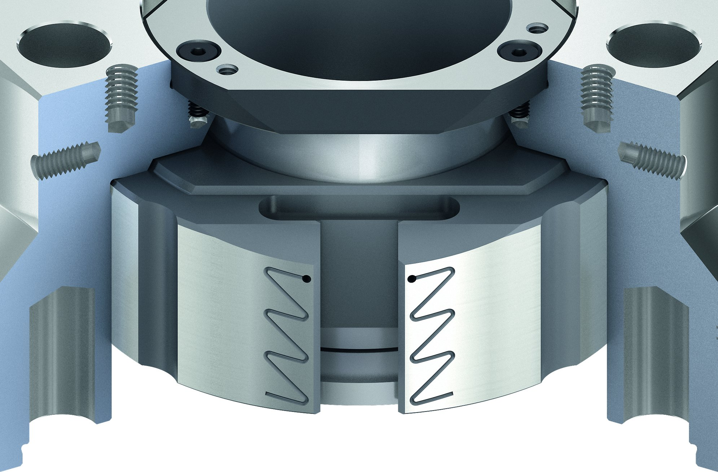
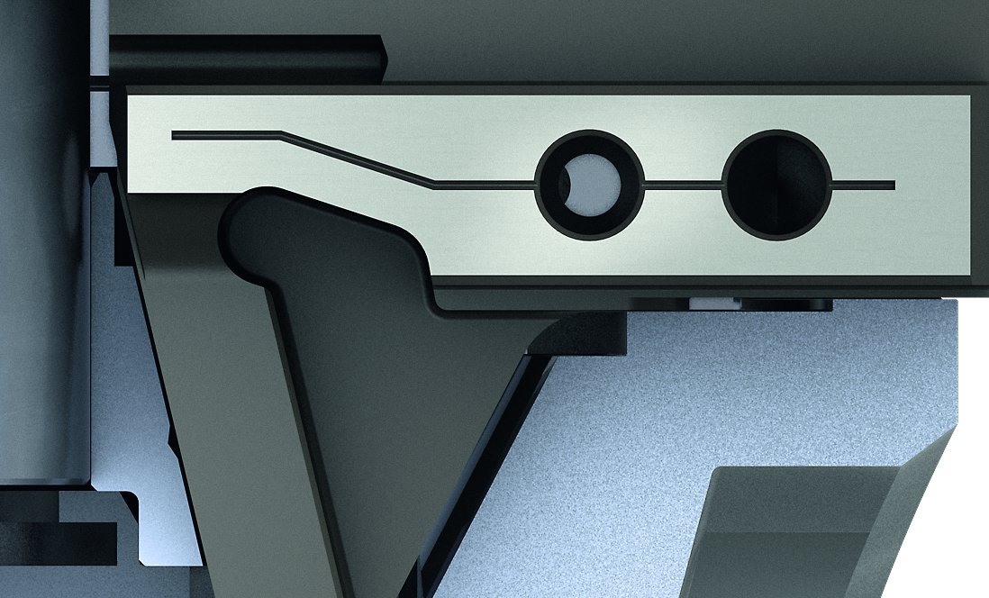
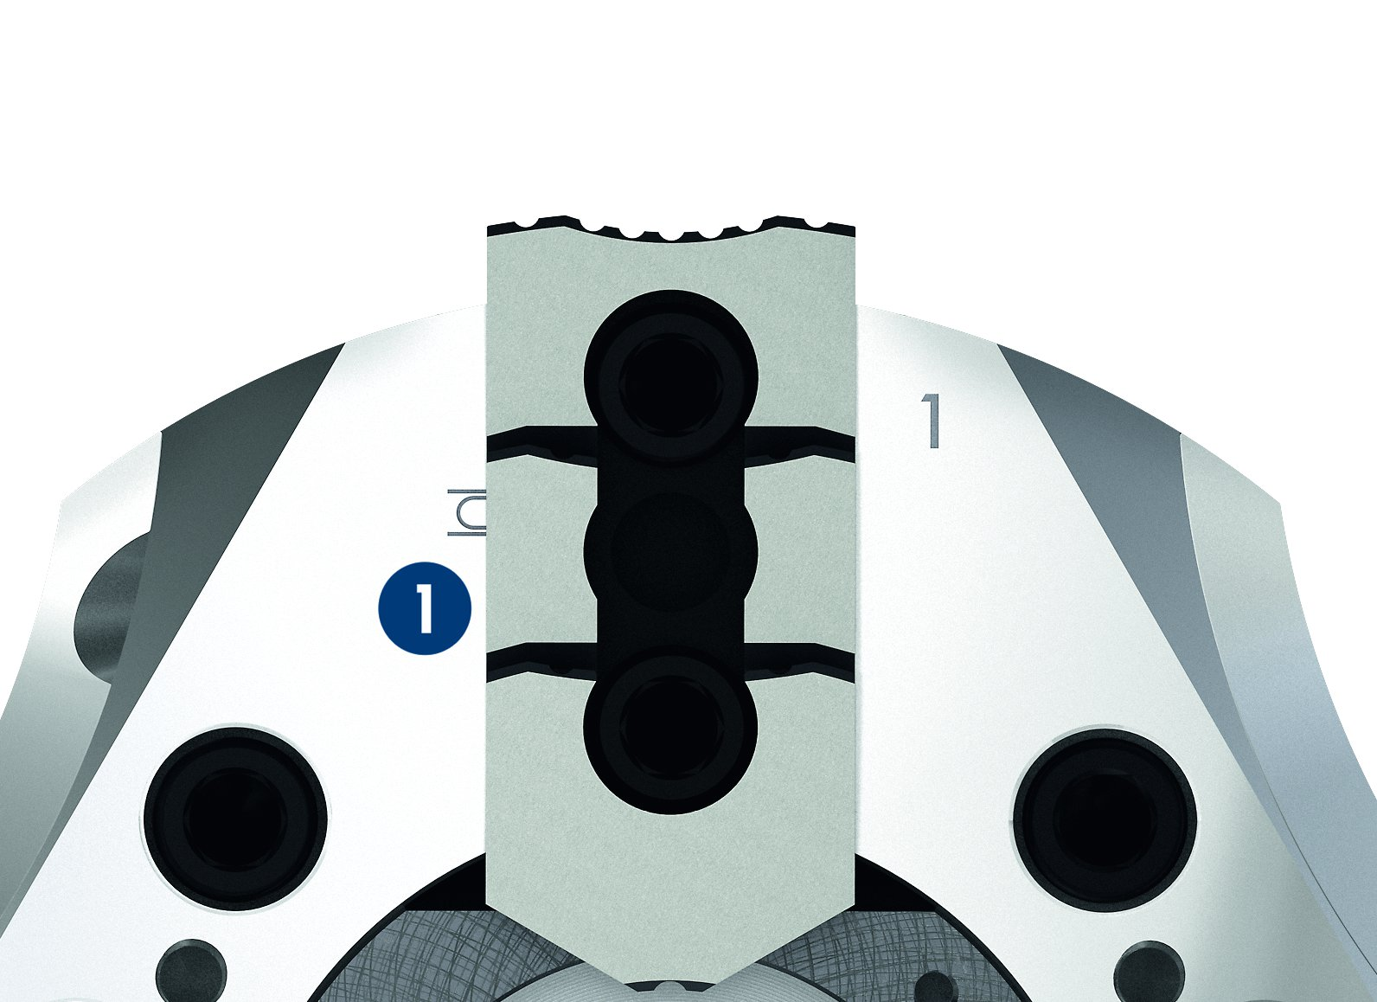
ROTA NCE
Changing the center sleeve
Optimized greasing system
Base jaw safety feature
Jaw stroke display
1
Jaw stroke display
1

Slide 9
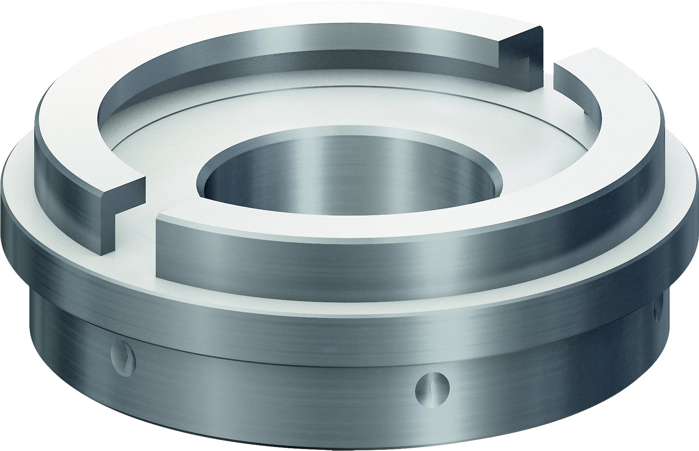
ROTA NCE
Absolute flexibility – blank draw nut

Slide 10
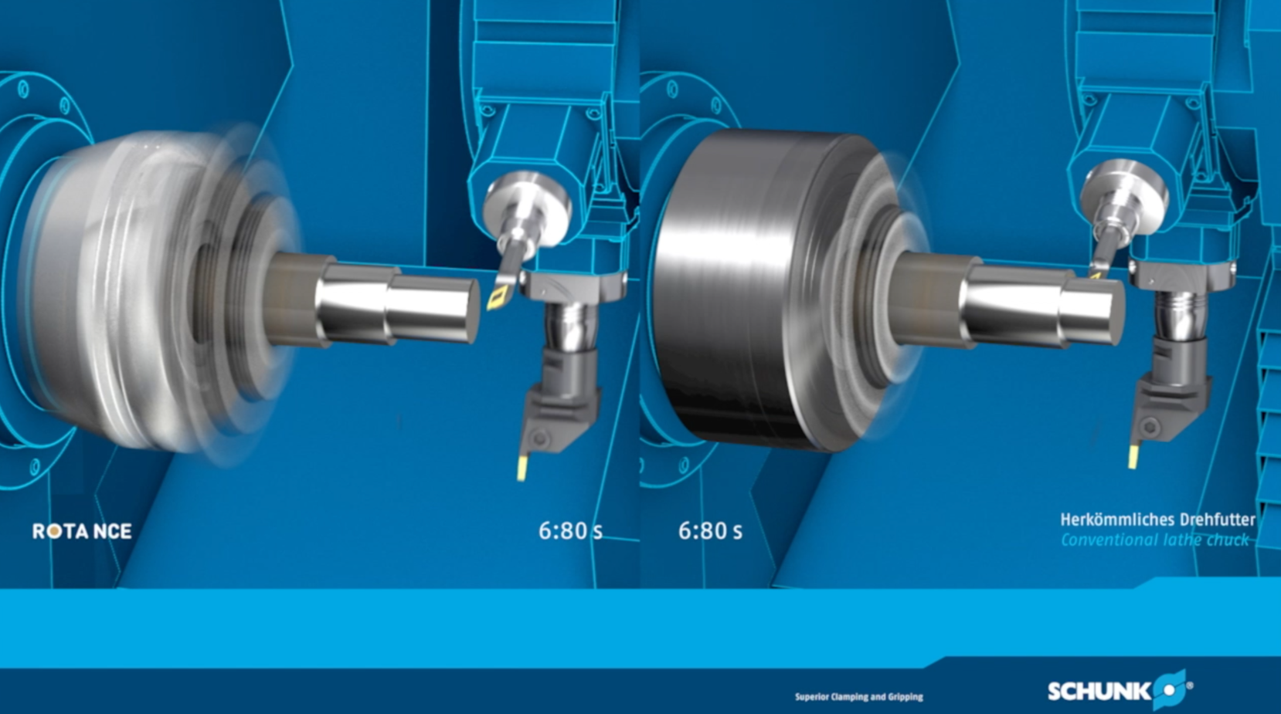
ROTA NCE

Slide 11
Variants ROTA NCE
Technical data | Max. RPM [min⁻¹] | Max. clamping force [kN] | Max. actuating force [kN] | Stroke/jaw [mm] | Through-hole [mm] | Piston stroke [mm]
ROTA NCE 130-38 | 7500 | 45 | 19 | 3.2 | 38 | 14
ROTA NCE 165-53 | 6000 | 65 | 26 | 3.3 | 53 | 14
ROTA NCE 210-66 | 5000 | 100 | 38 | 4.2 | 66 | 18
ROTA NCE 260-81 | 4500 | 130 | 45 | 4.9 | 81 | 21
ROTA NCE 315-106 | 3500 | 155 | 58 | 5.8 | 106 | 25

Slide 12



SCHUNK Services
Engineering
Dimensioning of special plates designed to the manufacturing specifications
Development of special solutions together with the customer
FEM analysis for critical components
Testing
Endurance tests with all new developments
Abrasion checking
Measurement of accuracy
Service
Initial operation of customer´s solution
Inspection and maintenance
Repairs

