Slide 1


Electric Linear Module
ELP
Detail presentation technics

Slide 2
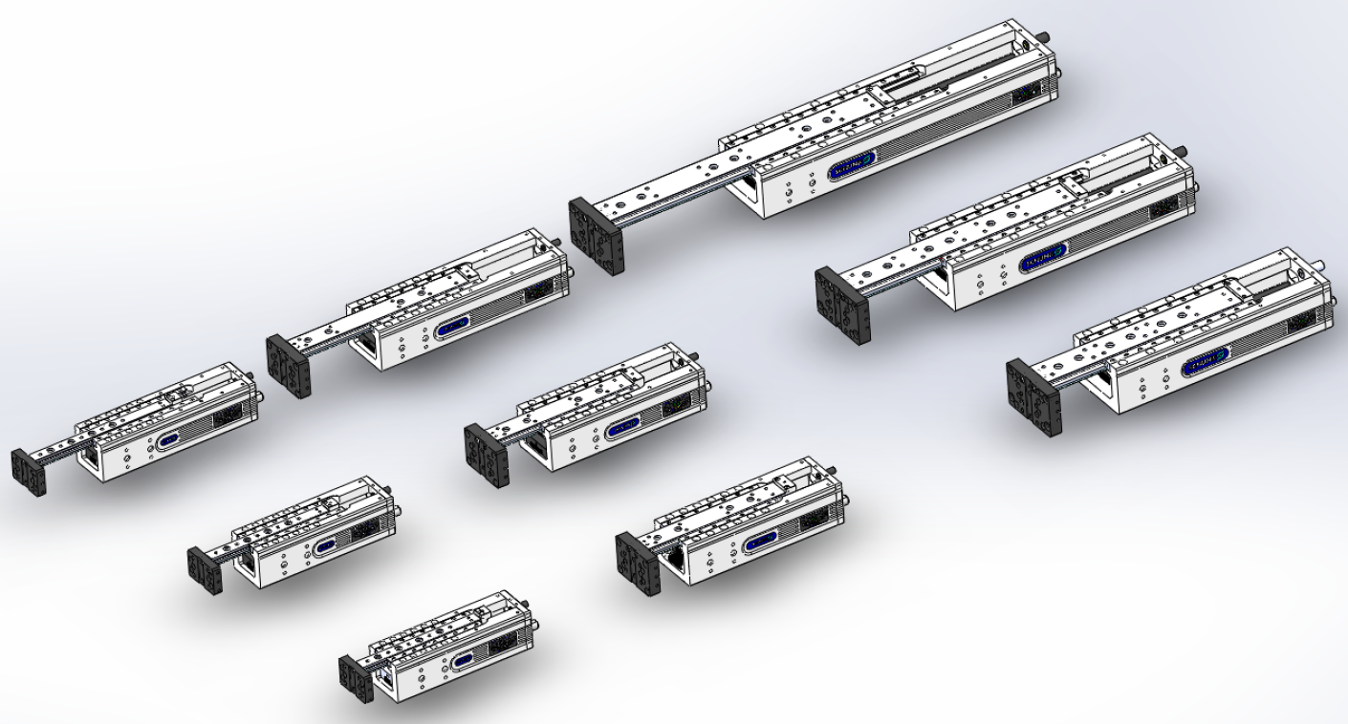
Sizes and stroke versions
ELP100
Stroke 200
Stroke 120
ELP50
Stroke 100
Stroke 80
ELP25
Stroke 80
Stroke 60
Stroke 50
Stroke 40
Stroke 30

Slide 3
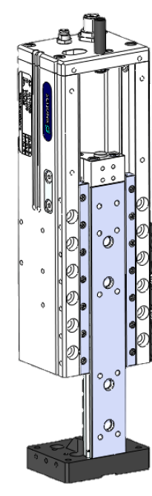
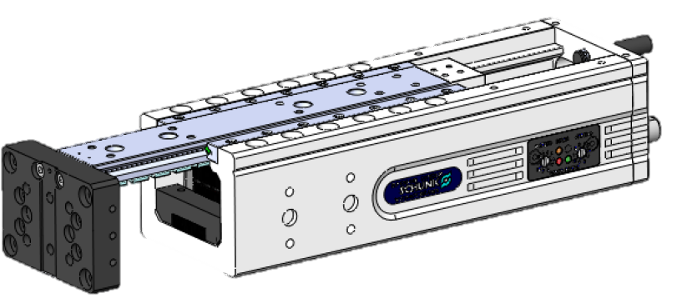
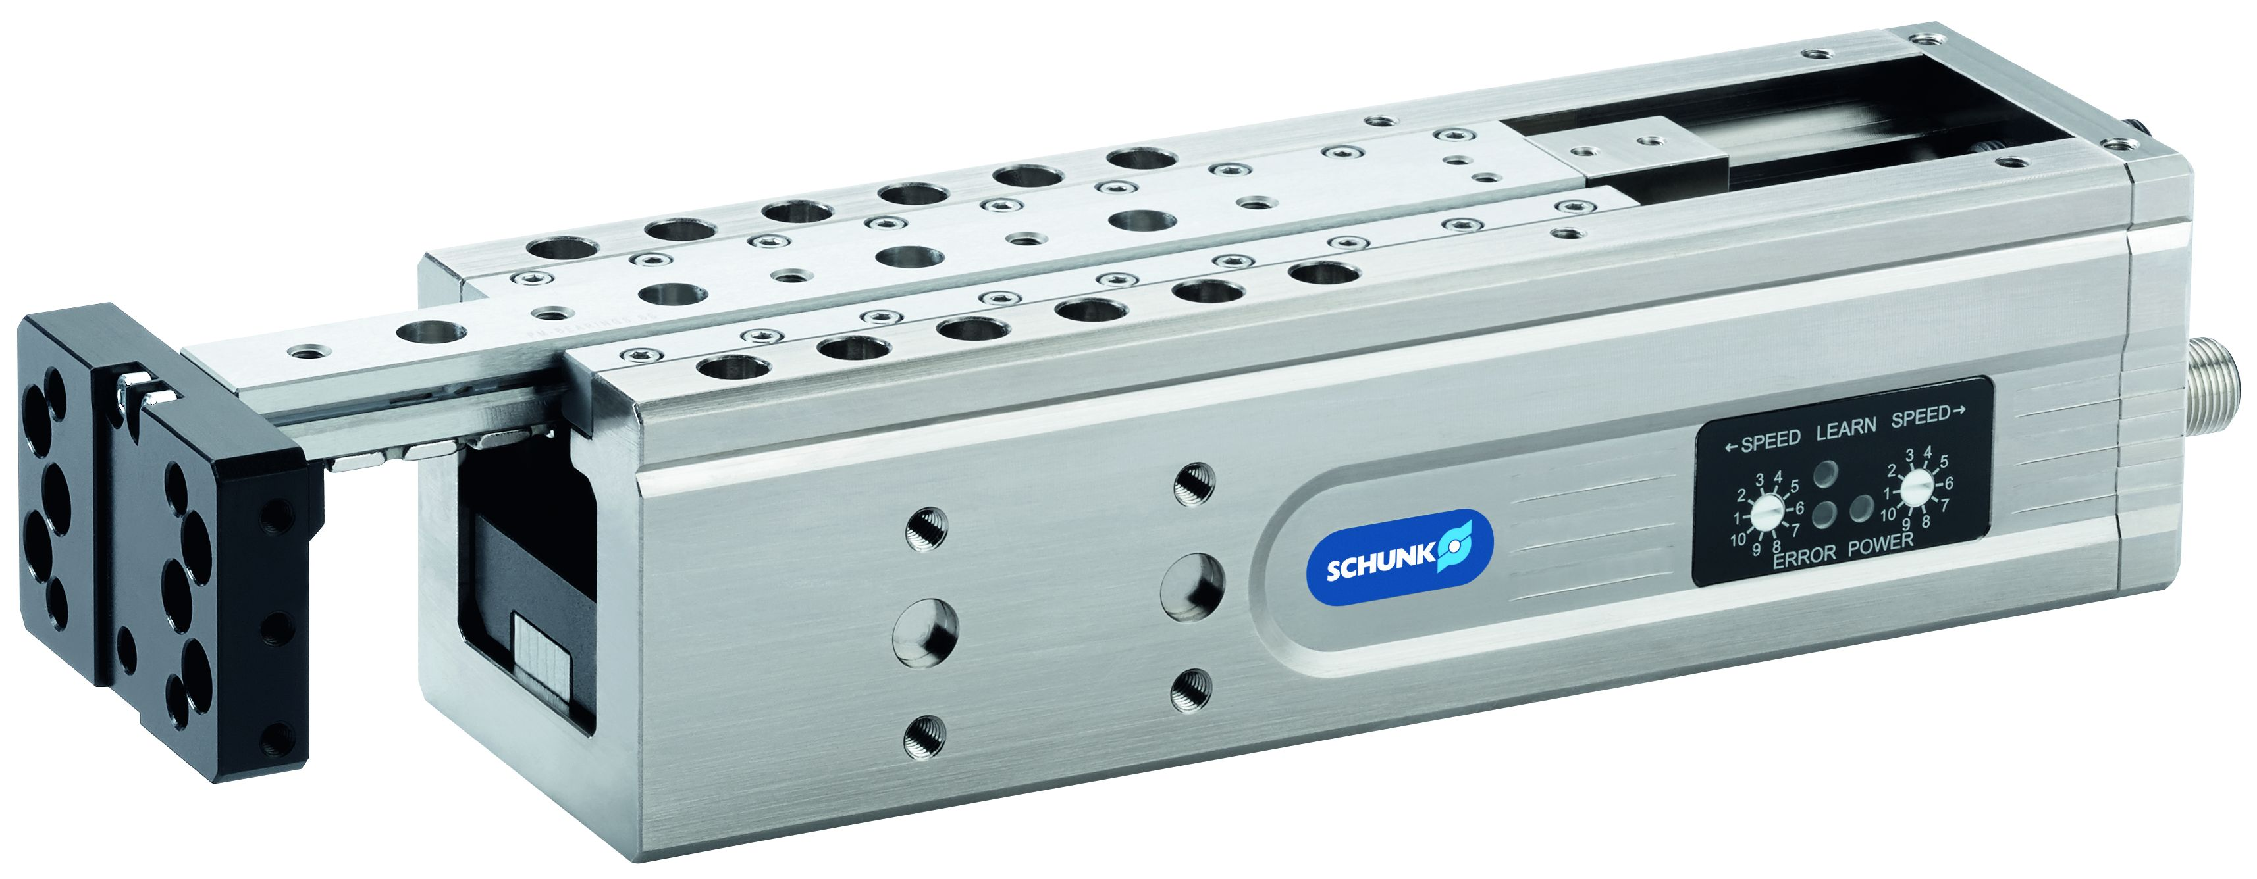

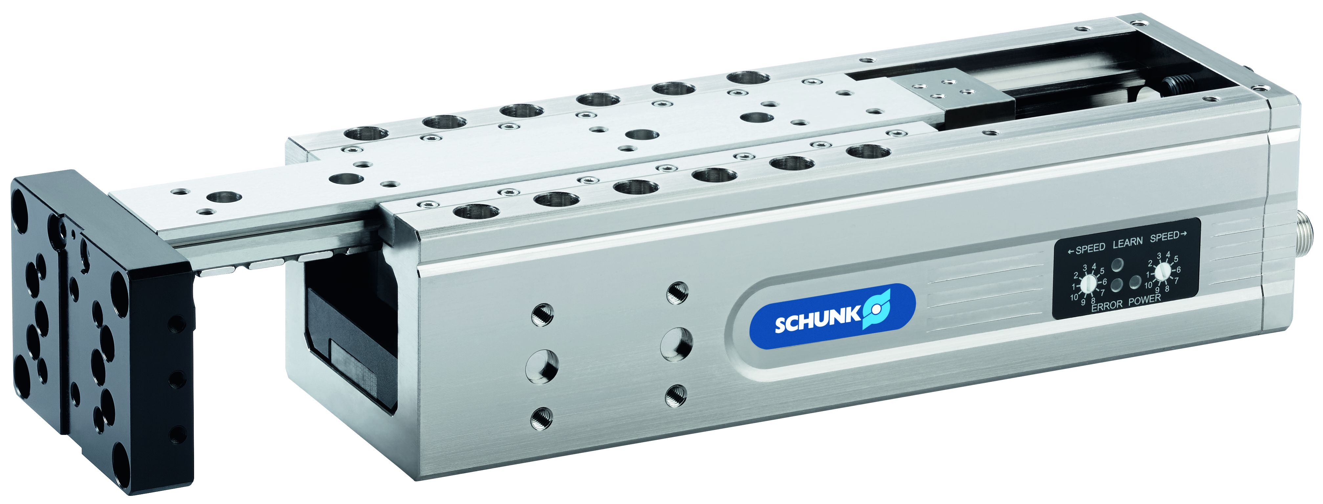
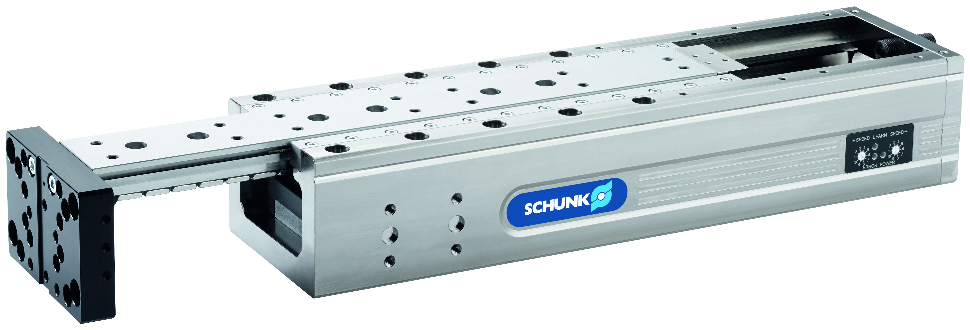
Allocation of payload
 | Payload vertical | Payload horizontal
ELP 25 | 0,75 kg | 1 kg
ELP 50 | 2 kg | 3 kg
ELP 100 | 4 kg | 6 kg

Slide 4
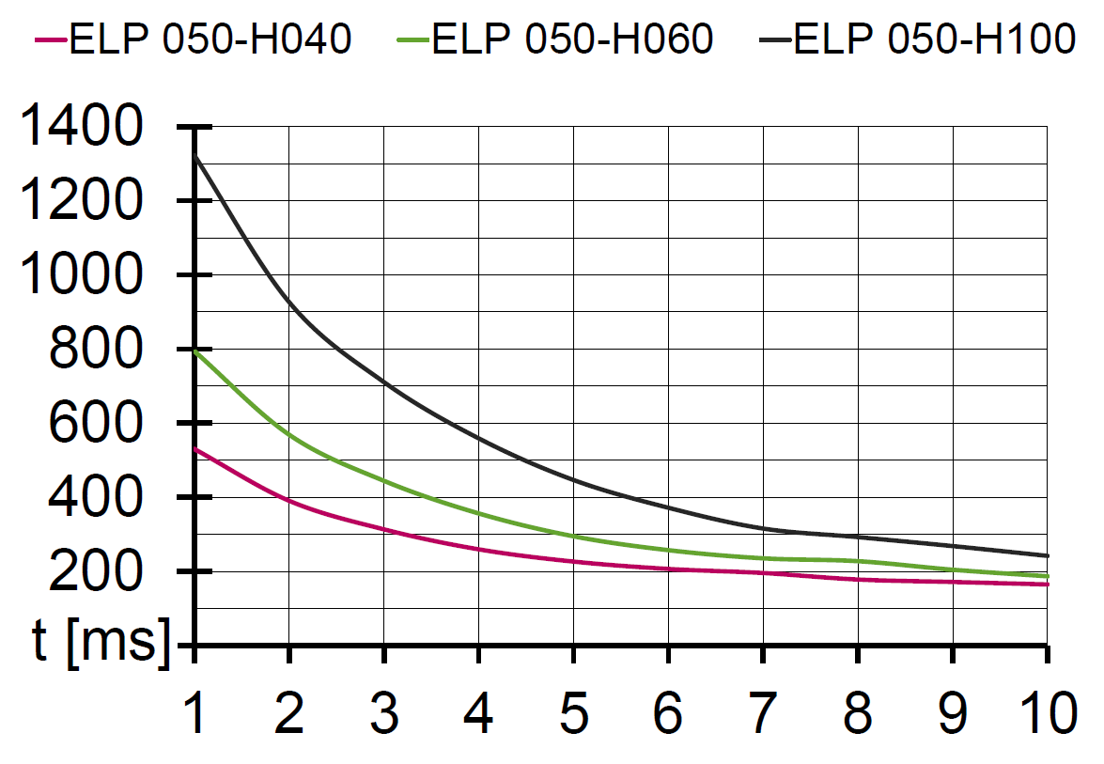
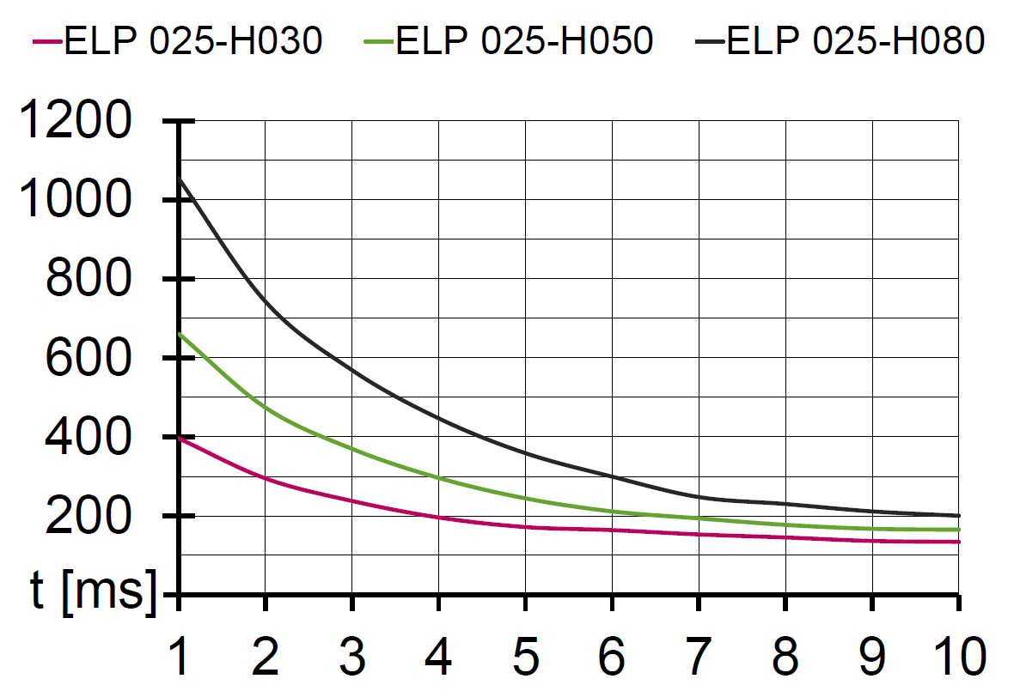
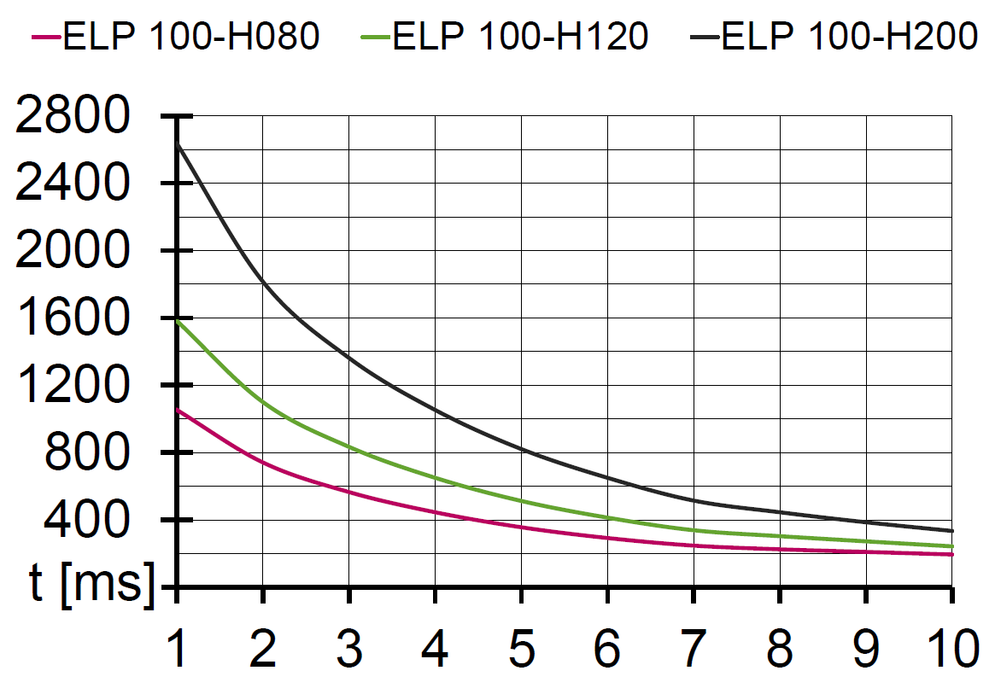
Calculation of cycle times
ELP 50
Travel times in horizontal installation position
With maximum playload
Speed levels 1 – 10
ELP 25
ELP 100

Slide 5
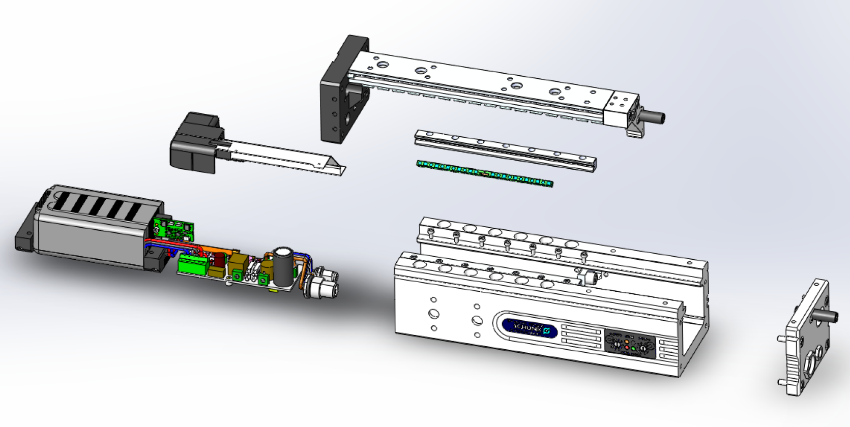
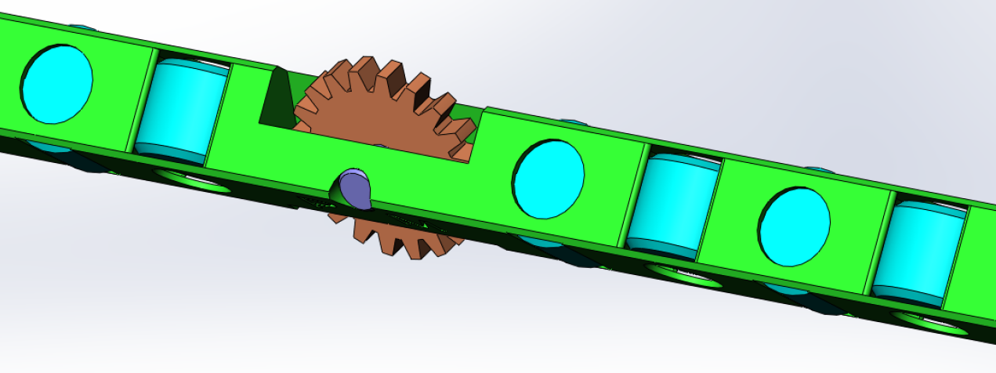
Internal construction
Secondary part as a
biprism guidance
Electronics cover
Measuring system
Roller cage with
forced guidance
Motor
Electronics
Housing

Slide 6
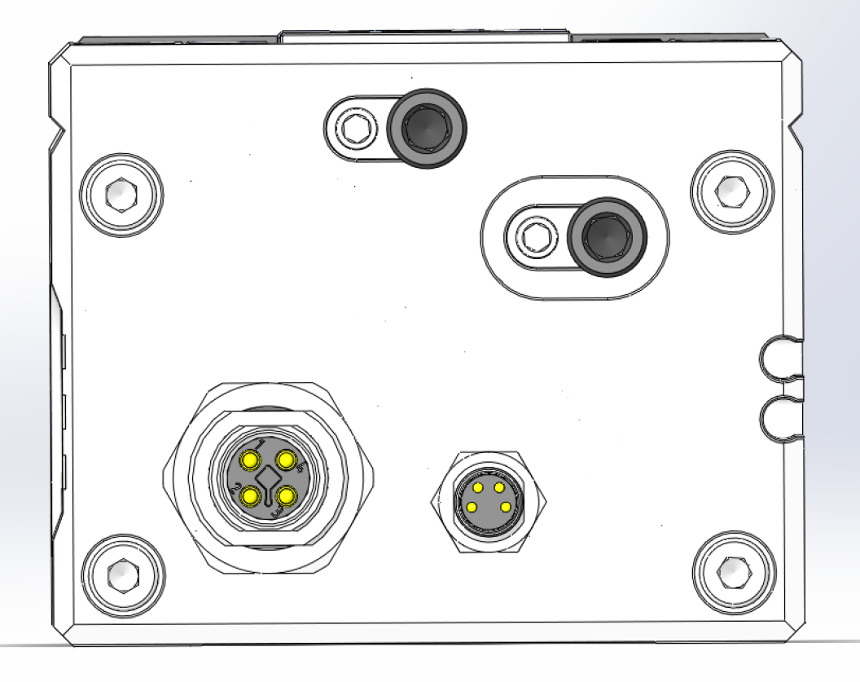
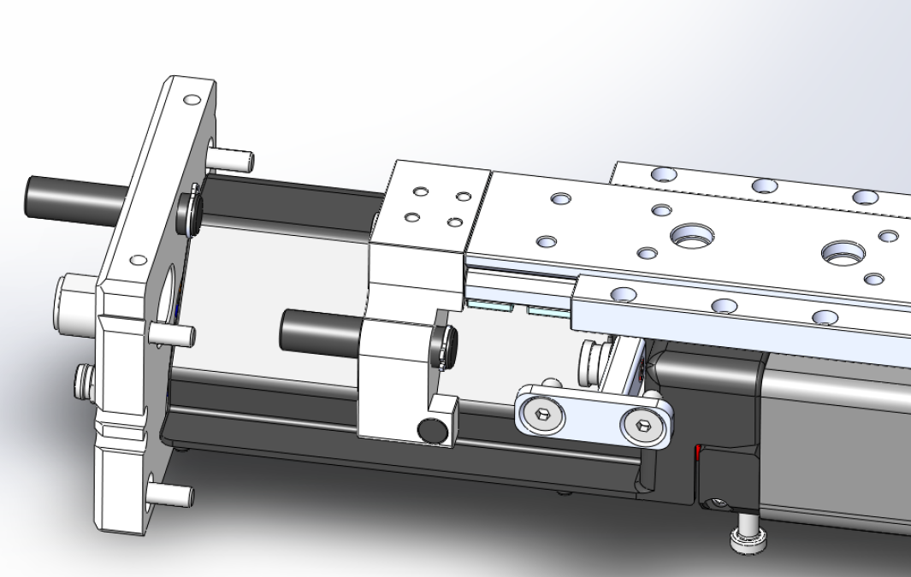
End position adjustability
Overstroke of +2mm
on both sides
stop plate
Adjusting screw end position front
Adjusting screw end position back

Slide 7
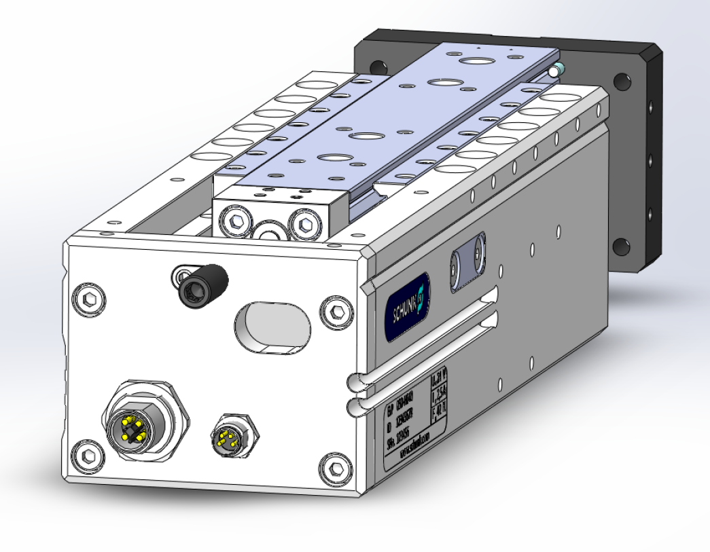
Electrical connection
Power supply
M12, 4 pole, T-coded
Control (SPS)
M8, 4 pole

Slide 8
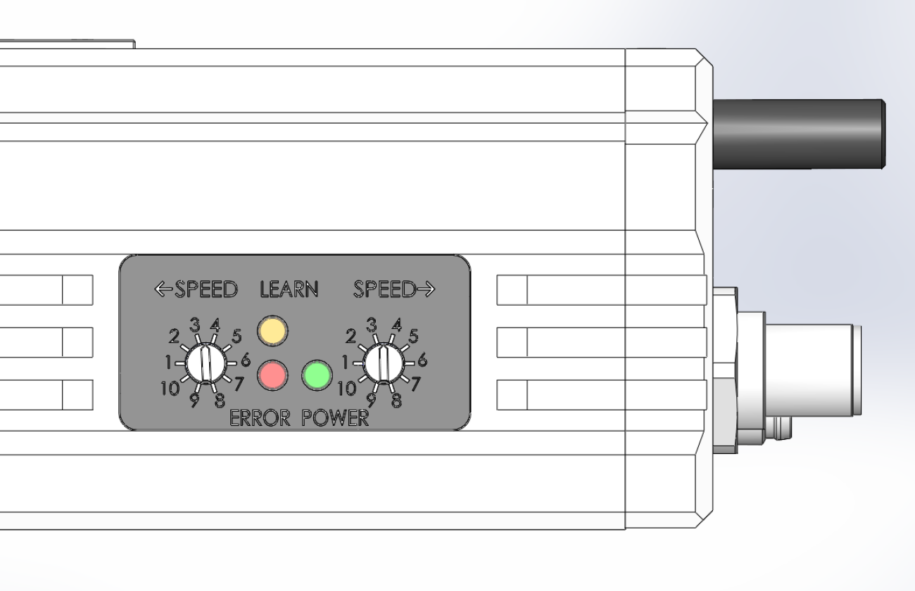
Control panel
LED display
Learn Mode
Error display
Ready
Speed adjustement
extending
Speed adjustment
retracting

Slide 9
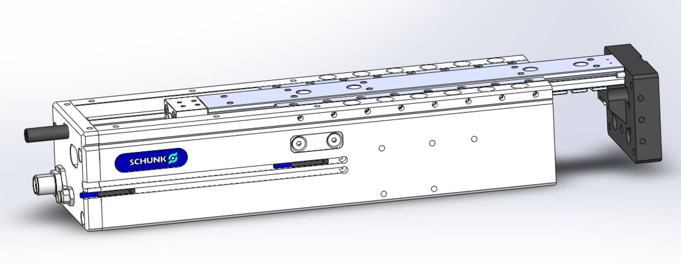
Sensors
Monitoring with magnetic switches MMS
Flush-mounted in the sensor groove
Monitoring position
extended
Monitoring position
retracted

Slide 10
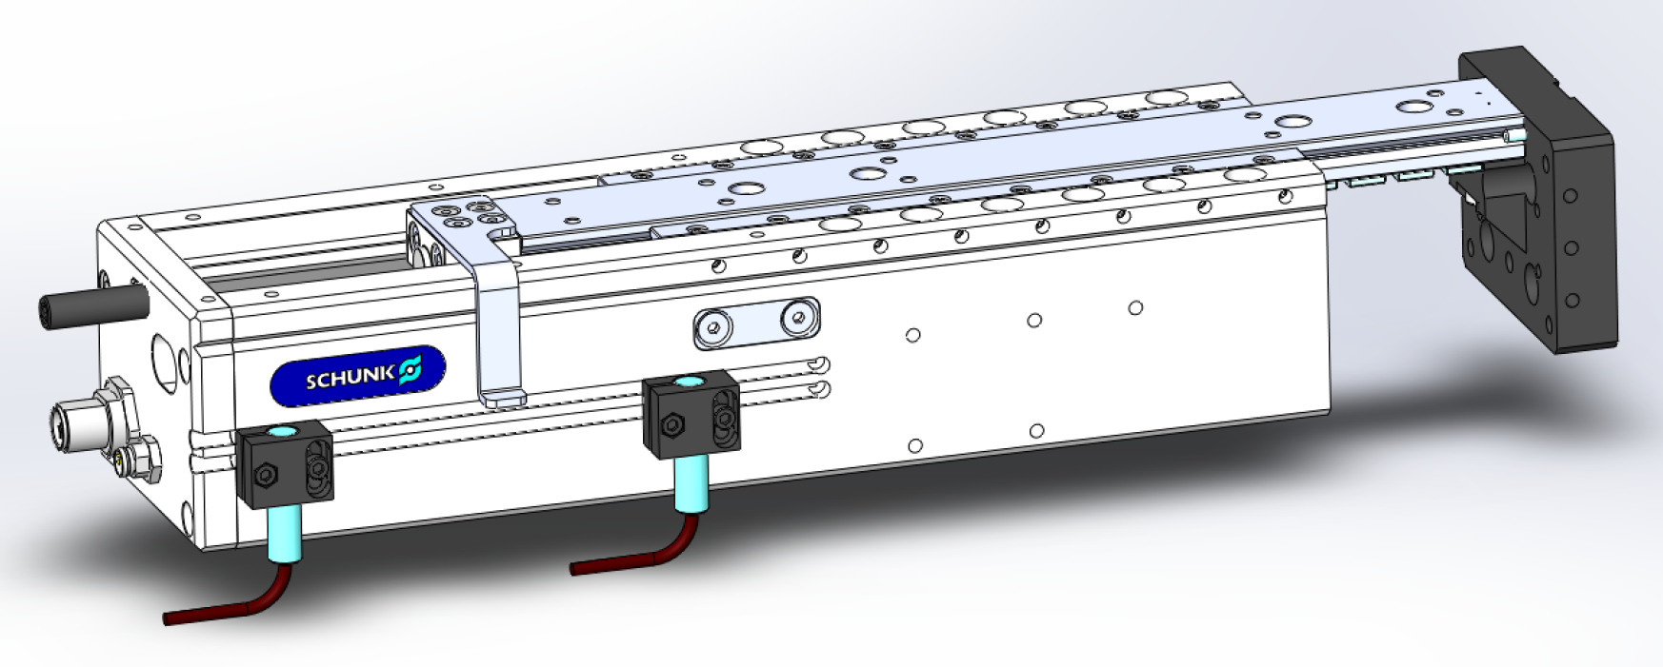
Sensors
Monitoring with inductive proximity switches IN
Attachment kit necessary
Bracket for IN 80
Cam switch
You can find further information in the catalog

Slide 11
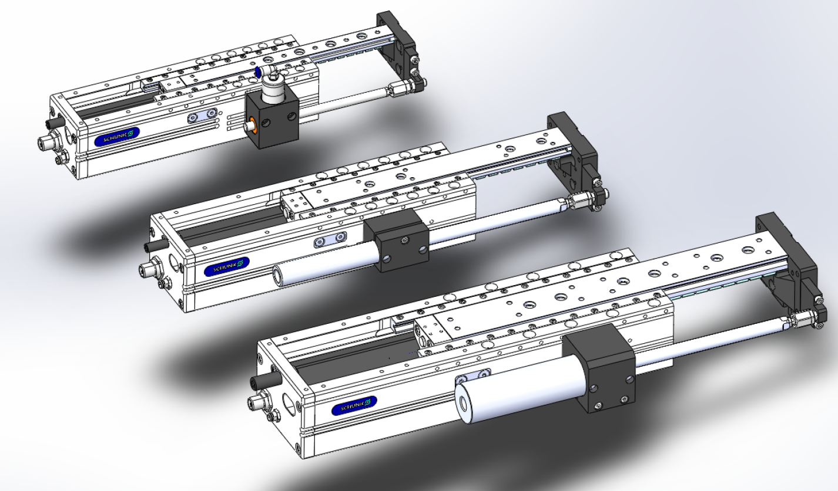
Attachment accessory
Load compensation - retrofittable with attachment kit
Pneumatic clamping device
(no standard availability)
Load compensation for ELP 25
MagSpring 20
Load compensation for ELP 100
MagSpring 37

Slide 12
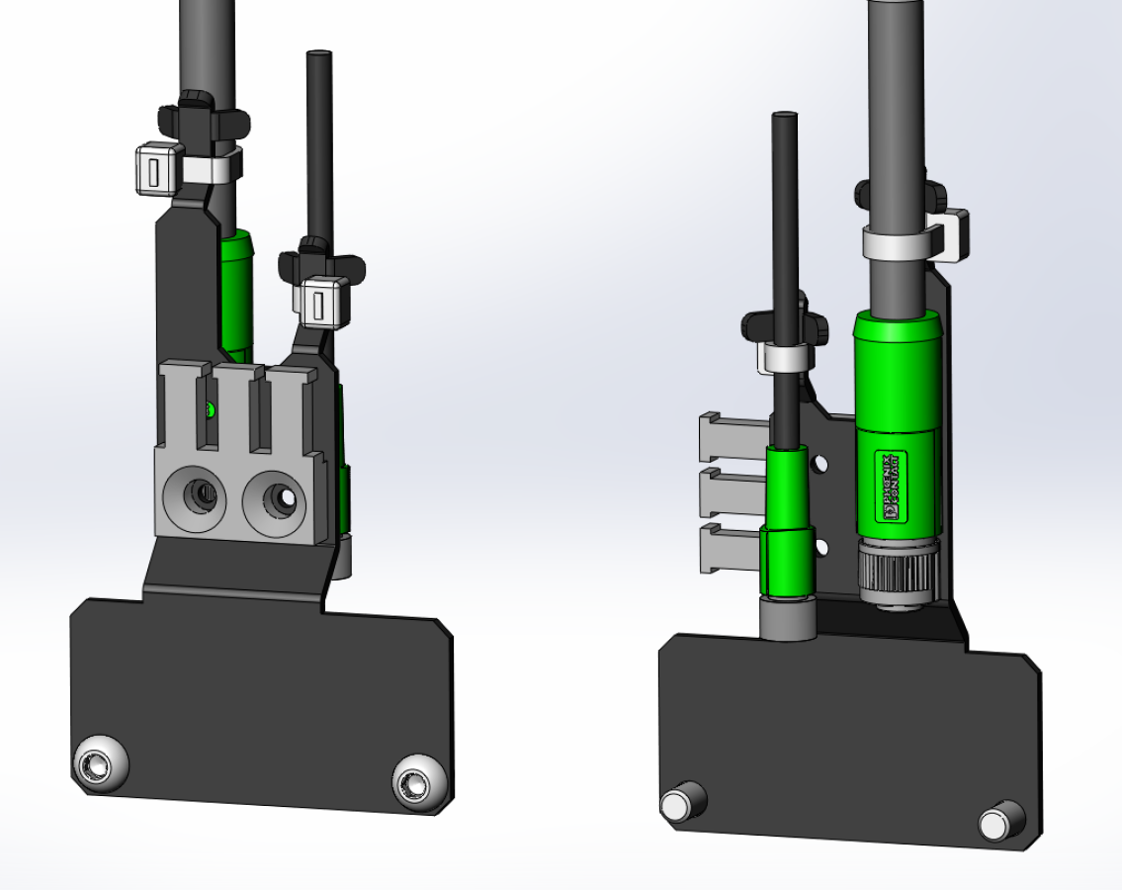
Strain relief accessory
Strain relief for electrical supply lines
Directly mountable
Mounting
ridge
Power cable
Signal cable

Slide 13
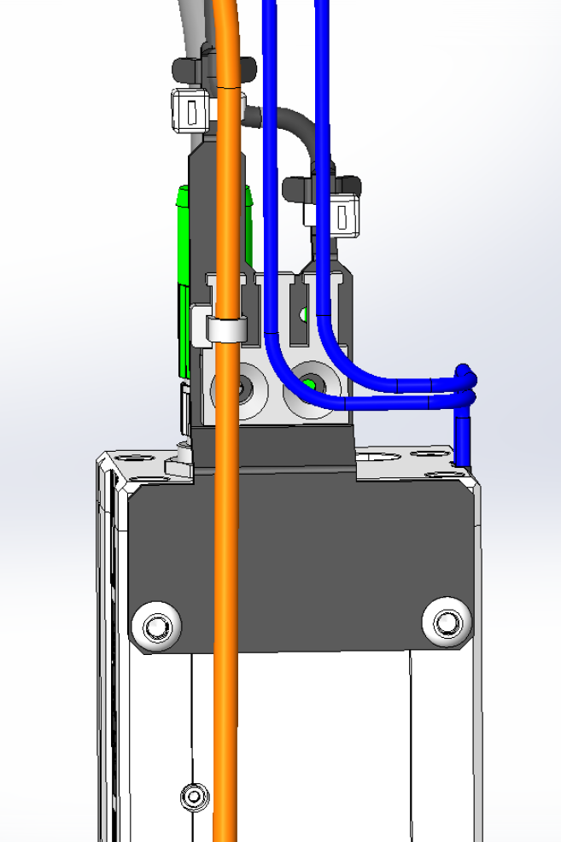
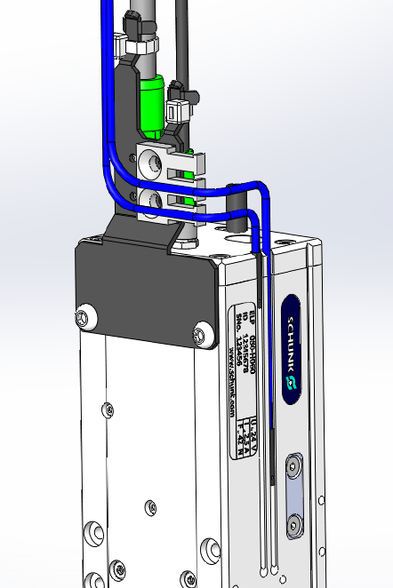
Strain relief accessory
Cables for sensors and other actuators can be fastened directly on the strain relief as well

Slide 14
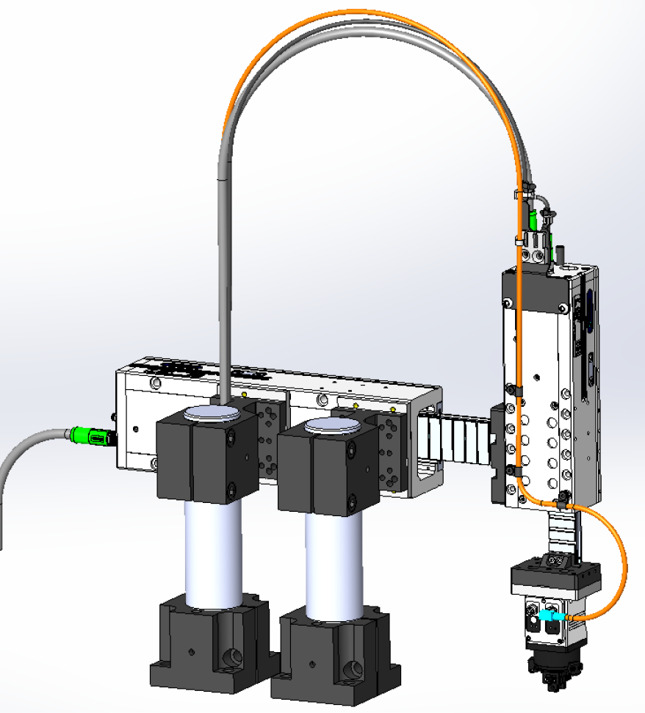
Strain relief accessory

Slide 15
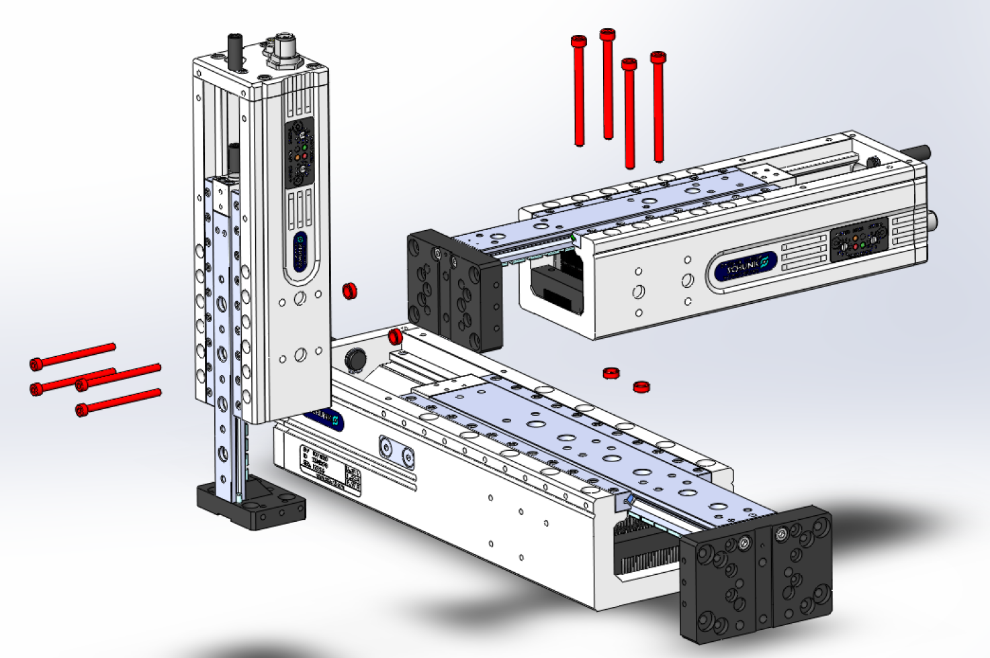
Possible Combinations
Modules can be assembled in many combinations among themselves without any adapter plates
4x Screws
2x Centering sleeves
You can find more informations in the operating manual

