Slide 1


6-Axis Force-Torque Sensors
- Use in practice
Confidential – For internal use only!

Slide 2
Available Systems
FTN - System
Evaluation of measuring data via Ethernet, DeviceNet or Profinet

Slide 3
Available Systems
FTD - System
Evaluation of the measuring data via data acquisition card (DAQ) on a measuring PC.

Slide 4
Available Systems
FTS - System
Evaluation of the measuring data via stand-alone controller, using
RS-232, analog voltage or discrete IO´s.

Slide 5
Available Systems
FTWN - System
Evaluation of the measuring data via W-LAN

Slide 6
Available Systems
FTE - System
Evaluation of the measuring data via Ethercat

Slide 7
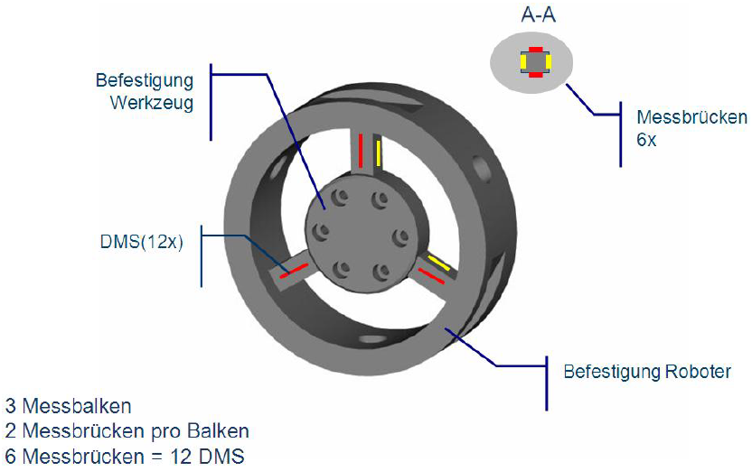
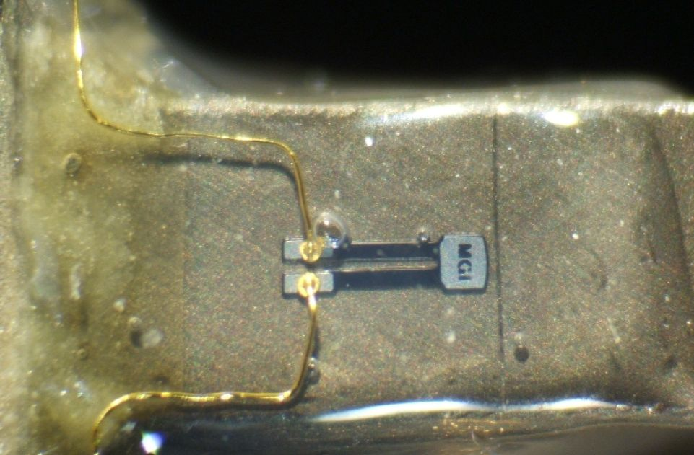
Silicon Stree-Strain Gauges
For measuring forces and torques with the FT sensors from SCHUNK, the silicon strain gauges are glued to the measuring bars within the sensor (see diagram). Every sensor size has 12 gauges, which are connected to 6 measuring bridges, and are integrated. They precisely record the most minor changes of forces and torques in different process applications.
The FT sensors have a mechanical overload of up to 40 times higher than the max. measurable force. The amount of overload differs depending on the size of the sensor.
If a force is applied to the FT sensor which is higher than the maximum admissible force, it could happen that the individual stress-strain gauges will be plastically deformed and the sensor will be irreparably destroyed.
You will find the maximum admissible forces in our catalog overview.

Slide 8
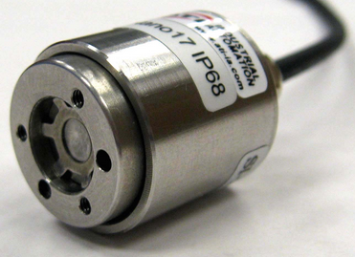
IP Protection Classes
Due to IP protection according to IP60, IP65 or IP68, FT sensors can be used in applications with direct contact to dust particles and fluids as well as applications under water.

Slide 9
Pricing
FT sensors are high-precision measuring devices and are always delivered with an individual calibration certificate.
There is no stock, and assembly and calibration is carried out only after an order has been received. At this point, the specific configuration with the desired evaluation electronics, cable length, IP protection etc., begins.
Moreover, the customer can benefit from the convenient situation that SCHUNK/ATI constitute an absolute unique selling point on the world market with a broad portfolio, the various options and the precision of the 6-axis force-torque sensors.
For this reason we cannot grant – or only in the rarest of cases – a discount on the FT sensors!

Slide 10
Practical Applictions
Table of contents
Grinding and polishing
Haptics measurements
Handling
Assembly
Climatic chamber product tests
Friction stir welding
Performance tests
Research and development
Confidential!
For internal use only!

Slide 11
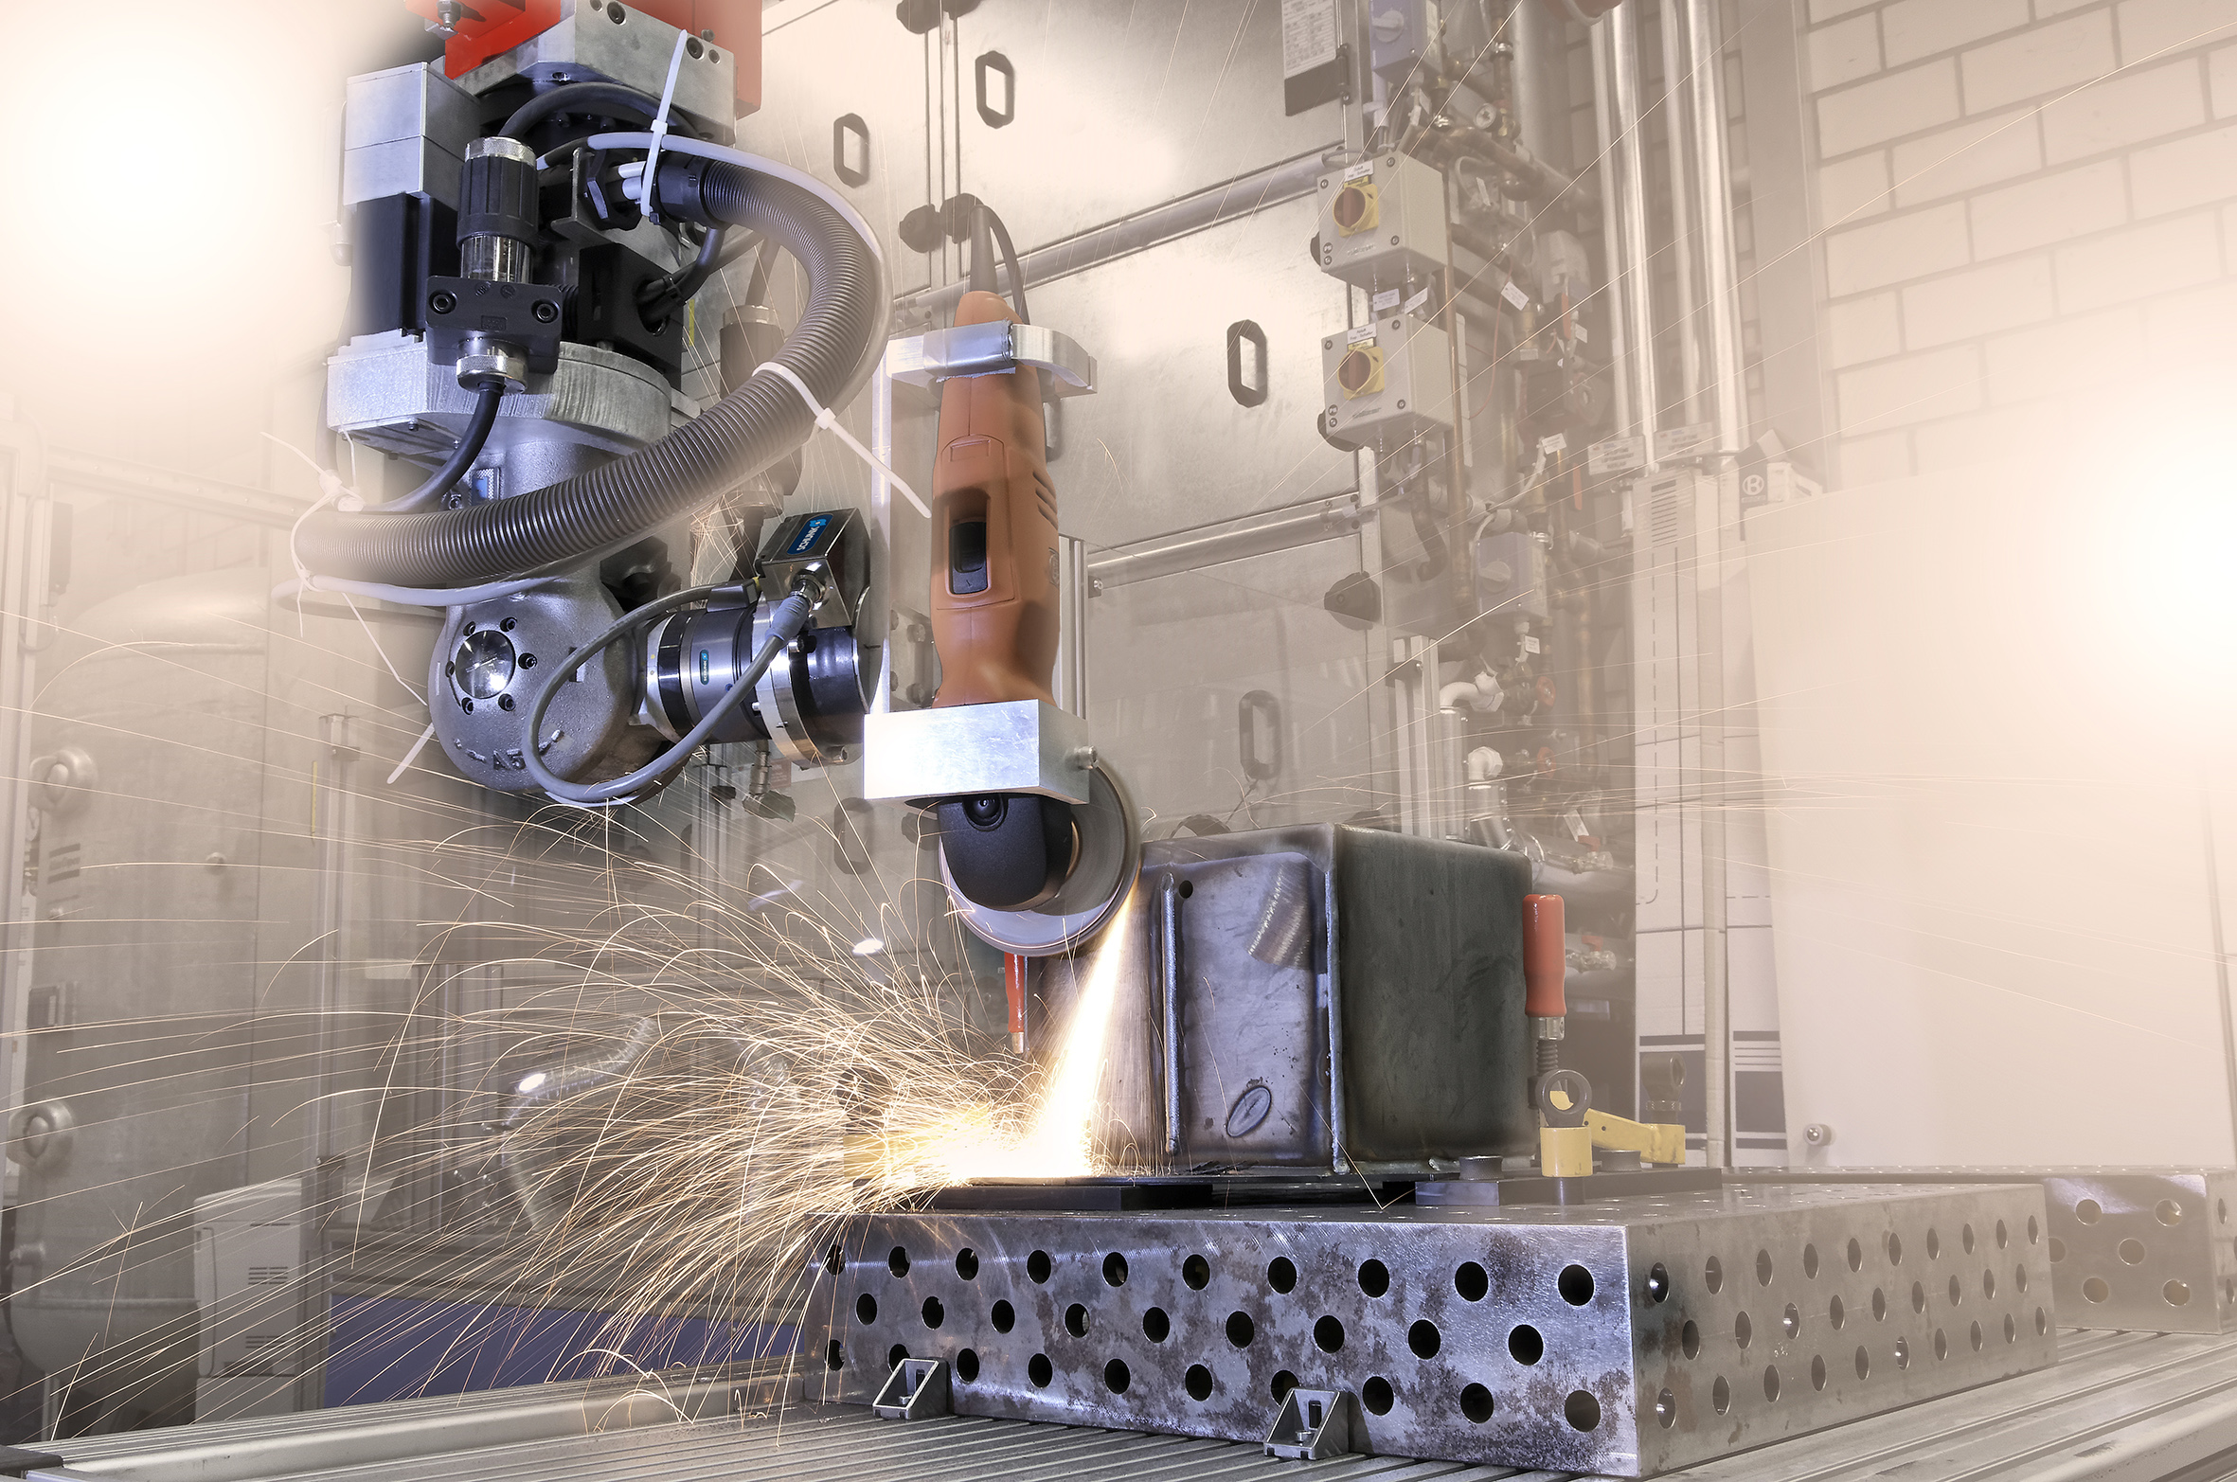
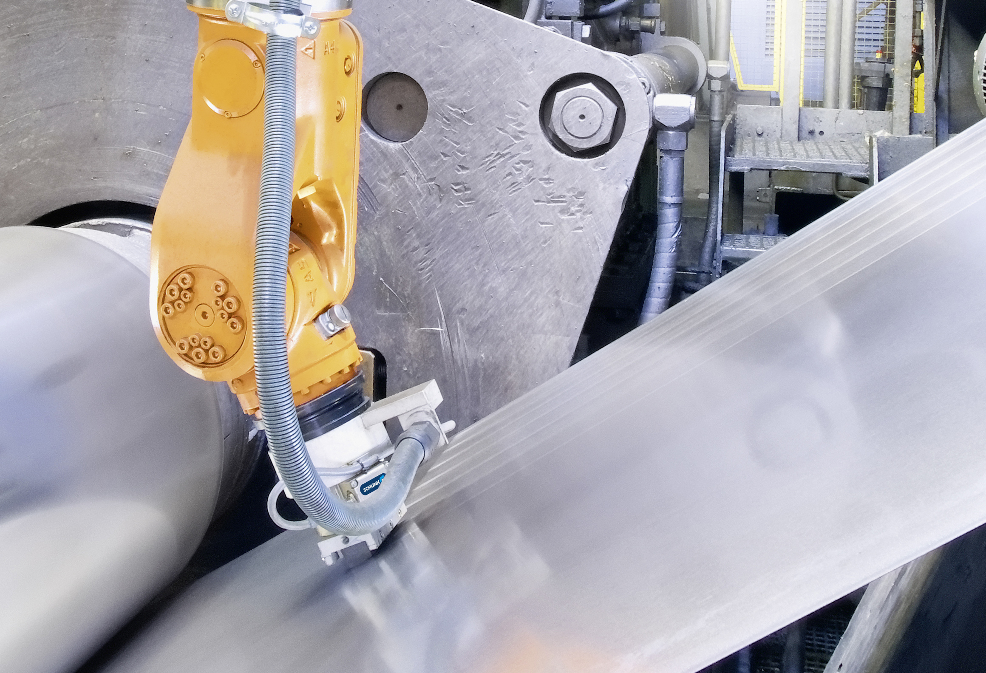

Grinding and Polishing
Constant process forces despite wear or uneven contours.
Confidential!
For inernal use only!
Inspection of surface quality of a steel strip by grinding.
Grinding of workpiece edges.
FT-DELTA
FT-DELTA

Slide 12
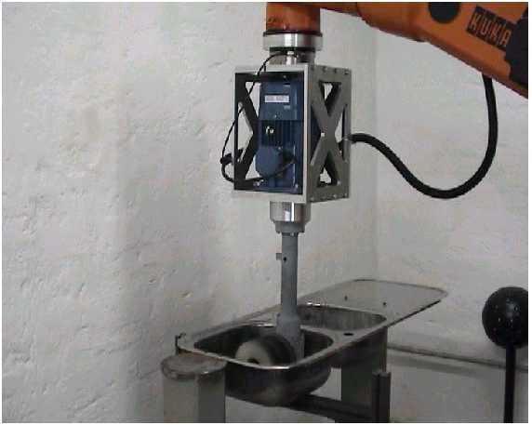
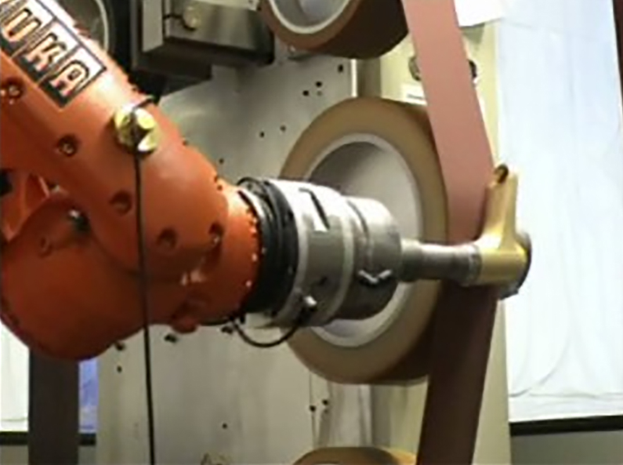
Grinding and Polishing
Constant process forces despite wear or uneven contours.
Confidential!
For internal use only!
Polishing of a sink.
Grinding of a water tap.
FT-DELTA
FT-DELTA

Slide 13
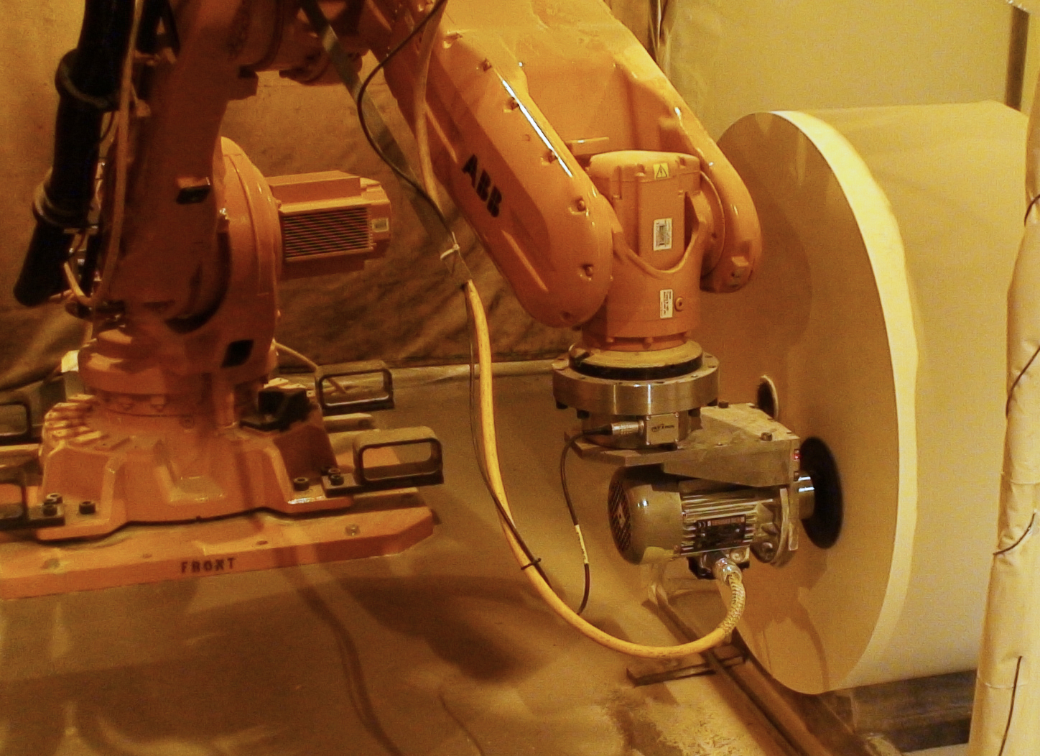
Grinding and Polishing
Constant process forces despite wear or uneven contours.
Confidential!
For internal use only!
Completion of a paper roll by grinding away uneven contours.
FT-Omega160

Slide 14
Haptics Measurements
Measuring the set points and actual values (N/Nm)
Confidential!
For internal use only!
Inspection of the ventilation nozzels ease of operation.
FT-MINI40

Slide 15
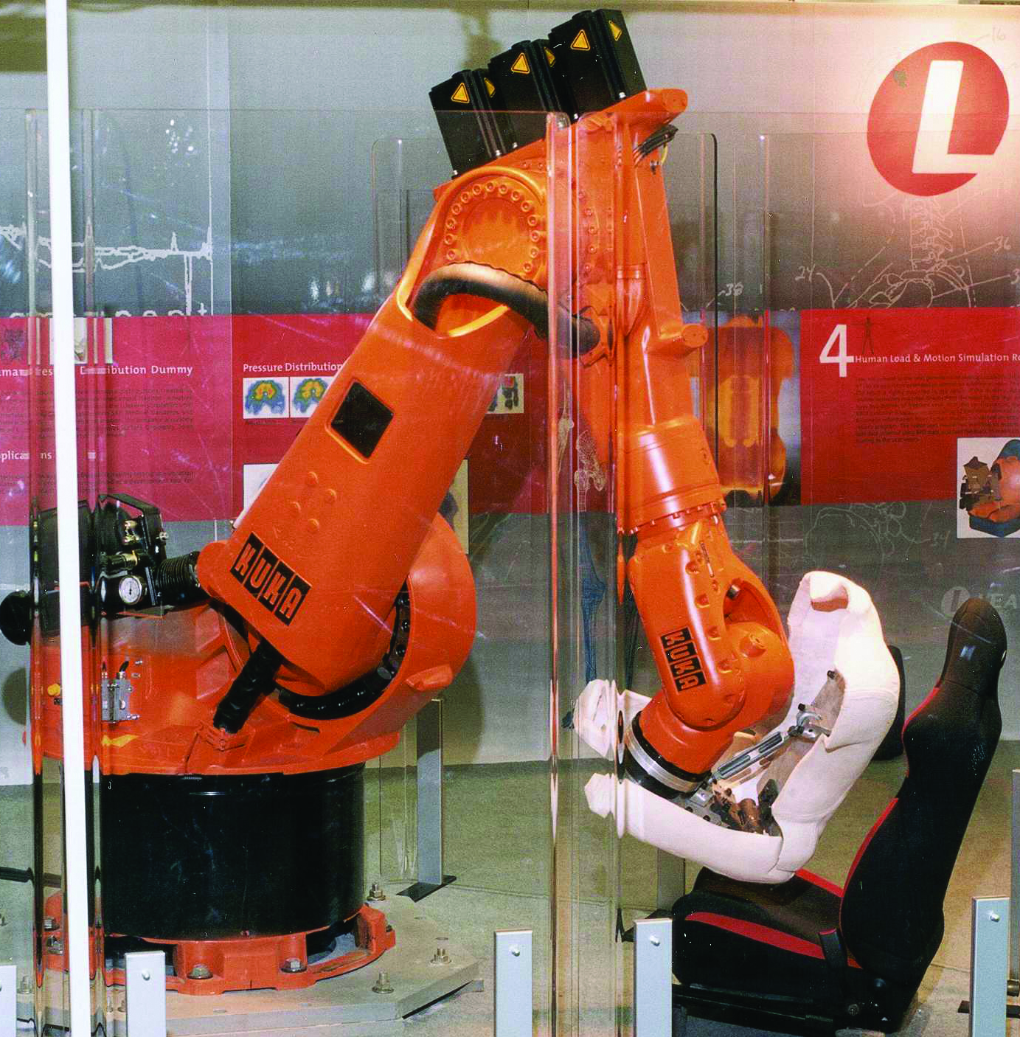
Haptics Measurements
Measuring the set points and actual values (N/Nm)
Confidential!
For internal use only!
Inspection of the load-beaering capacity of a car seat (force).
FT-Theta

Slide 16
Handling
Collaborative application: The user controls the robot via applied forces.
Confidential!
For internal use only!
Motor assembly via human/robot interaction.
FT-Delta

Slide 17
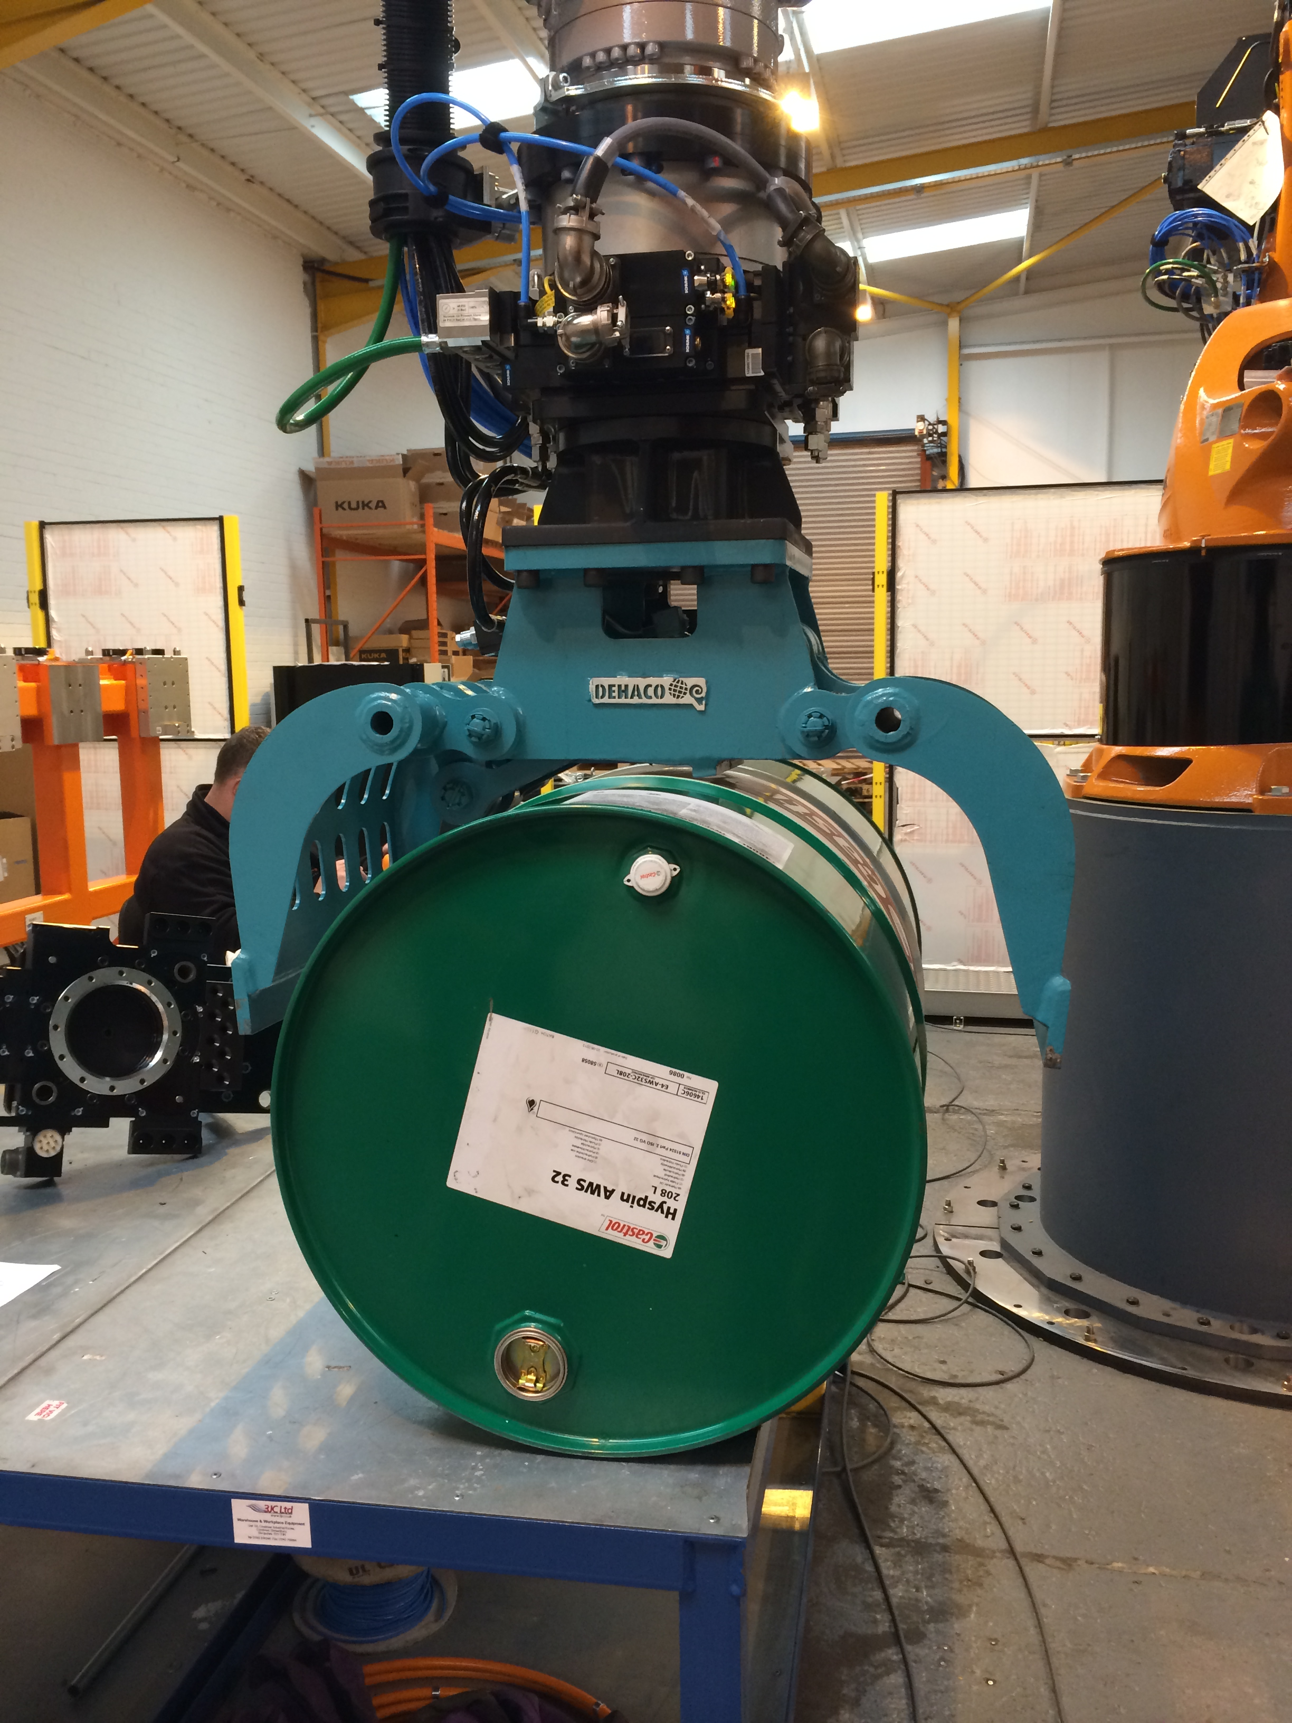
Handling
Force-controlled handling of workpieces.
Confidential!
For intenal use only!
Handling of barrels with radioactive material.
FT-Omega250

Slide 18
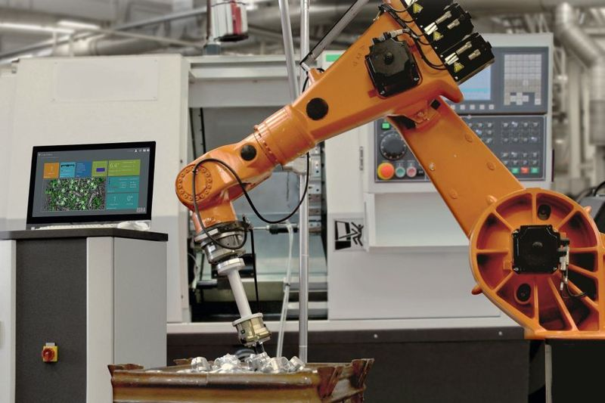
Handling
Bin picking.
Force-free gripping of workpieces.
Confidential!
For internal use only!
Secure gripping of workpieces, located in different positions.
FT-Delta

Slide 19
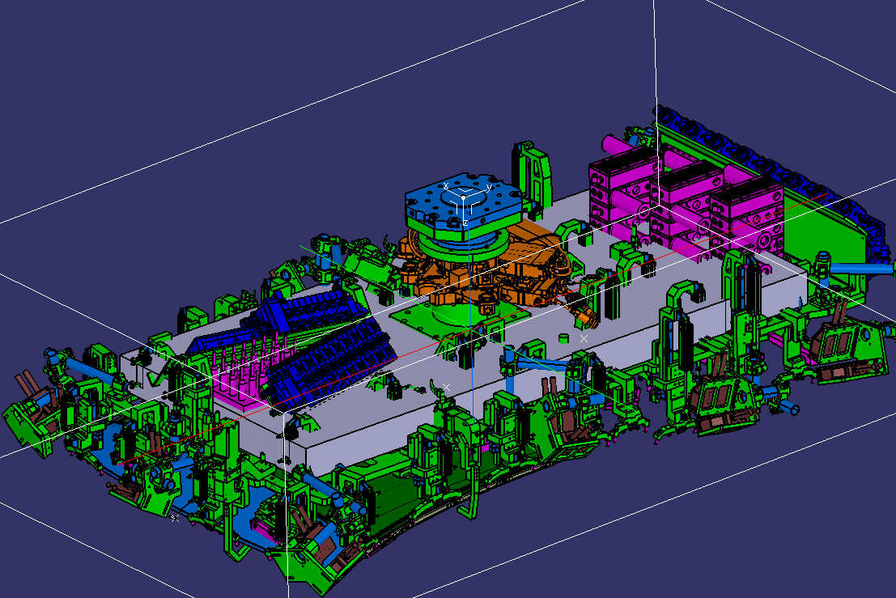
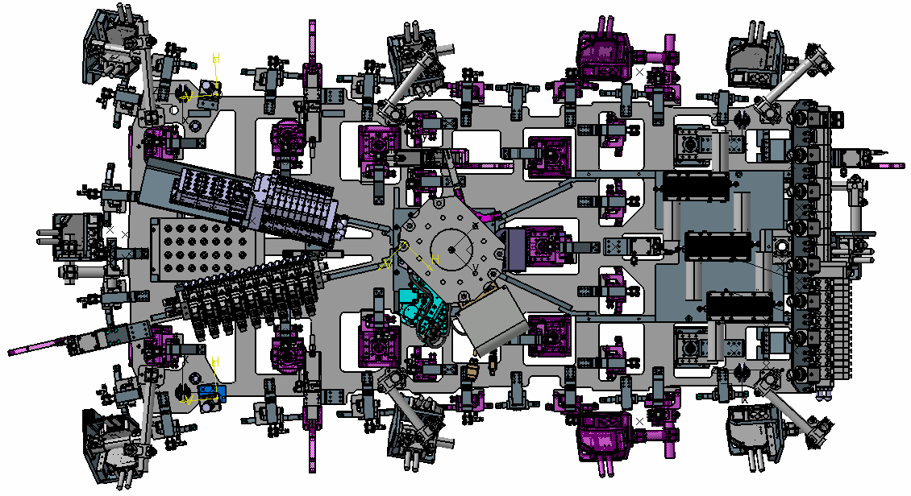
Handling
Assembly of vehicle roofs
Confidential!
For internal use only!
ca. 1900
ca. 1150
FT-Omega191
ca. 1000
Assembly of vehicle roofs with an identical contact pressure.

Slide 20
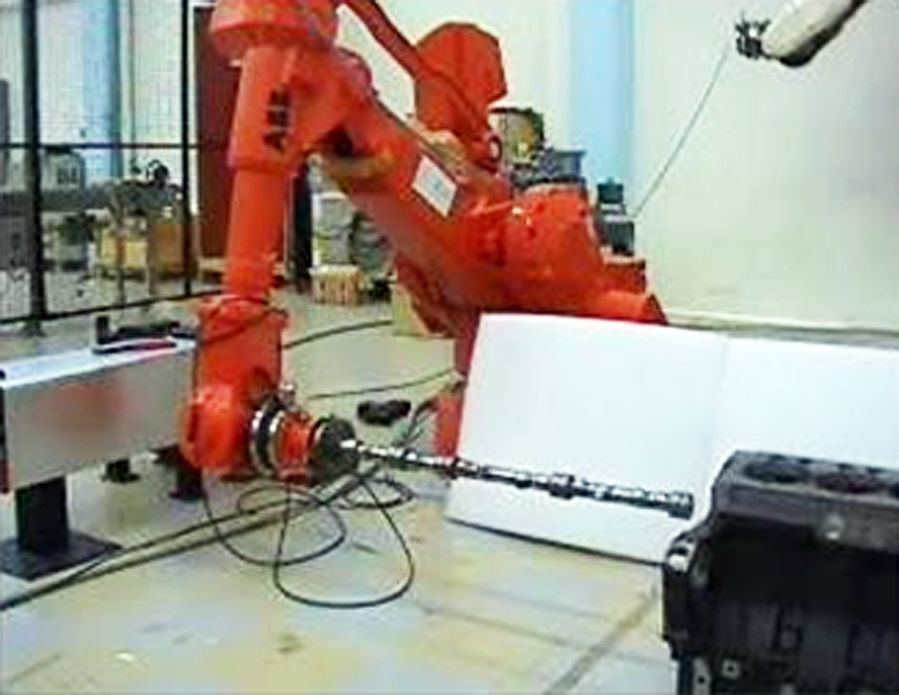
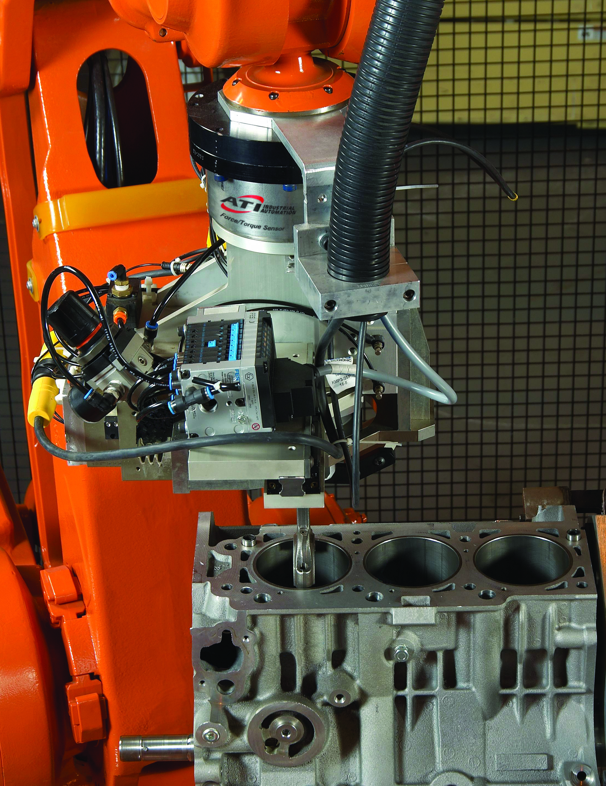
Montage
Force-controlled robot assembly
Confidential!
For internal use only!
Crankshaft assembly with an industrial robot.
FT-Omega160
FT-Delta

Slide 21
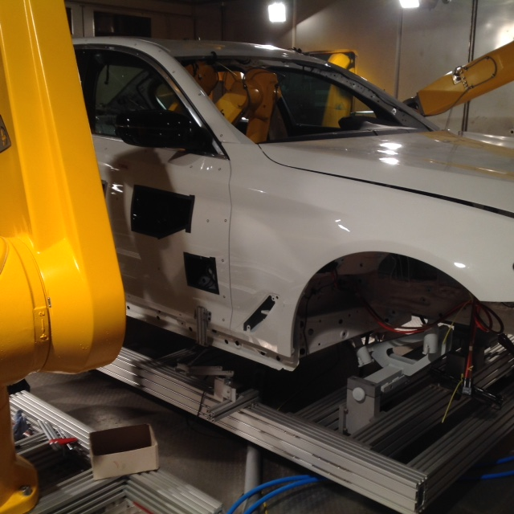
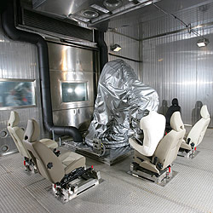
Climatic Chamber Product Tests
Measuring of set points and actual values (N/Nm)
Confidential!
For internal use only!
FT-Delta
Quality assurance: Passenger car in various ambient temperatures.

Slide 22
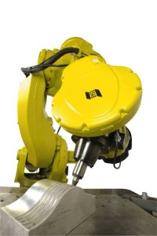
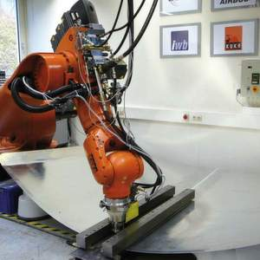
Friction Stir Welding
Measuring of set points and actual values (N/Nm)
Confidential!
For internal use only!
Combining of two components without additional material.
FT-Omega191
FT-Omega191

Slide 23
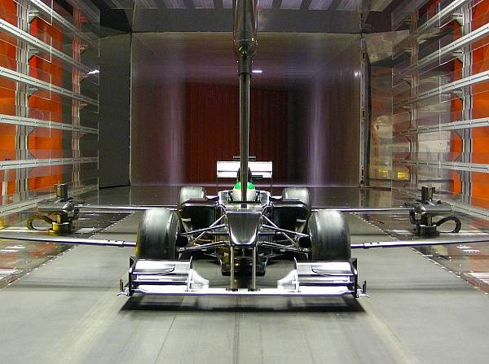
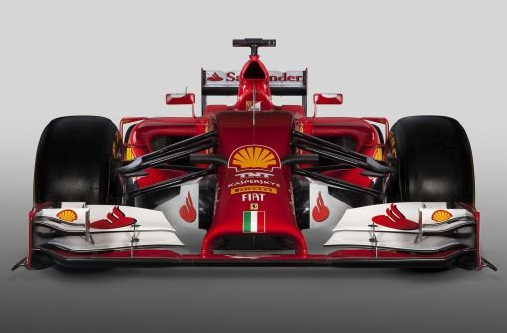
Performance Test
Measuring of process forces.
Confidential!
For internal use only!
6x FT-Mini58
6x FT-Mini58
Testing the aerodynamics at a F1 prototype.

Slide 24
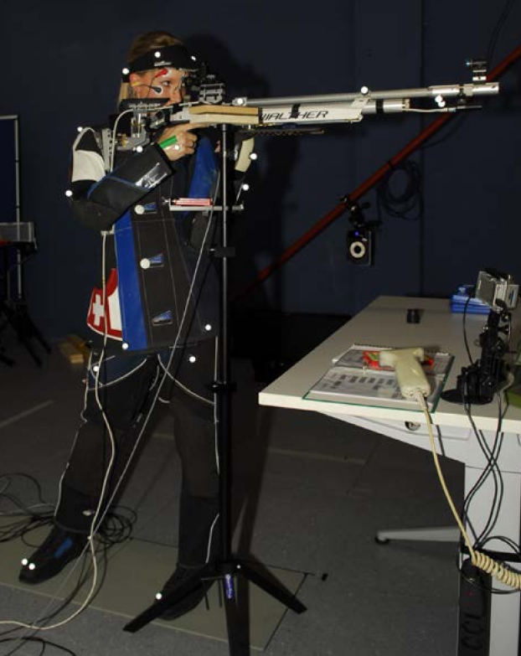
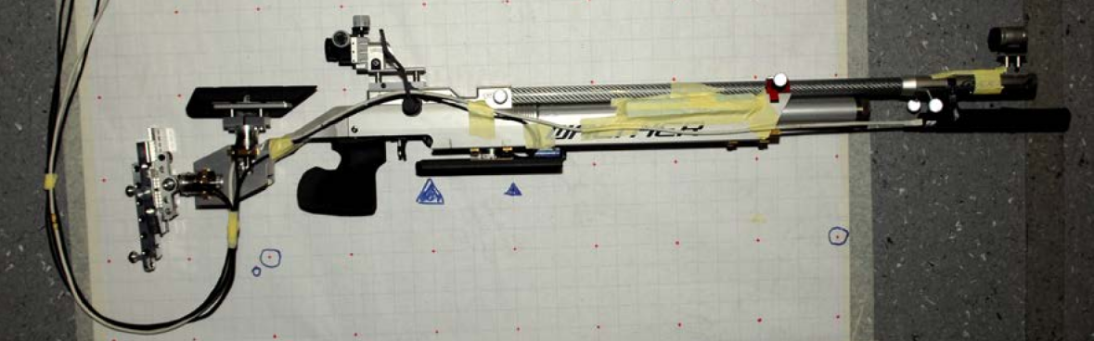
Performance Test
Measuring of process forces.
Confidential!
For internal use only!
Increase of the hit rate of competitive athletes.
4x FT-Nano25

Slide 25
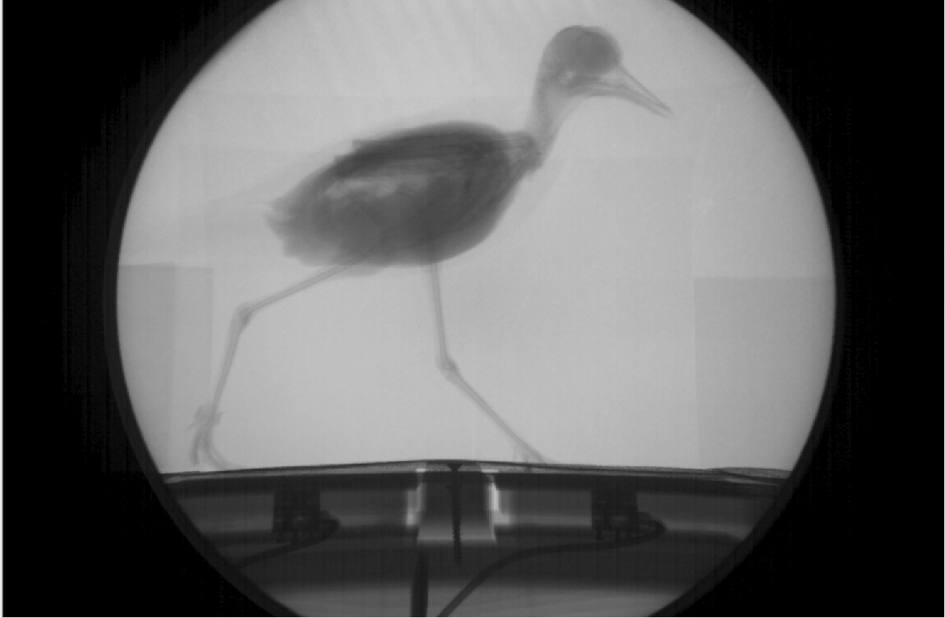
Research and Development
Measuring of process forces.
Confidential!
For internal use only!
Measuring of the lifting force of a bird.
FT-Mini40

Slide 26
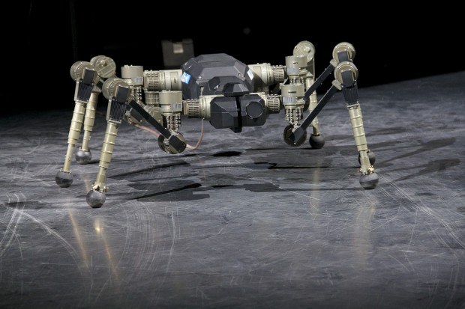
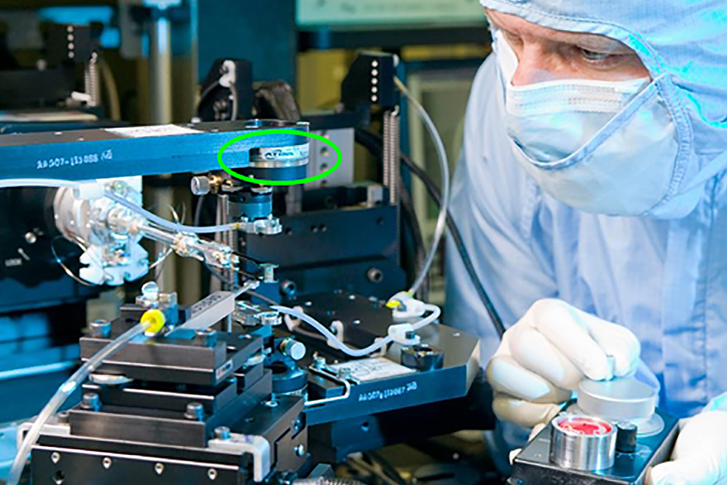
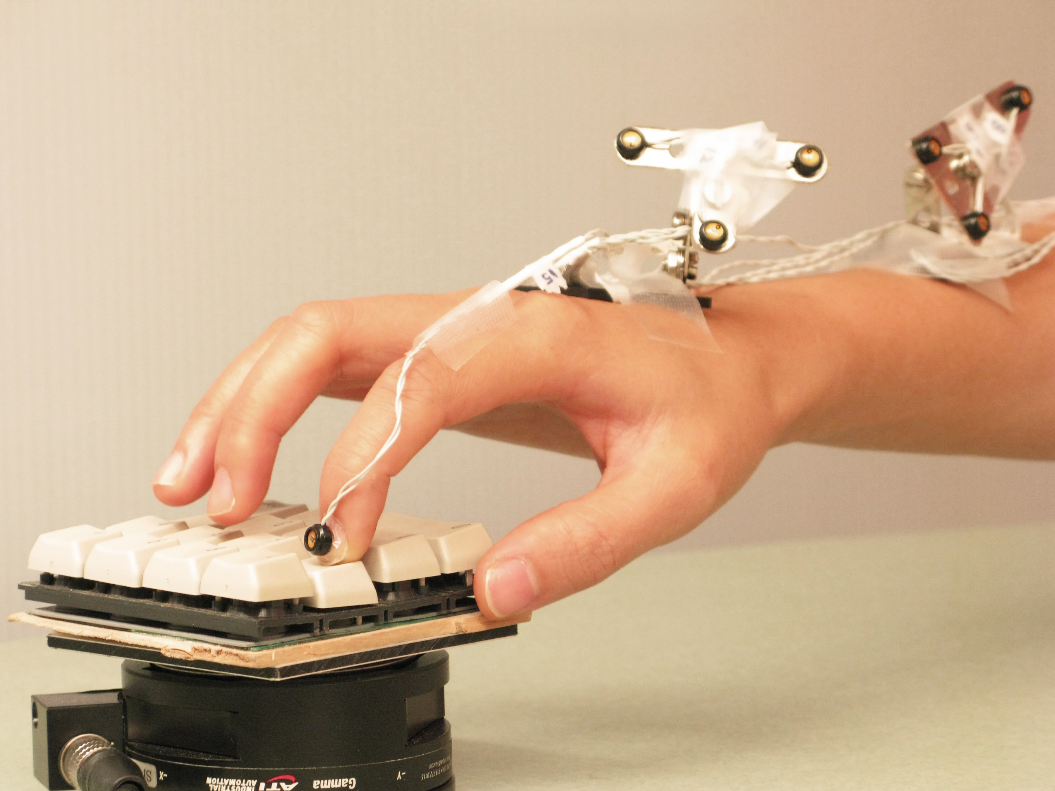
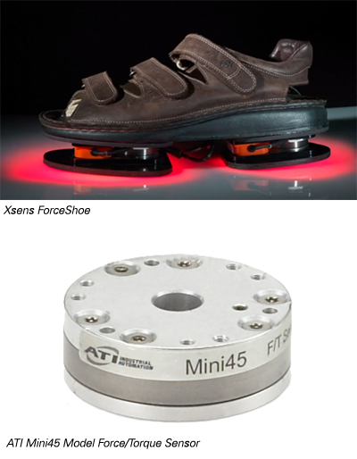
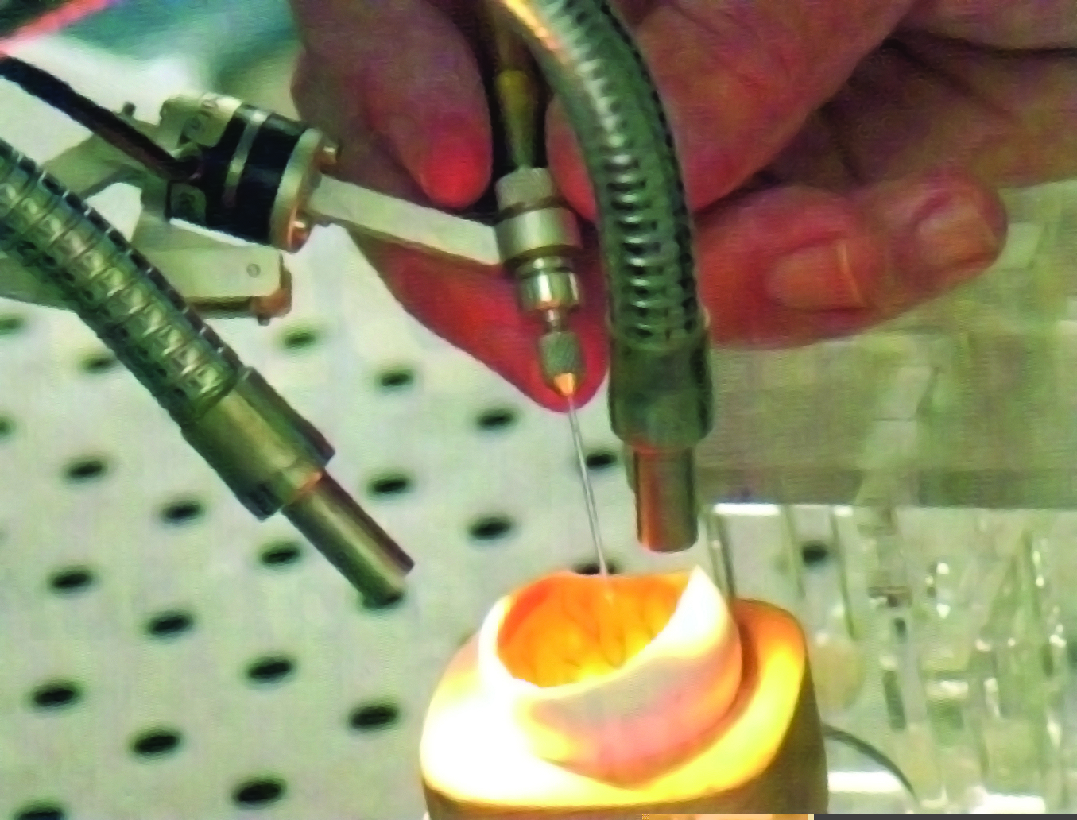
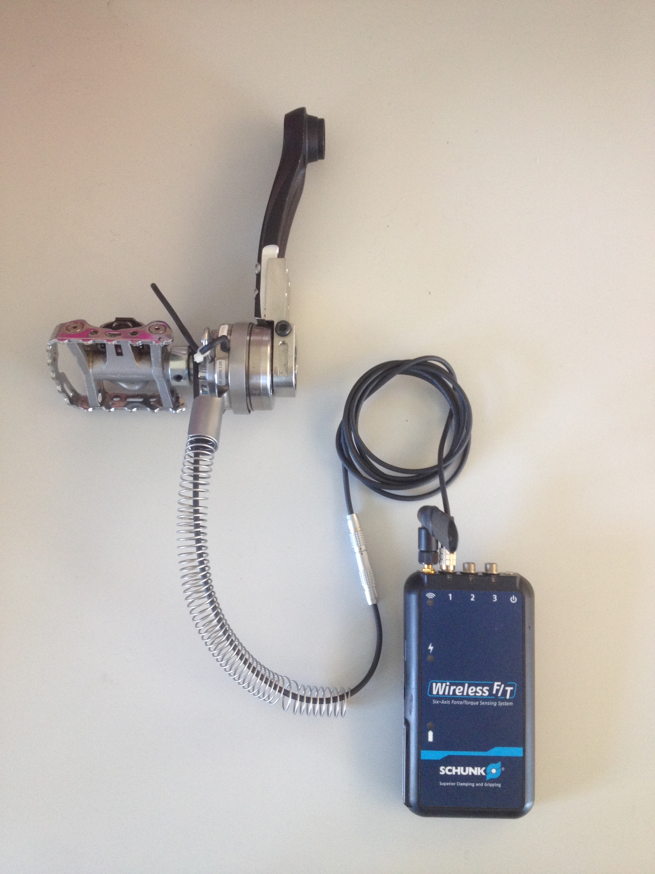
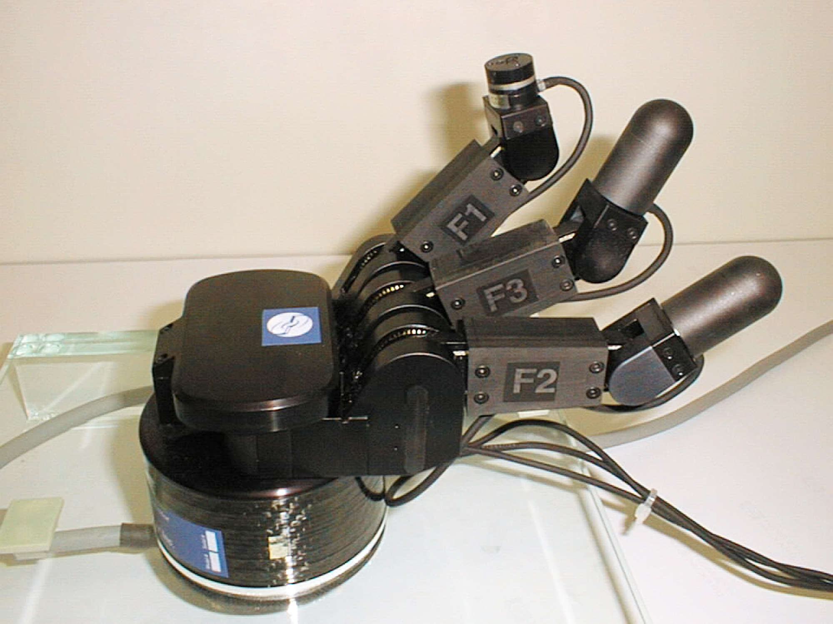
Research and Development
Confidential!
For internal use only!

Slide 27
Customer Applications
A 6 axis force-torque sensor makes sense to use where forces and torques need to be measured or the changes in forces and torques should be captured in all 6 axes!
If you should have further questions, please contacat the Robot Accessories Department under Roboterzubehoer@de.schunk.com.
Please also consider the check-list, which you will find in the attachment of the FT overview in the SalesToolBox.

