Slide 1

Product presentation
PGN-plus-P
Universal gripper

Slide 2
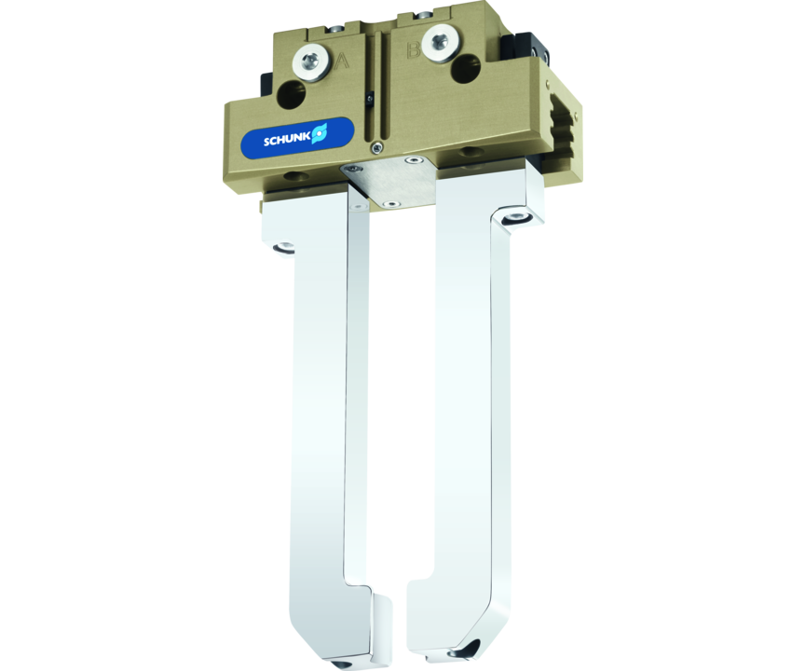
Universal gripper
Universal 2-finger parallel gripper with permanent lubrication, high gripping force, and high maximum moments due to the use of a multi-tooth guidance.
The world's most proven gripper on the market – with permanent lubrication in the multi-tooth guidance.
Lifelong maintenance-free Guaranteed!

Slide 3

Reliable. Robust. Flexible.
Perfected multi-tooth guidance
Lubricant pockets in the mult-tooth guidance
Dustproof version SD
ATEX version EX
Portfolio expansion - new sizes PGN-plus-P 40, 160 and 240

Slide 4
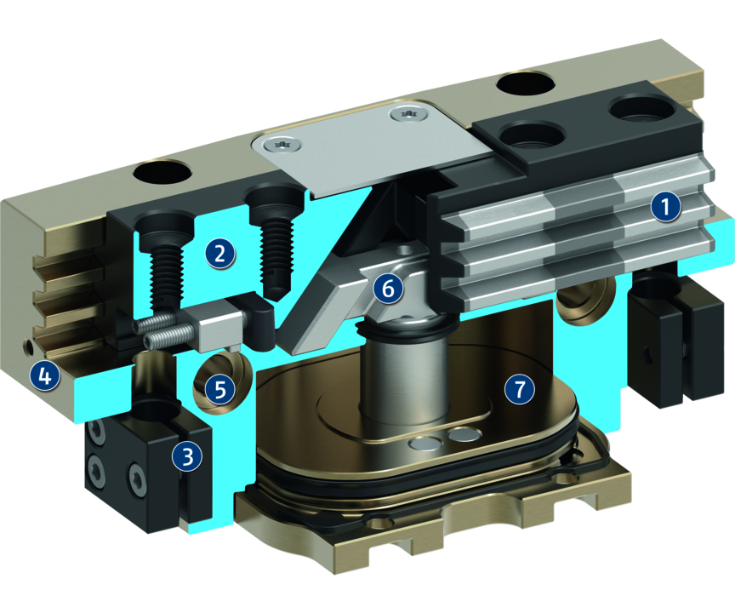
Principle of function
Functional description
The piston is moved up and down by compressed air.
The angled active surfaces of the wedge-hook produce a synchronized, parallel jaw motion.
1
Multi-tooth guidance
2
Base Jaw
3
Bracket for sensors
4
Housing
5
Centering and mounting possibilities
6
Wedge-hook design
7
Piston

Slide 5
Advantages – Your benefits
Robust multi-tooth guidance for precise handling
High maximum moments possible suitable for using long gripper fingers
Lubricant pockets in the mult-tooth guidance ensure process reliability and extended maintenance intervals
Maximum piston surface area for maximum gripping forces
Mounting from two sides in three screw directions for universal and flexible gripper assembly
Air supply via hose-free direct connection or screw connections for universal and flexible gripper assembly
Comprehensive sensor accessory program for versatile querying possibilities and stroke position monitoring
Manifold options for special optimization for your specific case of application (dustproof, high-temperature, corrosion-protected, etc.)

Slide 6
Technical data
Technical data overview
Size | Stroke per jaw | Closing force | Opening force | Recommended workpiece weight | Weight | Max. permissible finger length
 | [mm] | [N] | [N] | [kg] | [kg] | [mm]
40 | 2.5 | 180 .. 235 | 200 .. 260 | 0.9 | 0.08 .. 0.12 | 60 .. 65
50 | 2 .. 4 | 220 .. 490 | 235 .. 520 | 1.1 .. 1.9 | 0.17 .. 0.24 | 70 .. 80
64 | 3 .. 6 | 350 .. 920 | 375 .. 1050 | 1.75 .. 3.6 | 0.27 .. 0.42 | 85 .. 100
80 | 4 .. 8 | 550 .. 1500 | 610 .. 1600 | 2.75 .. 5.5 | 0.51 .. 0.7 | 105 .. 125
100 | 5 .. 10 | 870 .. 2200 | 930 .. 2400 | 4.35 .. 8.75 | 0.9 .. 1.22 | 130 .. 160
125 | 6 .. 13 | 1400 .. 4200 | 1520 .. 4450 | 7 .. 15 | 1.4 .. 2.1 | 170 .. 200
160 | 8 .. 16 | 2500 .. 6300 | 2800 .. 6900 | 12.5 .. 24.5 | 3 .. 4 | 215 .. 245
200 | 14 .. 25 | 3800 .. 8750 | 4050 .. 9350 | 19 .. 32.5 | 5.4 .. 7.6 | 220 .. 310
240 | 17 .. 30 | 5300 .. 14000 | 5600 .. 14500 | 26.5 .. 45 | 8.7 .. 12.7 | 260 .. 355
300 | 20 .. 35 | 6600 .. 15600 | 6800 .. 16000 | 33 .. 59 | 13.7 .. 18.7 | 250 .. 350
380 | 26 .. 45 | 10300 .. 26100 | 10800 .. 27000 | 51.5 .. 97.5 | 26.5 .. 39.8 | 300 .. 400

