Slide 1

Product presentation
ELP
Linear axis

Slide 2
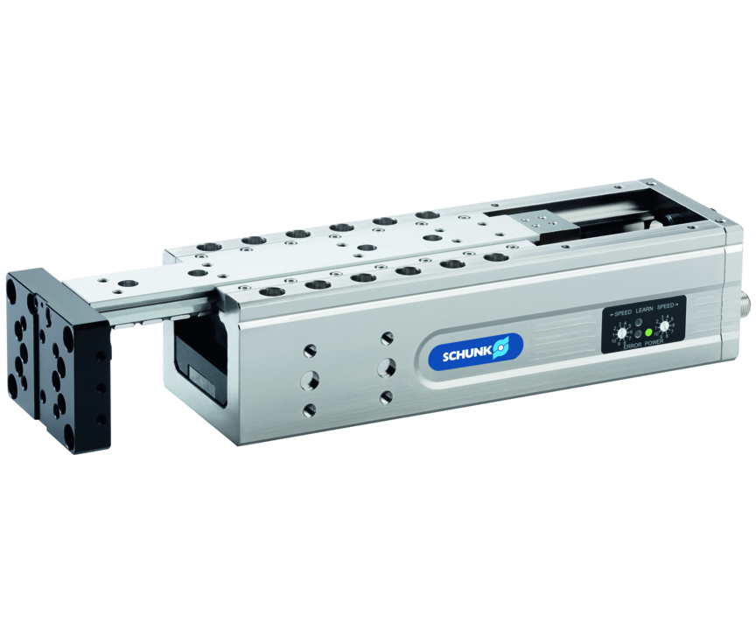
Linear axis
Electric linear module with direct drive and integrated controller, scope-free guided using pre-loaded roller guideü
There is no other electric linear module on the market that is as user-friendly to configure
Ready for takeoff in only 2 work steps!

Slide 3

Easy. Fast. Reliable.
Module operating mode now freely selectable (M1 or Auto-Learn function)
Manual speed configuration using rotary switches
Also suitable for use in cam-controlled systems
Control via digital I/O
Rotary switch optically improved

Slide 4
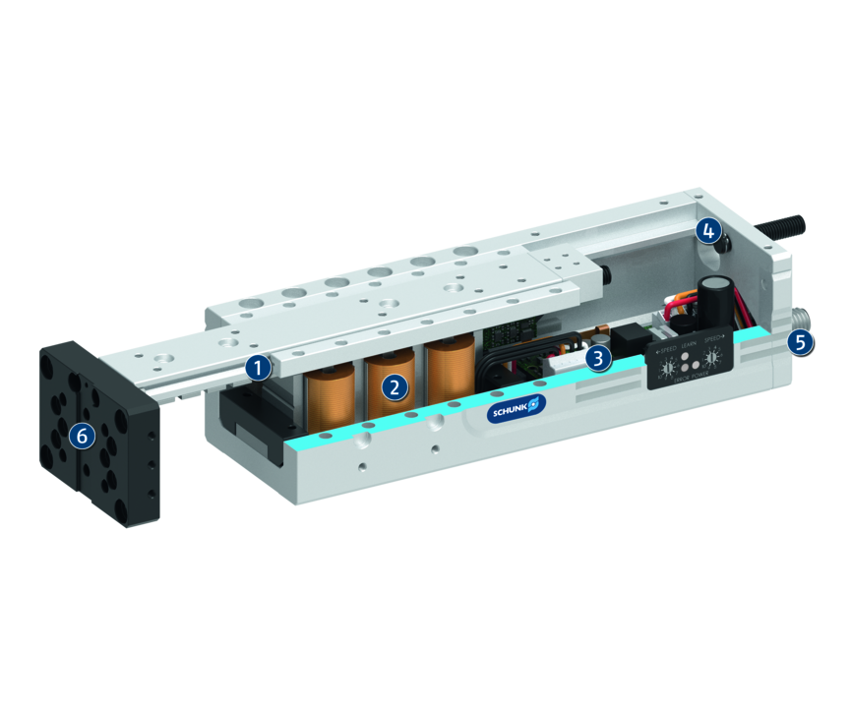
Principle of function
Functional description
The electric drive consists of a primary part (motor coil) and a secondary part (permanent magnets). Inside the controller the phase and amplitude of the applied electric current are controlled. This sets the profile, which is fitted with magnets, in motion.
1
Roller guide
2
Drive
3
Control electronics
4
End position adjustability
5
Connection plug
6
Mounting pattern

Slide 5
Advantages – Your benefits
Control via digital I/O for easy commissioning and rapid integration into existing systems.
10 independent extension and retraction speeds for high flexibility in cycle times
Linear direct drive for almost wear-free use and a long service life
Robust bearing guidance for high load capacities and end-position accuracy in all installation positions
Maintenance-free for high machine uptime and low operating costs
Compact dimensions for less interfering contours
Standardized mounting bores for numerous combinations with other components from the modular system

Slide 6
Technical data
Technical data overview
Size | Max. stroke | Nominal force | Max. useful load (horizontal) | Max. useful load (vertical)
 | [mm] | [N] | [kg] | [kg]
25 | 30 .. 80 | 17 | 1 | 0.75
50 | 40 .. 100 | 45 | 3 | 2
100 | 80 .. 200 | 104 | 6 | 4

