Slide 1

Product presentation
SHS
Gripper change system

Slide 2
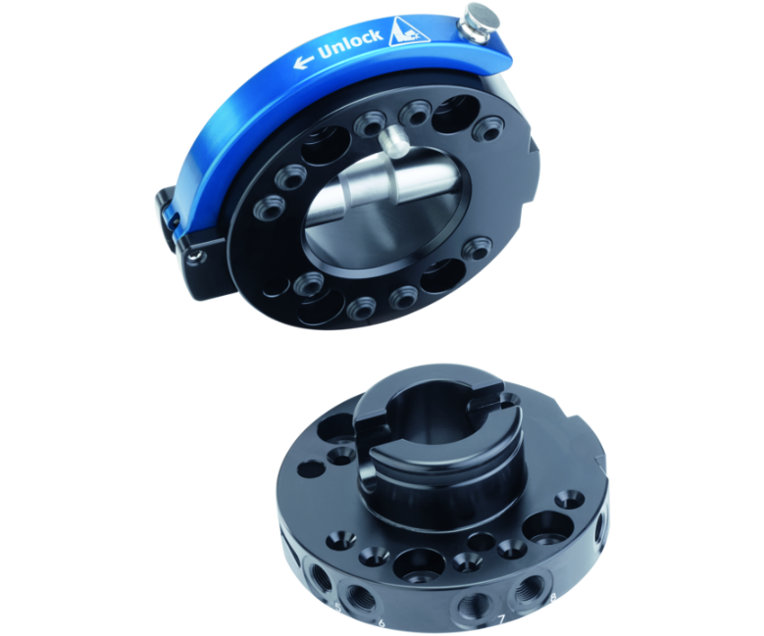
Gripper change system
Manual tool change system with integrated air feed-through, locking monitoring, and optional electric feed-through.
The world's first change system with integrated presence and locking monitoring.
up to a handling weight of 58 kg

Slide 3

Flexible. Compact. Intuitive.
Convenient manual operation using a simple locking lever
Six sizes are available
Sensor technology is optionally available for monitoring locking and presence monitoring
Integrated pneumatic feed-through
Wide range of electric, pneumatic, and fluid modules

Slide 4
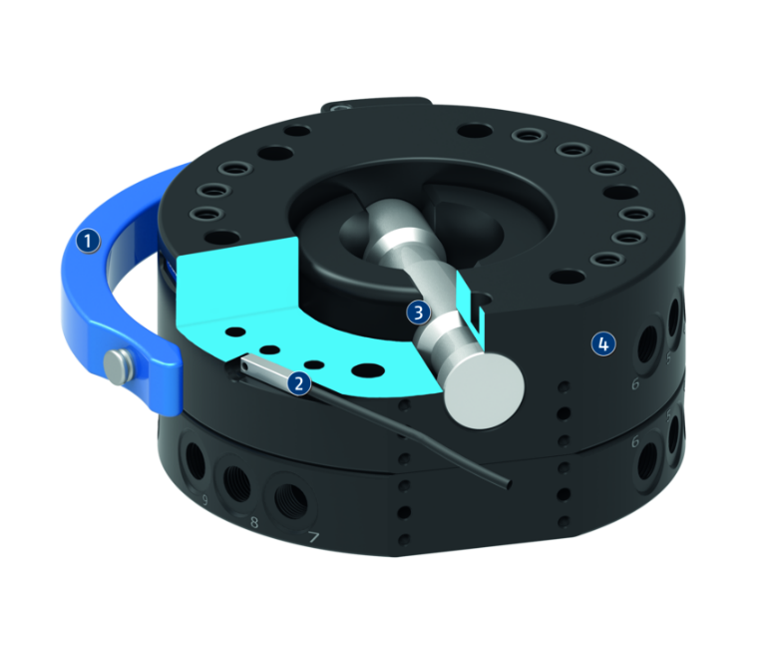
Principle of function
Functional description
The manual change system (SHS) consists of a manual change head (SHK) and a manual change adapter (SHA). The manual change head (SHK) is form-fit locked with the manual change adapter (SHA), and due to the patented locking it is free from play. A pin is pushed forward or backward via a locking lever for locking or unlocking. An integrated pneumatic feed-through supplies the tool with energy.
1
Locking lever
2
Lock sensing
3
Locking bolt
4
Air feed-through

Slide 5
Advantages – Your benefits
Series with six unit sizes for optimal size selection and a broad application range
Integrated pneumatic feed-through for a safe power supply of the handling modules and tools
The locking lever is opened sideways this allows the changer to be easily operated even in confined spaces
Optional locking and presence monitoring thus increased process reliability
Wide range of electric, pneumatic, and fluid modules for universal energy transmission possibilities
ISO mounting pattern for easy assembly to most types of robots without needing additional adapter plates

Slide 6
Technical data
Technical data overview
Size | Recommended handling weight | Lock sensing | Weight | Number of pneumatic feed-throughs | Feed-throughs for radial use | Connection flange according to
 | [kg] |  | [kg]
40 | 9 | optionally via attachment kit | 0.075 .. 0.14 | 4 | 2 .. 4 | ISO 9409-1-40-4-M6
50 | 11 | optionally via attachment kit | 0.1 .. 0.25 | 6 | 3 .. 6 | ISO 9409-1-50-4-M6
63 | 18 | optionally via attachment kit | 0.2 .. 0.41 | 6 | 3 .. 6 | ISO 9409-1-63-4-M6
80 | 36 | optionally via attachment kit | 0.35 .. 0.74 | 9 | 4 .. 9 | ISO 9409-1-80-6-M8
100 | 43 | optional | 0.55 .. 1.3 | 12 | 6 .. 12 | ISO 9409-1-100-6-M8
125 | 58 | optional | 1.2 .. 2.8 | 12 | 6 .. 12 | ISO 9409-1-125-6-M10

