Slide 1

Product presentation
PGN-plus-E
Universal gripper

Slide 2
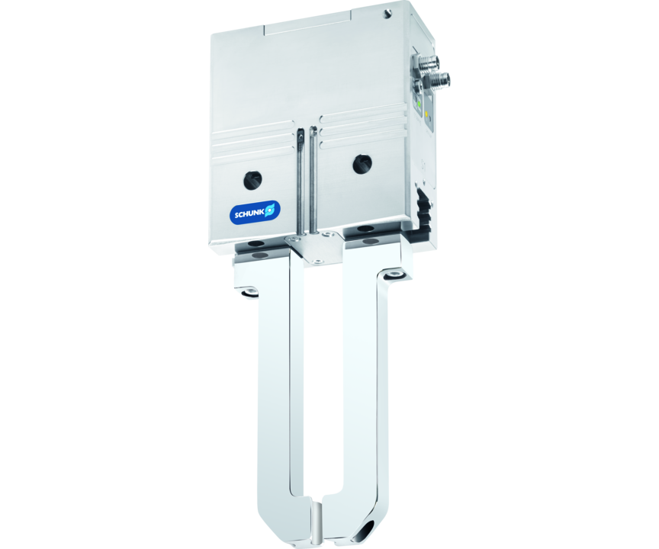
Universal gripper
Universal electric 2-finger parallel gripper with permanent lubrication, high gripping force, and a high maximum moment due to the use of a multi-tooth guidance.
The first simple electric gripper with reliable multi-tooth guidance.
Multi-tooth guidance, digital actuation and 24 V drive with permanent lubrication.

Slide 3

Reliable. Robust. Flexible.
New variant with IO-link interface
Four-step adjustable gripping force
Lifelong maintenance-free

Slide 4
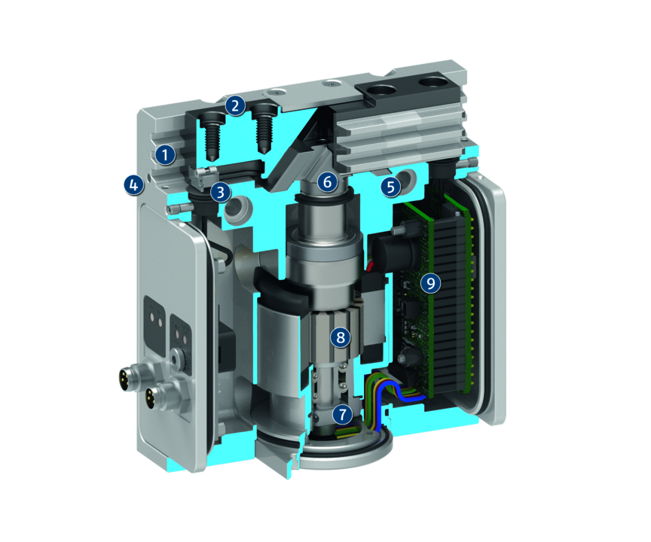
Principle of function
Functional description
The brushless servomotor forces the wedge-hook up or down via a ball-and-screw spindle drive.
Through its angled active surfaces, the wedge-hook transforms this motion into the horizontal, synchronous movement of the base jaws.
1
Multi-tooth guidance
2
Base Jaw
3
Sensor system
4
Housing
5
Centering and mounting possibilities
6
Wedge-hook design
7
Spindle nut

Slide 5
Advantages – Your benefits
Robust multi-tooth guidance for precise handling
High maximum moments possible suitable for using long gripper fingers
Lubricant pockets in the mult-tooth guidance ensure process reliability and extended maintenance intervals
Brushless DC servomotor for almost wear-free use and a long service life
Control via digital I/O for easy commissioning and rapid integration into existing systems.
Four-step adjustable gripping force for simple adaption to sensitive workpieces
Mounting from two sides in three screw directions for universal and flexible gripper assembly
Integrated sensor system and comprehensive sensor accessory program for versatile querying possibilities and stroke position monitoring
Control via IO-Link enables the prepositioning of the gripper finger and the evaluation of the gripper condition

Slide 6
Technical data
Technical data overview
Size | Stroke per jaw | Min. gripping force | Max. gripping force | Recommended workpiece weight | Max. permissible finger length | Weight
 | [mm] | [N] | [N] | [kg] | [mm] | [kg]
80 | 8 | 110 | 530 | 2.85 | 125 | 1.01 .. 1.08
100 | 10 | 200 | 810 | 4.05 | 160 | 1.73 .. 1.85

