Slide 1


Short presentation
FTW
Superior Clamping and Gripping

Slide 2
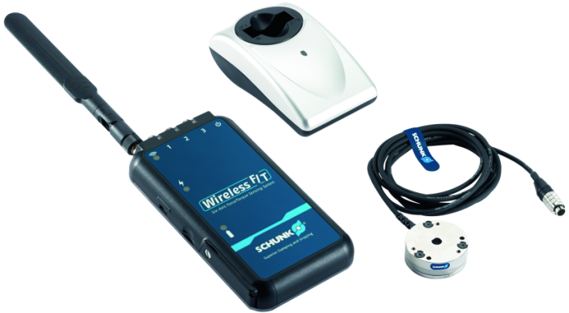
FTW
#1: Reliable, wireless signal transmittion for up to 6 force-torque sensors
New Product
Successor product
New Sizes
Unique Selling Points:
  Wireless transmitter for transmitting signals for up to 6 force-torque sensors
Further Product Features:
  2 Versions: for up to 3 sensors or up to 6 sensors
  Transmission via WiFi
  Typical signal range: 30m
  Available for sale
Cost Effectiveness/ Customer Benefits :
Wireless transmission increases the flexibility and freedom for mobile applications
Transmission via WiFi allows for easy integration in existing systems

Slide 3
FTW
#1: Reliable, wireless signal transmittion for up to 6 force-torque sensors
New Product
Successor product
New Sizes
Basic Technical Data:
  Is able to transmit the signal from up to 6 sensors at the same time
  2 versions: for up to 3 sensors or up to 6 sensors
  Typical signal range: 30m
  Communication: IEEE 802.11 a/b/g/n with 2.4 GHz or 5.0 GHz
  Size:
    150 x 82 x 19mm (for 3 sensors)
    150 x 82 x 33mm (for 6 sensors)
  Complementary Products:
Nano and Mini FT sensors

Slide 4




Jens Lehmann, a German goalkeeper legend,
brand ambassador for SCHUNK since 2012
www.schunk.com

