Slide 1

Product presentation
EGL
Universal gripper

Slide 2
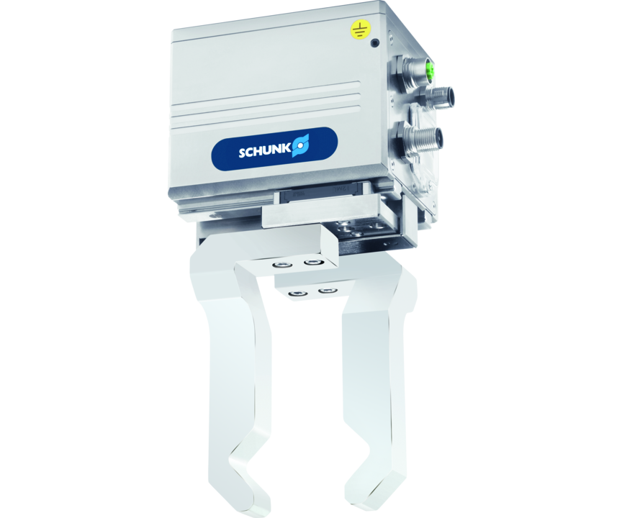
Universal gripper
Servo-electric 2-finger parallel gripper with sensitive gripping force control and long stroke
The electric gripper with the highest power density on the market.
Up to 600 N gripping force

Slide 3

Flexible. Robust. Bus capable.
Available interfaces: PROFINET, EtherNet/IP and EtherCAT
New with integrated web server
Long and freely programmable stroke
Current-controlled gripping force adjustment of a large force range
Control via 24 V power supply

Slide 4
Principle of function
Functional description
The DC servomotor drives the base jaw gear racks via the gear mechanism. The position is sensed by an encoder.
The rotational movement is transformed into the linear movement of the base jaw by base jaws mounted on the spindle nuts.
1
Control electronics
2
Encoder
3
Electrical brake
4
Drive
5
Kinematics
6
Service window

Slide 5
Advantages – Your benefits
Current-controlled gripping force adjustment of a huge force range for the delicate or powerful gripping of different workpieces
Long and freely programmable stroke for flexible workpiece handling
Fully integrated control and power electronics for creating a decentralized control system
Versatile actuation options for simple integration into existing servo-controlled concepts via PROFINET, PROFIBUS or CAN
Connectors in industrial standard for easy electrical connection
Service interface: USB Host and USB Device for comfortable parameter setting and firmware updates by USB flash drive or PC
Rotary encoding switch and DIP switch for manual fieldbus addressing, baud rate setting and service functions

Slide 6
Technical data
Technical data overview
Size | Stroke per jaw | Min. gripping force | Max. gripping force | Recommended workpiece weight | Max. permissible finger length | Weight | Nominal voltage | Communication interface
 | [mm] | [N] | [N] | [kg] | [mm] | [kg] | [V DC]
90 | 42.5 | 50 | 600 | 3 | 165 | 1.8 | 24 | PROFIBUS .. PROFINET

