Slide 1
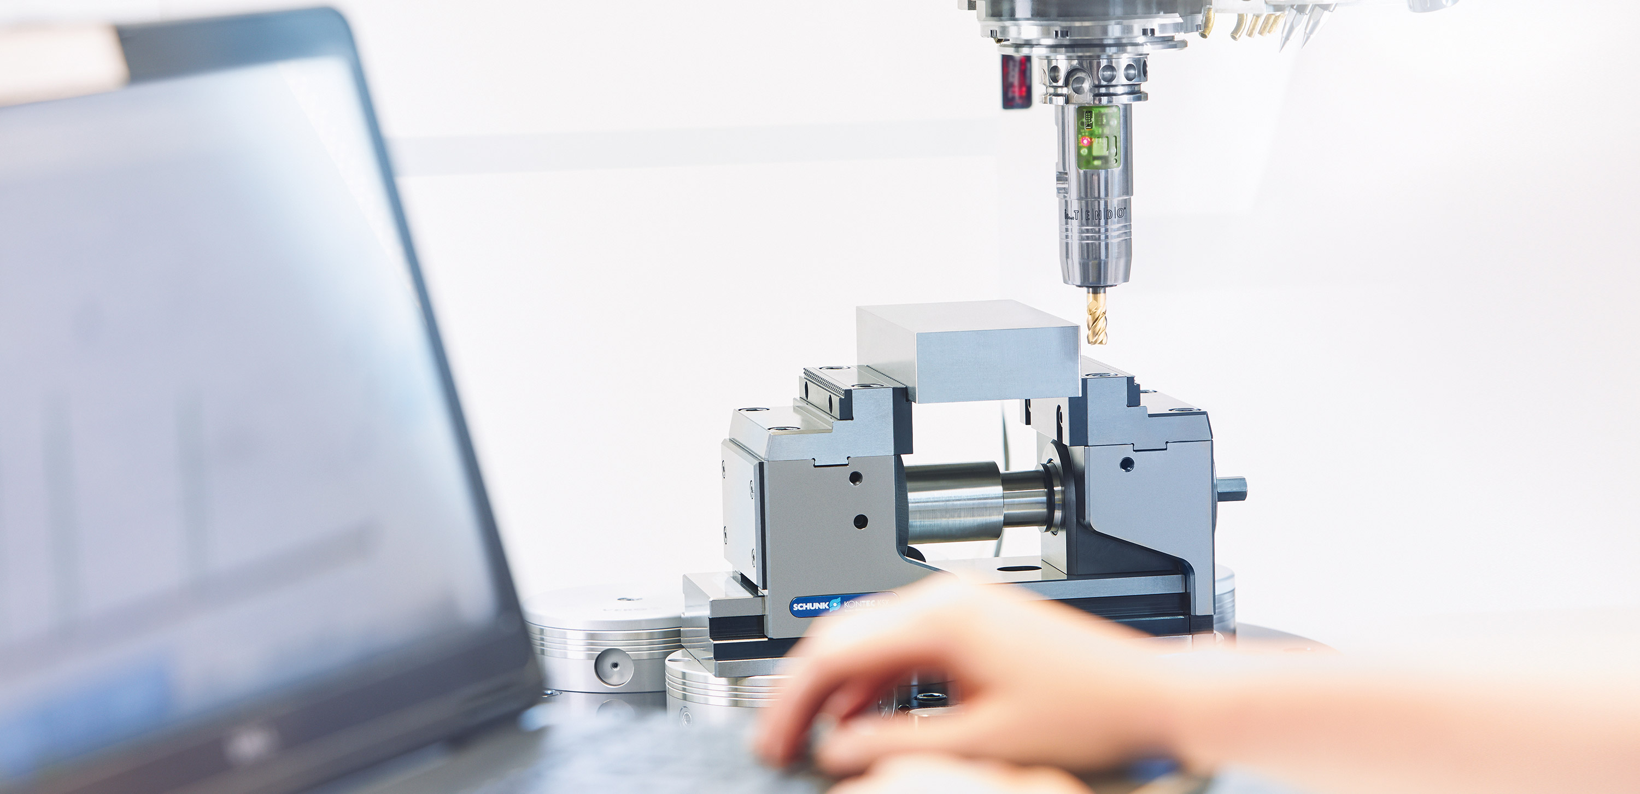

Mechanical Tool grinding toolholder
PRISMO3 - Roland Böhm

Slide 2
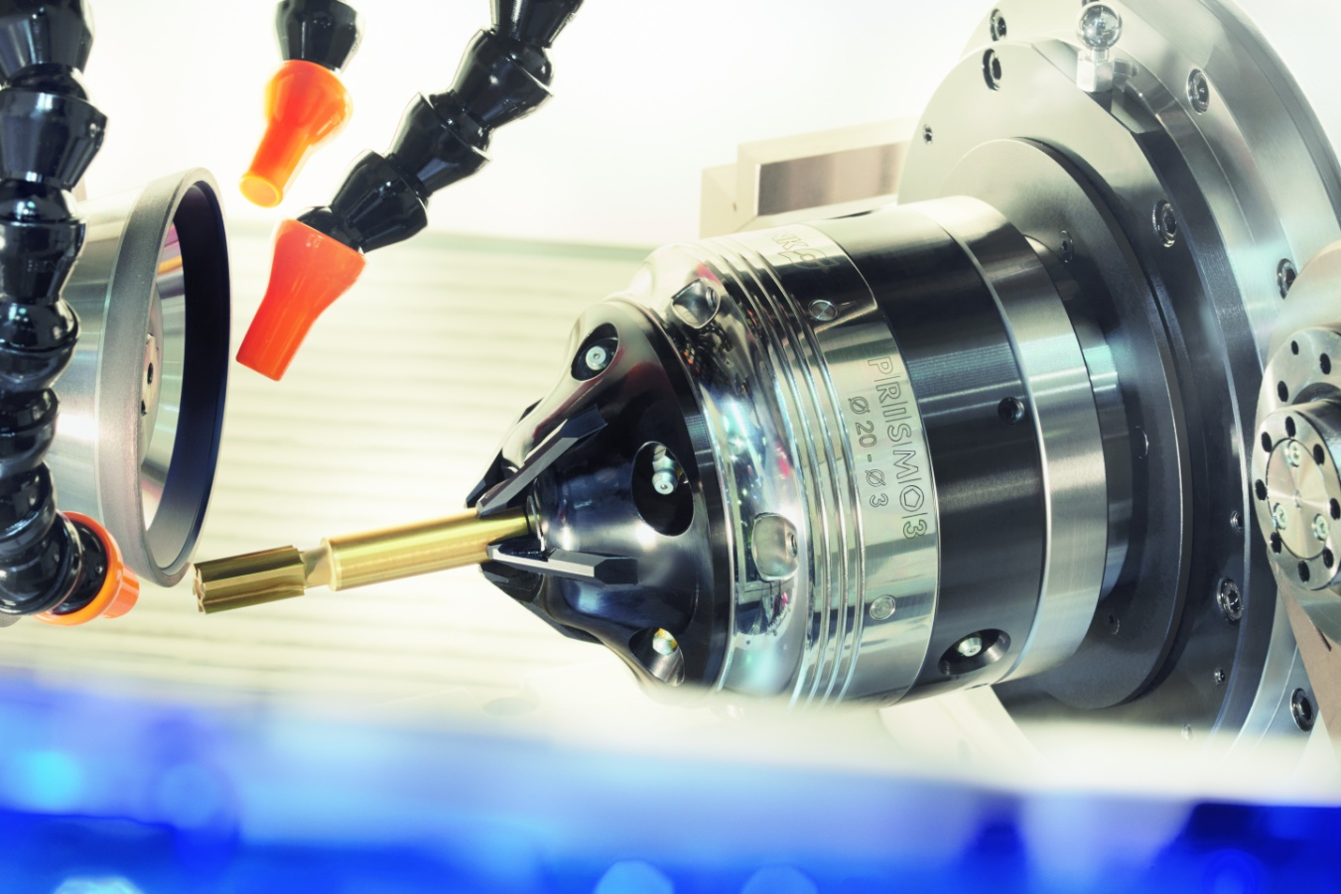
Flexible clamping in clamping diameter range 3-20 mm
-> without retooling

Slide 3
Produktmerkmale
  Flexible multi-range chuck for direct clamping from diameter 3 to 20mm –seamless
  Precise, durable clamping- and run-out accuracy<= 0,010 mm*
  No x-axis displacement: therefore permanent, durable and reliable clamping position – also without axial stop !
  Interference contour optimized for optimal grinding / sharpening processing- grinding wheels outlet
  Wear resistant and reliable clamping diameter/area through hard coating of the eroded jaws
  Automated, unmanned loading 24/7, therefore flexible loading possibility of different shank diameters
  Savings of set-up costs up to 70%
  *With an extension length of max. 45mm, over the entire clamping range, at maximum clamping force.
  *Higher / more detailed run-out accuracys can be garantueed with adapted process conditions!

Slide 4
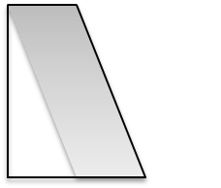
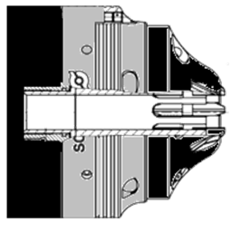







0,001mm true-running
Operation
With an unclamping maximum of 45mm: Run-out accuracy <=0,010mm
4
feeding ca. – 1mm from the center /-0,2mm
1. Automated loading
2.
3. Flange
4. Actuation
SCHUNK clamping expertise in tool grinding !

Slide 5
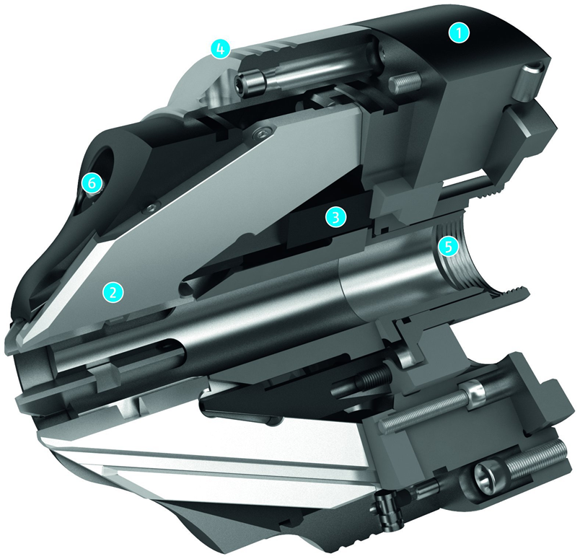

Sectional diagram
1 Chuck body
2 Jaws
3 Ram
4 case
5 Tension sleeve
6 Grease nipple

Slide 6
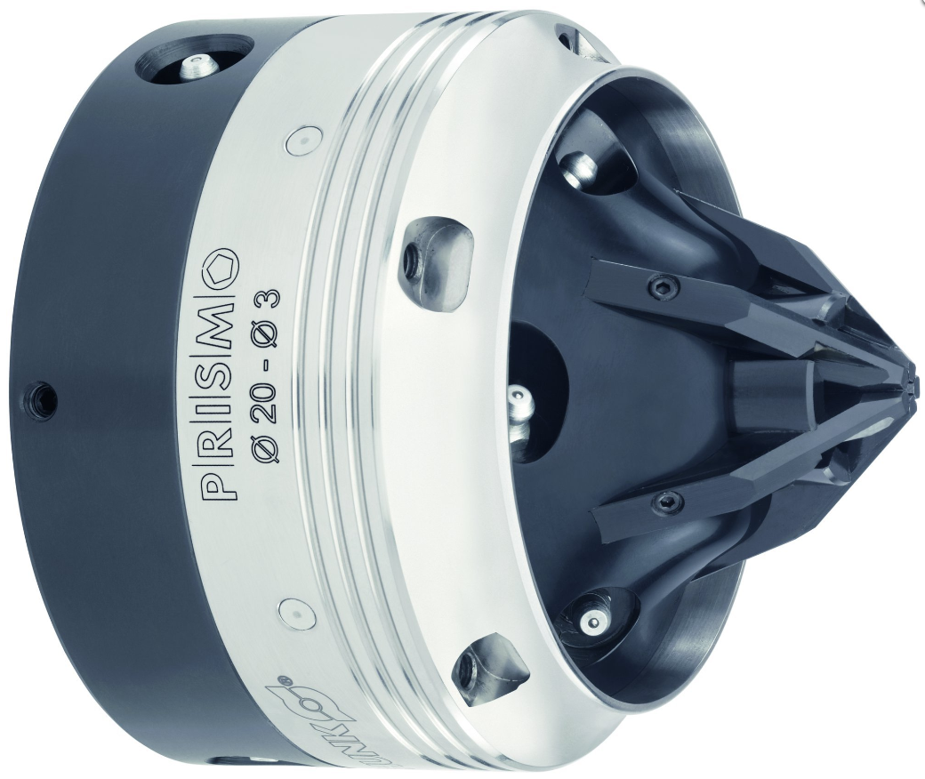
Technical data
Clamping-Ø Position „close“ 3 mm
Clamping-Ø Position „open“ 20 mm
Size outside 125 mm
Piston stroke length 22,5mm
Stroke per jaws 8,5mm
Clamping depth 42 mm
Max Operating force 10 kN
Max. ´clamping force 12,5 KN
Max. rotation speed 2500 U/min
Run-out accuracy <=0,010mm *
Repeat accuracy <0,005mm
weighting 6,4 kg
*With an extension length of max. 45mm, over the entire clamping range, at max. clamping force

Slide 7
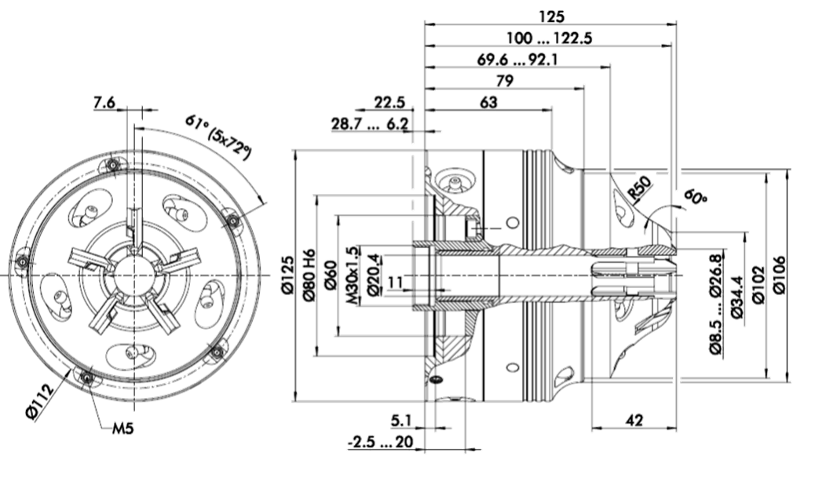
Technical data
ID: 0206601 M30x1,5/internal thread
ID: 0206602 M32x1,5/external thread

Slide 8
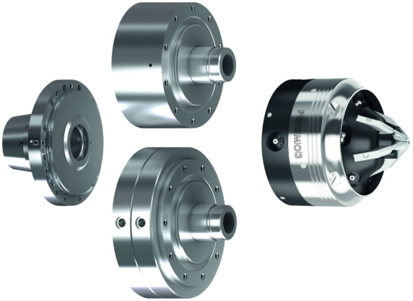
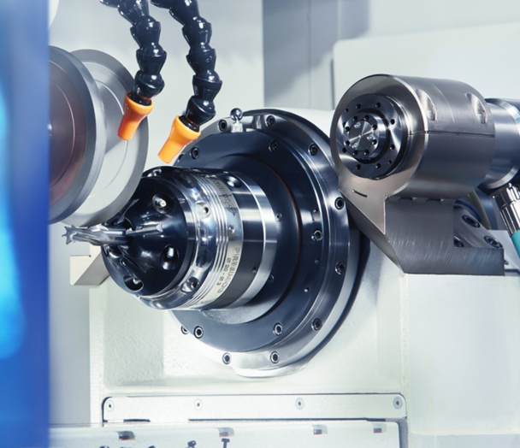
Actuation
The can be operated in different ways :
  1. Flange with drawbar
  2. Clamping cylinder and flange with air supply tube
  3. Front end cylinders

Slide 9
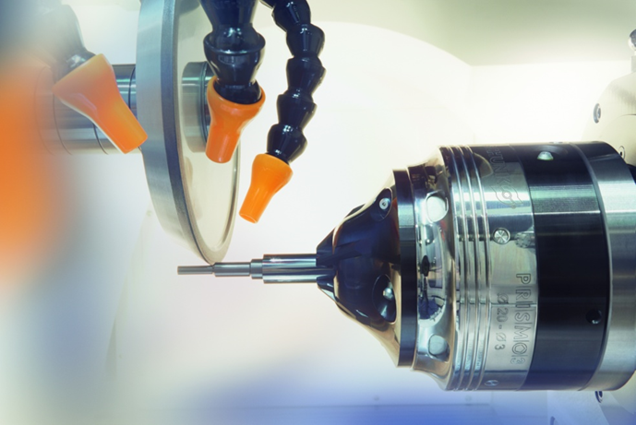
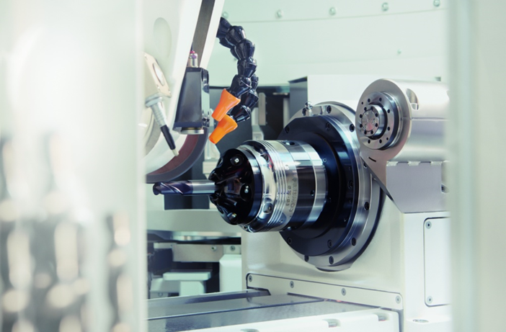
Examples of application

Slide 10

Industries / fields of application
  Tool grinding / sharpening
  Automated grinding / sharpening
  Use of measuring machines
  Tool grinder manufacturer
  Tool maker / Tool grinder / Tool sharpener
  End-User tool grinder / tool sharpener

Slide 11
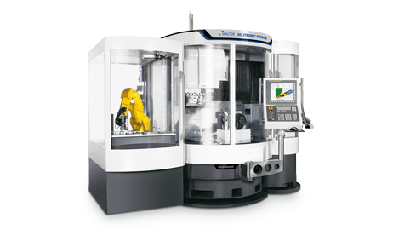
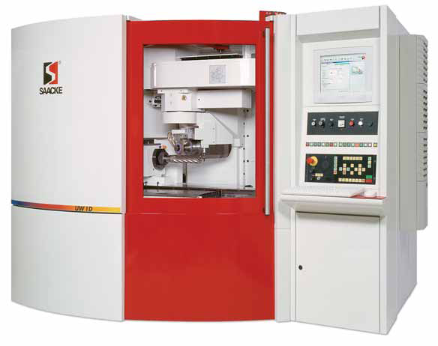
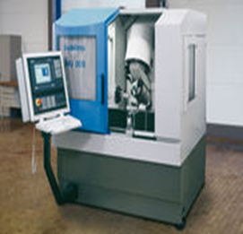
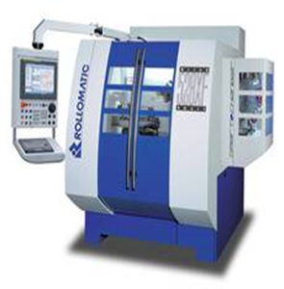
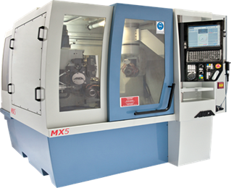
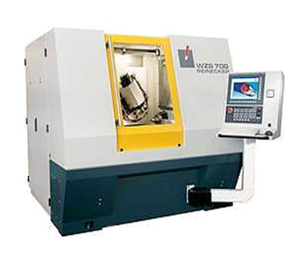
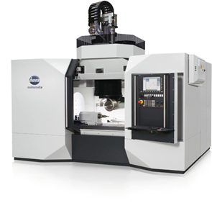
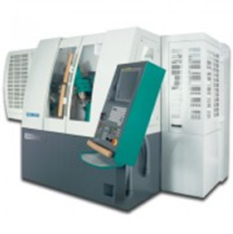
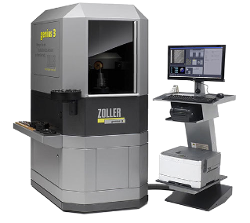
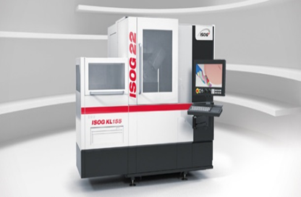
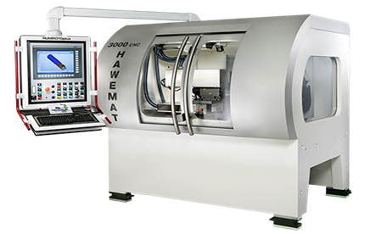
CNC- maufacturer of tool grinding machines / measuring machines
Saacke
Walter
Schütte
Rollomatic
Anca
Ulmer
Haas
Schneeberger
ISOG
Hawema
Zoller

Slide 12
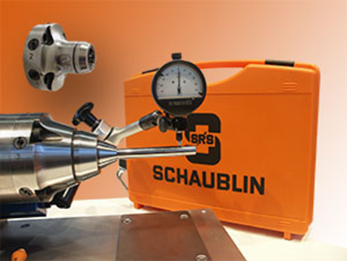

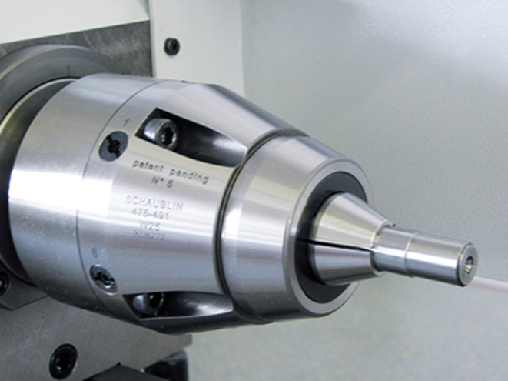
Competitors
  Clamping ranges at SRS W 15 of 0,3mm-10mm
  Clamping ranges at SRS depends on installation type: upto 20mm, 25mm and 32mm
  Price (depending on the version and inputs/attachments): starting at 12.500€ to 15.000€

Slide 13
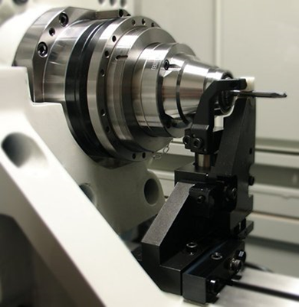

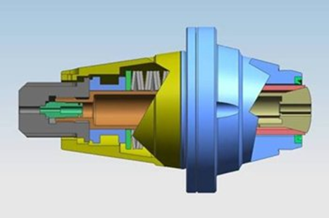
Competitors
ANCA MicroPlus workpiece clamping system collet chucks / support system
The MicroPlus system consists of two separate parts: the Flexi-chuck (Workpiece/tool holder) and the Overhead-clamping system, for tool guidance!
Clamping ranges at MicroPlus: 1mm-13mm (Schaublin W20 collet chucks are used!)
Price for the Flexi-chuck: 6500.-€
Price for the required OTC-mounting: ?

Slide 14
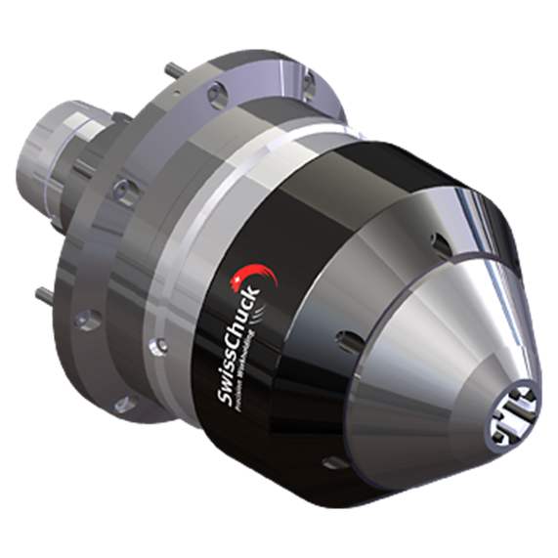


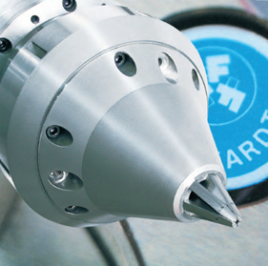
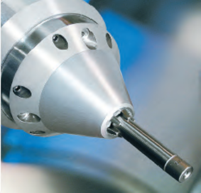
Competitors
SwissChuck TGC / FTGC
Lamellar chuck with a clamping range of 2mm – 15mm
Run-out accuracy <= 0,005mm with defined overhang and clamping length
Execution TGC-operation by means of power clamping cylinder
Execution FTGC – front end operation
Price: depending on variant and installation/attachment parts
from 17000€ up to ca. 20000€

Slide 15

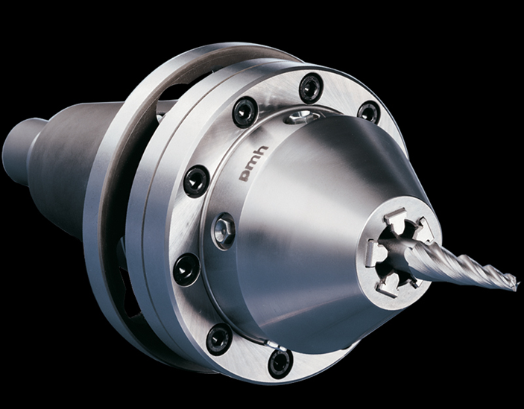
Competitors
pmh Heyn SEG collet chuck
Run-out accuracy < 0,005mm over the entire clamping range (Clamping length?)
Operation types of the SEG collet chuck: pneumatic and external
Price: depending on the variant and installation/attachment parts from 8.000€ up to 12.000€

Slide 16
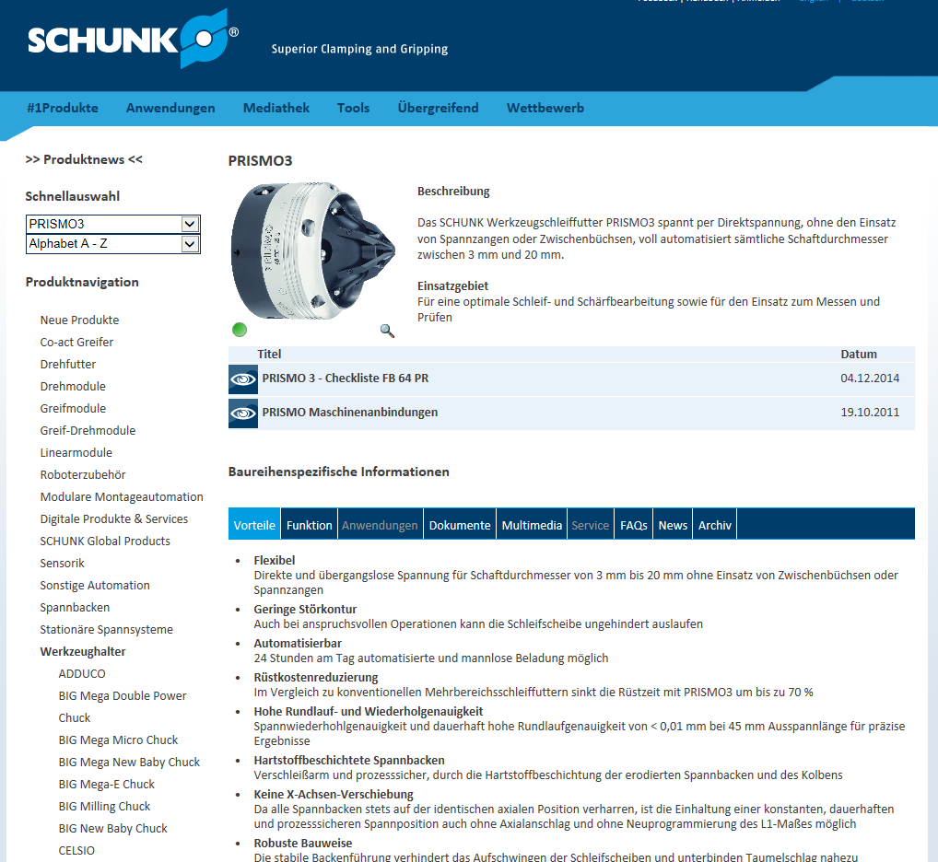
Marketing measures / informations
Sales Tool Box - STB
http://www.schunk.int/schip/salestoolbox/index.php?lngCode=de&prokl=werkzeughalter&prgr=PRISMO3&data=advantages&data1=&baugroesse=#inhaltmittefenster

